Slide 1
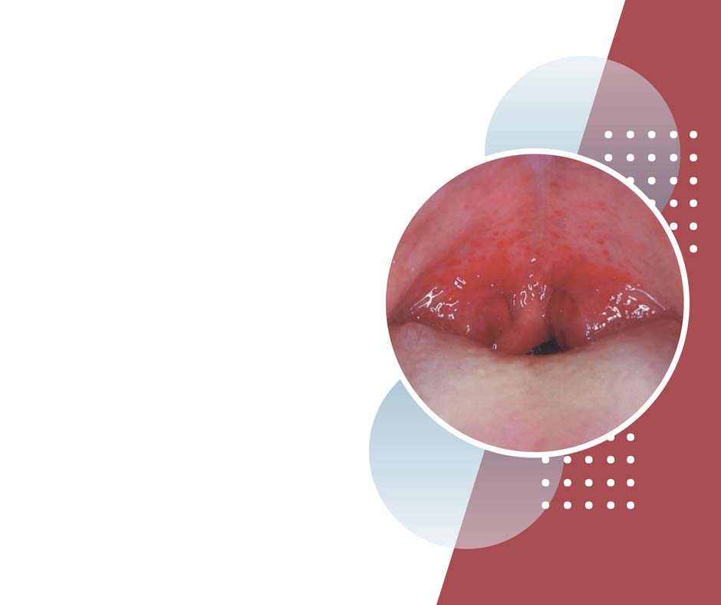
Strep Throat
Does Your Patient Have Streptococcal Pharyngitis?
Nader Sadigh MD
Ali Asghar Children's Hospital

Slide 2
Uncertainty to diagnosis
Case:
8 yr old female itchy throat
Did not eat her dinner
Looks well, erythema in oropharynx and tonsilar pillars, no exudate, some ant LAP, hx of strp throt 5 time this year.
Needs for AB?

Slide 3
Introduction
Group A Strep pyogenesis live in skin mucus memb of human
Close contact droplet secretions
Asymptomatic carriers
Suppurative complications: peritonsilar abcess, sinusitis, Otitis media, skin, soft tissue infection: pyomyositis nec fascitis.
Blood born: meninges, brain, Jugular vein
The diagnostic approach to acute infectious pharyngitis focuses on identification of pathogens that require treatment to prevent complications or transmission of disease. >> minimize the unnecessary use of antibiotics in viral infections

Slide 4
Mimics of strep
Arcanobacterium haemolyticum
No nonsuppurative complication, no medication needed usually
Group C, G strep: food born, pharyngitis+diarrhea
Fusobacterium necrophorum (Lemierre synd),
necrotizing tonsillopharyngitis,
septic thrombophlebitis in int jugular V,
septic emboli
Abscess, peritonsilar, retropharyngeal
H. influenza, unvaccinated, Epiglotitis
Inf mono EBV
N gonorrhea
Acute retroviral synd

Slide 6
Features of strep disease
Centor criteria
Numerical score, score the same weight to all features
1 > 15% risk
2-3 > 30% risk
4 or more > 50% risk
Risk, PPV, NPV for each component are not the same
Risk > baseline epidemiology
This tool is maximally as good as a flip of a coin!

Slide 7
PPV NPV
what is the chance that a person with a positive test truly has the disease?
PPV, NPV influenced by the prevalence of disease in the.
If we test in a high prevalence setting, it is more likely that persons who test positive truly have disease than if the test is performed in a population with low prevalence.
Population based test that not apply to individual in front of you

Slide 9
Likelihood ratios
How likely is that the patient has/does not have the disease if the test is +/-
They protect us from whatever prevalence of disease may or may not be
They use both sen/spc
As an example, with a LR of 5 and an initial estimated probability of 20%, a positive test would imply a patient has a 60% probability of the disease. LRs higher than about 5 can be useful in ruling in a disease.

Slide 10
Pre/post test probability

Slide 11
Fagan Nomogram for Likelihood Ratios
1. Decide on your pre-test probability of the disease (choose an approximate probability based on our assessment) 2. Use the likelihood ratio that correlates to your exam. 3. Draw a straight line from your pre-test probability starting point, to the LR of the feauture/test, take it through to find your post-test probability 4. Use this new post-test probability to help in your decision

Slide 13
Your patient has palatal petechiae, which confers a positive likelihood ratio (LR+) of 2.7

Slide 16
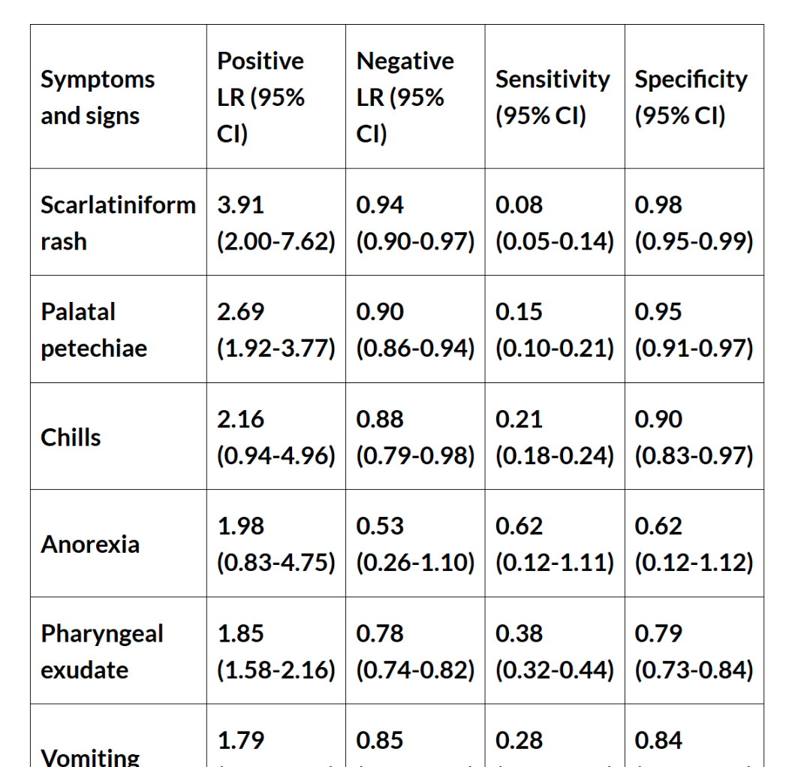
List of Likelihood Ratios for Streptococcal Pharyngitis
List of Likelihood Ratios for Streptococcal Pharyngitis
Modified from: Shaikh et al. 2012

Slide 17
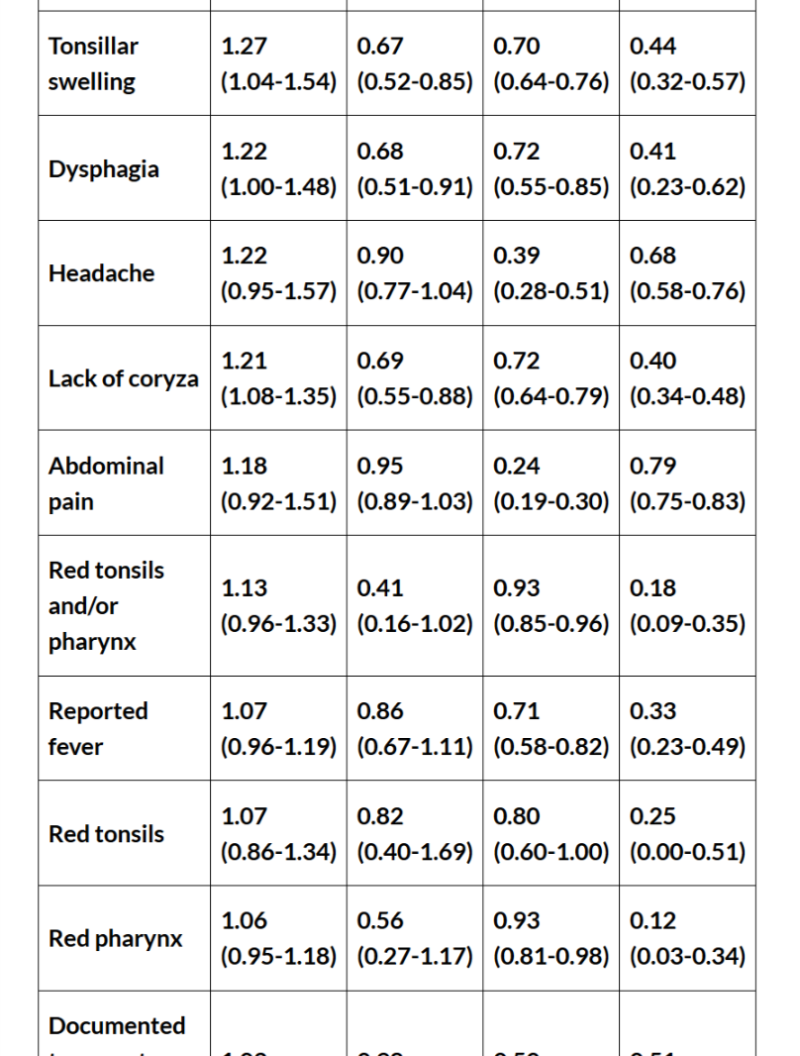

Slide 18
…..case
Erythema + reduce 20% risk
LAP - reduce 20% risk
Fever - reduce 20% risk
Cough+ reduce 20% risk
Next>> ??

Slide 19
RADT test
95% Spc
70% Sen
>>False neg
100 cases of strep throat > 86 confirm 14 will miss
Infectious dis soc. Recommend RADT+culture simultaneously.
So many people are colonized by GBS
25% are carrier upto 37% in children

Slide 20
Mental play…
You think your patient have viral one but swab!
Most have viral ethiology (70%)
1/3 patients in your ward are + regardless of symptoms
Large number >> pharyngitis and + swab !!!
More power to test than our clinical skill

Slide 21
antibiotics
In adult NNT to prevent RHD is 1:1000s
PSGN not preventable
Reduce Acute rheumatic fever
Reduce suppurative complications such as peritonsillar abscess, cervical lymphadenitis, and mastoiditis

Slide 22
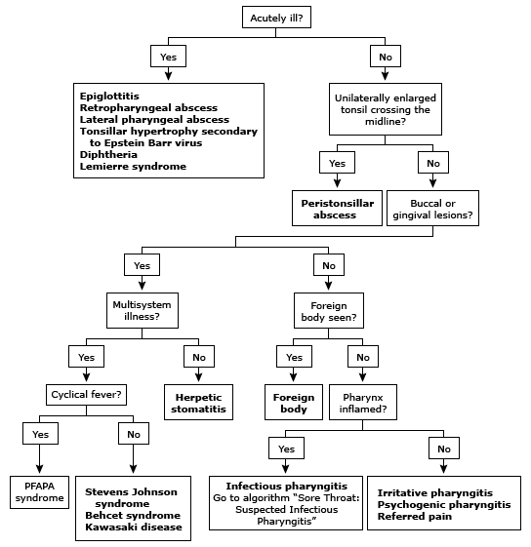

Slide 23
