Slide 1
WCO
World Customs Organization

Slide 2
History
The history of the WCO began in 1947 when the thirteen European Governments represented in the Committee for European Economic Co-operation agreed to set up a Study Group. This Group examined the possibility of establishing one or more inter-European Customs Unions based on the principles of the General Agreement on Tariffs and Trade (GATT).

Slide 3
General Agreement on Tariffs and Trade
  General Agreement on Tariffs and Trade (GATT) was a multilateral agreement regulating international trade. According to its preamble, its purpose was the "substantial reduction of tariffs and other trade barriers and the elimination of preferences, on a reciprocal and mutually advantageous basis." It was negotiated during the United Nations Conference on Trade and Employment and was the outcome of the failure of negotiating governments to create the International Trade Organization (ITO). GATT was signed by 23 nations in Geneva on October 30, 1947 and took effect on January 1, 1948. It lasted until the signature by 123 nations in Marrakesh on April 14, 1994 of the Uruguay Round Agreements, which established the World Trade Organization (WTO) on January 1, 1995.

Slide 4
In 1948, the Study Group set up two committees - an Economic Committee and a Customs Committee. The Economic Committee was the predecessor of the Organization for Economic Co-operation and Development (OECD), the Customs Committee became the Customs Co-operation Council (CCC).

Slide 5
In 1952, the Convention formally establishing the CCC came into force. The Council is the governing body of the CCC and the inaugural Session of the Council was held in Brussels on 26 January 1953.
Representatives of seventeen European countries attended the first Council Session of the CCC.
After years of membership growth, in 1994 the Council adopted the working name World Customs Organization, to more clearly reflect its transition to a truly global intergovernmental institution. It is now the voice of 180 Customs administrations which operate on all continents and represent all stages of economic development. Today, WCO Members are responsible for processing more than 98% of all international trade.

Slide 6
1947 Thirteen Governments represented in the Committee for European Economic Co-operation set up a Study Group to examine the possibility of establishing one or more Customs Unions between the various European countries in accordance with GATT principles.
1948 The Study Group decided to establish two Committees: an Economic Committee which later evolved into the Organisation for Economic Co-operation and Development (OECD), and a Customs Committee which later became the Customs Co-operation Council (CCC).
1952 The Convention establishing the CCC enters into force on 4 November.

Slide 7
1953 The inaugural session of the CCC Council was held in Brussels on 26 January in the presence of representatives of seventeen European countries. This date is now celebrated annually as International Customs Day.
1974 The International Convention on the Simplification and Harmonization of Customs procedures (Kyoto Convention) enters into force on 25 September.
1980 The Convention on Mutual Administrative Assistance in the Prevention, Repression and Investigation of Customs Offences (Nairobi Convention) enters into force on 21 May.

Slide 8
1988 The WCO’s International Convention on the Harmonized Commodity Description and Coding System (HS Convention) enters into force on 1 January.
1994 The WCO Council adopts the informal name "World Customs Organization" to better reflect the Organization’s global nature.
1999 The WCO Council adopts the revised International Convention on the Simplification and Harmonisation of Customs Procedures (Revised Kyoto Convention)

Slide 9
2002 The WCO celebrates its 50th anniversary and is honoured with a visit by HM King Albert II of Belgium accompanied by the Hon. Didier Reynders, the Belgian Deputy Prime Minister and Minister of Finance.
2005 The WCO Council adopts the Framework of Standards to Secure and Facilitate Global Trade.
2006 The revised Kyoto Convention on the Simplification and Harmonization of Customs Procedures enters into force.

Slide 10
2007 The HS Nomenclature 2007 Edition enters into force on 1 January.
2012 The HS Nomenclature 2012 Edition enters into force on the 1 of January.

Slide 11
Trade facilitation
In December 2013, WTO members concluded negotiations on a Trade Facilitation Agreement at the Bali Ministerial Conference, as part of a wider “Bali Package”. Since then, WTO members have undertaken a legal review of the text. The resulting final text is available here. In line with the decision adopted in Bali, WTO members adopted on 27 November 2014 a Protocol of Amendment to insert the new Agreement into Annex 1A of the WTO Agreement. The Trade Facilitation Agreement will enter into force once two-thirds of members have completed their domestic ratification process.

Slide 12
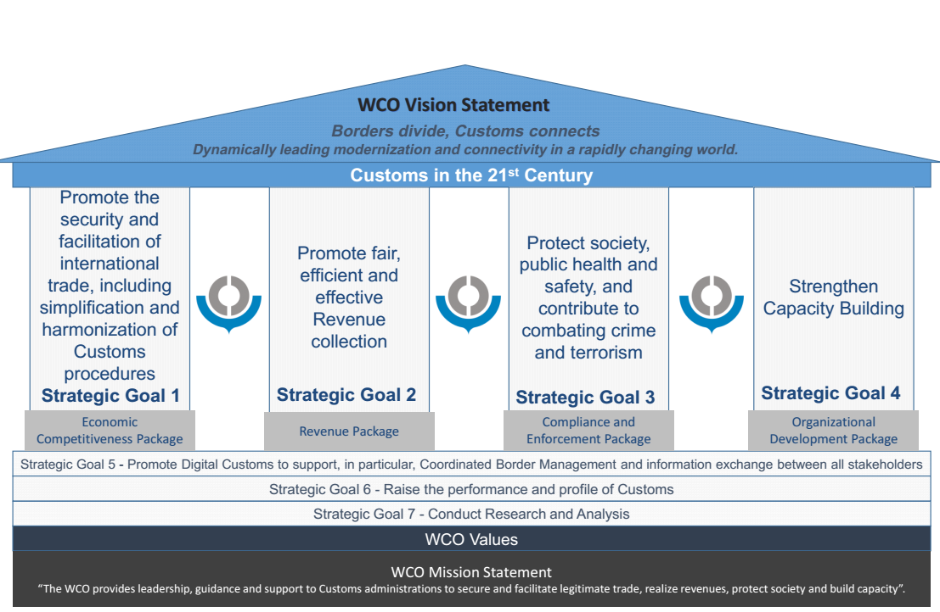

Slide 13
Strategic Goals
Strategic Goal 1 - Promote the security and facilitation of international trade, including simplification and harmonization of Customs procedures = Economic Competitiveness Package
  Strategic Activity :1.1. Develop, manage and promote conventions, guidelines, standards and tools on trade security and facilitation
  1.2. Support effective implementation of WTO TFA provisions through use of WCO instruments, tools and assistance
  1.3. Promote cooperation with other border agencies to enhance border efficiency and effectiveness
  1.4. Enhance partnership with private sector

Slide 14
Strategic Goal 2 - Promote fair, efficient and effective Revenue collection = Revenue Package
  Collection of revenue remains a top priority for many Customs administrations, particularly in economies where a substantial portion of government revenue is derived from Customs duties. A modern Customs administration needs to apply the relevant tools and instruments - developed by the WCO and other international bodies - in a consistent manner in order toachieve fair, efficient, and effective revenue collection.

Slide 15
  Strategic Activity : 2.1. Develop, manage and promote standards, guidelines and tools on revenue collection
  2.2. Manage and promote the uniform interpretation and application of Conventions and Agreements related to revenue collection

Slide 16
Strategic Goal 3 - Protect society, public health and safety, and contribute to combating crime and terrorism = Compliance and Enforcement Package
  The WCO will continue to develop and maintain standards and guidelines with respect to the goal of protecting society, and contributing to the fight against crime and terrorism. The exchange of Customs enforcement information and Intelligence is crucial to the WCO’s Enforcement Strategy. To this end, the WCO will coordinate and implement Customs law enforcement initiatives and operational activities with assistance from key stakeholders.

Slide 17
Strategic Activity :3.1. Develop, manage and promote standards, guidelines and tools to combat illicit trade, and contribute to combating crime and terrorism
3.2. Manage capacities to exchange Customs enforcement information and Intelligence
3.3. Coordinate and implement Customs law enforcement initiatives and operational activities

Slide 18
Strategic Goal 4 - Promote Digital Customs to support, in particular, Coordinated Border Management and information exchange between all stakeholders
  4.1. Digital Customs : Provide a framework to consolidate the development, promotion and deployment of the WCO’s Information Technology (IT)-related standards, instruments, tools, guidelines and systems
  4.2. Implement Globally Networked Customs (GNC)
  4.3. Use of IT in support of Coordinated Border Management The WCO will continue to promote and enhance the use of IT related to Coordinated Border Management, including Single Window environments
  4.4. Develop, promote and manage WCO instruments and tools that provide the legal basis for technologically-enabled reforms

Slide 19
Strategic Goal 5 - Raise the performance and profile of Customs
  5.1. Deliver Capacity Building according to Members’ needs
  5.2. Promote the role of Customs and enhance its performance
  5.3. Enhance communications with strategic stakeholders
  5.4. Promote the activities and tools of the WCO, and enhance partnerships with relevant international organizations and strategic stakeholders
  5.5. Manage sound administration of WCO Secretariat

Slide 20
Strategic Goal 6 - Conduct Research and Analysis
  6.1. Produce and disseminate research on Customs and international trade topics
  6.2. Enhance the WCO’s research partnerships with academia and practitioners

Slide 21
WCO Working Bodies

Slide 22
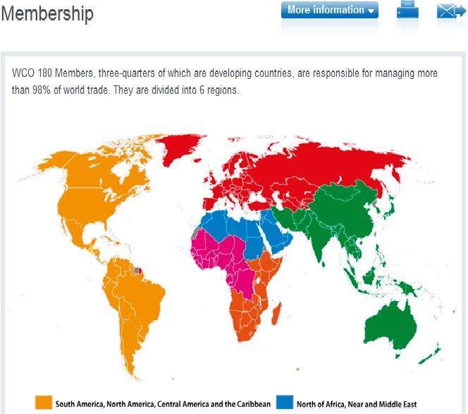

Slide 23
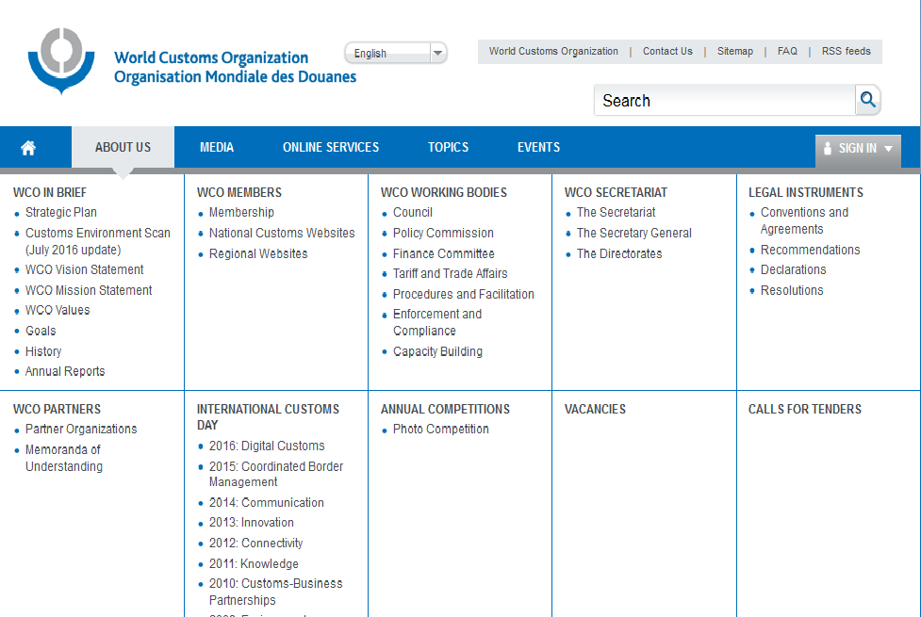

Slide 24
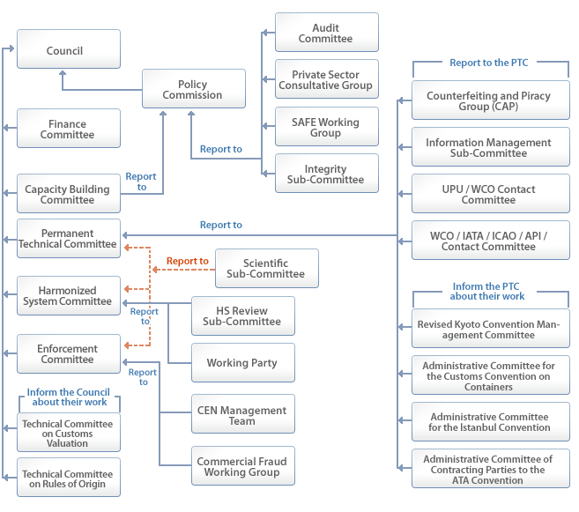

Slide 25
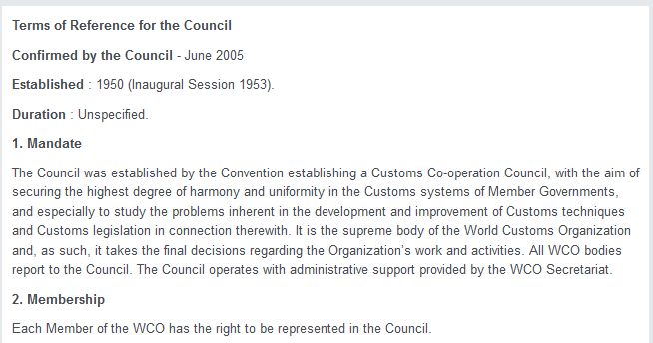

Slide 26
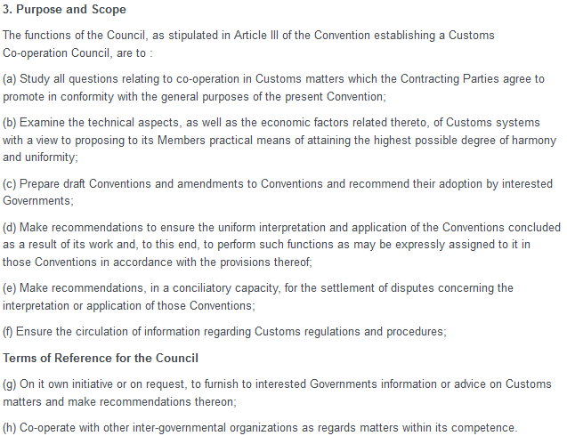

Slide 27
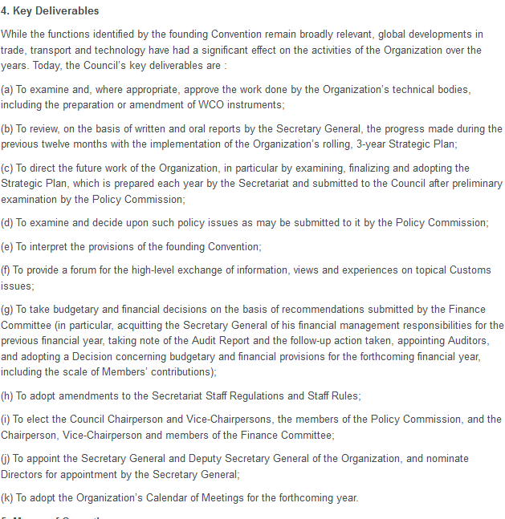

Slide 28
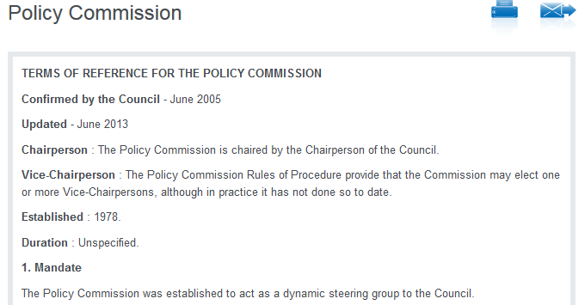

Slide 29
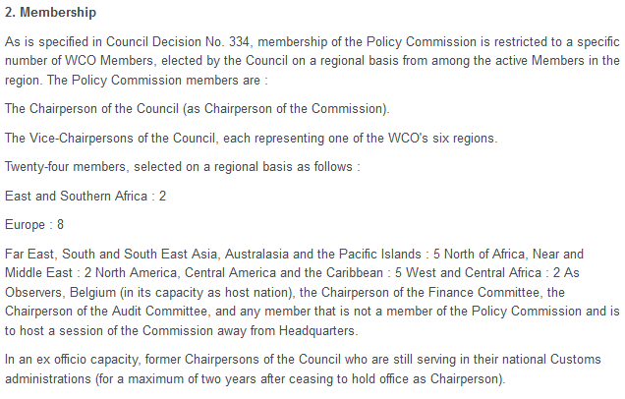

Slide 30
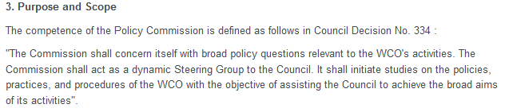

Slide 31
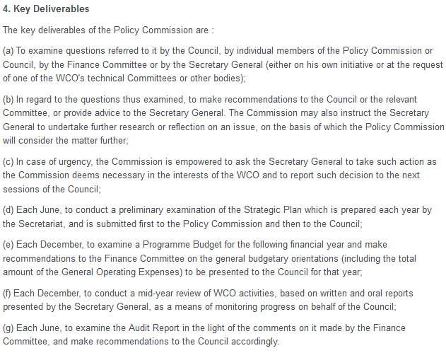

Slide 32
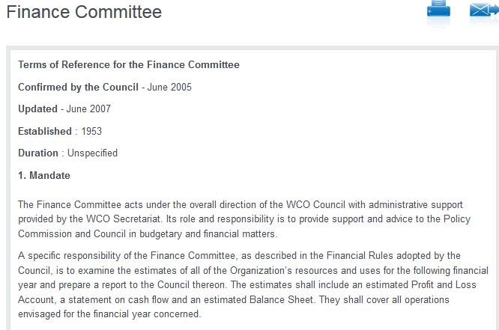

Slide 33
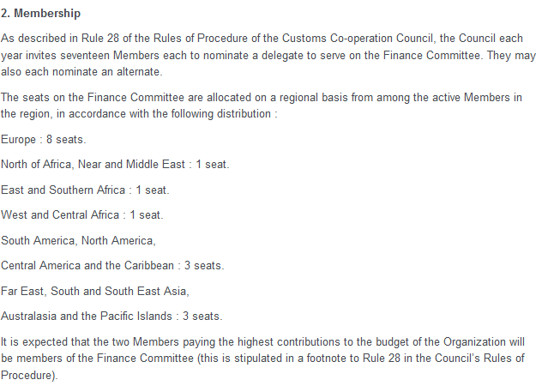

Slide 34
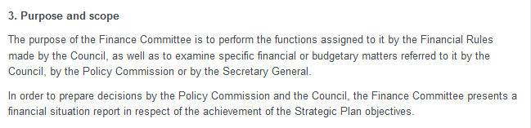

Slide 35
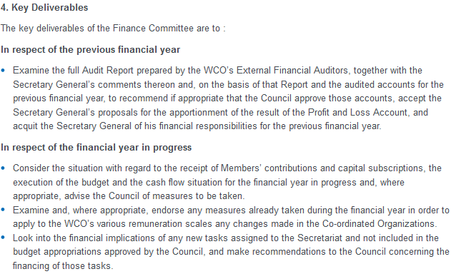

Slide 36
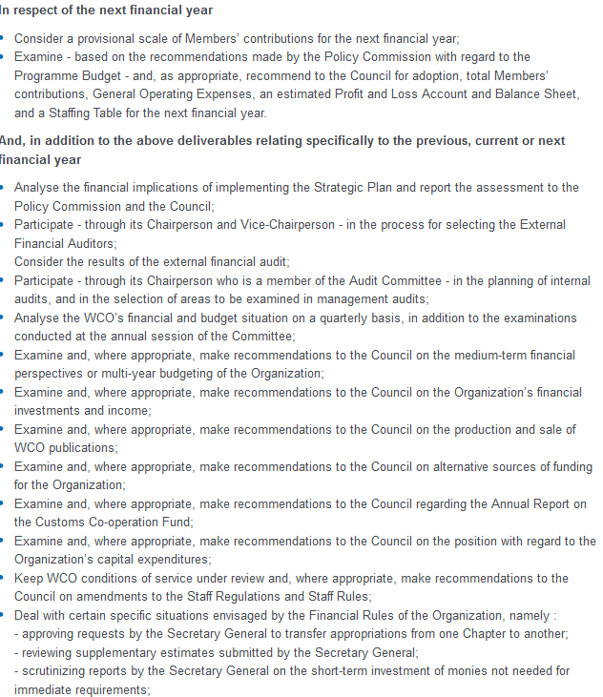

Slide 37
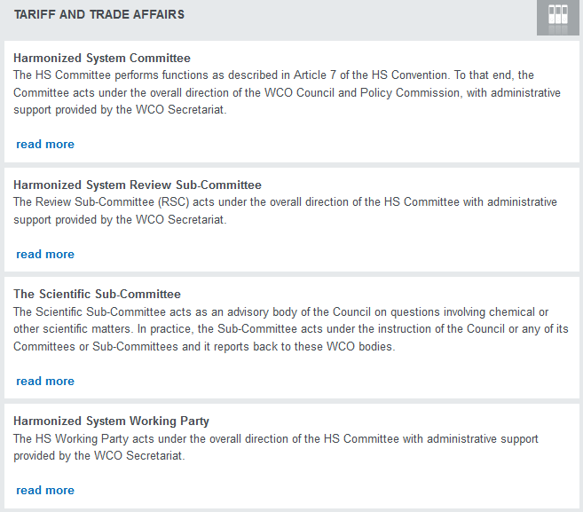

Slide 38
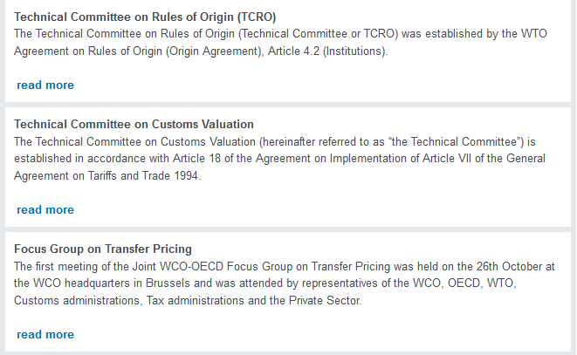

Slide 39
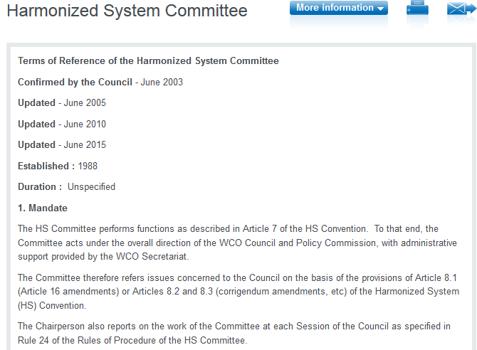

Slide 40
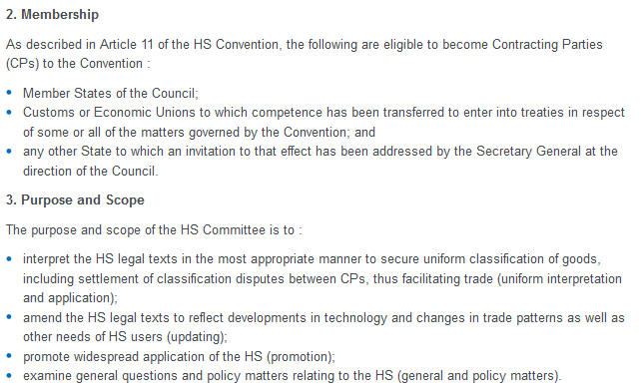

Slide 41
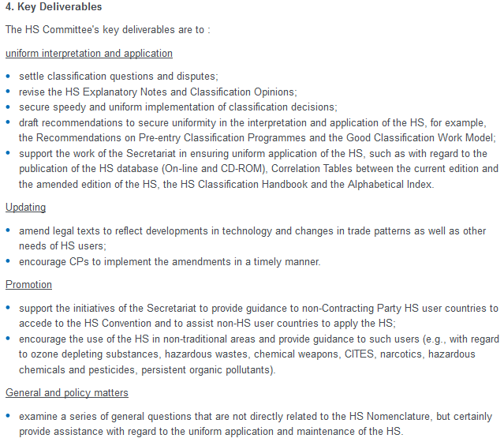

Slide 42
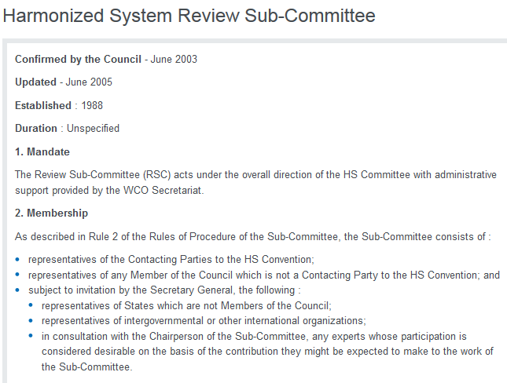

Slide 43
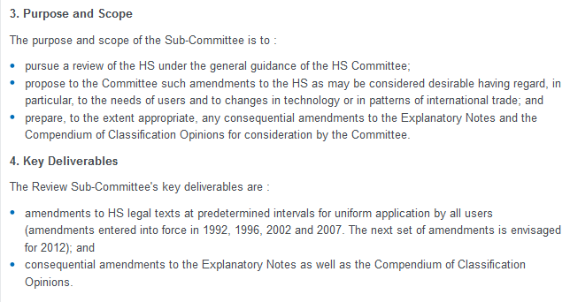

Slide 44
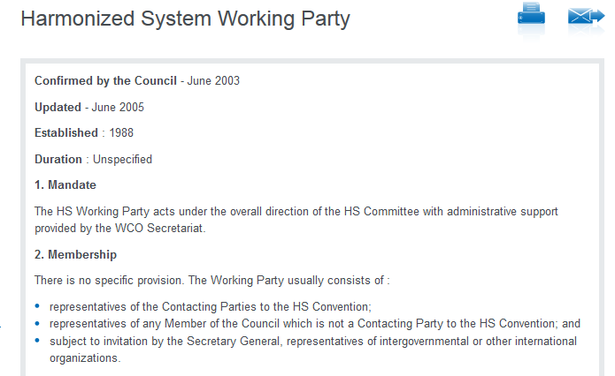

Slide 45
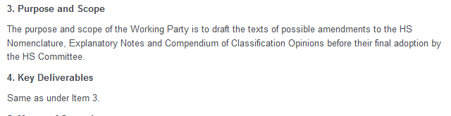

Slide 46
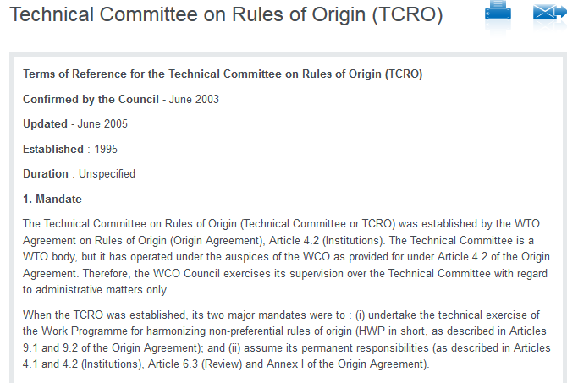

Slide 47
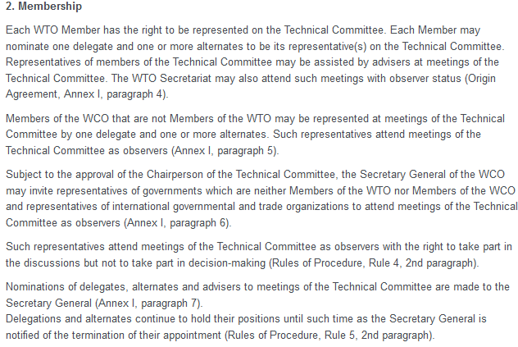

Slide 48
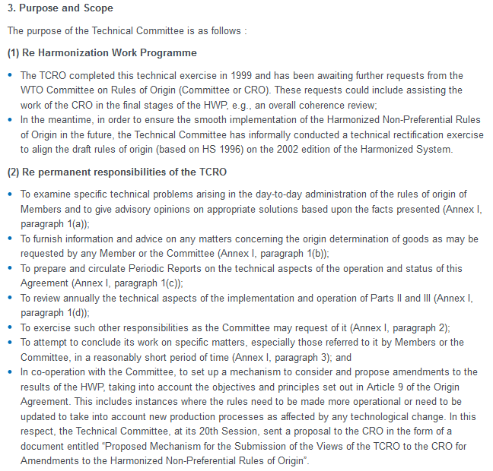

Slide 49
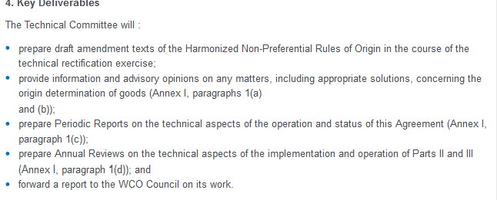

Slide 50
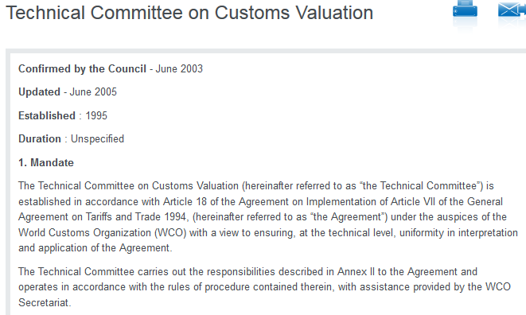

Slide 51
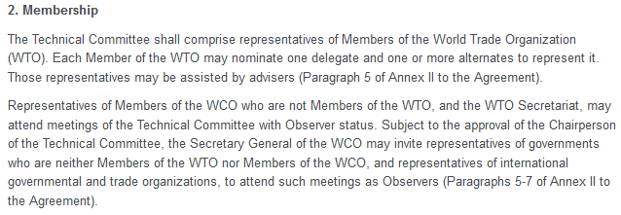

Slide 52
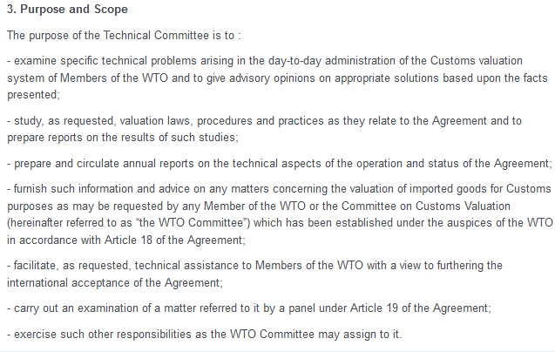

Slide 53
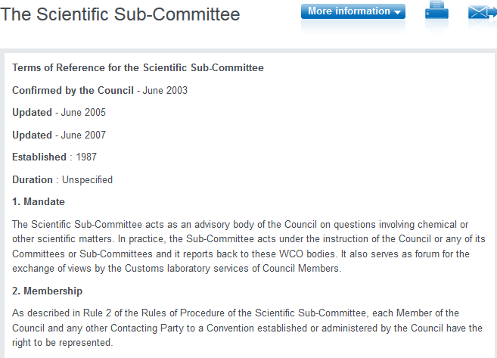

Slide 54
