Slide 1
In the name of allah
Excitons in Single Wall
Carbon Nanotubes
Nasim Moradi
Under Supervision of:
University of Qom
Dr. Fazeli and Dr. Mozaffari

Slide 2
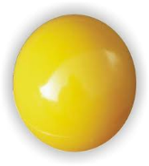
Outline
Introduction to carbon nanotubes and excitons
Theoretical backgrounds
ABINIT code
Results and Our Model

Slide 3
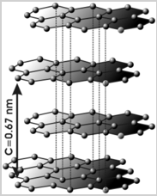
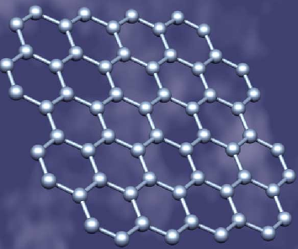
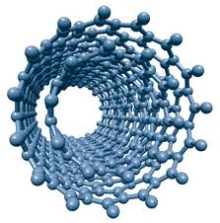
Nasim Moradi
introduction to nanotubes ■□□□□□□□□□
□
Carbon nanotubes were discovered in 1991 by Iijima
Graphite
A single layer of graphite, graphene
1
Excitons In Single – Walled Carbon Nanotubes

Slide 4
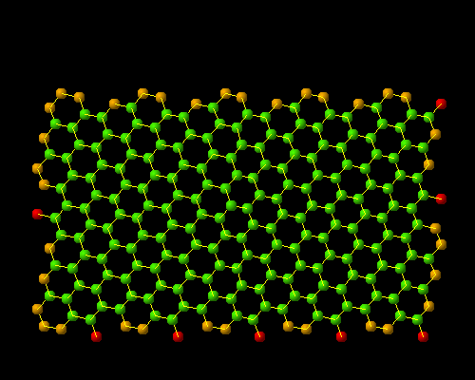
introduction to nanotubes ■□□□□□□□□□
Nasim Moradi
a carbon nanotube made of a single graphite
layer rolled up into a hollow cylinder
Animation from S. Maruyama’s carbon nanotube site
with diameter as small as nm
Length : few nm to microns
2
Excitons In Single – Walled Carbon Nanotubes

Slide 5
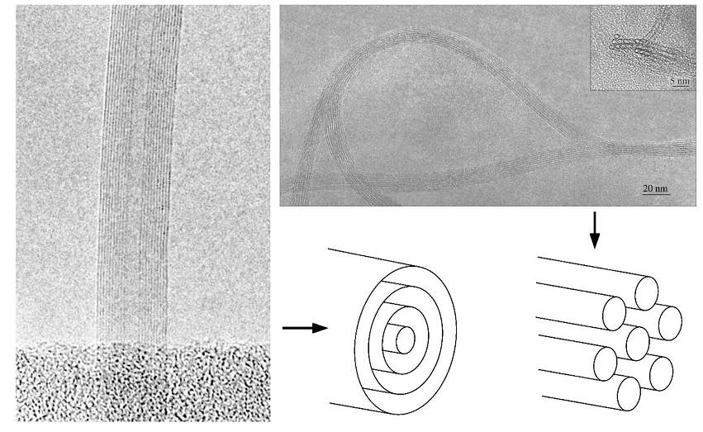
Images of nanotubes
multi-walled nanotube (mwnt)
Diameter ~ 10 – 50 nm
Single-walled nanotube (swnt)
Diameter ~ 0.5 - 2nm
J. Charlier et al. , “electronic properties of nanotubes”, Rev. Mod. Phys. 79, ( 2007 )
3
Excitons In Single – Walled Carbon Nanotubes

Slide 6
SWNT’s geometry
specified by a pair of integers (n , m) :
$$d_{t}={|c_{h}|}/π=\frac{a}{π}\sqrt{n^{2}+nm+n^{2}}$$
Chiral vector
diameter
a = lattice constant of the honeycomb network
a = $\sqrt{3}×a_{cc}$ ($a_{cc}≅1.42A^{0}$, the C-C bond length)
4

Slide 7
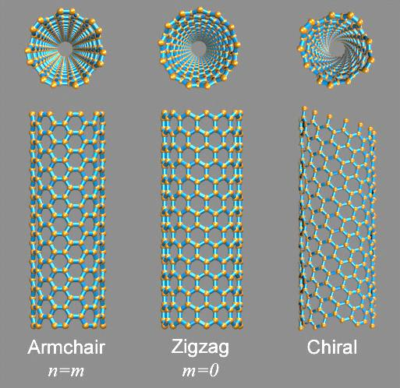
SWNT’s geometry
5
Excitons In Single – Walled Carbon Nanotubes

Slide 8
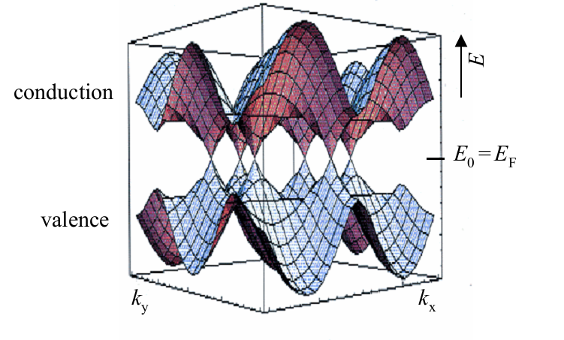
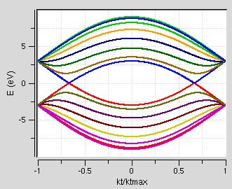
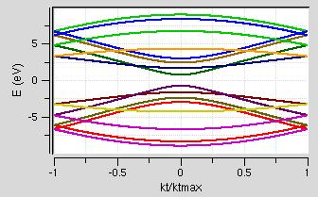
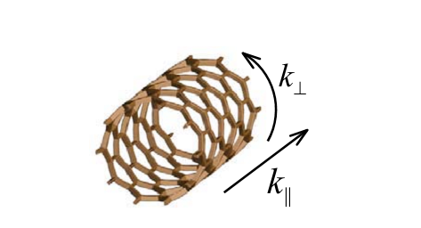
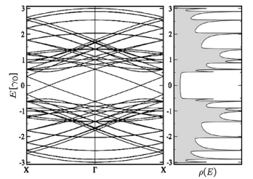
Electronic properties □■□□□□□□□□
Nasim Moradi
(7,7)
(7,0)
(7,7)
$$k_{⊥}=\frac{2πl}{|c_{h}|}$$
Metallic:
Semiconducting:
ethan minot , “Tuning the band structure of cnt”, PhD Thesis, cornell univ (2004 ), page : 28
6
Excitons In Single – Walled Carbon Nanotubes

Slide 9
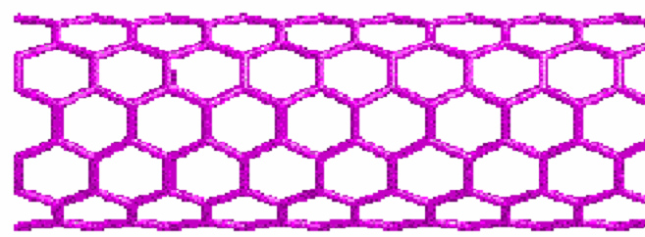
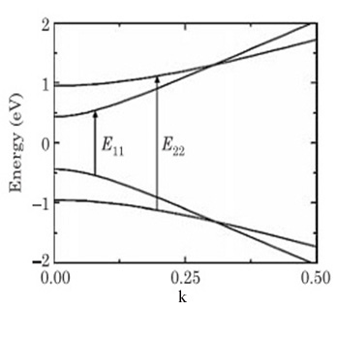
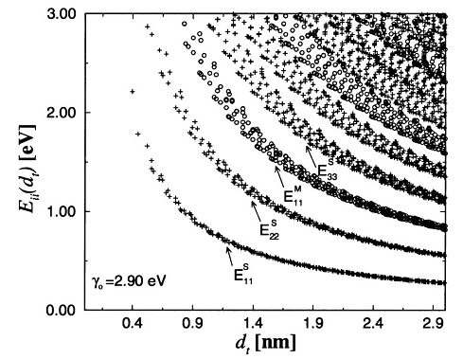
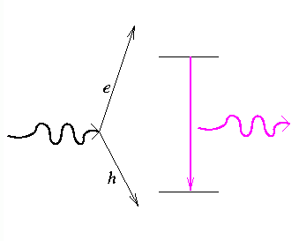
optical properties □□■□□□□□□□
Nasim Moradi
Kataura plot
Ratio problem :
‎C‎. ‎L‎. ‎Kane et al., “ Ratio Problem in Single Carbon Nanotube Fluorescence Spectroscopy”, ‎Phys. Rev. Lett. 90, (2003)‎
‎ H‎. ‎Kataura‎ et al., “Optical Properties of Single-Wall Carbon Nanotubes”, ‎Synth. Met. ‎103, ‎(1999)
7
Excitons In Single – Walled Carbon Nanotubes

Slide 10
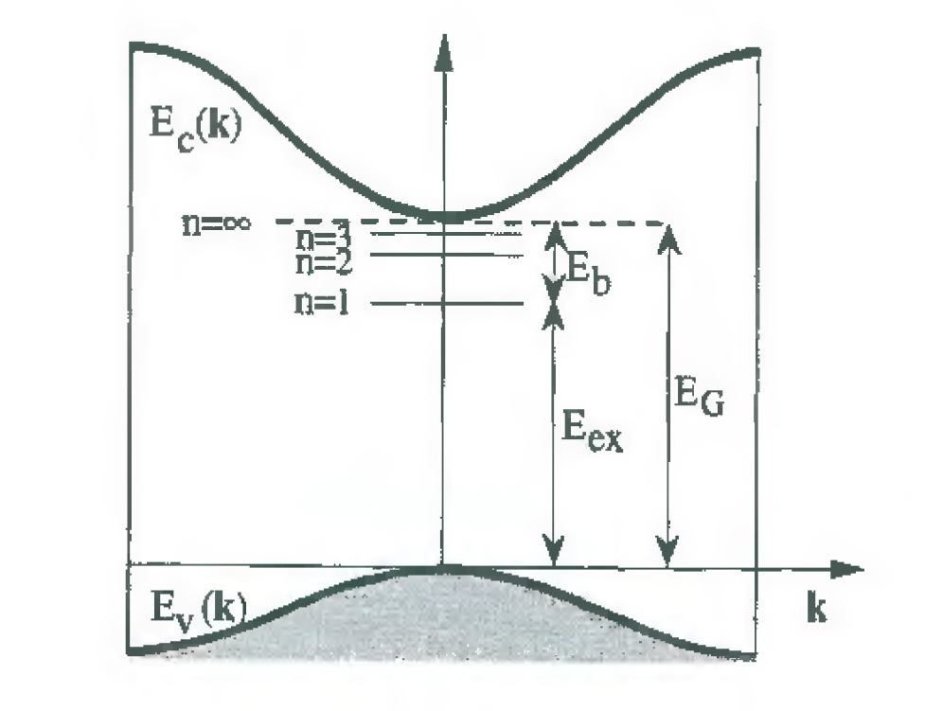
optical properties □□■□□□□□□□
Nasim Moradi
Many-body effects modify the physical picture :
exciton
An exciton is a bound state of an electron and hole which are attracted to each other by the electrostatic coulomb force.
Grosso, Solid state physics, page: 233
8
Excitons In Single – Walled Carbon Nanotubes

Slide 11
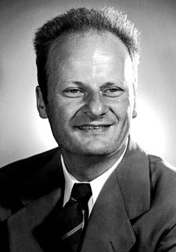
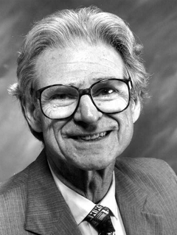
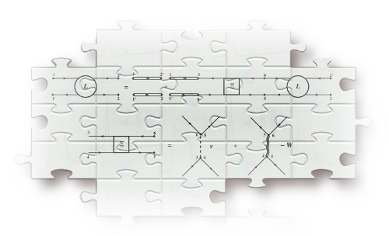
Bethe – Salpeter Equation
The equation was actually first
published in 1951.
describes the bound states of a two-body (particles) system in a formalism.
Hans Bethe
Edwin Ernest Salpeter
1906 - 2005
1924 - 2008
9
Excitons In Single – Walled Carbon Nanotubes

Slide 12
Problem definition □□□■□□□□□□
Nasim Moradi
How can we obtain
optical spectra by solving
the Bethe-Salpeter equation?
10
Excitons In Single – Walled Carbon Nanotubes

Slide 13
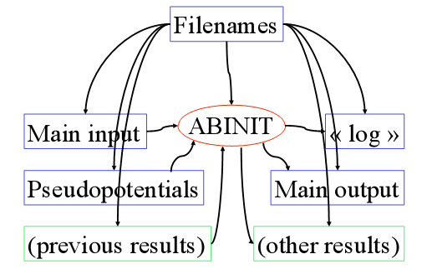
ABINIT code □□□□■□□□□□
Nasim Moradi
ABINIT is an ab initio computational package, using the pseudopotentials and
plane-wave basis set. It allows one to find the total energy , charge density and electronic structure of systems within Density Functional Theory.
acell bdgw bs_algorithm bs_freq_mesh ecut ecuteps enunit ixc
iscf nsppol nstep nsym soenergy symsigma xred zcut znucl
F. .
gwcalctyp gwmem kptopt ngfft ngkpt npwkss
‎X. ‎Gonze ‎et ‎al. “‎ABINIT: First-principles approach to material and nanosystem properties”, ‎ Comput. Phys. ‎Comm‎‎. 180 (‎2009)‎
11
Excitons In Single – Walled Carbon Nanotubes

Slide 14
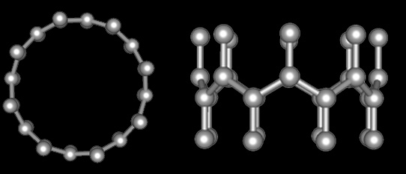
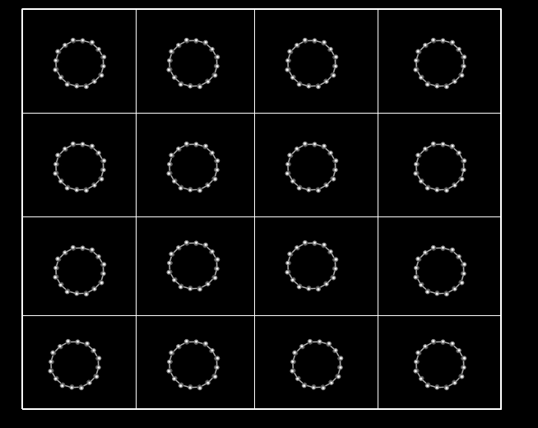
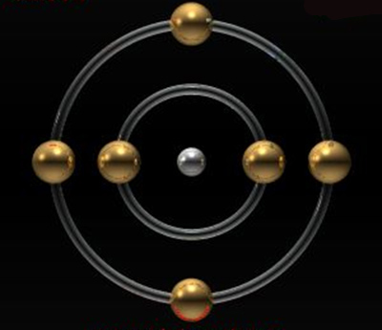
(8,0)
Unit cell contains 32 carbon atoms .
The Carbon atom has six electrons .
$$×$$
$${\text{1}\text{s} }^{2}{ \text{2}\text{s} }^{2}{ \text{2}\text{p} }^{2}$$
y
x
12
Structures producted by jmol software

Slide 15
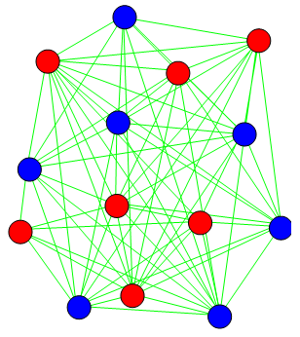
Density Functional Theory (DFT) □□□□□■□□□□
Nasim Moradi
Kohn-Sham equations
exchange-correlation energy
No
Self – Consistent?
Local density approximation
Yes
LDA: Teter Pade parametrization
R. M. Martin, Electronic Structure, page 173
13
Excitons In Single – Walled Carbon Nanotubes

Slide 16
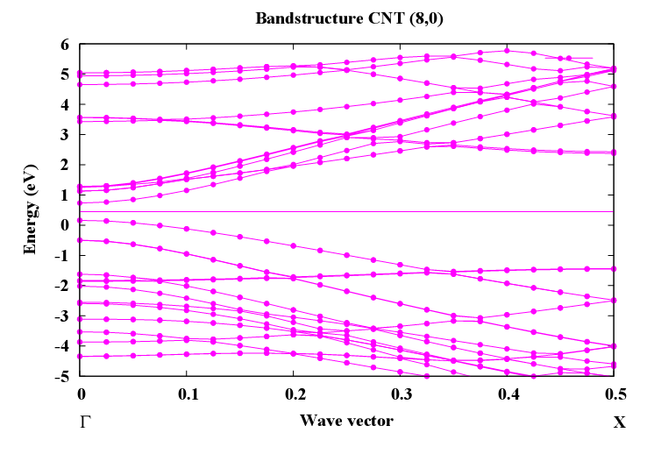
ABINIT code □□□□□■□□□□
Nasim Moradi
Band structure obtained with ABINIT
14
Excitons In Single – Walled Carbon Nanotubes

Slide 17
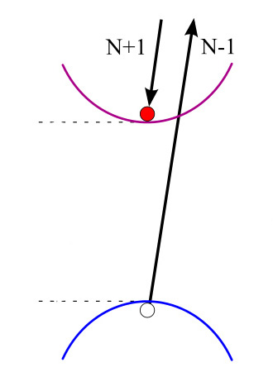
Many-Body Perturbation Theory (MBPT) □□□□□□■□□□
Nasim Moradi
Dyson Equation or Quasiparticle (QP) Equation :
equation:
First - Order Perturbation Theory :
W. G. Aulbur, Quasiparticle calculations in solids
15
Excitons In Single – Walled Carbon Nanotubes

Slide 18
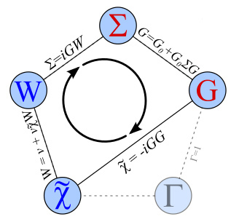
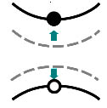
GW approximation □□□□□□■□□□
Nasim Moradi
‎L‎. ‎Hedin‎, “New Method for Calculating the One-Particle Green's Function with Application to the Electron-Gas Problem”, ‎ Phys‎. ‎Rev. 139 , (1965)‎‎
16
Excitons In Single – Walled Carbon Nanotubes

Slide 19
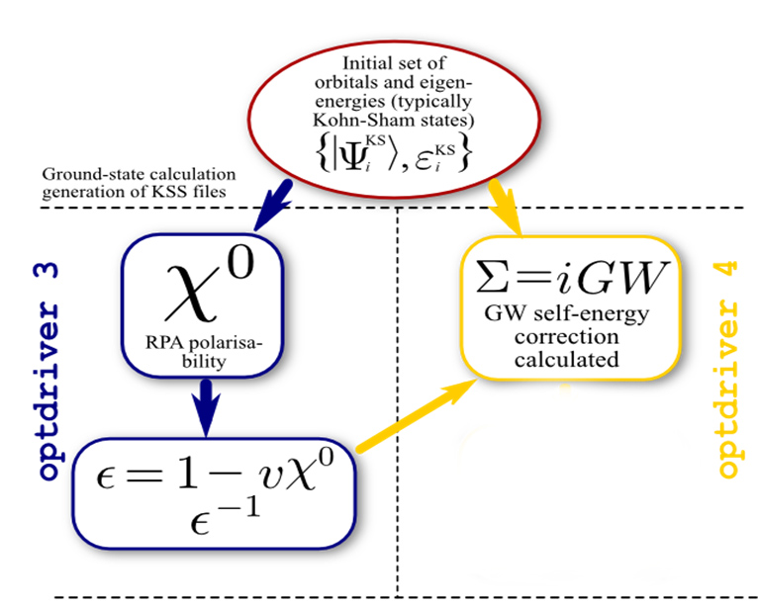
ABINIT code □□□□□□■□□□
Nasim Moradi
KSS file
SCR file
GW file
17
Excitons In Single – Walled Carbon Nanotubes

Slide 20
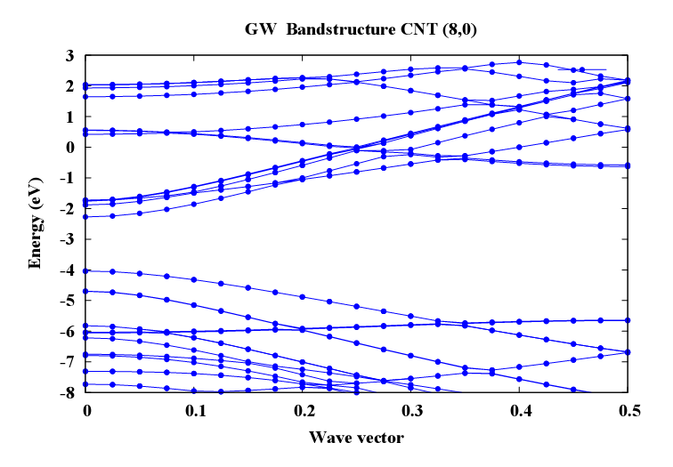
ABINIT code □□□□□□■□□□
Nasim Moradi
GW Band structure obtained with ABINIT
18
Excitons In Single – Walled Carbon Nanotubes

Slide 21
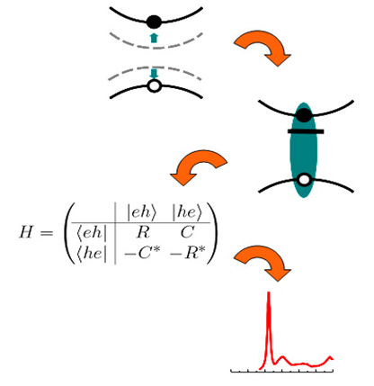
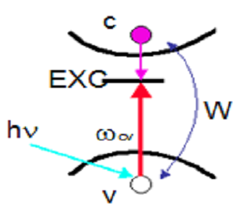
□□□□□□□■□□
Bethe-Salpeter Equation
Nasim Moradi
$${[E}_{ck}−E_{vk}]A_{vck}^{s}+\sum_{v^{′}c^{′}k^{′}}{〈vck|}K^{eh}|v^{′}c^{′}k^{′}〉A_{v^{′}c^{′}k^{′}}^{s}=Ω^{s}A_{vck}^{s}$$
$$H^{BS}|φ^{s}〉=Ω^{s}|φ^{s}〉$$
$$H^{BS}=H_{0}+K^{eh}$$
$$|φ^{s}〉=\sum_{vck}{A_{vck}^{s}}|vck〉$$
$$K^{eh}=2V−W$$
19
Excitons In Single – Walled Carbon Nanotubes

Slide 22
□□□□□□□■□□
Bethe-Salpeter Equation
Nasim Moradi
Tamm-Dancoff approximation
20
Excitons In Single – Walled Carbon Nanotubes

Slide 23
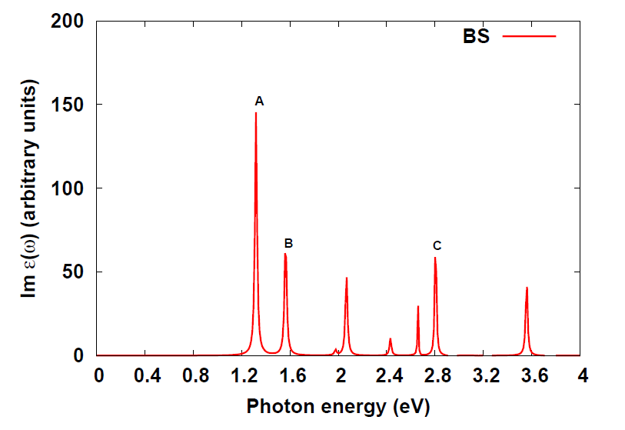
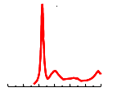
Optical spectra by solving the BSE □□□□□□□□■□
□□□□□□□□□
Nasim Moradi
21
Excitons In Single – Walled Carbon Nanotubes

Slide 24
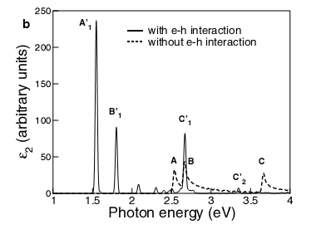
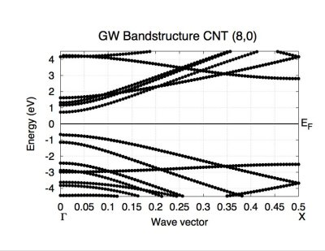
ab initio | E11=1.55 (eV) | E22=1.80 (eV) | Ratio=1.16
exp | E11=1.60 (eV) | E22=1.88 (eV) | Ratio=1.17
S‎. ‎M‎. ‎Bachilo‎ et al., Science. 298 (2002)
C. Spataru, S. Ismail-Beigi, L. X. Benedict, S. G. Louie
“ Excitonic Effects and Optical Spectra of SWCNTs ” , Phys. Rev. Lett. 92 ( 2004 )
22

Slide 25
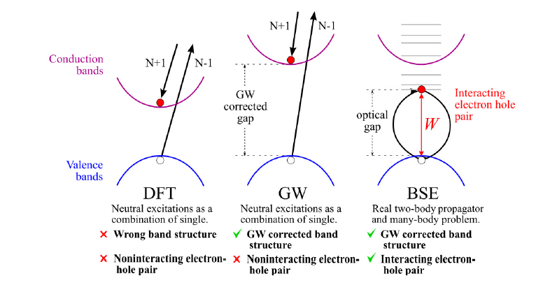

Slide 26
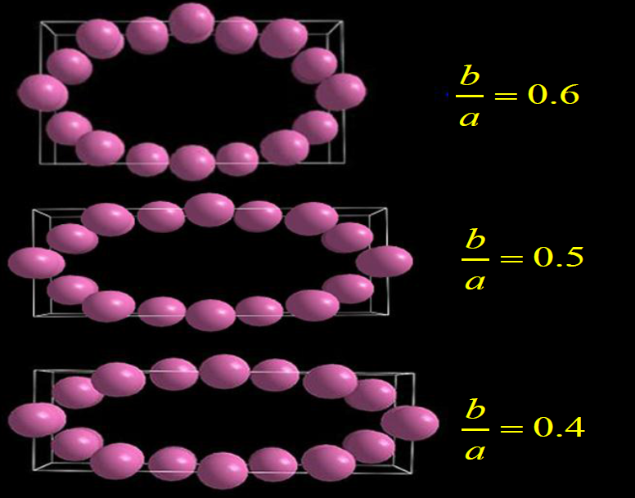
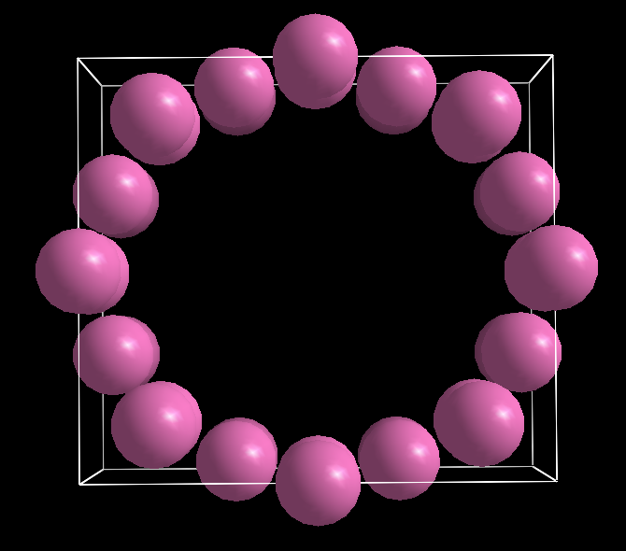
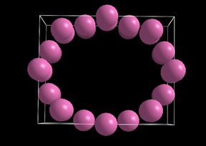
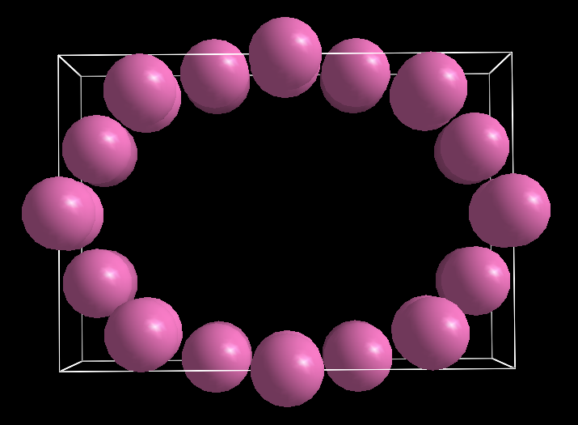
Deformation
Structures producted by v_sim software
23

Slide 27
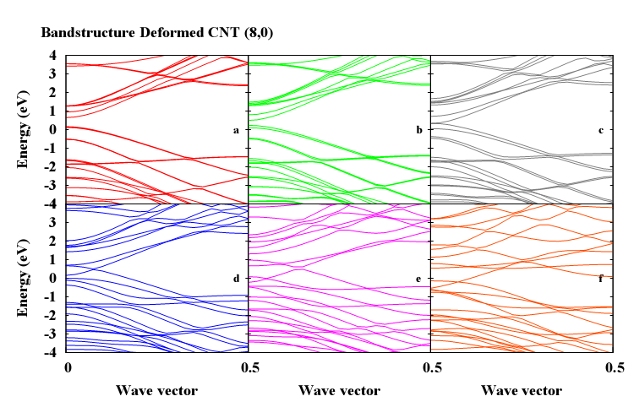
□□□□□□□□□■
Results and our model
Nasim Moradi
Semiconductor-Metal Transition
This result reported in :Yaroslav V‎. ‎Shtogun‎, ‎Lilia M‎. ‎Woods‎, “‎Electronic Structure Modulations of Radially Deformed Single Wall Carbon Nanotubes under Transverse External Electric Fields”‎, ‎ J‎. ‎Phys‎. ‎Chem‎. ‎C. 113 (2009)‎
24

Slide 28
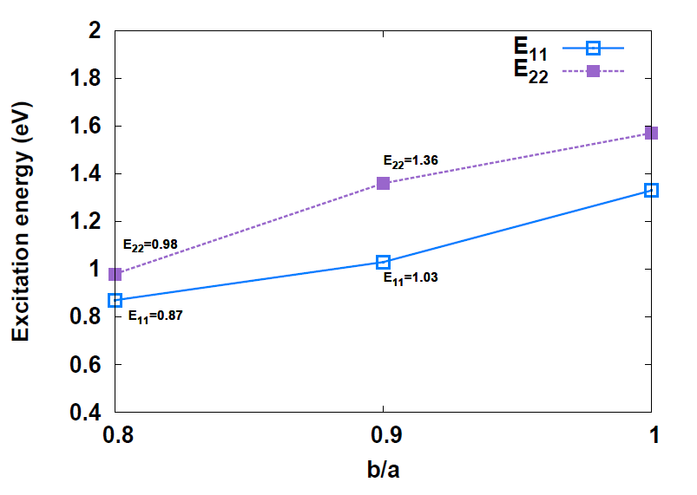
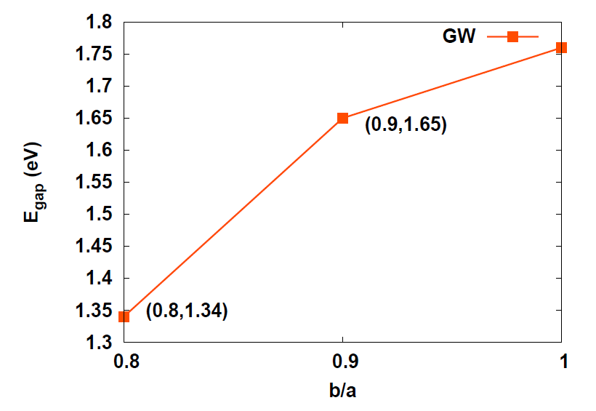
□□□□□□□□□■
Results and our model
Nasim Moradi
25

Slide 29
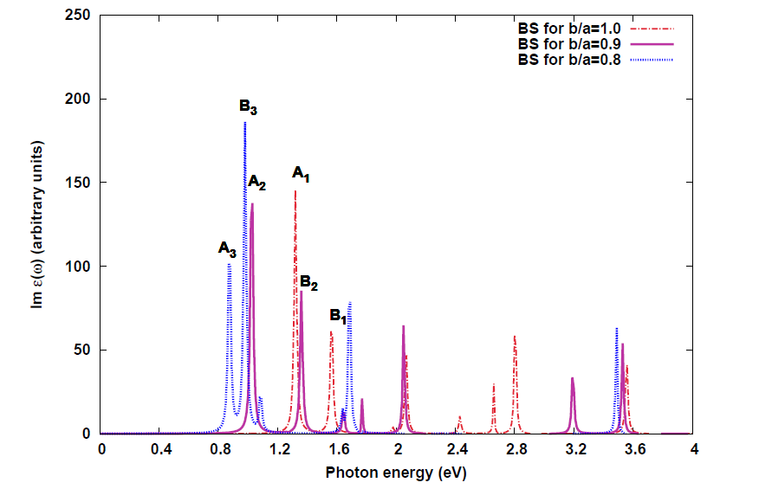
□□□□□□□□□■
Results and our model
Nasim Moradi
Red Shift
25

Slide 30
DFT
Time and memory
GW
Time and memory
BSE
Time and memory
Cputime: 5.5h
Mem: 1.5 GB
Cputime: 438h
Mem > 20 GB
Cputime: 1.5-15h
Mem: 4-12 GB
26

Slide 31
Thanks for
your attention

Slide 32
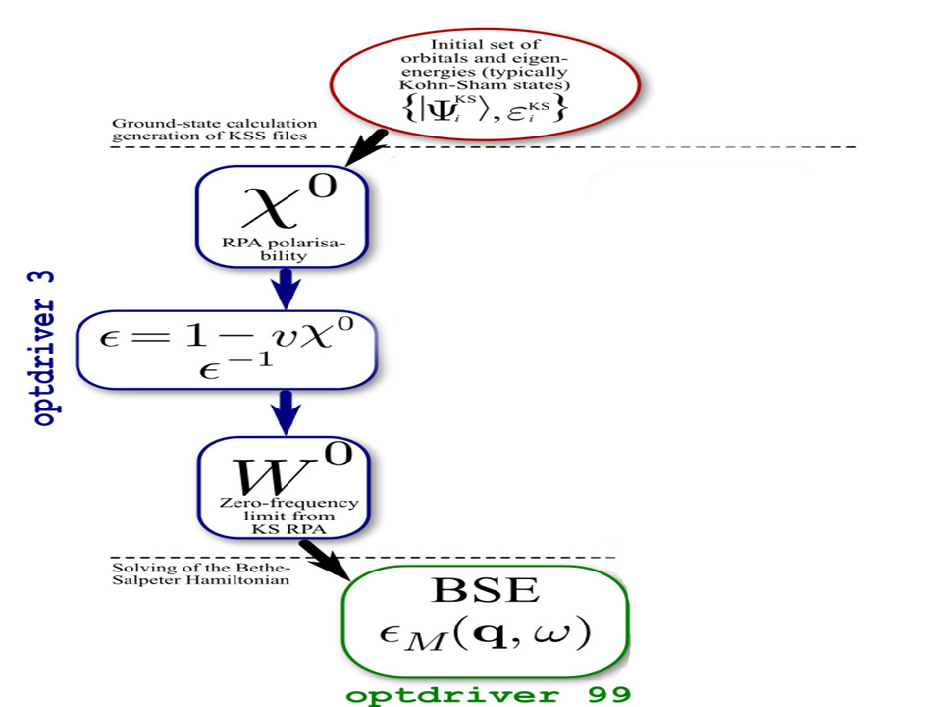
ABINIT code □□□□□□□□□
Nasim Moradi
KSS file
SCR file
Soenergy
MDF file
Excitons In Single – Walled Carbon Nanotubes

Slide 33
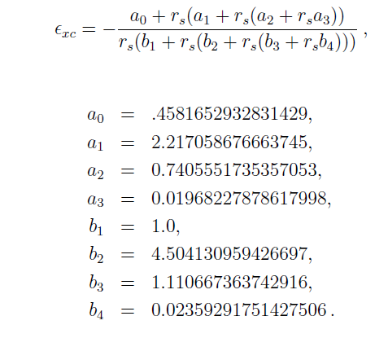

Slide 34
