Slide 1


UNRAVELING
Bit-Torrent
Presented by :
Daniyal Safaee

Slide 2




























































Bit Torrent was created by Bram Cohen in 2001.
It is a file transferring system that allows peer to peer (P2P) data communication .
It is used to transfer very huge files.
All torrent clients use the Bit Torrent Protocol.
This is the most popular and efficient file
transferring system.
More efficient than the Client–Server System.
Figure 1: Author Of Bit-Torrent Protocol

Slide 3














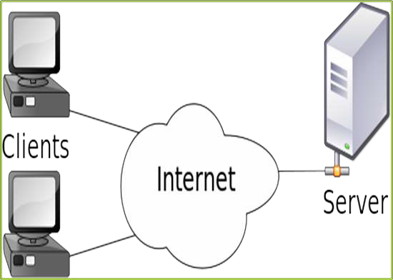


























Client sends the GET Message to Server.
Server sends the required files.
Transfer is handled by FTP and HTTP.
Advantages :
Most widely used model.
Easy to implement.
Disadvantages :
Traffic congestion.
Whole system crashes, when server fails.
Figure 2: Common Client–Server Model

Slide 4














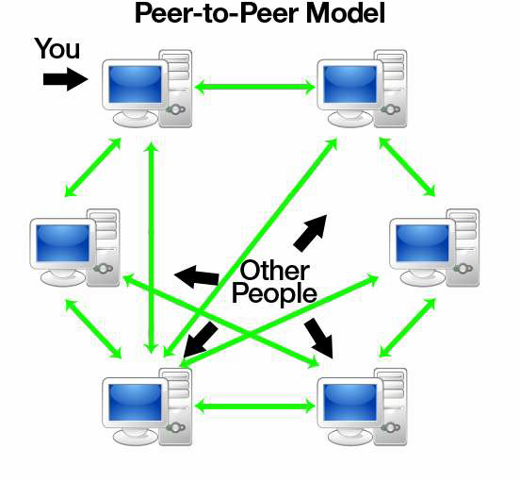














































A peer-to-peer (P2P) network is a type of decentralized and distributed network architecture .
In this architecture, individual nodes in the network are called as the ”peers”.
All nodes act as both suppliers and consumers of resources, in contrast to the centralized Client–Server Model where client nodes request access to resources provided by central servers.
Figure 3 : A Common P2P Network

Slide 5

























































The P2P architecture was first pioneered by NAPSTER (a famous online music provider in MP3 format) in
1999.
Further development in this field was later made by KaZaA (FastTrack) which helped in the sharing of music as well as the video files.
It was best implemented by Gnutella which is a fully distributed alternative to the semi-centralized systems such as the KaZaA & Napster.

Slide 6


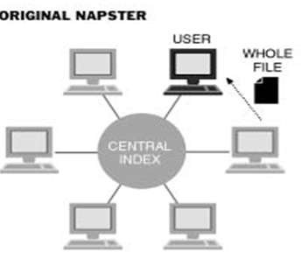
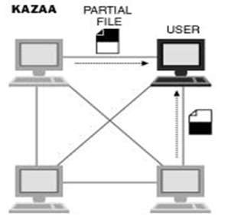
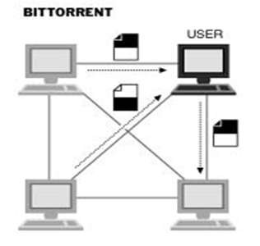
Figure 4 : Original Napster
Figure 5 : KAZAA
Figure 6 : Bit-Torrent

Slide 7




































Bit-torrents (also known as the "torrents") work by downloading small segments of files from different web sources at the same
time.
It enables fast downloading of large files using minimum internet bandwidth.
Figure 7 : A Bit-Torrent Network

Slide 8


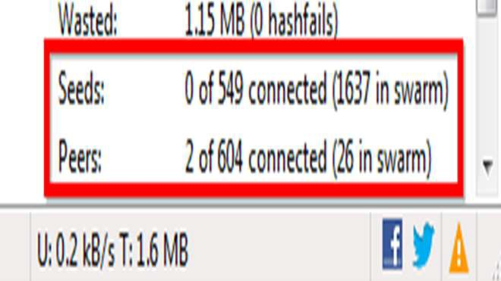
Seed:
A seed refers to a machine possessing the complete data.
A downloader that obtains 100% of the data also becomes a seed.
Leech:
Leecher , (synonymous with downloader), is a peer or any client that does not have 100% of the data.
Leech also refers to a peer (or peers) that has a negative effect on the swarm by having a very poor share ratio.
Figure 8 : Seeds & Peers In A Bit-torrent Client

Slide 9









































































Swarm:
  All the peers (including seeds), sharing a torrent are called as the swarms. For example, six ordinary peers and two seeds make a swarm of eight.
.torrent File:
  A torrent can mean either a .torrent metadata file or all
files described by it, depending on context.
  The torrent file contains metadata about all the files it makes downloadable, including their names and sizes and checksums of all pieces in the torrent.

Slide 10
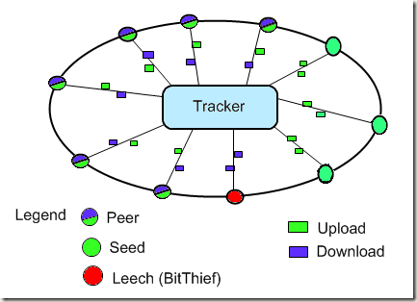
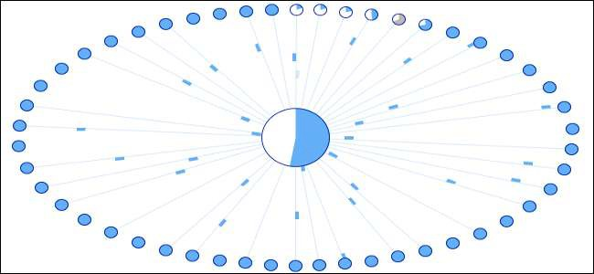
FIG 9: PARTS OF A TORRENT NETWORK
FIG 10: SWARM OF PEERS IN A TORRENT NETWORK

Slide 11


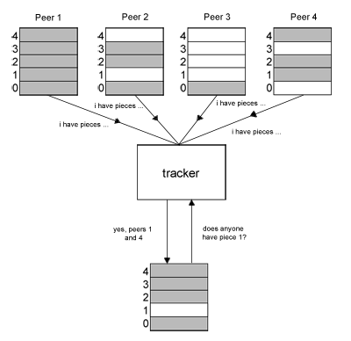








































Tracker:
A tracker is a server that keeps track of those seeds & peers that are in the
swarm.
The tracker is not directly involved in the data transfer and does not have a copy of the file.
Figure 11: Working Of Tracker

Slide 12


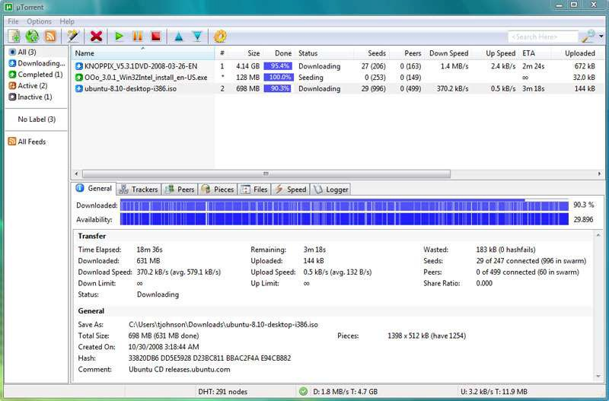































Client:
A Bit Torrent client is an executable program which implements the Bit- Torrent protocol in it.
It runs together with the operating system on a user‟s machine, and handles interactions with the tracker and peers.
Figure 12: Working of Client

Slide 13












































Piece (of a file):
The file which is to be downloaded is divided into similar size of pieces but last piece size varies.
These
pieces
are downloaded in
Example : A
1.4Mb file into the
parallel.
could be split
following pieces:
5 * 256kb pieces, and a
final piece of 120kb.
Each piece
is downloaded
from
different peers.

Slide 14




















































































The torrent file functions as a special pointer to locate a specific file and the swarm of people currently sharing that file.
The torrent client software, then talks to a tracker server for 2 to 10 minutes, while it scours the internet for people to swarm with.
As the tracker locates torrent users to swarm with, each user will be automatically labeled as either a “leech/peer” or as a “seed”.
Then the client software then begins the transfer depending upon the connection type.
Once the transfer is complete, seeding starts automatically.

Slide 15


Web Server
Tracker
Web page with link to .torrent
C
A
Peer
[Seed]
Peer [Leech] Downloader
B
Peer [Leech]

Slide 16
Web Server
Tracker
Web page with link to .torrent
C
A
Peer
[Seed]
Peer [Leech] Downloader
B
Peer [Leech]

Slide 17

Web Server
Tracker
Web page with link to .torrent
C
A
Peer
[Seed]
Peer [Leech] Downloader
B
Peer [Leech]

Slide 18
Web Server
Tracker
Web page with link to .torrent
C
A
Peer
[Seed]
Peer [Leech] Downloader
B
Peer [Leech]

Slide 19
Web Server
Tracker
Web page with link to .torrent
C
A
Peer
[Seed]
Peer [Leech] Downloader
B
Peer [Leech]

Slide 20
Web Server
Tracker
Web page with link to .torrent
C
A
Peer
[Seed]
Peer [Leech] Downloader
B
Peer [Leech]

Slide 21

Web Server
Tracker
Web page with link to .torrent
C
A
Peer
[Seed]
Peer [Leech] Downloader
B
Peer [Leech]

Slide 22
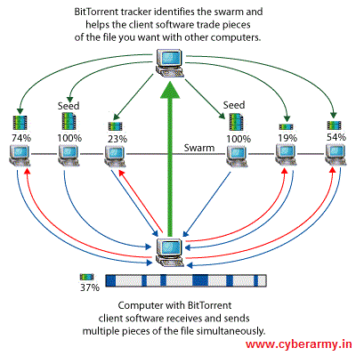
FIG 9 COMPLETE WORKFLOW OF BIT TORRENT

Slide 23




































































The behavior of a peer running the Bit-Torrent peer-to-peer protocol is mostly determined by two algorithms:
Peer Selection Algorithm : Determines who the local peer will cooperate with i.e. who it will download from and upload to.
Piece Selection Algorithm : Determines which pieces of the file being downloaded should be obtained from which peer as the download progresses.

Slide 24

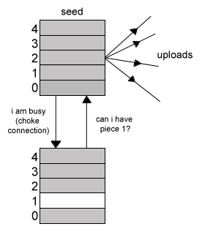





























































Choking:
When a peer receives a request for a piece from another peer, it can opt to refuse to transmit that piece. If this happens, the peer is said to be choked.
The most common option is that by default, a client will only maintain a default number of simultaneous uploads (max_uploads).
All further requests to the client will be marked as choked.

Slide 25
















































































Advantages:
Bit Torrent is one of the most common protocols for transferring large files and peer-to-peer networks.
As of February 2013, BitTorrent was responsible for 3.35% of all worldwide bandwidth, more than half of the 6% of total bandwidth dedicated to file sharing.
Demand of torrent file sharing has doubled due to latest smartphones and tablets.
Disadvantages:
Possibility of sharing any file type has led bit torrent to Legal issues with Piracy & Copyright Infringement Laws which has hampered its credibility.

Slide 26










































































































RECENT DEVELOPMENTS
Bit Torrent Sync:
A file synchronizing tool
to sync files between devices on a local network, or
between remote devices over the Internet
via secure,
distributed P2P technology.( Launched since August 2013)
Bit Torrent plus:
Upgraded bit torrent client for premium customers providing additional features such as inbuilt virus protection , hd playback,Faster downloads ,etc.
Bit Torrent live - A New Way to Live Broadcast
Bit Torrent Live is a powerful new web-based live streaming technology.
Designed to eliminate barriers to, Live is an entirely new protocol, designed to deliver high quality video to large audiences - with significant reduction in infrastructure cost and network delays.

Slide 27




































































in current network
Bit torrent is a very widely used peer to peer scenario
protocol
A growing number of individuals and organizations are using BitTorrent to distribute their own or licensed material.
Because of its simplicity & flexibility bit torrent has become the most widely
used to transfer files like music,videos,games, etc.
As of January 2012, BitTorrent is utilized by 150 million active users
(according to BitTorrent, Inc.)

Slide 28





































REFERENCES
http://www.morehawes.co.uk/the-bittorrent-protocol.html
http://www.howtogeek.com/141257/htg-explains-how-does-bittorrent-work
www.slideshare.net/gsantosh031/bit-torrent-ppt
A. R. Bharambe, C. Herley and V. N. Padmanabhan, “Analyzing and Improving Bit Torrent Performance”, Technical Report MSR-TR-2005-03, Microsoft Research,
USA, Feb 2005
www.cs.cornell.edu/courses/cs514/2008sp/bittorrent.ppt
https://en.wikipedia.org/wiki/Bit_torrent
http://www.bittorrent.org/protocol.html

Slide 29


