Slide 1
In the name of god

Slide 2
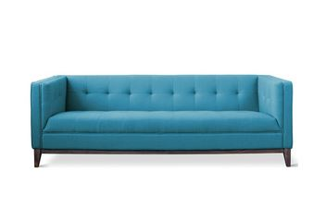
furniture
Design and construction of
Mohammadali Honardoost
Mostafa khatib

Slide 3
Design for Manufacturing
Modular Design
Sustainable Design
Diagrams Of WLC
Customer Satisfaction
Furniture Design
Sofa Contents
Ways to be better
Finish

Slide 4
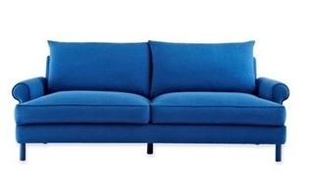
Design for manufacturability
Design for manufacturability (also sometimes known as design for manufacturing or DFM) is the general engineering art of designing products in such a way that they are easy to manufacture. The basic idea exists in almost all engineering disciplines, but of course the details differ widely depending on the manufacturing technology. This design practice not only focuses on the design aspect of a part but also on the producibility. In simple language it means relative ease to manufacture a product, part or assembly. DFM describes the process of designing or engineering a product in order to facilitate the manufacturing process in order to reduce its manufacturing costs. DFM will allow potential problems to be fixed in the design phase which is the least expensive place to address them. The design of the component can have an enormous effect on the cost of manufacturing. Other factors may affect the manufacturability such as the type of raw material, the form of the raw material, dimensional tolerances, and secondary processing such as finishing.

Slide 5
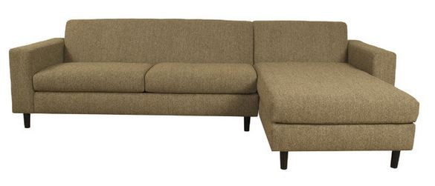
Modular design
Modular design, or "modularity in design", is a design approach that subdivides a system into smaller parts called modules or skids, that can be independently created and then used in different systems. A modular system can be characterized by functional partitioning into discrete scalable, reusable modules, rigorous use of well-defined modular interfaces and making use of industry standards for interfaces.

Slide 6
Modular construction

Slide 7
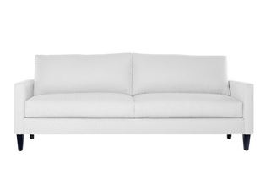
Besides reduction in cost (due to lesser customization, and less learning time), and flexibility in design, modularity offers other benefits such as augmentation (adding new solution by merely plugging in a new module), and exclusion. Modular design is an attempt to combine the advantages of standardization (high volume normally equals low manufacturing costs) with those of customization.

Slide 8
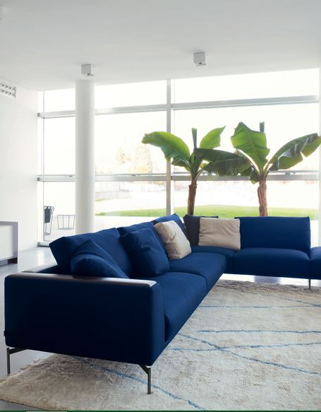
Sustainable design
Sustainable design (also called environmental design, environmentally sustainable design, environmentally conscious design, etc.) is the philosophy of designing physical objects, the built environment, and services to comply with the principles of social, economic, and ecological sustainability

Slide 9
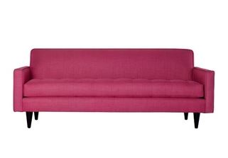
Mass Production
Mass production is the production of large amounts of standardized products, including and especially on assembly lines. With job production and batch production it is one of the three main production methods Mass production is a diverse field, but it can generally be contrasted with craft production or distributed manufacturing. It has occurred for centuries; there are examples of production methods that can best be defined as mass production that predate the Industrial Revolution. However, it has been widespread in human experience, and central to economics, only since the late 19th century.

Slide 10
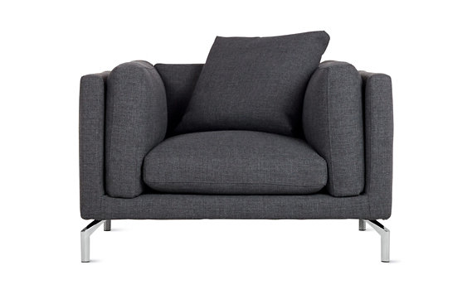
Sofa
Design + Construction

Slide 11
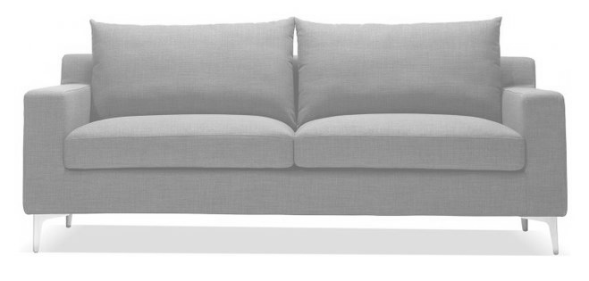
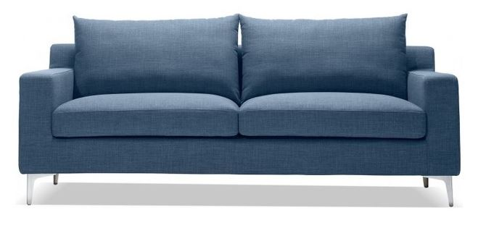
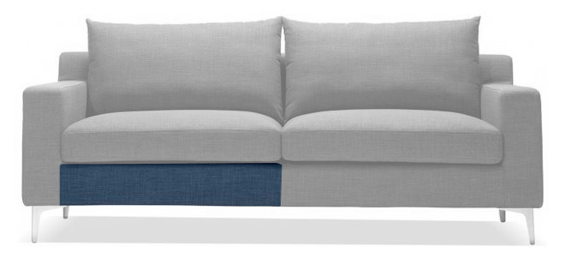
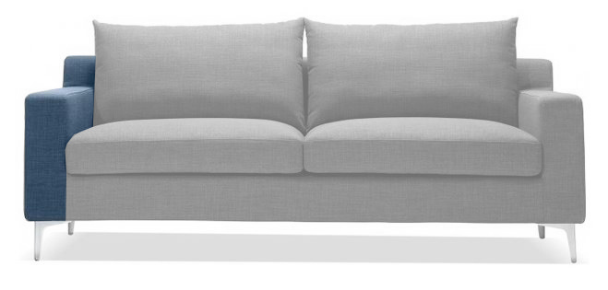
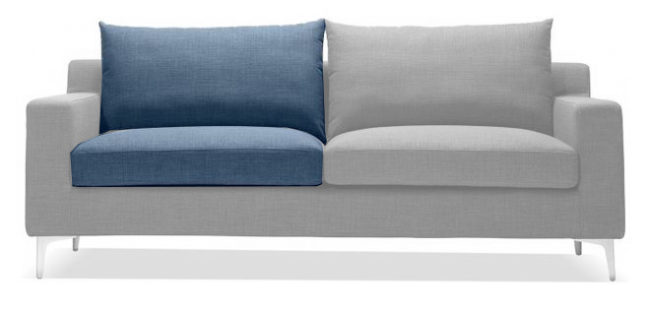
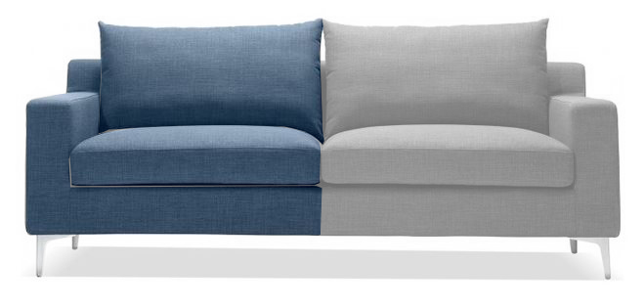
Modular Sofa

Slide 12
Sofa design
Structure
Sponge
Cloth

Slide 13
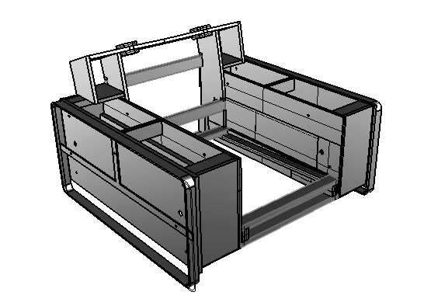
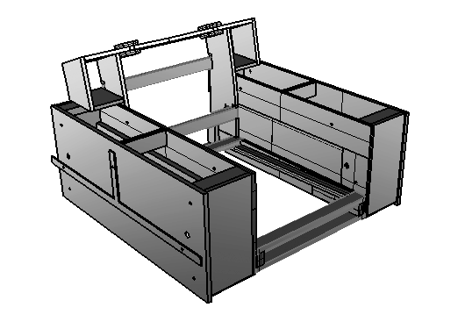
Structure
Pan
Handle
Leg

Slide 14
Modular design
In materials
In structure
In sponges
In cloths
In connections
In details

Slide 15
Echo efficiency
In design
+construction
Customer
satisfaction
performance

Slide 16
In process of production

Slide 17
Aim?
Customer satisfaction
What is customer satisfaction?
Cost
Efficiency
Performance
Durability
…

Slide 18
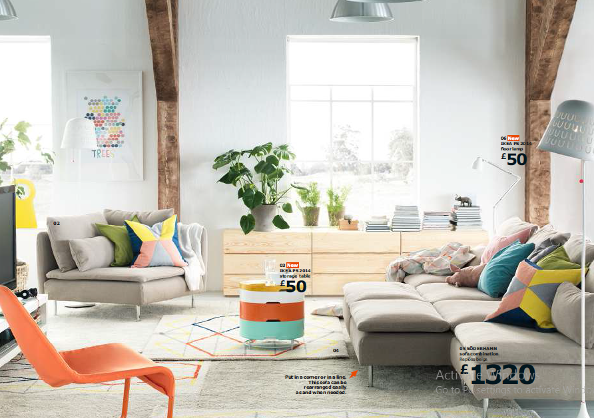
Samples

Slide 22
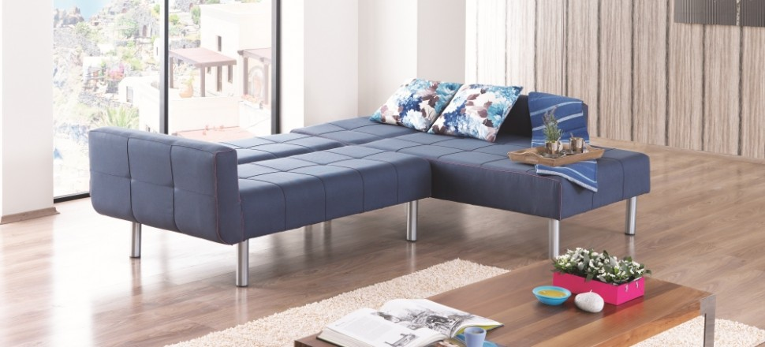

Slide 24
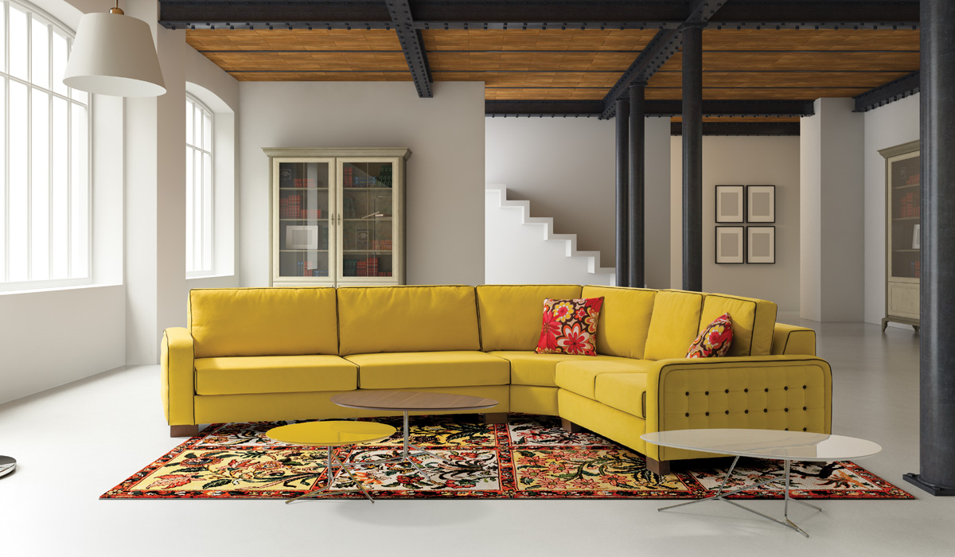

Slide 25
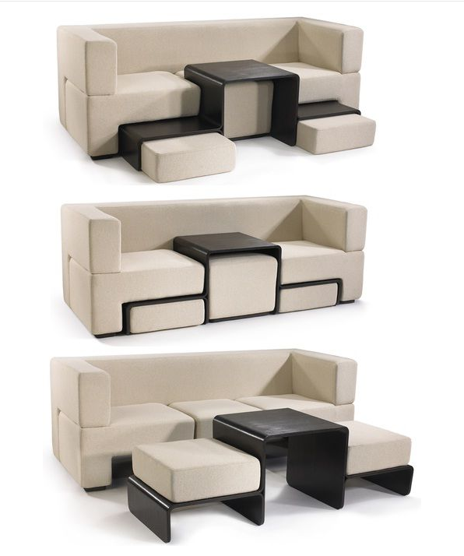

Slide 26
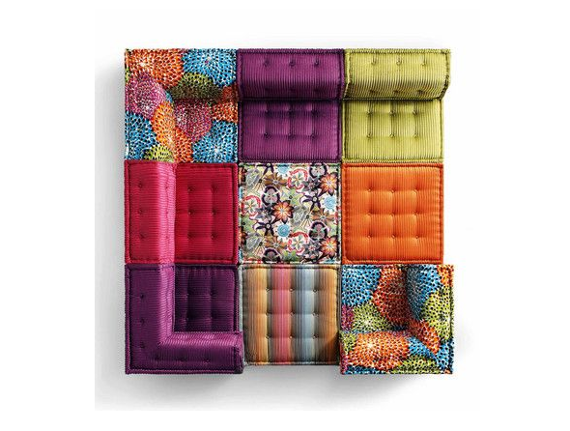

Slide 27
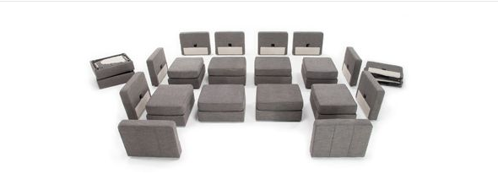

Slide 28
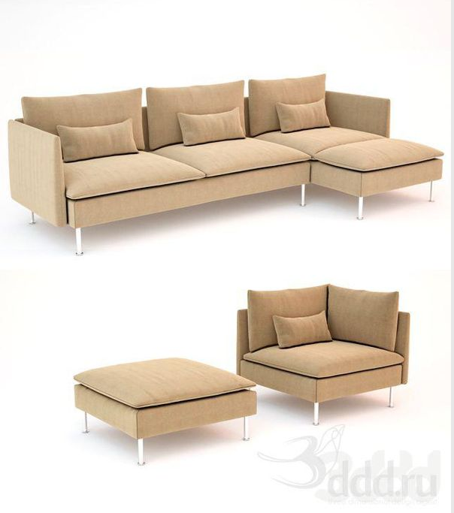

Slide 30
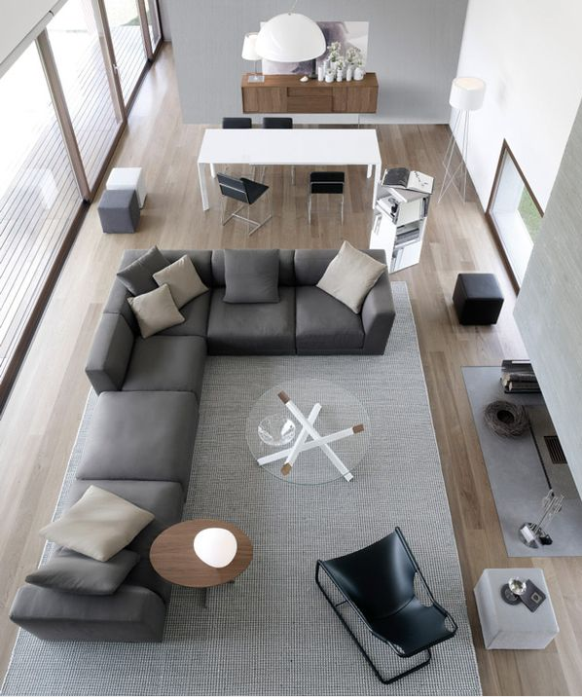

Slide 38
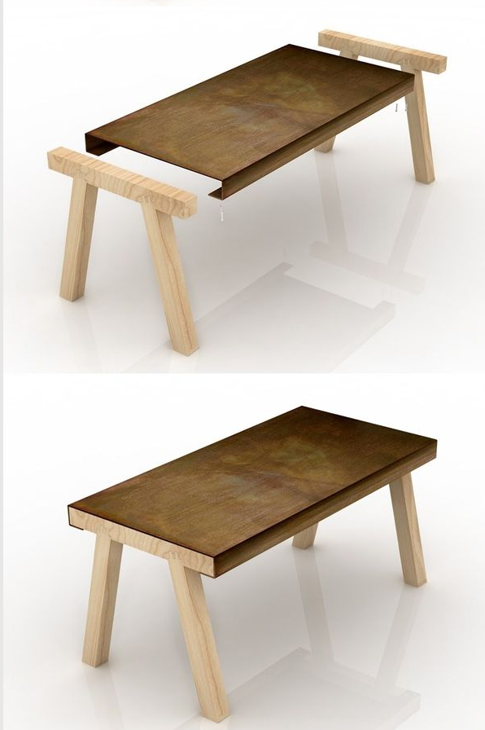

Slide 39
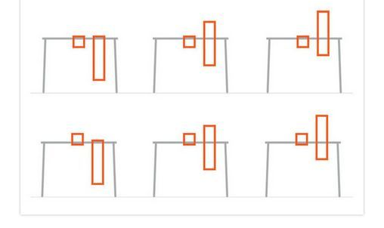

Slide 44
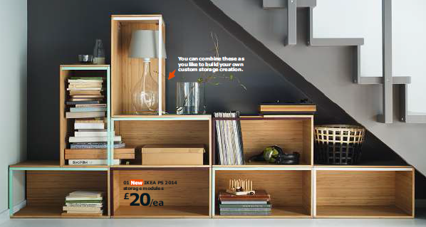

Slide 51
sources
http://www.momastore.org
· Design for Manufacturability And Statistical Design: A Constructive Approach, by Michael Orshansky, Sani Nassif, Duane Boning ISBN 0-387-30928-4
www.memarima.ir
www.ikea.com
www.fmh.ir
www.Wikipedia.com

