Slide 1
WSN Applications
6.2
Advanced Computer Networks
By: Mahdi Sadeghizadeh

Slide 2
Application Spectrum

Slide 3
WSN Applications
Environmental/Habitat monitoring
Acoustic detection
Seismic detection
Military, battlefield surveillance
Medical monitoring
Smart spaces
Commercial Applications

Slide 4
Environmental/Habitat monitoring
Forest fire detection
Disaster relief operations
  Drop sensor nodes from an aircraft over a wildfire
  Each node measures temperature
  Derive a “temperature map”
FireWxNet: A Multi-Tiered Portable Wireless System for Monitoring Weather Conditions in Wildland Fire Environments,
C. Hartung, R. Han, C. Seielstad, S. Holbrook, Mobisys 2006.
Notes:
recovery

Slide 5
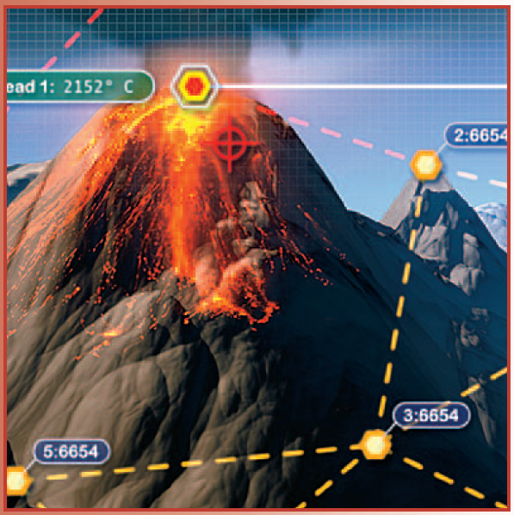
Environmental/Habitat monitoring
Forest fire detection
Active Volcano Monitoring
Deploying a Wireless Sensor Network on an Active Volcano,
G. Werner-Allen, K. Lorincz, M. Ruiz, O. Marcillo, J. Johnson, J. Lees, and M. Welsh, IEEE Internet Computing, 2006.

Slide 6
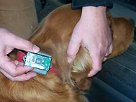
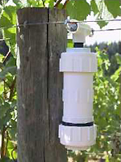
Environmental/Habitat monitoring
Forest fire detection
Active Volcano Monitoring
Precision agriculture
The “Wireless Vineyard”
  Sensors monitor temperature, moisture
  Roger the dog collects the data
Notes:
accuracy

Slide 7
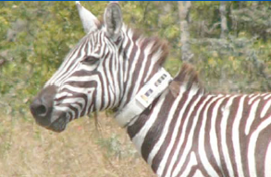
Environmental/Habitat monitoring
Forest fire detection
Active Volcano Monitoring
Precision agriculture
Habitat monitoring
Biodiversity mapping: Use sensor nodes to observe wildlife
The ZebraNet Project: Collar-mounted sensors monitor zebra movement in Kenya
Dynamic Virtual Fences for Controlling Cows, Z. Butler, P. Corke, R. Peterson, and D. Rus, ISER 2004

Slide 8
Environmental/Habitat monitoring
Forest fire detection
Active Volcano Monitoring
Precision agriculture
Habitat monitoring
Biocomplexity mapping of the environment
Flood detection

Slide 9
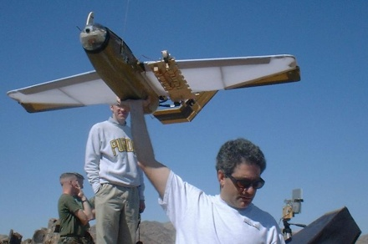
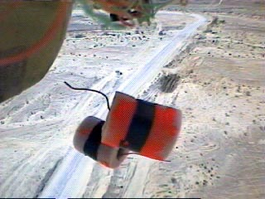

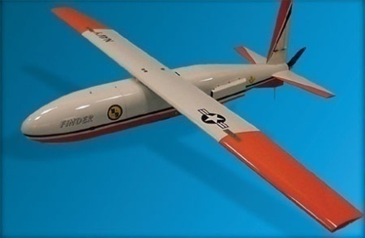


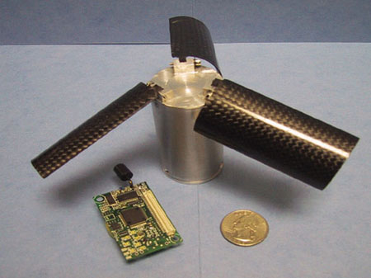


Military, battlefield surveillance
Monitoring friendly forces, equipment and ammunition
Battlefield surveillance
Reconnaissance of opposing forces and terrain
Battle damage assessment
Nuclear, biological and chemical attack detection and reconnaissance
!
Sniper localization
Notes:
شناسایی و خنثی کردن

Slide 10
Medical monitoring
Tele-monitoring of human physiological data
Tracking and monitoring patients and doctors inside a hospital
Drug administration in hospitals

Slide 11
Smart spaces
Intelligent buildings (or bridges)
  Reduce energy wastage by proper humidity, ventilation, air conditioning (HVAC) control
  Needs measurements about room occupancy, temperature, air flow, …
  Monitor mechanical stress after earthquakes
WBAN Examples

Slide 12

Mahdi Sadeghizadeh
Quchan University of Advanced Technologies Engineering

Slide 13
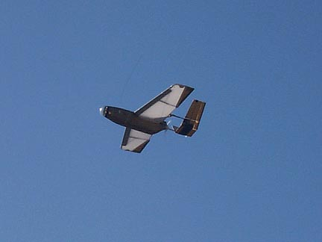
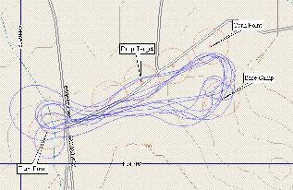
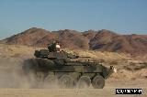
Industrial & Commercial Applications
Interactive museums
Facility management
  Intrusion detection into industrial sites
  Control of leakages in chemical plants
  Managing inventory control
Vehicle tracking and detection
Machine surveillance and preventive maintenance
  Embed sensing/control functions into places no cable has gone before
  E.g., tire pressure monitoring
  Detecting and monitoring car thefts
Process monitoring

Slide 14
Structuring WSN application types
Interaction patterns between sources and sinks classify application types:
  Event detection: Nodes locally detect events (maybe jointly with nearby neighbors), report these events to interested sinks
    Event classification additional option
  Periodic measurement
  Function approximation: Use sensor network to approximate a function of space and/or time (e.g., temperature map)
  Edge detection: Find edges (or other structures) in such a function (e.g., where is the zero degree border line?)
  Tracking: Report (or at least, know) position of an observed intruder (“pink elephant”)

Slide 15
Deployment options for WSN
How are sensor nodes deployed in their environment?
  Dropped from aircraft ! Random deployment
    Usually uniform random distribution for nodes over finite area is assumed
    Is that a likely proposition?
  Well planned, fixed ! Regular deployment
    E.g., in preventive maintenance or similar
    Not necessarily geometric structure, but that is often a convenient assumption
  Mobile sensor nodes
    Can move to compensate for deployment shortcomings
    Can be passively moved around by some external force (wind, water)
    Can actively seek out “interesting” areas

Slide 16
Maintenance options
Feasible and/or practical to maintain sensor nodes?
  E.g., to replace batteries?
  Or: unattended operation?
  Impossible but not relevant? Mission lifetime might be very small
Energy supply?
  Limited from point of deployment?
  Some form of recharging, energy scavenging from environment? E.g., solar cells
Notes:
خودکار

Slide 17
Characteristic requirements for WSNs
Type of service of WSN
  Not simply moving bits like another network
  Rather: provide answers (not just numbers)
  Issues like geographic scoping are natural requirements, absent from other networks
Quality of service
  Traditional QoS metrics do not apply
  Still, service of WSN must be “good”: Right answers at the right time
Fault tolerance
  Be robust against node failure (running out of energy, physical destruction, …)
Lifetime
  The network should fulfill its task as long as possible – definition depends on application
  Lifetime of individual nodes relatively unimportant
  But often treated equivalently

Slide 18
Characteristic requirements for WSNs
Scalability
  Support large number of nodes
Wide range of densities
  Vast or small number of nodes per unit area, very application-dependent
Programmability
  Re-programming of nodes in the field might be necessary, improve flexibility
Maintainability
  WSN has to adapt to changes, self-monitoring, adapt operation
  Incorporate possible additional resources, e.g., newly deployed nodes

Slide 19
Required mechanisms to meet requirements
Multi-hop wireless communication
Energy-efficient operation
  Both for communication and computation, sensing, actuating
Auto-configuration
  Manual configuration just not an option
Collaboration & in-network processing
  Nodes in the network collaborate towards a joint goal
  Pre-processing data in network (as opposed to at the edge) can greatly improve efficiency
Data centric networking
  Focusing network design on data, not on node identifies (id-centric networking)
  To improve efficiency
Locality
  Do things locally (on node or among nearby neighbors) as far as possible
Exploit tradeoffs
  E.g., between invested energy and accuracy
Notes:
تاآنجا که

Slide 20
MANET vs. WSN
Many commonalities: Self-organization, energy efficiency, (often) wireless multi-hop
Many differences:
  Applications, equipment: MANETs more powerful (read: expensive) equipment assumed, often “human in the loop”-type applications, higher data rates, more resources
  Application-specific: WSNs depend much stronger on application specifics; MANETs comparably uniform
  Environment interaction: core of WSN, absent in MANET
  Scale: WSN might be much larger (although contestable)
  Energy: WSN tighter requirements, maintenance issues
  Dependability/QoS: in WSN, individual node may be dispensable (network matters), QoS different because of different applications
  Data centric vs. id-centric networking
  Mobility: different mobility patterns like (in WSN, sinks might be mobile, usual nodes static)

Slide 21
Wireless fieldbuses and WSNs
Fieldbus:
  Network type invented for real-time communication, e.g., for factory-floor automation
  Inherent notion of sensing/measuring and controlling
  Wireless fieldbus: Real-time communication over wireless
! Big similarities
Differences
  Scale – WSN often intended for larger scale
  Real-time – WSN usually not intended to provide (hard) real-time guarantees as attempted by fieldbuses

Slide 22
Enabling technologies for WSN
Cost reduction
  For wireless communication, simple microcontroller, sensing, batteries
Miniaturization
  Some applications demand small size
  “Smart dust” as the most extreme vision
Energy scavenging
  Recharge batteries from ambient energy (light, vibration, …)

Slide 23

Thank You

