Slide 1
Clinical Use of Antiarrhythmic Agents

Slide 2
Antiarrythmic Drugs Action
Reduce Automaticity
Slow Conduction of electrical impulses through the heart
Prolong refractory (rest) period of myocardial cells

Slide 3
Antiarrhythmic Drug-Use Principles Applied to Atrial Fibrillation
Atrial fibrillation is the most common sustained arrhythmia observed clinically.
Its prevalence increases from ~ 0.5% in individuals younger than 65 years of age to 10% in individuals older than 80.
Diagnosis is usually straightforward by means of an ECG.
Hyperthyroidism is an important treatable cause of atrial fibrillation, and a thyroid panel should be obtained at the time of diagnosis to exclude this possibility.
With the clinical history and physical examination as a guide, the presence and extent of the underlying heart disease should be evaluated, preferably using noninvasive techniques such as echocardiography

Slide 4
Treatment of atrial fibrillation
Treatment of atrial fibrillation is initiated to relieve patient symptoms and prevent the complications of thromboembolism and tachycardia-induced heart failure, the result of prolonged uncontrolled heart rates.
The initial treatment objective is control of the ventricular response.
This is usually achieved by use of a calcium channel-blocking drug alone or in combination with a β-adrenergic blocker.
Digoxin may be of value in the presence of heart failure. A second objective is a restoration and maintenance of normal sinus rhythm.

Slide 5
paroxysmal atrial
For patients with paroxysmal atrial fibrillation, normal sinus rhythm may be restored with a single large oral dose of propafenone or flecainide, provided that safety is initially documented in a monitored setting.
A class 1 or class 3 antiarrhythmic drug is used to maintain normal sinus rhythm.

Slide 6
Pretreatment Evaluation
Several important determinations must be made before initiation of any antiarrhythmic therapy:
1. Eliminate the cause.
Precipitating factors must be recognized and eliminated if possible.
These include: abnormalities of internal homeostasis, such as hypoxia or electrolyte abnormalities (especially hypokalemia or hypomagnesemia),
drug therapy (NO) and underlying disease states such as hyperthyroidism or cardiac disease.
It is important to separate this abnormal substrate from triggering factors, such as myocardial ischemia or acute cardiac dilation, which may be treatable and reversible.

Slide 7
Pretreatment Evaluation
2.Make a firm diagnosis
A firm arrhythmia diagnosis should be established. For example, the misuse of verapamil in patients with ventricular tachycardia mistakenly diagnosed as supraventricular tachycardia can lead to catastrophic hypotension and cardiac arrest.
As increasingly sophisticated methods to characterize underlying arrhythmia mechanisms become available and are validated, it may be possible to direct certain drugs toward specific arrhythmia mechanisms.

Slide 8
Pretreatment Evaluation
3.Determine the baseline condition
-Underlying heart disease is a critical determinant of drug selection for a particular arrhythmia in a particular patient.
-A key question is whether the heart is structurally abnormal.
-Few antiarrhythmic drugs have documented safety in patients with congestive heart failure or ischemic heart disease.
On the other hand, some drugs pose a documented proarrhythmic risk in certain disease states, eg, class 1C drugs in patients with ischemic heart disease.

Slide 9
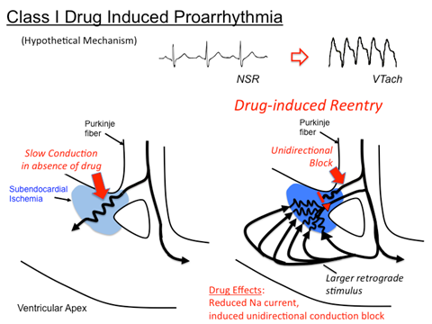

Slide 10
A reliable baseline should be established against which to judge the efficacy of any subsequent antiarrhythmic intervention. Several methods are now available for such baseline quantification. These include prolonged ambulatory monitoring, electrophysiologic studies that reproduce a target arrhythmia, reproduction of a target arrhythmia by treadmill exercise,

Slide 11
Pretreatment Evaluation
4.Question the need for therapy
The mere identification of an abnormality of cardiac rhythm does not necessarily require that the arrhythmia be treated. An excellent justification for conservative treatment was provided by the Cardiac Arrhythmia Suppression Trial (CAST) referred to earlier

Slide 12
Benefits & Risks
The benefits of antiarrhythmic therapy are actually relatively difficult to establish.
Two types of benefits can be envisioned: reduction of arrhythmia-related symptoms, such as palpitations, syncope, or cardiac arrest;
reduction in long-term mortality in asymptomatic patients.
Among drugs discussed here, only β blockers have been definitely associated with reduction of mortality in relatively asymptomatic patients, and the mechanism underlying this effect is not established

Slide 13
Benefits & Risks
Antiarrhythmic therapy carries with it a number of risks.
In some cases, the risk of an adverse reaction is clearly related to high dosages or plasma concentrations. Examples include lidocaine-induced tremor or quinidine-induced cinchonism.
In other cases, adverse reactions are unrelated to high plasma concentrations (eg, procainamide-induced agranulocytosis).
For many serious adverse reactions to antiarrhythmic drugs, the combination of drug therapy and the underlying heart disease appears important

Slide 14
Benefits & Risks
Several specific syndromes of arrhythmia provocation by antiarrhythmic drugs have also been identified, each with its underlying pathophysiologic mechanism and risk factors. Drugs such as quinidine, sotalol, which act—at least in part—by slowing repolarization and prolonging cardiac action potentials, can result in marked QT prolongation and torsade de pointes.
Treatment for torsade de pointes requires recognition of the arrhythmia, withdrawal of any offending agent, correction of hypokalemia, and treatment with maneuvers to increase heart rate (isoproterenol); intravenous magnesium also appears effective, even in patients with normal magnesium levels.

Slide 15
Benefits & Risks
Drugs that markedly slow conduction, such as flecainide, or high concentrations of quinidine, can result in an increased frequency of reentry arrhythmias, notably ventricular tachycardia in patients with prior myocardial infarction in whom a potential reentry circuit may be present.
Treatment here consists of recognition, withdrawal of the offending agent, and intravenous sodium.

Slide 16
Conduct of Antiarrhythmic Therapy
The urgency of the clinical situation determines the route and rate of drug initiation.
When immediate drug action is required, the intravenous route is preferred. Therapeutic drug levels can be achieved by administration of multiple intravenous boluses.
Drug therapy can be considered effective when the target arrhythmia is suppressed (according to the measure used to quantify it at baseline) and toxicities are absent. Conversely, drug therapy should not be considered ineffective unless toxicities occur at a time when arrhythmias are not suppressed.

Slide 17
Drug Interaction
Monitoring plasma drug concentrations can be a useful adjunct to managing antiarrhythmic therapy. Plasma drug concentrations are also important in establishing compliance during long-term therapy as well as in detecting drug interactions that may result in very high concentrations at low drug dosages or very low concentrations at high dosages.

Slide 18
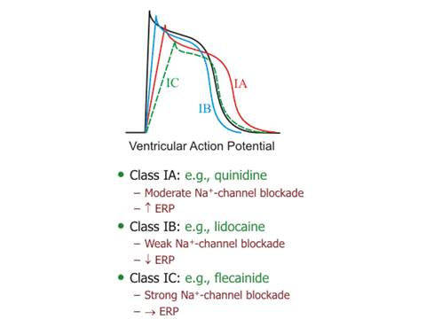

Slide 19
Summary: Antiarrhythmic Drugs
Class IA
Procainamide
INa (primary) and IKr (secondary) blockade
Slows conduction velocity and pacemaker rate prolongs action potential duration and dissociates from INa channel with intermediate kinetics . direct depressant effects on sinoatrial (SA) and atrioventricular (AV) nodes

Slide 20
Clinical Indication
Most atrial and ventricular arrhythmias. drug of second choice for most sustained ventricular arrhythmias associated with acute myocardial infarction
Oral, IV, IM .eliminated by hepatic metabolism to N-acetylprocainamide (NAPA) and renal elimination . NAPA implicated in torsade de pointes in patients with renal failure . Toxicity: Hypotension . long-term therapy produces reversible lupus-related symptoms

Slide 21
Class 1B
Lidocaine
Sodium channel (INa) blockade
Blocks activated and inactivated channels with fast kinetics. does not prolong and may shorten action potential
Terminate ventricular tachycardias and prevent ventricular fibrillation after cardioversion
IV. first-pass hepatic metabolism. reduce dose in patients with heart failure or liver disease . Toxicity: Neurologic symptoms

Slide 22
Class 1C
Flecainide
Sodium channel (INa) blockade
Dissociates from channel with slow kinetics. no change in action potential duration
Supraventricular arrhythmias in patients with normal heart . do not use in ischemic conditions (post-myocardial infarction)
Oral. hepatic, and kidney metabolism . half life ~ 20 h .Toxicity: Proarrhythmic

Slide 23
Class 2
Propranolol
β-Adrenoceptor blockade
Direct membrane effects (sodium channel block) and prolongation of action potential duration . slows SA node automaticity and AV nodal conduction velocity
Atrial arrhythmias and prevention of recurrent infarction and sudden death
Oral, parenteral . duration 4–6 h . Toxicity: Asthma, AV blockade, acute heart failure. Interactions: With other cardiac depressants and hypotensive drugs
Esmolol: Short-acting, IV only; used for intraoperative and other acute arrhythmias

Slide 24
Class 3
Amiodarone
Blocks IKr,INa,ICa-L channels,β-adrenoceptors
Prolongs action potential duration and QT interval . slows heart rate and AV node conduction . low incidence of torsade de pointes
Serious ventricular arrhythmias and supraventricular arrhythmias

Slide 25
Side Effect
Oral, IV. variable absorption and tissue accumulation. hepatic metabolism, elimination complex and slow . Toxicity: Bradycardia and heart block in diseased heart, peripheral vasodilation, pulmonary and hepatic toxicity. hyper- or hypothyroidism. Interactions: Many, based on CYP metabolism

Slide 26
Class 4
Verapamil
Calcium channel (ICa-L type) blockade
Slows SA node automaticity and AV nodal conduction velocity . decreases cardiac contractility. reduces blood pressure
Supraventricular tachycardias
Oral, IV . hepatic metabolism .caution in patients with hepatic dysfunction . Toxicity
Diltiazem: Equivalent to verapamil

Slide 27
Miscellaneous
Adenosine
Activates inward rectifier IK. blocks Ica
Very brief, usually complete AV blockade
Paroxysmal supraventricular tachycardias
IV only. duration 10–15s. Toxicity: Flushing, chest tightness, dizziness Interactions: Minimal

Slide 28
Magnesium
Poorly understood interacts with Na+,K+ ATPase, K+ and Ca2+ channels
Normalizes or increases plasma Mg2+
Torsade de pointes digitalis-induced arrhythmias
IV . duration dependent on dosage . Toxicity: Muscle weakness in overdose

Slide 29
Potassium
Increases K+ permeability, K+ currents
Slows ectopic pacemakers . slows conduction velocity in heart
Digitalis-induced arrhythmias . arrhythmias associated with hypokalemia
Oral, IV. Toxicity: Reentrant arrhythmias, fibrillation or arrest in overdose

