Slide 1
Real-Time And embedded systems
1
Lecture 1: Real-Time Systems
Dr. Mahdi Sadeghizadeh
Computer Engineering Department
Quchan University of Technology
February 2019

Slide 2
Outline
Definition of Real-time systems
Real-time systems Applications Area
Examples of Real-time systems
Properties of Real-time systems
Time Properties in Real-time systems
Classifications of Real-time systems (Types of RTS)
Real-time Computing Today
Designing a Real-time System
What is Difficult about RTS?

Slide 3
Real-Time Systems
real-time systems are defined as those systems in which the correctness of the system depends not only on the logical result of computation, but also on the time at which the results are produced.
A real-time system will usually have to meet many demands within a limited time.

Slide 4
Real-Time Systems
a real-time system consists of a controlling system (computer) and a controlled system (environment).
The controlling system interacts with its environment based on information available about the environment.

Slide 5
Some Application Areas

Slide 6
Some Application Areas

Slide 7
Examples of Real-Time Systems
Real-time systems span a broad spectrum of complexity from very simple micro-controllers to highly sophisticated, complex and distributed systems.
Some examples of real-time systems include :
Process Control Systems,
Flight Control Systems,
Flexible Manufacturing Applications,
Robotics,
Intelligent Highway Systems,
High Speed Systems
Multimedia Communication Systems
Railway Switching Systems
Telecommunications Systems

Slide 8
Properties of a Real-time System
Logical Correctness
Strict timing constraints (Timing Correctness)
Responsiveness (deadlines), periodicity (sampling rate)
Constraints should be verified
Application-specific design
Embedded systems
Carefully specified system properties
Well-known operating environment
High reliability
Thoroughly-tested components
High cost of failure
Predictable behavior

Slide 9
Time Properties
Release time (or ready time): Time at which the task is ready for processing.
Deadline: Time by which execution of the task should be completed, after the task is released.
Minimum delay: Minimum amount of time that must elapse before the execution of the task is started, after the task is released.
Maximum delay: Maximum permitted amount of time that elapses before the execution of the task is started, after the task is released.
Worst case execution time: Maximum time taken to complete the task.
Run time: Time taken without interruption to complete the task, after the task is released.
Weight (or priority): Relative urgency of the task.

Slide 10
Classifications of Real-time (Types of RTS)
soft real-time Systems
firm real-time Systems
hard real-time Systems

Slide 11
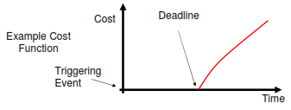
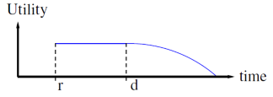
Soft Real-time Systems
Deadline overruns are tolerable, but not desired.
There are no catastrophic consequences of missing one or more deadlines.
There is a cost associated to overrunning, but this cost may be abstract.
Often connected to Quality-of-Service (QoS)

Slide 12
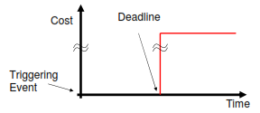
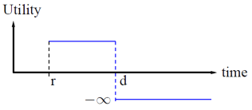
Hard Real-time Systems
An overrun in response time leads to potential loss of life and/or big financial damage
Many of these systems are considered to be safety critical.
Sometimes they are “only” mission critical, with the mission being very expensive.
In general there is a cost function associated with the system.

Slide 13
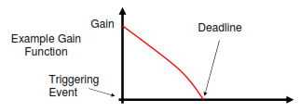
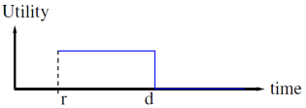
Firm Real-time Systems
The computation is obsolete if the job is not finished on time.
Cost may be interpreted as loss of revenue.
Typical example are forecast systems.

Slide 14
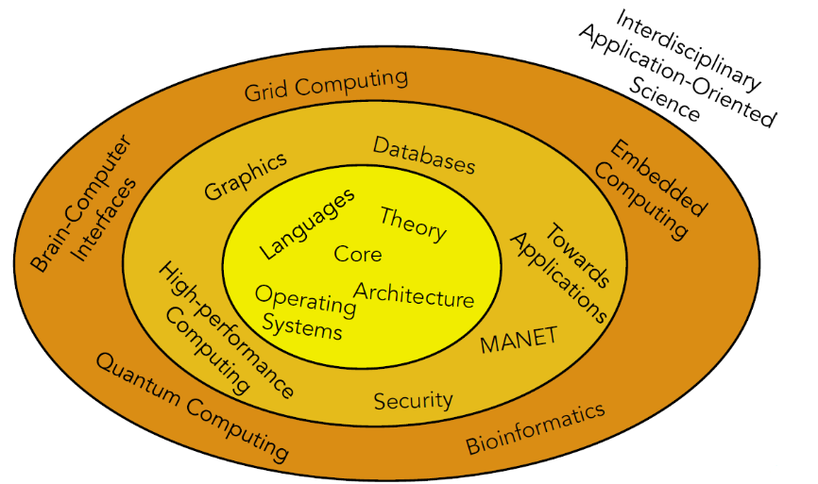
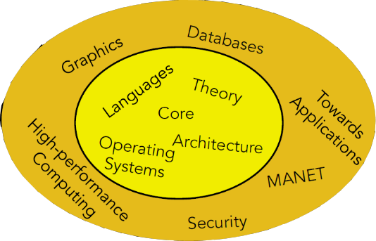
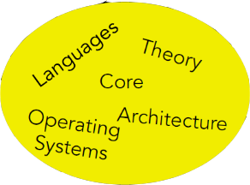
Where are computer systems going?

Slide 15
Real-time Computing Today?
Real-time data processing in cloud!
Werner Vogels (Chief technology officer and Vice President of Amazon ) :
Theguardian,18 Nov, 2013: Four cloud computing trends for 2014
Cloud will enable your content to follow you wherever you go
Cloud based analytics enhances the offline world
The cloud allows everyone to become a media company
cloud moves data processing to real-time

Slide 16
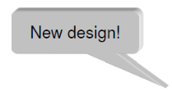
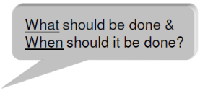
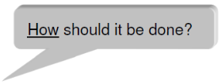
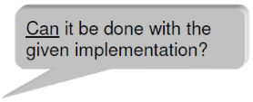
Designing a Real-time System
Requirement
Specification
Implementation
Verification

Slide 17
Requirement
Functional requirements: Operation of the system and their effects.
Non-Functional requirements: e.g., timing constraints.
F & NF requirements must be precisely defined and together used to construct the specification of the system.
Timing constraints
A task must complete its execution within given time frames (example: task periodicity or deadline)
Exclusion constraints
A task must execute a code region without being interrupted (example: a task needs exclusive access to a shared resource)
Precedence constraints
A task must complete its execution before another task can start (example: a data exchange must take place between the tasks)

Slide 18
Specification
A specification is a mathematical statement of the properties to be exhibited by a system. It is abstracted such that
it can be checked for conformity against the requirement.
its properties can be examined independently of the way in which it will be implemented.
The usual approaches for specifying computing system behavior entail enumerating events or actions that the system participates in and describing orders in which they can occur. It is not well understood how to extend such approaches for real-time constraints.
F18, therac-25 example

Slide 19
Implementation
Critical choices to be made at design time:
Application software:
Programming language
Determines run-time performance and code size
Determines productivity, maintainability and reliability
Determines degree of timing verification that is possible
Concurrent programming
Program is structured as multiple sequential tasks
Models the execution of multiple sequential task simultaneously
single-processor system: only pseudo-parallel execution possible
multiprocessor system: true parallel execution possible

Slide 20
Implementation
Critical choices to be made at design time:
Hardware architecture:
Single or multiprocessor architecture
Determines degree of true parallelism that can be exploited
Microprocessor family
RISC processor (pipelines, caches, support for multiprocessors)
Micro-controller (no, or very simple, pipelines/caches)
Determines cost and run-time performance
Determines difficulty in worst-case execution time (WCET) analysis
Communication network technology and topology
Determines cost, performance and reliability

Slide 21
Implementation
Critical choices to be made at design time:
Run-time system:
System services
Operating system (real-time kernel with system calls)
Stand-alone system (linked library with subroutine calls)
Determines run-time performance and code size
Determines cost, flexibility and portability
Task and message dispatching model
Time vs. priority driven dispatching
Preemptive vs. non-preemptive dispatching
Determines potential of meeting timing constraints
Determines processor and network utilization

Slide 22
Verification
Ad hoc testing:
Run the system for ”a while” and let the absence of failures ”prove” the correctness
fast method that indicates that ”everything seems to work”
pathological cases can be overlooked during testing
too frequently used as the only method in industrial design
Exhaustive testing:
Verify all combinations of input data, time and faults
considers all possible cases
requires an unreasonable amount of time for testing
Formal analysis of the implementation:
Verify logical correctness using proof machine
requires dedicated description language
abstraction level very high (often implementation independent)
Verify temporal correctness using schedulability analysis
necessary for verifying hard-real-time systems
requires WCET for each task
requires support in programming language and run-time system

Slide 23
What is Difficult about RTS?
1. Concurrency
• Devices operate in parallel in the real-world
• Conflicts with sequential execution on controller
• Hard to maintain deterministic, reproducible behavior
2. Reactive behavior
• Continuous operation
• Pace is controlled by environment
3. Guaranteed response times
• Predictability is essential – still efficiency is important
• Worst case must be predictable
• Response times on system level
4. Interaction with special purpose hardware
• Devices must be programmed in a reliable and abstract way
• Interfaces, device drivers are often a large development-time sink

Slide 24
What is Difficult about RTS?
Maintenance usually difficult
• Hardly maintenance loop
• Instead: “First time right”
6. Harsh environment
• Temperature, EMI, radiation, etc.
7. Constrained resources
• Processing power, memory, power, etc.
8. Often cross development
• Target platform ≠ development platform
9. Size and complexity
• x100 million lines of code (car, plane)
10. Reliability and safety requirements
• Embedded systems control the environment in which they operate
• Control failures can result in enormous damage to environment, to substantial financial loss, or even the loss of human life

Slide 25
Thank You

