Slide 1
Speech Act Theory
Mohammad Alipour
Ahvaz Branch, Islamic Azad University, Ahvaz, Iran

Slide 2
Speech Act Theory History
Speech act theory originates in Austin's (1962) observation that language is a form of action. He was especially interested in certain utterances that do not seem to communicate much information, but instead, serve as an action. When we use phrases such as “ I promise…”, “ I congratulate…”, and “I apologize…” the very act of uttering the sentence is a kind of action.

Slide 3
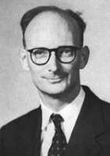
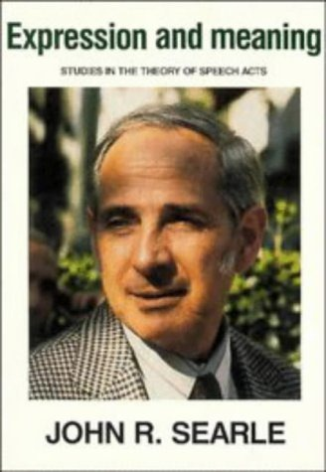
Speech Act Theory History
Speech act theory was proposed by John . L. Austin and has been developed by J. R. Searle. They believe that language is not only used to inform or to describe things, it is often used to “do things”, to perform acts.
Ex. (1) You’re fired.
(2) “There is a policeman on the corner”

Slide 4
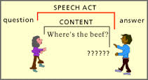
Speech Act Theory
It is a term to refer to a theory which analyses the role of utterances in relation to the behavior of speaker and hearer in inter-personal communication. It is not an ‘act of speech’ but a communicative activity (a locutionary act), defined with reference to the intentions of speakers while speaking (the illocutionary force of their utterances) and the effects they achieve on listeners (the perlocutionary effect of their utterances).

Slide 5
Speech Act Theory
While you speak, the speech, the utterances that you produce, might have forces or they might be force free. Some utterances might carry some forces and that means that while your speaking, you are also performing some actions such as promising, guaranteeing, warning, announcing something, and this is called the speech act (means action through speech).

Slide 6
Speech Events
A speech event can be defined by a unified set of components throughout the same purpose of communication, the same topic, the same participants and the same language variety (generally). For example: exchanging greetings, telling jokes, giving speeches.
When I say “ It’s too hot” what does it mean?
I have an intention and that is “turn on the air conditioner” and then you understand that.
Speech events refer to the environment or circumstances under which a speech act is realized by the hearer. So, it is the environment in which one speech act is realized.

Slide 7
Speech Act Theory
Every speech that we perform has three components, which Austin called them : Locution, Illocution, and Perlocution. The first refers to a propositional statement, the second to its intended meaning, and the third to its expected response.
Austin(1962) argues that speech acts are communicative behaviors used systematically to accomplish particular purposes. Thus, language has three distinct aspects:
1) Locutionary Act 2) Illocutionary Act
3) Perlocutionary Act

Slide 8
Speech Act Theory
Locutionary Act : The act of saying something, refers to the meaningful production of sounds, words and utterances.
Illocutionary Act: The intended meaning. The action that is performed by speaker in uttering a sentence (Force of the utterance in a given context).
Perlocutionary Act: The effect and importance of consequences of communicative speech acts on the feelings, thoughts, or actions of the listener/ hearer/ addressee.

Slide 9
Constatives vs. Performatives
Constatives are declarative utterances expressing some state of affairs, such as:
1.She walked out. 2. Mr. Ward was out on his feet, hat in hand.
Such utterances are easily evaluated in terms of their truth condition.
Performatives do not express a state of affairs, but rather are used to perform an act, such as:
Mike apologized to Mrs. Madison.
Clean your boots.
The utterance Mike apologized… does not describe some act of apologizing, but performs the act of apologizing; the utterance itself is the apology.

Slide 10
Felicity Conditions
For speech acts or performatives to happen, there should be some conditions and those conditions need to be met, otherwise the action does not happen in future. These conditions are referred to as “Felicity Conditions”. The conditions under which the speech acts are performed and they are required, otherwise the speech act does not happen.
The sentence might be felicitous if the sentence is appropriate, if the speech act , the performative verb is appropriate we say that the sentence is felicitous, and if it is not, we can say it is infelicitous. Time, place and person , at least, should be appropriate.
I announce you husband and wife.
I sentence you to death.

Slide 11
Felicity Conditions
By felicity conditions we mean conditions that must be present for a speech act to be understood as sincere or valid.
Five types of felicity conditions:
General conditions
Content conditions
Preparatory conditions
Sincerity conditions
Essential conditions

Slide 12
Felicity Conditions
General conditions: The participants should understand the language and they should not play roles.
E.g.: Someone in a movie promises to do something
2) Content conditions: It should be about the future action. When you say something, in future something should happen (a future action should take place).
E.g.: When I make a promise, I should do something in the future.

Slide 13
Felicity Condition
3) Preparatory conditions: Some necessary conditions must be met, for a promise, for example, there should be at least two people and something should happen in the future.
4) Sincerity conditions: Tell the truth; do not lie. When you are promising, you are supposed to be telling the truth.
5) Essential conditions: There should be an obligation for the speaker. The obligation is put on the shoulder of the speaker. Again when I promise, I should do something.

Slide 14
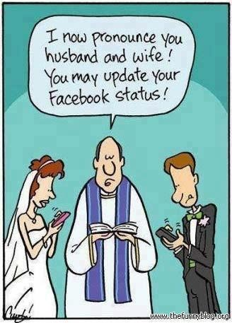
Felicity Conditions
Some examples:
I bet you five dollars the Yankees win.
I dare you to step over the line.
I pronounce you husband and wife.
I hereby promise to never again make loud noises.
Sit down!
I thank you for your attention.

Slide 15
Five Categories of Speech Acts
Searle (1976) proposes that there are five basic kinds of action that one can perform in speaking:
Assertives/Representatives
Directives
Commissives
Expressives
Declaratives

Slide 16
Five Categories of Speech Acts
Assertives/Representatives:
Which commit the speaker to the truth of the expressed proposition; expressing a belief. They include statements, descriptions, assertions, predictions.
For example:
statements of fact (The earth is round)
assertions (Chomsky didn’t write about peanuts)
descriptions (It was a sunny day)

Slide 17
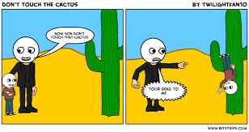
Five Categories of Speech Acts
2) Directives:
Which are attempts by the speaker to get the addressee to do something. They are speech acts that speakers use to get someone else do something. They express what the speaker wants. Paradigm cases: requesting, questioning, ordering, expressing a wish, commands, suggestions, etc. They can be positive or negative).
Examples:
Give me a cup of coffee. Make it black.
b. a. Could you lend me a pen please.
c. Don’t touch that.

Slide 18
Five Categories of Speech Acts
3) Commissives:
Which commit the speaker to some future course of action. They are speech acts that the speakers use to commit themselves to some future action.They express what the speaker intends. Paradigm cases: promising, threatening, offering, expressing an intention, refusals, pledges. They can be performed by the speaker alone or as a member of a group.
Examples:
a. I’ll be back.
b. I’m going to get it right next time.
c. We will not do that.

Slide 19
Five Categories of Speech Acts
4) Expressives:
Which expresses a psychological state. They are speech acts that state what the speaker feels (psychological states). For example, expressing pleasure, pain, likes, dislikes, joy, sorrow, thanking, welcoming, apologizing, congratulating, etc. They can be caused by something the speaker does or the hearer does, but they are about the speaker’s experience.
a. I’m really sorry.
b. Congratulations!
c. Oh, yes, mummy, great, mmmm

Slide 20
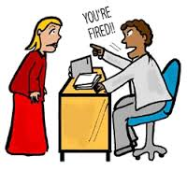
Five Categories of Speech Acts
5) Declaratives:
Which affect immediate changes in the institutional state of affairs and which tend to rely on elaborate extra-linguistic institutions. Paradigm cases: excommunicating, baptizing, declaring war, christening, firing from employment, abdicating.
Example:
“You’re fired” uttered by the boss to an employee
--the employee is thereby fired

Slide 21
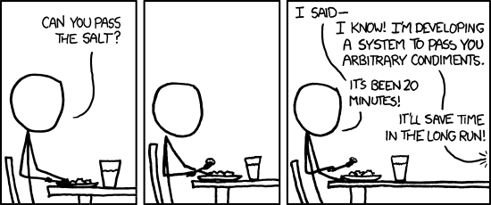
Direct & Indirect Speech Acts
Direct Speech Act: An action which is the form used (interrogative), directly matches the function (question) performed by a speaker with an utterance.
Example: Can you ride a bicycle? Yes.
Indirect Speech Act: An action in which the form used (interrogative) does not directly match the function (e.g. request) performed by a speaker with an utterance.
Example: Can you pass the salt?

Slide 22
Direct & Indirect Speech Acts
On the basis of structure, provided by the three basic sentence types in English which relate to the three general communicative functions (Yule, 1996:54):
Direct/indirect relationship between sentence type & function
Utterance | Sentence type Comm. | Function
You wear a seat belt. | Declarative | Statement
Do you wear a seat belt? | Interrogative | Question
Wear a seat belt! | Imperative | Command/Request

Slide 23
Indirect Speech Act
One type of speech act that has drawn considerable interest is the indirect speech act which is a speech act in which the intended meaning (illocutionary act) does not correspond to the literal meaning of the sentence.
An interesting fact about indirect speech act is that although no direct relationship exists between the form of the sentence and its intended meaning, listeners apparently have little trouble comprehending these speech acts.
Example:
Can you shut the door?

Slide 24
Speech Act Theory Drawbacks
1) An important practical drawback is expressed by Levinson (1982): If one even looks cursorily at a transcribed record of a conversation, it becomes immediately clear that we do not know how to assign speech acts in a non-arbitrary way. The problem with identifying speech acts should not necessarily lead the analyst to abandon their investigation. Rather, it should lead the analyst to recognize that the way speech acts are conventionally classified into discrete types such as request, promise, warn, etc.

Slide 25
Speech Act Theory Drawbacks
2)From the speakers’ point of view several sentences (or syntactic chunks) strung together may constitute a single act, on the other hand, the utterance may perform several simultaneous acts. Consider the following utterance of a husband to his wife:
Hey, Michael, you’ve passed the exam
He may be doing several things at once. He may be simultaneously ‘asserting’, ‘congratulating’, ‘apologizing’, etc. As it presently formulated, speech act theory does not offer the discourse analyst a way of determining how a particular set of linguistic elements, uttered in particular conversational context, comes to receive a particular intended meaning.

