Slide 1
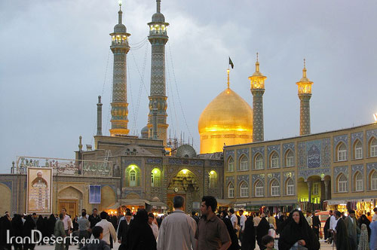
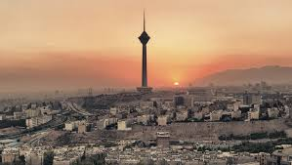
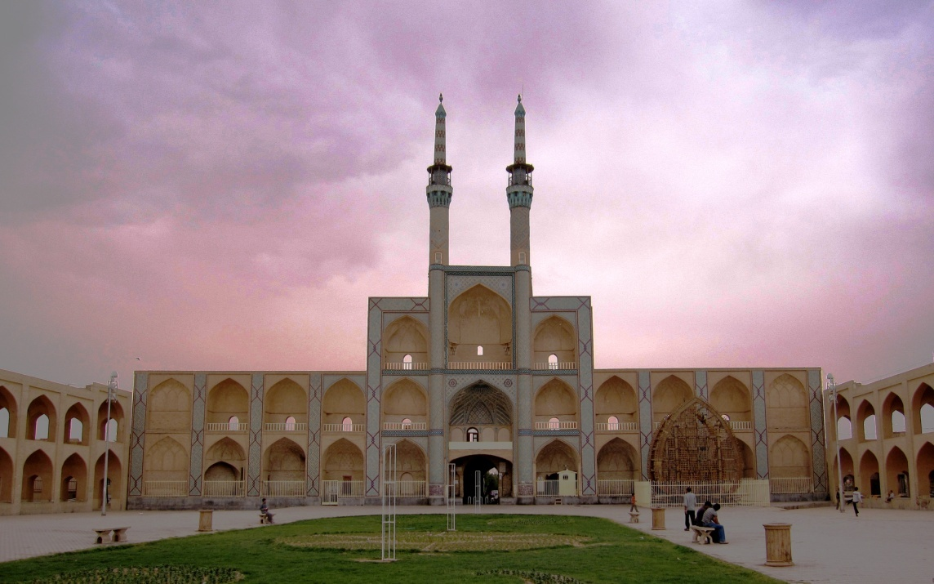
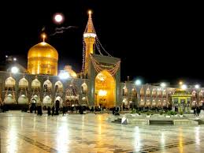
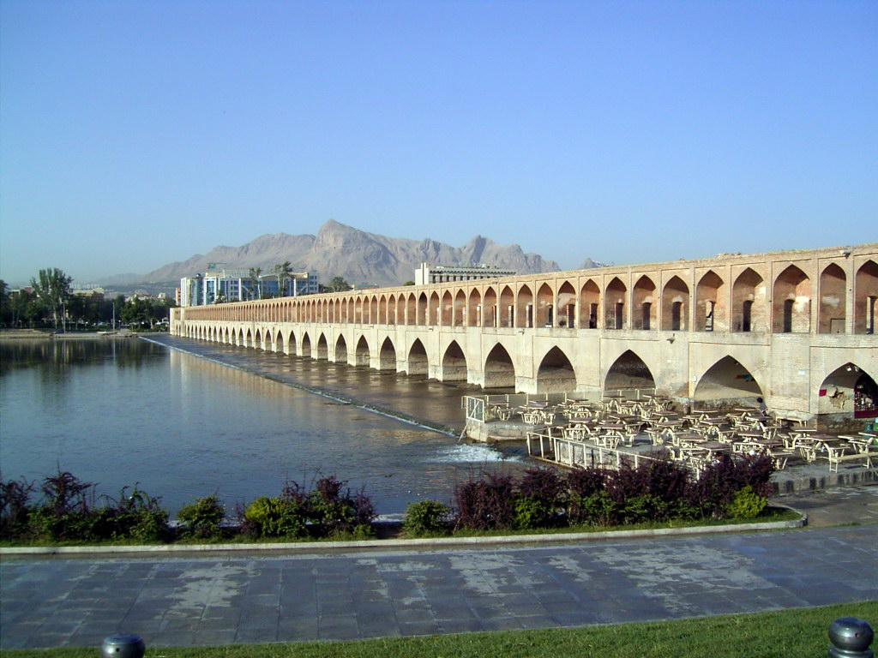
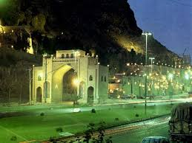
My city

Slide 2
North
North-west
North-east
West
Center
East
South-west
South-east
South

Slide 3
Capital

Slide 4
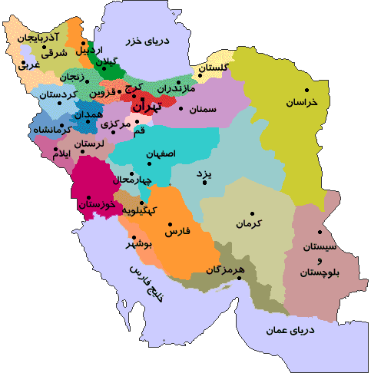
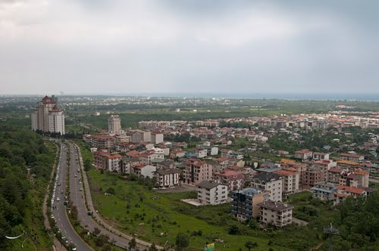
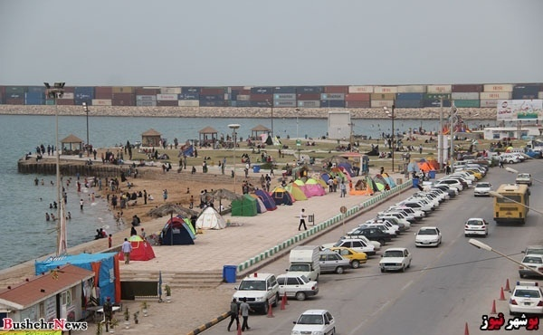
Chalous
Yazd
Boushehr
Where is ……….?

Slide 5
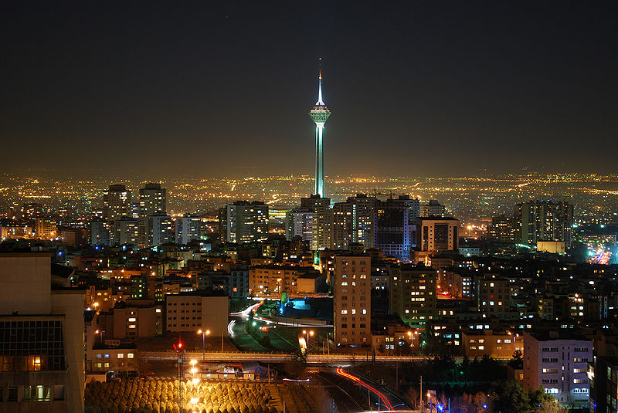
Ghamsar
a small city
Tehran
A big city

Slide 6
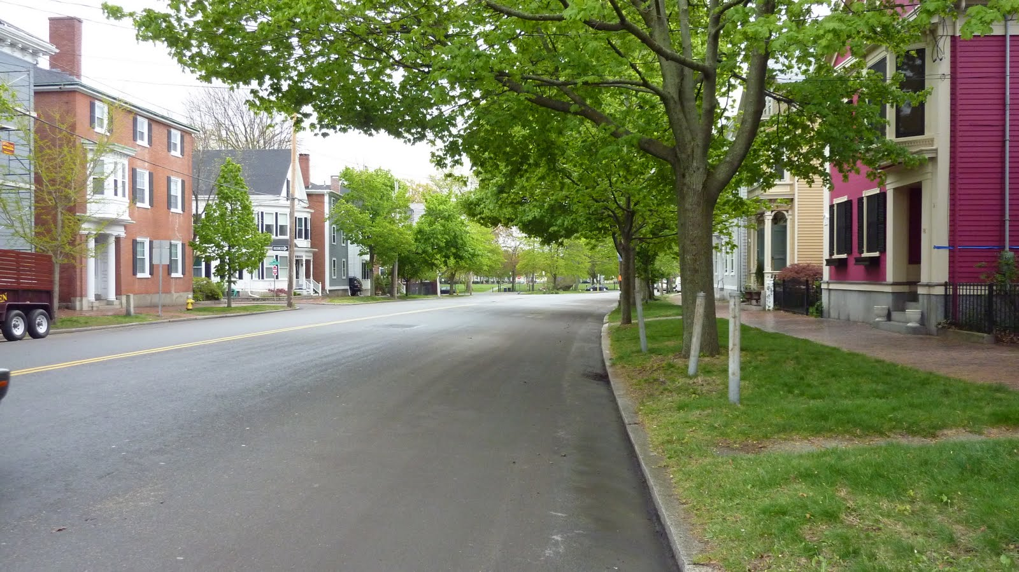
A dirty city
A clean city

Slide 7
Now talk about your city.
What is your city like?
What is it famous for?

Slide 8
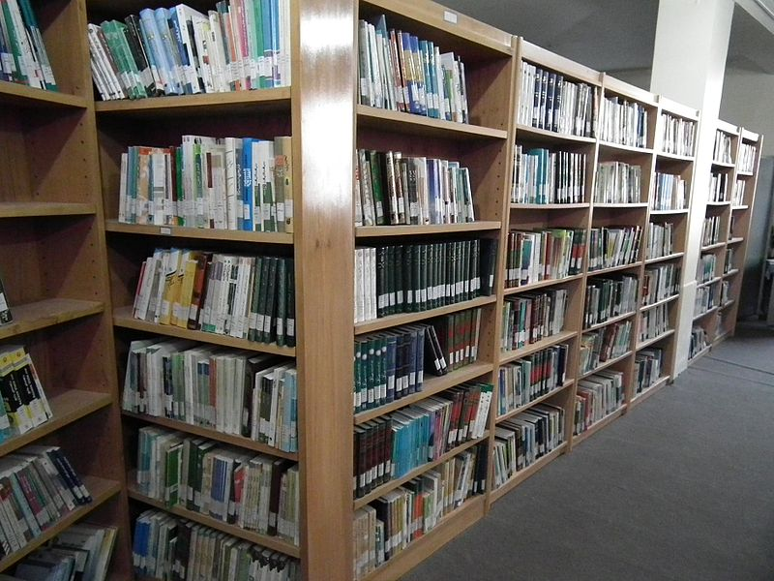
Are there any libraries in your city?
Yes, there are.
No, there aren’t.

Slide 9
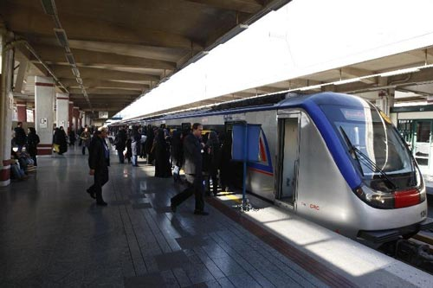
Is there a metro system in your city?
Yes, there is.
No, there isn’t.

Slide 10
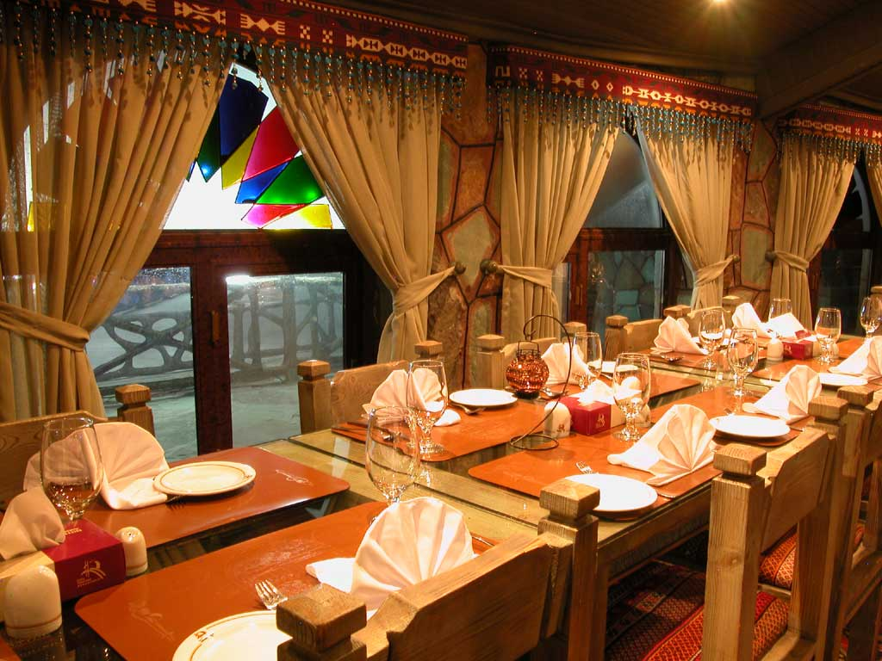
Are there any restaurants in your city?
Yes, there are.
No, there aren’t.

Slide 11
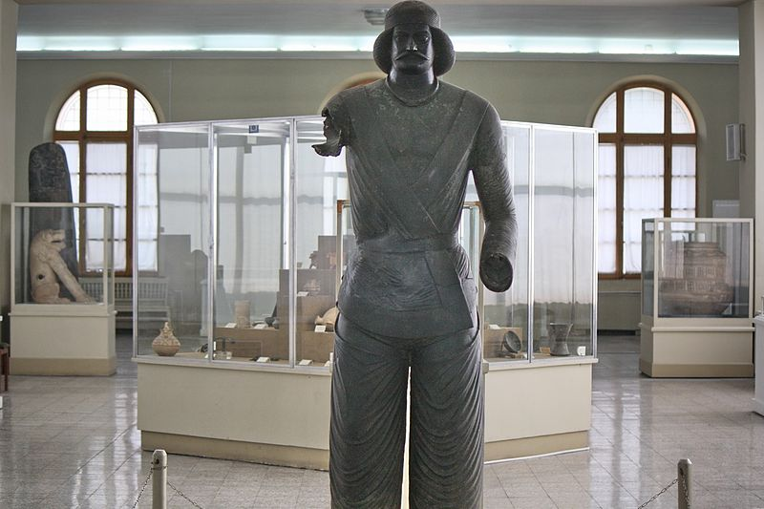
Are there any museums in your city?
Yes, there are.
No, there aren’t.

Slide 12
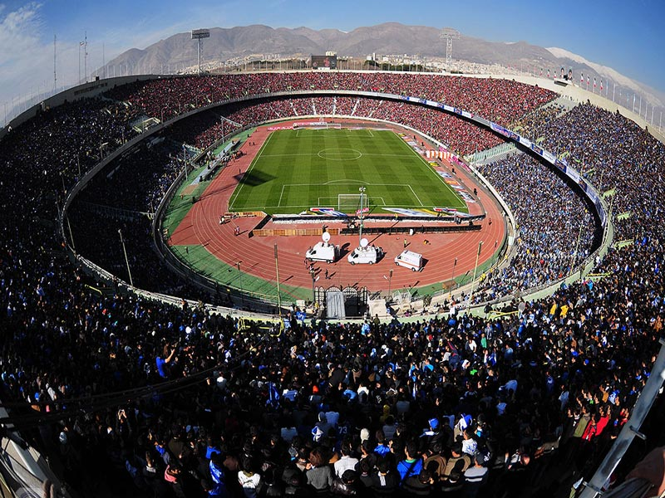
Is there a stadium in your city?
Yes, there is.
No, there isn’t.

Slide 13
Now talk about your city.

