Slide 1
GI Manifestations in CF
Mehri Najafi MD
Professor in pediatric
Pediatric gastroenterologist

Slide 2
Much of the associated morbidity and mortality is related to pulmonary complications.
Pathophysiology of CF is related to abnormal chloride and bicarbonate transport caused by mutations in CFTR gene.
The mutations cause the production of abnormally tenacious mucus and secretions in the lungs, GI tract, pancreas, and hepatobiliary.
As a result , the lumens of these become obstructed leading to clinical findings associated with disease.

Slide 3
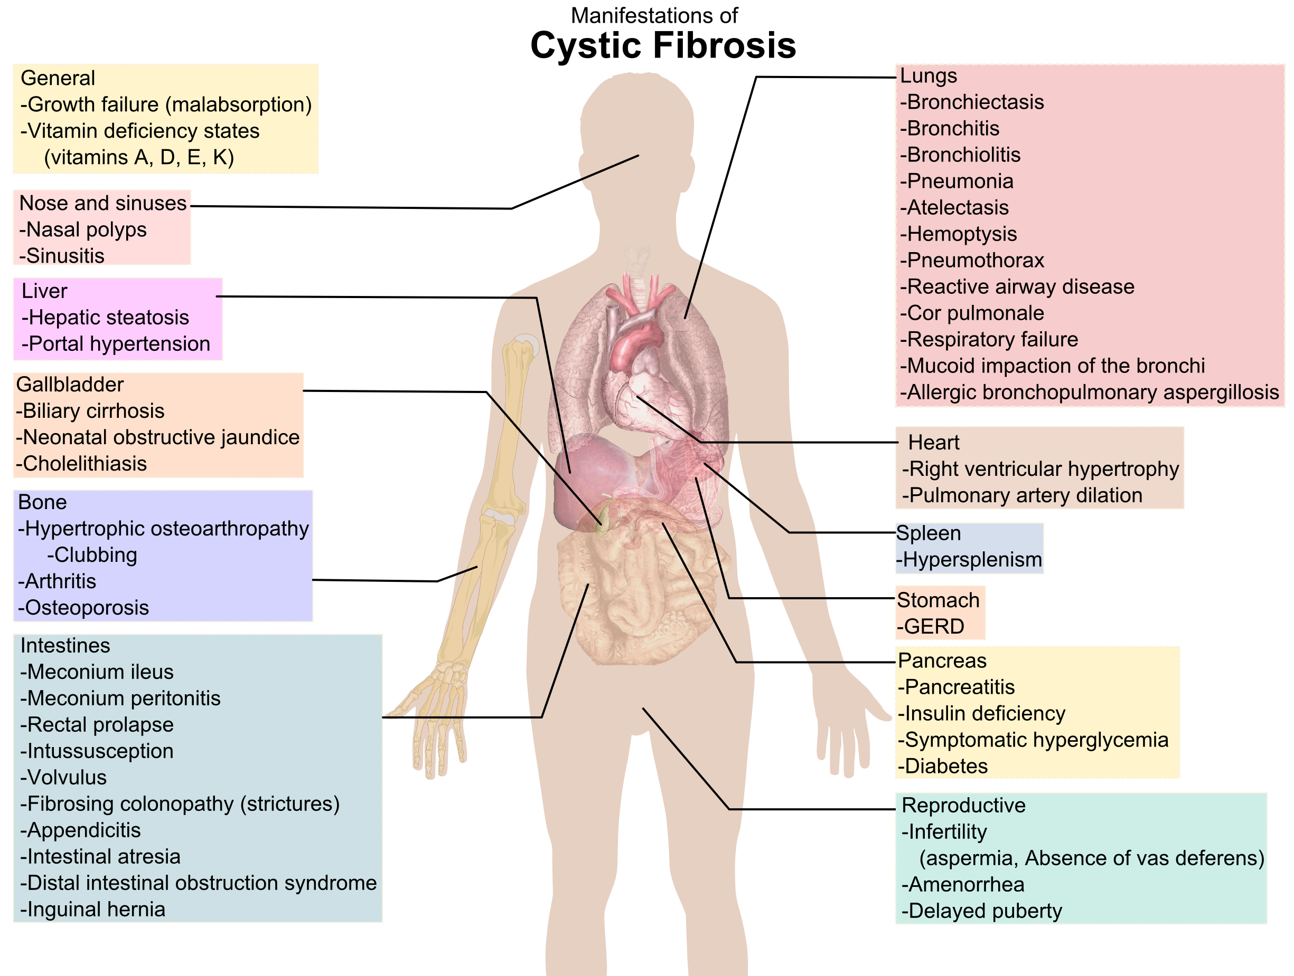

Slide 4
GI complications….
GI complications have become important cause of morbidity in CF.
( improved life expectancy)
GERD and constipation are not unique to CF , but are more common and warrant special considerations in the diagnosis and management in CF.

Slide 5
GERD
GERD is more common in CF.
It is symptomatic in 1/3 of patients,( silent in 90%)
There is convincing evidence that GERD contributes to pulmonary disease in the majority of patients with CF.
Decisions about treatment with acid suppressing medications depends on considerations about several different potential risks and benefits, and clinical characteristics of the individual patient.

Slide 6
Mechanism
Transient LES relaxation
Increase intra-abdominal pressure due to chronic cough, Lung hyperinflation
Gastric hyperacidity , and decrease clearance in esophagus
Medications that reduce LES pressure
Delayed gastric emptying
Supine position in chest physiotherapy
May be associated with constipation

Slide 7
Symptoms & Treatment..
Symptoms : is the same as non CF.
Diagnosis: clinical symptoms & response to treatment.
Treatment
Acid suppression agents ( PPI)
Life style : regimen( fat , beverages…), no weight loss
Chest physiotherapy
Surgery

Slide 8
Distal Ileal Obstruction Syndrome ( DIOS)
Completely or partially block of small intestine ( most commonly at ileocecal junction), by inspissated intestinal contents.
It occur in 10-47% of CF .
It tends to occur in patients with pancreatic insufficiency ( 90%).
Risk factors( severe genotypes, PI, fat malabsorption, dehydration, past DIOS episodes).
DIOS is characterized by progressive cramping abdominal pain in the RLQ.
Mass in RLQ
± vomiting
Diagnosis(triad: abdominal pain & distension, mass in RLQ. X ray findings), sonography, CT , BE

Slide 9
CF & DIOS

Slide 10
CF & DIOS

Slide 11
Treatment
Incomplete obstruction:
- Rehydration, lavage with osmotic laxatives, or gastrografin
In complete obstruction:
- Hyperosmolar enema,
- Surgery

Slide 12
Intussusception
Occurs in 1% of patients with CF.
It causes by inspissated bowel contents that serve as the lead point.
It characterized by colicky abdominal pain, vomiting, and palpable mass.
It is difficult to distinguish from DIOS.
Diagnosis can be made with ultrasound or with a contrast enema.

Slide 13
Small intestine bacterial overgrowth ( SIBO)
It is common in CF patients.
Up to 35% have SIBO.
RFs ; decrease intestinal motility, altered bacterial flora due to chronic use of AB, using acid suppression, malnutrition.
Bloating , flatulence, abdominal pain, watery diarrhea, dyspepsia, weight loss, or failure to gain weight.
Diagnosis usually based on clinical history and the empiric trial of antibiotics.

Slide 14
Rectal Prolapse
Occur in 3% of patients with CF.
In the past it was more common( up to 20%)
May be associated with constipation, diarrhea, malnutrition , and insufficient PERT dosing.
Should be manually reduced ± daily osmotic laxative.

Slide 15
Meconium ileus ( MI)
Is a disorder of neonate.
Obstruction of small intestine at the level of terminal ileum with inspissated meconium.
Widespread use of prenatal carrier testing and prenatal detection of MI by ultrasound enables clinicians to counsel patients and plan proactive management .
10 % of CF patients present as neonates with MI.
Most have severe genotypes.
80-90% of neonate with MI have CF.

Slide 16
Neonates with MI present during the first three days of life with abdominal distention, failure to pass meconium, ± vomiting.
Stabilized with NG, & correction of fluid and electrolyte.
Abdominal X ray for dilated bowel loops, perforation, calcifications, or…
IN BE small caliber colon, ( micro-colon), meconium pellets in terminal ileum, dilatation of ileum proximal to obstruction.

Slide 17
Meconium ileus

Slide 18
Treatment
Management : non-operative, operative
Medical:
- Simple MI ( If no perforation ); BE with hyperosmolar contrast
Surgery:
- Complicated MI ( perforation, meconium peritonitis, atresia, volvulus)
- Simple no response to medical treatment

Slide 19
Fibrosing colonopathy
Severe intestinal fibrotic process associated with strictures .
It see in patients who took large doses of PERT.
Maximum dose of 2500 lipase IU/kg/meal ( or 10000 lipase IU/kg/day)

Slide 20
constipation
It occurs in about 25 to 50% of patients.
Abnormal intestinal fluid composition, dysmotility, and PI ± inadequate PERT ??
Treat with osmotic laxative.

Slide 21
C. Difficile colitis
CF patients are at risk for life threatening complications from toxigenic CD.
Risk is much more after LT.
Recommendations evaluation and management like general population , with high index of suspicion in seriously ill, hospitalized patients or those who have undergone LT.

Slide 22
Effects of CFTR modulators on GI function
Management of CF has been changed radically by CFTR modulators.
They effect on pulmonary function and also on nutrition and GI symptoms.
Ivacaftor potentiator, improved nutritional status over 48 W in patients with mutation ( G551D).
IN patients with F508 del mutations lumacaftor & ivacaftor results improvement in pulmonary and growth parameters.
LFT increase in some patients so D/C .
Pre-existing liver disease were at risk of increase Bi, LFT, encephalopathy.

Slide 23
Intestinal inflammation, microbiome and probiotics
Although GI symptoms have been thought to related to malabsorption in CF, even patients with adequate PERT continue to complain of GI symptoms.
Intestinal inflammation might contribute to GI pathology in CF.
Study with capsule endoscopy in adults had varying degrees of inflammatory findings including edema, mucosal breaks, and ulcerations.
Fecal calprotectin ( marker of intestinal inflammation) is elevated in patients with CF.

Slide 24
CF patients have an intestinal microbiome that differs from without CF.
Manipulating the intestinal microbiome through use of probiotics could have a beneficial effect on intestinal inflammation.
One study : in 47 CF , two- thirds had elevated fecal calprotectin levels, then randomized to receive probiotics or placebo. Those treated with probiotic had lower FC after 4 weeks.
Another study: giving probiotic Lactobacillus reuteri improved GI discomfort and decreased FC.
Further studies will be needed.

Slide 25
Associations with other GI disease
Celiac disease, and IBD have been reported in CF.
TTG must check in every CF case with growth failure and malabsorptive stools despite proper PERT dosing.
Intestinal biopsy is required for definitive diagnosis.
Is celiac more common in CF than other population ??
CF patients had higher prevalence of IBD, particularly of Crohn’s disease,

