Slide 1
Importance of Nutrition in Cystic Fibrosis
Golnar Raissi ND.,L.Ac.,MS
Board certified in Integrative Medicine
Columbia University Medical Center
Sue & John L. Weinberg Cystic Fibrosis
Center
December 18,2019

Slide 2
Objectives
Participants will be able to:
Describe the relationship between nutrition & lung function and the factors that affect calorie and protein need
Understand typical management of nutrition- related complications in CF
    such as pancreatic insufficiency, gastrointestinal complications, & CF- related diabetes
Understand importance of bone disease

Slide 3
Notes:
Really intended to be a clinical practice talk, rare segues into ongoing research and opportunities

Slide 5
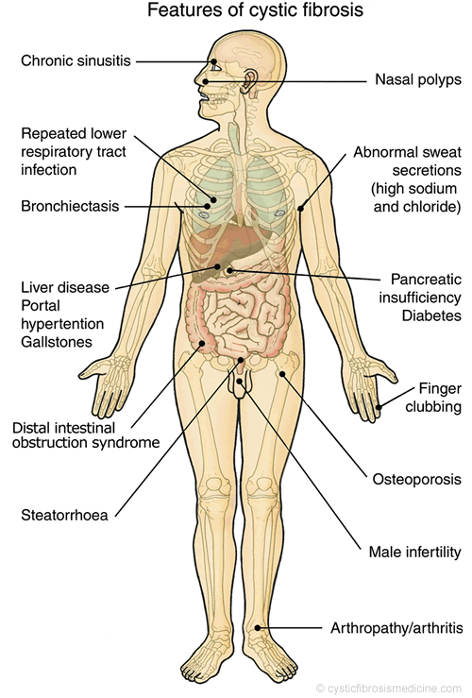

Slide 7
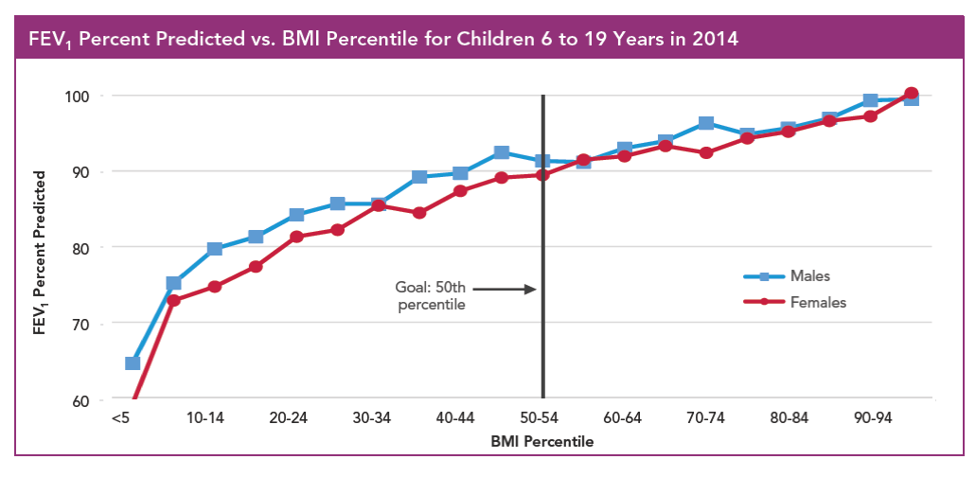
BMI Percentile is strongly associated with FEV1
GOAL: BMI at the 50th percentile for all pediatric patients
ALWAYS CHECK THE GROWTH CHART FOR EVERY PATIENT AT EVERY VISIT!
Notes:
The higher BMI has been associated with improved pulmonary function.
Strong relationship between nutritional status and quality of life, lung function and life expectancy in CF are well documented
positive association exists between pulmonary function, generally measured by forced expiratory volume in 1 s (FEV1) percentage predicted and nutritional status .

Slide 8
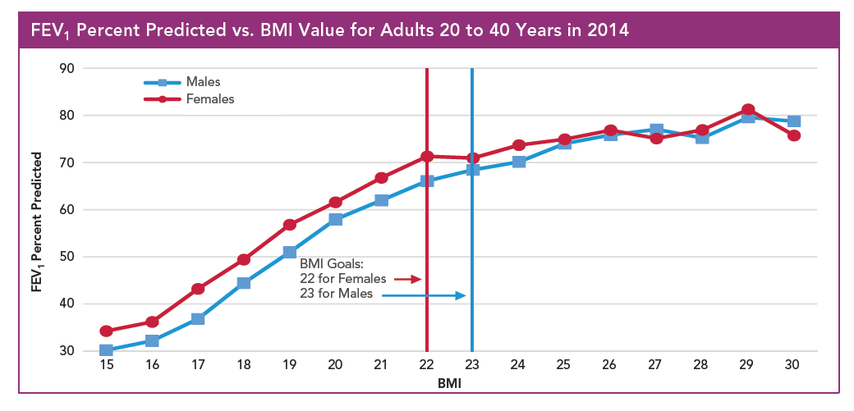
BMI percentile is strongly associated with FEV1
GOAL: BMI 22 for females and BMI 23 for males
Notes:
-false picture in stunt patients
-Important to check that patient is growing within his/her genetic height potential.
-For younger children, should check average rate of weight gain between visits
WHY THIS MATTERS
An improved BMI and good nutrition can affect your health in several ways.
In addition to better lung function, a healthier BMI can provide a “cushion”
for times your calorie
needs are higher, and your appetite is low, such as when you are sick. Good nutrition and a healthier weight
also decrease the risk of bone loss and may help strengthen your immune system to fight off infection.

Slide 9
Better Nutritional Status Early in life is Associated with Improved Lung function and Survival in CF
Newborn screening efforts have lead to improved nutritional status and growth, fewer pulmonary exacerbations, and fewer hospital days
(Siret et al,2003;Sims et al, 2007;Stallings et al,2008)
CF infants that achieve early nutrition response (by 2 years of diagnosis) are more likely to sustain better growth and better lung function through 12 years of age (Sanders et al,2018)
Greater weight at age four is associated with greater height, pulmonary function, and better survival through age 18 (Yen et al, 2013)
Notes:
-newborn screening efforts have led to improved outcomes, including improved nutritional status and lung function
-several studies suggest that it is efforts early on to improve nutritional status has the greatest impact

Slide 10

Achieving Optimal Stature is Important
Height is related to lung volumes & should be considered as part of overall health of individuals with CF
Stunting is an independent risk factor for mortality in CF
Notes:
The key to improved lung function may be related to achieving adequate height. This may be related to achieving lung volumes

Slide 11
CF Weight Goals- Pediatrics
Ideal Body Weight for Children:
- Ages 0-2: 50% of weight for length
- Ages 2-20: 50% BMI
American Academy of Pediatric recommends:
- Ages 0-2: use WHO growth chart
- Ages 2-20: use CDC growth chart
Adults
CFF recommended goals:
BMI ≥ 22 for women, ≥ 23 for men
Upper limit is BMI >30

Slide 12
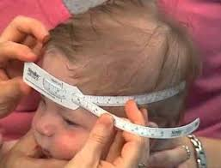
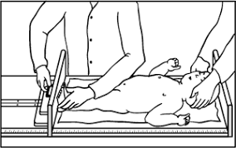
Anthropometrics
Infants: < 24 months
Weigh without clothes and with a clean diaper
Obtain recumbent length using a length board
Head circumference
Goals: < 24 months
  Weight/length > 50%ile
  Determine weight gain per day since last visit and compare to norms

Slide 13

Anthropometrics
Children/Adolescents 2-20 years
Obtain accurate measurements at every clinic visit
Weigh with jackets/shoes off
Use a wall mounted stadiometer for height
Goals:
  BMI >50%ile
  Weight >10%ile for preschool ages 2-5 years

Slide 14
Growth
Poor weight gain
inflammation
Steroid therapy
Low IGF
Vitamin/mineral deficiency (Salt, zinc, EFA)
Diabetes
Notes:
Focus on interventions that impact weight gain and vitamin/mineral status in my portion of our talk today; I will focus on Growth factors

Slide 15
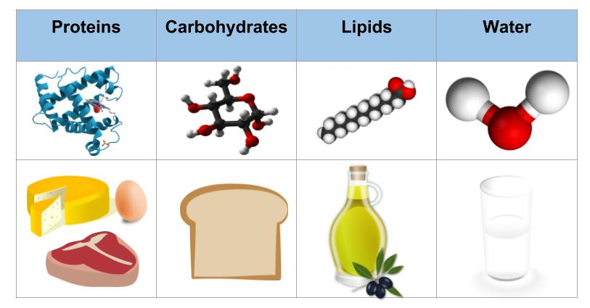
Macronutrient Needs
High energy needs due to increased energy expenditure from work of breathing & increased losses from malabsorption
Energy needs highly individual and difficult to estimate
Recommend macronutrient distribution- 35-40% fat, 15% protein, %50 carbohydrate
Protein requirement 1.5-2 times the RDA
Calorie requirement 1.5-2 times the RDA

Slide 16

Why Higher Calorie Needs?
Increased energy requirements secondary to malabsorption associated with pancreatic insufficiency, possible increased REE & increased work of breathing.
Energy needs will be influenced by:
  Severity of lung disease, infection & inflammation
  Degree of malabsorption
  Glucose intolerance (usually if CFRD diagnosed) due to lack of insulin to utilize calorie from carbohydrates
  Other factors (CF liver disease)

Slide 17

What do we do to Improve Nutritional Status?
  High calorie diet
  Use pancreatic enzymes
  Treat lung infections
  Treat reflux
  Consider appetite stimulants
  Oral supplements
  G Tube feeds
  Insulin if CFRD is diagnosed

Slide 18
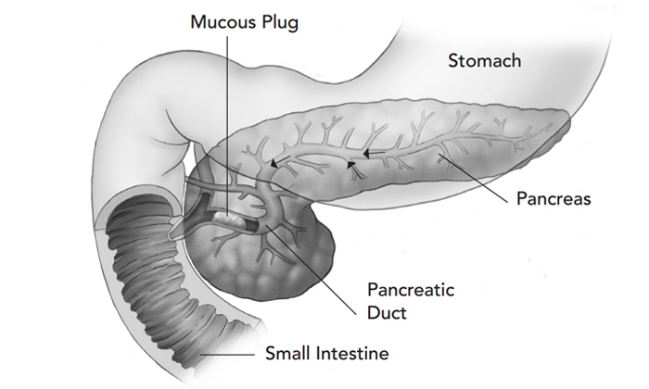

Slide 19
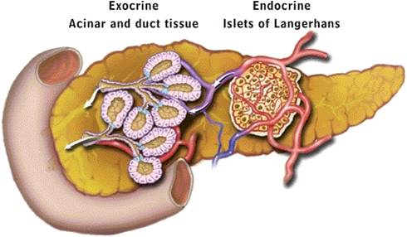

Slide 20
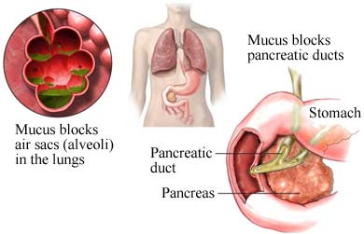

Slide 21
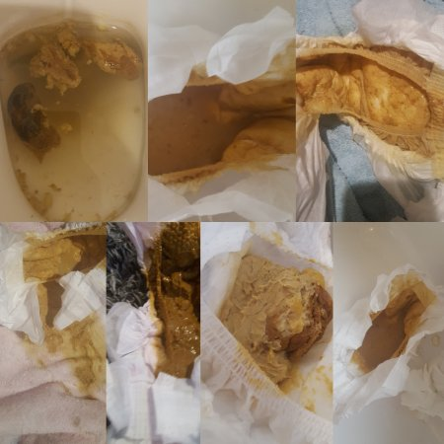
Malabsorption
Pancreatic Insufficiency
  85-90% of all CF individuals
  Only 40-65% of ingested dietary fat is absorbed without treatment
  This is likely due to the action of lingual and gastric lipase
  Improvement up to 85%-90% should be possible with the current enzyme preparations
Goal of pancreatic enzyme replacement therapy (PERT) is to minimize the symptoms of malabsorption, promote adequate weight gain and growth, & prevent nutritional deficiencies

Slide 22
Signs and Symptoms of Malabsorption
Stools: frequent (>3 days),foul smelling, oily or
difficult to flush
Increased gas or frequent stomach aches
No weight gain for 2 consecutive visits in a growing child or involuntary or unexplained weight loss
Other GI causes, constipation, SIBO and celiac disease
Low pH in the small intestine due to bicarbonate deficiency
Notes:
The major consequences of PI are due to fat malabsorption which is caused by decreased production of pancreatic enzymes, as a result, patients are risk for steatorrhea,
malnutrition, fat- soluble vitamin deficiency.

Slide 24
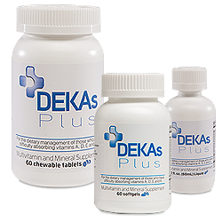

Slide 26
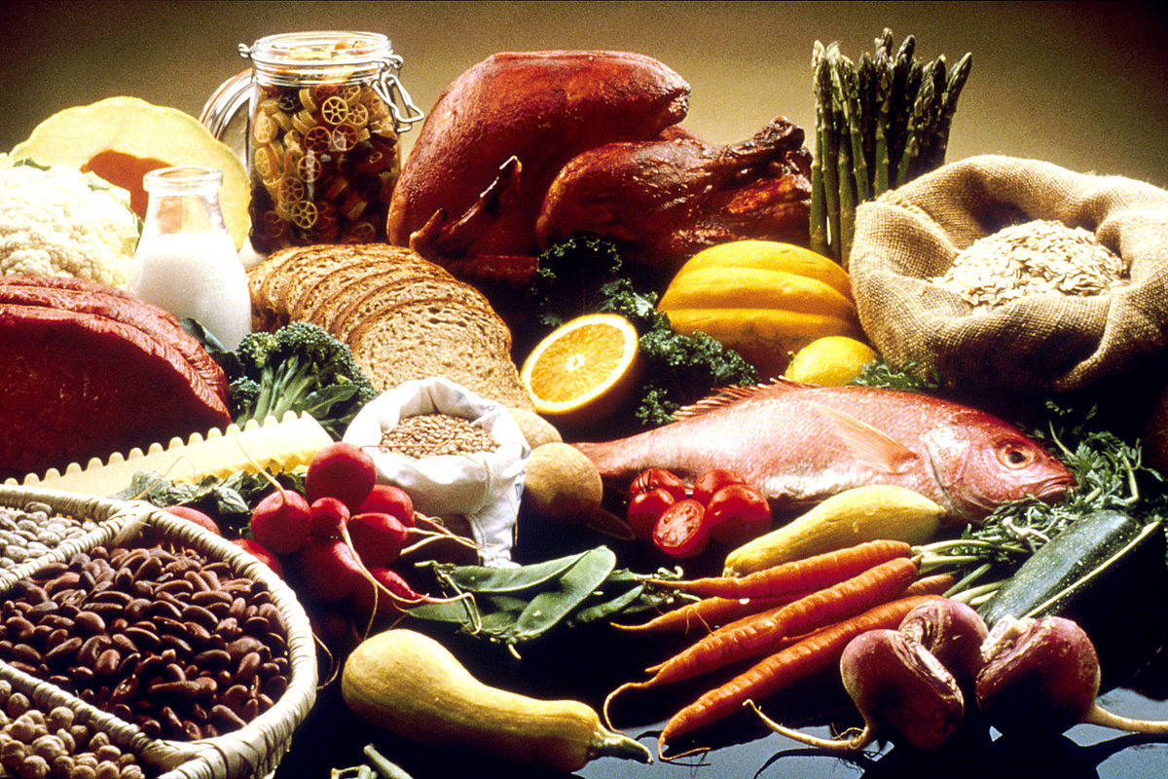
Appetite Stimulants
Most commonly encountered: cyproheptadine, megestrol acetate & dronabinol
Cyproheptadine:
Antihistamine with secondary effect of appetite stimulation
Typically well-tolerated; some transient drowsiness with initiation of therapy
Effect on weight may be modest and short-lived; cycling drug may increase efficacy
Notes:
Seen about 50% effectiveness in our clinic

Slide 27

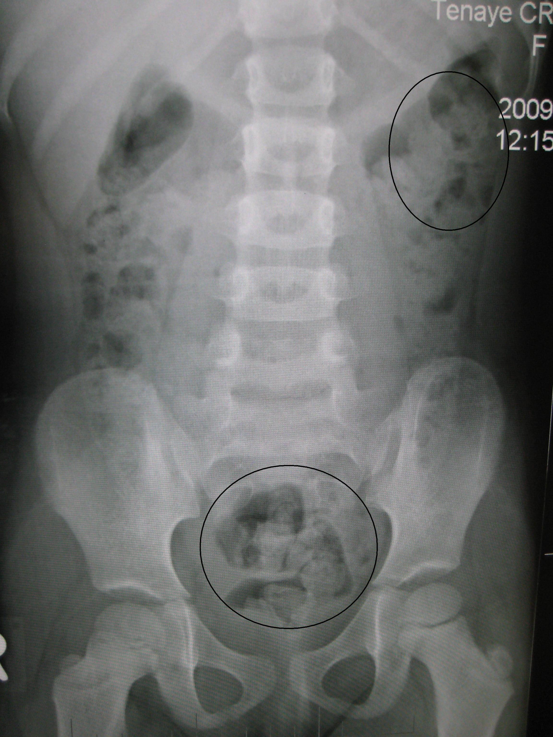
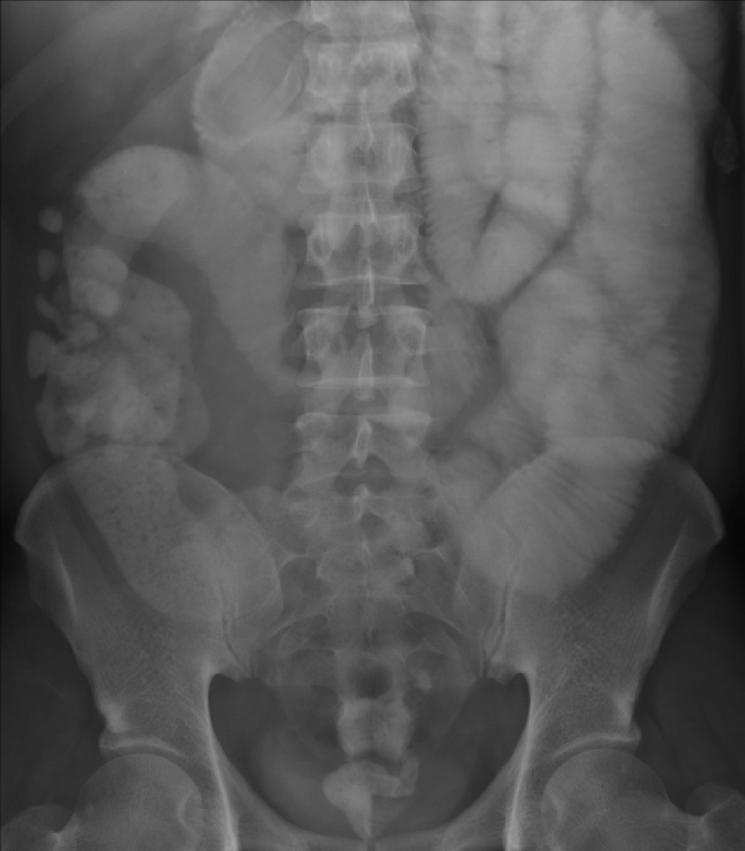
GI Complications
Constipation
DIOS
SIBO

Slide 28
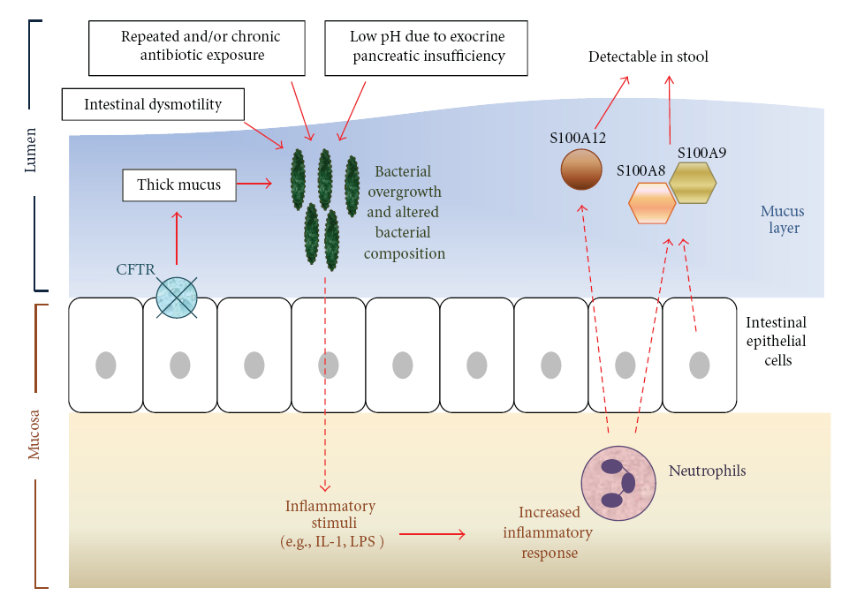
Proposed Pathogenesis of Intestinal Inflammation in CF
Lee JM et al, Mediat Inflamm:doi.10.1155/2012/948367

Slide 29
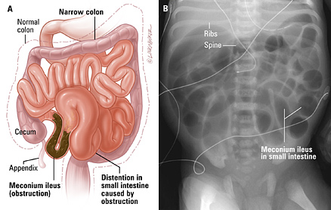
GI Manifestations
Meconium Ileus
GE reflux
Focal biliary
Cirrhosis/fatty liver
Pancreatitis
Gastroparesis
SIBO
Constipation
DIOS
Notes:
Cirrhosis is 5%. Meconium Ileus is 15 -20 %

Slide 30
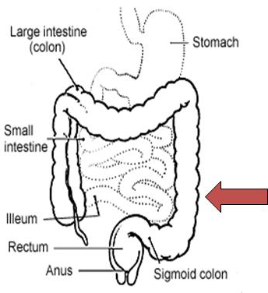
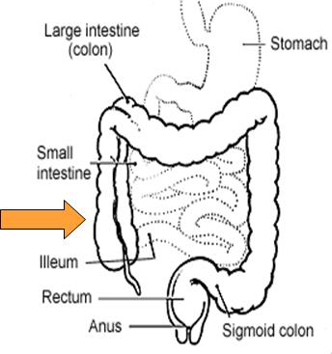
GI Complications
Constipation
Fecal material is distributed
throughout the colon
symptoms are gradual and starts
sigmoid colon
PI and PS
DIOS
complete or incomplete intestinal obstruction with fecal mass
Symptoms are sudden onset
Starts in terminal ileum and cacecum
Imaging required
Notes:
Dios Happens in 10-20% of cf , in RLQ and mimics appendicitis
Mutation in CFTR gene happnes through out the intestinal track this, lead to abnormal salt and water balance, sticky mucus, poor motility and impacted secretions in the intestine

Slide 31
DIOS Management
Prevalence: 1 out of every 10-20 people with CF
Aggressive early treatment with polyethylene glycol ( Miralax )
PEG 2 g/kg/day, maximum 8—100 per g/day
Sever episode may require hospitalization with IV rehydration
Surgical reaction typically not needed with early treatment
Colombo, et el, 2011

Slide 32
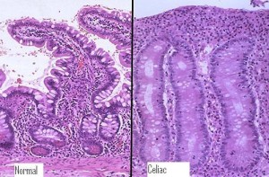
Celiac Disease
Celiac disease is:
  A permanent, immune-mediated enteropathy, where ingestion of gluten (and related proteins) triggers a lymphocytic destruction of small bowel villi in genetically susceptible individuals
  Viral/inflammatory insult (inciting event)
  Improper immune regulation (cytokine storm)
  Conversion of lymphocytes to cytotoxic NK cells
  Characterized by histologic changes in duodenal biopsies
Fasano, Gastro, 2005, Hill, JPGN, 2005, DiSabatino, Lancet, 2009
Notes:
HLA DQ2/DQ8

Slide 33
Celiac Disease—Signs/Symptoms
CF
Notes:
HLA DQ2/DQ8

Slide 34

Celiac Disease & CF
Presumed low co-morbidity rate
  Mostly case reports / systematic reviews
  Appears celiac prevalence is elevated in CF patients
    General population 1/100
    CF population 1/50 to 1/85
Significant overlap in symptoms / clinical picture / biopsies
  Never wrong to get a serum screen
Hot topic: role of CFTR in modulating celiac disease
  Gluten binds to CFTR and impairs function
  Ivacaftor attenuates inflammatory response and promotes tolerance
    In mice and human celiac cells, not yet studied in vivo
Fluge, JCF, 2009, Walkowiak, Acta Bio, 2010, Genkova, Folia Med, 2013, Villella, EMBO, 2018
Notes:
HLA DQ2/DQ8

Slide 35
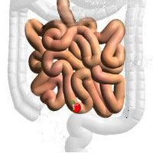
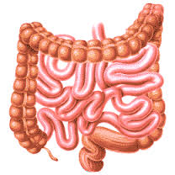
Two Kinds of GI Dysbiosis in CF
Small Intestinal Bacterial overgrowth (SIBO)
Alterations in whole gut microbiota

Slide 36
GI Microbiota and
host health
GI microbes impact:
  nutrient and vitamin uptake
  drug pharmacokinetics
  waste elimination
  immunity and inflammation
  overall health
  AND
Patients with CF have a set up for ‘dysbiosis’

Slide 37
Small Intestinal Bacterial Overgrowth—Defined
CF
SIBO is:
  colonization of small bowel with aerobic & anaerobic bacteria typically found at higher concentrations in the colon
  caused by:
    Motility disorders (lack of small bowel clearance)
    Anatomic / surgical changes (lack of IC valve allows for direct contact of SI/LI contents)
    Gastric acid suppression
    Pancreatic insufficiency (changes quantity/composition of bile and pH/flow through small bowel)
  Choung, APT, 2011, Pimentel, Am J Gastro, 2010, Uptodate: SIBO
Notes:
HLA DQ2/DQ8

Slide 38
SIBO—Signs/Symptoms
CF
Bloating
Flatulence
Abdominal discomfort
Chronic watery diarrhea
Anemia (B12/folate losses, Iron def)
Failure to thrive/poor nutrition
Can develop: fat-soluble vitamin deficiencies, hypoalbuminemia, fat malabsorption
Emergency: d-lactic acidosis (carbs → d-lactate in colon → absorbed rather than further broken down → metabolic acidosis without elevation in lactate)
  Confusion, ataxia, slurred speech, memory loss, seizures
Uptodate: SIBO, Wiecek, Disease Markers, 2018
Notes:
HLA DQ2/DQ8

Slide 39
SIBO & CF
Presumed VERY HIGH co-morbidity rate
  As many as 30-40% of CF patients have been reported to have SIBO
  Testing is either inaccurate or invasive (and then still inaccurate)
    Risk factors (not well studied, my bias): MI c resection, liver disease
Significant overlap in symptoms / clinical picture with typical CFGI complaints
Hot topic: role of CFTR in modulating SIBO
O’Brien et al, 1993; Lewindon et al, 1998; Fridge et al. 2007; Lisowska et al, 2010; Gelfond, GTC, 2017
Notes:
HLA DQ2/DQ8

Slide 40
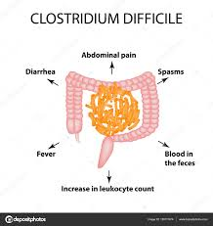
C. diff & CF
VERY HIGH carriage rate
  47% of patients carry c. diff without c. diff colitis symptoms (presumed)
    77% of those have non-toxigenic strains (compared to only 17% of controls)
CF patients are often on PPIs
  No longer needed for PERT
    gastroduodenal protection and aid in absorption with little pancreatic bicarb/water
  In general population, use of PPI is known risk factor for development of c. diff
CF patients have other risk factors
  Abnormal microbiome (presumed to allow c. diff to take hold)
  Intestinal inflammation/barrier disruption (c. diff carriage also up in IBD)
  Lots (and lots and LOTS) of antibiotics, with untoward microbiome impact
Bauer, Clin Micro Infect, 2013
Notes:
HLA DQ2/DQ8

Slide 41
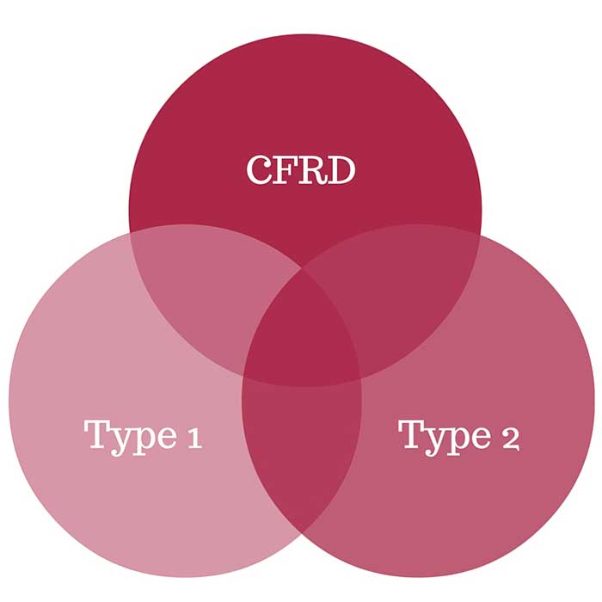
Cystic Fibrosis Related Diabetes
Shares features of both: type 1 (insulin deficiency) and type 2 (insulin resistance) – they can’t make or use insulin
It is one of the most common health issues in people with CF occurring in approximately 20% of adolescents and 40% to 50% of adults
Symptoms of CFRD include feeling very tired, losing weight without trying or having a hard time gaining weight
Uncontrolled CFRD can potentially increase the risk of more serious lung co-infections with Staphylococcus aureus & Pseudomonas aeruginosa compared to infection with just one pathogen

Slide 42
CFRD Treatment
Achieve and maintain good nutrition status and normalize blood sugars
Complications:
  Undiagnosed/ untreated diabetes may cause decline in lung function and weight
  Microvascular damage
  Macrovascular damage
Continue high-calorie, high-fat, and high-sodium diet - DO NOT restrict intake except to limit high-sugar non-nutritive beverages
Spread carbohydrates throughout the day
  Use carb counting only to help dose insulin correctly, not to restrict intake
  Only pharmacological treatment is insulin

Slide 43
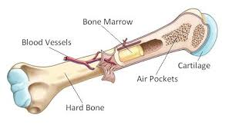
Overview of Bone Physiology
Other markers of bone turnover include:
  Bone formation
    Bone specific alkaline phosphatase
    Osteocalcin
  Bone Resorption
    Carboxy-terminal cross-linked telopeptide of type I collage (CTX)
    Aminoterminal cross-linked telopeptide of type I collagen (NTX)
Notes:
Helpful for baseline, monitoring treatment

Slide 44
Major Causes of Low Bone Density in Patients with CF
Pancreatic insufficiency
Malnutrition
Malabsorption (fat- soluble vitamins and calcium)
CF related diabetes
Glucocorticoids
Sex steroid deficiency
Chronic inflammation
Tobacco, alcohol, caffeine
Moderate to sever lung disease
Lack of exercise
Organ transplant
Possible direct role of CFTR on bone
Gore et el, Journal of Osteoporosis, 2011

Slide 45
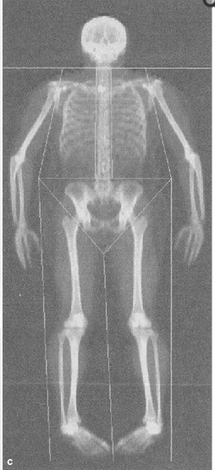
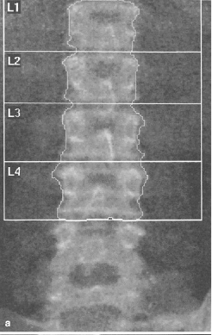
Dual-energy X-ray Absorptiometry (DXA)
Evaluation in pediatrics includes the lumbar spine & whole body minus the head
These sites are preferred over the hip (used in adults) due to rapid change in geometry during growth & puberty
Binkovitz LA et Henwood MJ. Pediatric DXA. Pediatric Radiology. 2007
Notes:
Depending on patient, may use another site (those in a wheelchair, CONTRACTURES, history of fracture/casting, pinning)

Slide 46
Dual-energy X-ray Absorptiometry (DXA)
Low bone mineral density: DXA Z score ≤ -2.0 SDS
  Adjust for age, sex, body size/height, tanner staging if possible
Osteoporosis in children
  Low BMD along with clinically significant fracture
    Long bone fracture of lower extremity
    Vertebral compression
    2 or more upper extremity long bone fractures
Lee DY et al. J Bone Miner Res. 2015
Notes:
Low BMD instead of osteopenia is the term used in children
BMD not acurate measure of volume
Adult pateints – bone volume does not change over time (chidl’s bones grown and model) → sufficient population based data correlating BMD measures with fractures rates not available → Cannot use osteoporosis
Z scores not T-scores
Z score accounts for reference group – sex and age
T score based on a gereralzied reference group of people who have ACHIEVED PEAK BONE MASS

Slide 47
Cystic Fibrosis Related Bone Disease:
Fracture Risk
Rates of vertebral fractures as high as 30% in adults with CF with further increased risk after lung transplant (37-42%).
Vertebral Fractures may
  Result in worsening lung volumes
  Negatively impact chest physiotherapy
  Be a contraindication to transplantation
Few reports evaluating fracture risk and DXA outcomes in children
Notes:
**rate of fracture >10%, including femur

Slide 48
Cystic Fibrosis: Evaluation
Routine DXA screening (with correction for height and lean mass) in adults older than 18 years and children older than 8 years is recommended if
  Body weight is less than 90th percentile of Ideal body weight
  FEV1 is less than 50% predicted
  History of delayed puberty
  Received more than 90 days per year of high dose steroid treatments
Follow-up assessment with DXA is based on the initial screening result:
  Repeat every 5 years if BMD z score ≥– 1.0
  Repeated every 2 years if z scores are between – 1.0 and -2.0
  Repeat yearly if z scores < -2.0
Sermet-Gaudelus I et al. J Cyst Fibros 2011
Bianchi ML et al. J Clin Densitom 2014
Aris RM et al JCEM 2005
Notes:
Malnutrition: mild 80-90% IBW, moderate 70-80% IBW, severe 70% IBW

Slide 49
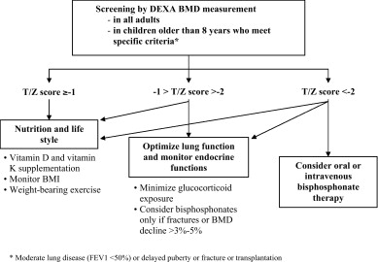
From: Javier & Jacquot, Joint Bone Spine, 2011

Slide 50
Treatment
Participate in weight-bearing exercise to improve lean muscle mass
Optimize nutritional status (BMI >25%)
Optimize vitamin D and calcium stores
Minimize steroid dosing
Evaluation of delayed puberty/hypogonadism
Bisphosphonate treatment
Hartman C et al. J Pediatr Gastronenterol Nutr 2004
Trovato CM et al. J Ped Gastroen Nutr 2014
Mora S. Rev Endo Metab Disor 2008

Slide 51
Calcium
Most abundant mineral in the human body – bones, teeth
Actively and passively absorbed through the gut
Excess dietary calcium is excreted through the gut (unabsorbed) or urine
Extracellular calcium is transported by albumin
Calcium mediates a variety of actions in cells including neurotransmitters
Serum calcium is not a useful indicator of adequate intake or bone health
Notes:
Serum calcium does not typically reflect calcium intake
Calcium in the blood is tightly controlled because it is so important for regulating muscle and nerve activity
Circulating calcium stays in the normal range when intake is low because calcium leaves the bone as needed to maintain serum.
Serum calcium levels do not predict bone health
Transferrin for iron
Ceruloplasmin for copper

Slide 52
Calcium: Choosing a supplement
Dietary sources of calcium are preferred over supplement
When supplementing, smaller doses are preferred as higher doses overwhelm gut absorption and may be wasted.
  Calcium citrate – does not require acid for absorption
  Calcium carbonate-affordable (TUMS),requires acid for absorption
  Calcium phosphate – primary form in fortified foods/formulas
  Calcium lactate – only 13% elemental calcium
Elemental Ca
Calcium Citrate 21%
Calcium Carbonate 40%
Calcium phosphate 40%
Calcium Lactate 13%
Notes:
Can we supplement list to a table for ease of viewing?

Slide 53
Calcium: Drug Nutrient interactions
Drugs Common in CF clinic:
  Corticosteroids: increase calcium needs
  Fluoroquinolone and Tetracycline (Cipro)
    Combine to reduce absorption of calcium and the medication
    Schedule 2 hours prior/4-6 hours after calcium or calcium-rich food
Drugs Less common in CF Clinic:
  AEDs: increase metabolism of vitamin D.
    Phenytoin, fosphenytoin, phenobarbital, and carbamazepine
  Loop diuretics: increase urinary calcium excretion
  Levothyroxine:
    calcium reduces absorption of the drug, take at least 4 hours apart from calcium supplement
Notes:
Dilantin
Cerebyx
Tegretol
Fluoroquinolones include ciprofloxacin (Cipro), levofloxacin (Levaquin), ofloxacin (Floxin), moxifloxacin (Avelox), gatifloxacin (Tequin), and others.
Tetracyclines include demeclocycline (Declomycin), doxycycline (Vibramycin), and minocycline (Minocin)
300 mg daily (three to four cups of coffee, or six 12 oz cola drinks)
phytic acid (found in wheat bran), oxalic acid (found in spinach and rhubarb)
Low protein diet (< 10% energy) may decrease intestinal absorption

Slide 54
Calcium Patient ED: Calcium & Kidney Stones
With CF, kidney stones are typically calcium-oxalate stones
Dietary calcium helps lower your risk for forming calcium oxalate stones, especially when calcium-rich foods are consumed with meals
  Calcium binds oxalate during digestion and the complex is retained in stool
  Foods rich with available calcium at meals may lower the absorption of oxalate from food
Notes:
Taking in too much or too little calcium can increase your risk of stones

Slide 55
Calcium and Vitamins D and K
Calcium intake
0-12 months: 210-270 mg
1-3 years: 500 mg
4-8 years: 800 mg
>9 years: 1300 to 1500 mg
Vitamin D3, 25 (OH) D level > 30 ng/ml
Vitamin K
-0.3- 0.5mg PO daily

Slide 56
Vitamin D Deficiency in CF
Glococorticoids
Decreased gastrointestinal absorption
Decreased fat stores
Impaired hydroxylation of vitamin D
Suboptimal intake of vitamin D containing food or supplements
Geographic location, seasonal influence and reduced sun exposure

Slide 57
Vitamin D: Converting IU’s to MCG
Vitamin D | IU | 1 IU = 0.025 mcg
Age | Routine dosing with CF-specific multivitamins* IU/day (mcg/d) | Step 1: Dose increases IU/day (mcg/d) | Step 2: Dose titration maximum IU/day (mcg/d) | Step 3
Birth to 12 months | 400-500 (10-12.5) | 800-1,000 (20-25) | Not more than 2,000 (50) | Refer
>12 months to 10 yr | 800-1,000 (20-25) | 1,600-3,000 (40-75) | Not more than 4,000 (100) | Refer
>10 yr to 18 yr | 800-2,000 (20-50) | 1,600-6,000 (40-150) | Not more than 10,000 (250) | Refer
> 18 yr | 800-2,000 (20-50) | 1,600-6,000 (40-150) | Not more than 10,000 (250) | Refer
Vitamin D intakes and treatment recommendations of vitamin D deficiency in children and adults with CF
Notes:
25-hydroxyvitamin D [25OHD]), is the storage form of vitamin D.
Screen:
Children on medications that predispose to vitamin D deficiency
Unsupplemented children with food allergy
Children with chronic conditions
Exclusively breastfed or premature infants who are not reliably taking supplements of vitamin D (400 international units daily).
Certain anticonvulsants and antiretroviral drugs used to treat HIV infection can precipitate vitamin D deficiency by enhancing catabolism of 25OHD and 1,25-dihydroxyvitamin D
800–1000 UI (20-25 mcg/d) of vitamin D is safe and should be considered in children with CP
An inverse association exists between obesity and 25OHD levels [30,65-67], that has been attributed to the sequestration of vitamin D in fat. I supplment less than 20 or with milk avoidance in the population
Vitamin D requirements are higher in patients on glucocorticoids because they inhibit intestinal vitamin D-dependent calcium absorption
primary natural (unfortified) dietary sources of vitamin D are oily fish (salmon, mackerel, sardines), cod liver oil, liver and organ meats, and egg yolk.Infant formulas in the United States are required to contain 40 to 100 international units of vitamin D/100 kcal (usually providing at least 400 international units per liter), and milk and orange juice that are labeled vitamin D-fortified are required to contain at least 400 international units of vitamin D/liter.
Malabanan A, Veronikis IE, Holick MF. Redefining vitamin D insufficiency. Lancet 1998; 351:805.
Gordon CM, Williams AL, Feldman HA, et al. Treatment of hypovitaminosis D in infants and toddlers. J Clin Endocrinol Metab 2008; 93:2716.
Boas SR, Hageman JR, Ho LT, Liveris M. Very high-dose ergocalciferol is effective for correcting vitamin D deficiency in children and young adults with cystic fibrosis. J Cyst Fibros 2009; 8:270.
Ish-Shalom S, Segal E, Salganik T, et al. Comparison of daily, weekly, and monthly vitamin D3 in ethanol dosing protocols for two months in elderly hip fracture patients. J Clin Endocrinol Metab 2008; 93:3430.
Goulding A, Rockell JE, Black RE, Grant AM, Jones IE, Williams SM. Children who avoid drinking cow's milk are at increased risk for prepubertal bone fractures. J Am Diet Assoc.2004;104 :250– 253
The relationship between cow's milk and stores of vitamin D and iron in early childhood.
Maguire JL¹, Lebovic G, Kandasamy S, Khovratovich M, Mamdani M, Birken CS, Parkin PC; TARGet Kids!; Collaboration.
x AT, Du Toit G, Lang A, Lack G. Food allergy as a risk factor for nutritional rickets. Pediatr Allergy Immunol 2004; 15:566.
Allen KJ, Koplin JJ, Ponsonby AL, et al. Vitamin D insufficiency is associated with challenge-proven food allergy in infants. J Allergy Clin Immunol 2013; 131:1109.
Carol L. Wagner, Thomas C. Hulsey, Deanna Fanning, Myla Ebeling, and Bruce W. Hollis.Breastfeeding Medicine.Jun 2006

Slide 58
Treatment: Bisphosphonates
How it works
  Adheres to bone surface and upon contact with osteoclasts, is released from the bone matrix and is internalized by osteoclasts preventing bone breakdown/remodeling
Effects on bone
  Increases cortical thickness due to blunted resorption
  Net increase in BMD and BMC
    Effect in children greater than in adults as modeling is still ongoing and there is no negative effect on osteoblast function
  Majority of gain in first 2-4 years of treatment
Sermet-Gaudelus I et al. J Cyst Fibros 2011x
Notes:
Flu like - (first infusion, activation of T cells);
Indications: OI, Pediatric bone malignancy, osteoporosis
Teriparatide – recombinant PTH – used for osteoprosis; increases bone by activating osteoblasts
Denosumab – monoclonal antibody that INHIBITS RANKL (prevents development of osteoclasts)

Slide 59
Treatment: Bisphosphonates
Side Effects
  Short term
    Hypocalcemia
    Acute Phase Reaction (usually first dose) – flu-like symptoms
    Nephrotoxicity (never reported in children)
    Gastrointestinal irritation and toxicity – stay upright for 30 minutes
    Ocular toxicity – anterior uveitis
  Long term
    Extended half life more than 10 years in adults
    Detected in urine up to 8 years after discontinuation of treatment in children
    Iatrogenic osteopetrosis (bone turnover suppression)
    Delayed fracture healing
    Osteonecrosis of the jaw (adults) – if history of poor dentition
Notes:
Nephrotoxicity – never reporte din children; need to know BUN/Cr – contraindication
In PO
Anterior 2/215 children
Goal dose <9mg/kg/year pamidronate dosing

Slide 60
Bisphosphonate Use in Cystic Fibrosis
Cochrane Review – 7 trials of bisphosphonate therapy in adults with CF
Oral and intravenous bisphosphonate therapy (over average of 6 months) was effective at increasing bone density
Unable to detect an improvement in fracture rate
Larger trials needed

Slide 61

Any Questions?

Slide 64
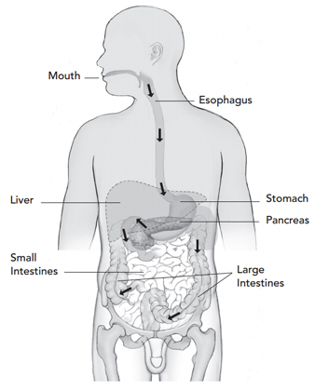
Gastrointestinal Complications
Common in CF related to mucus a food sticking to GI tract
Pathogenesis controversial, inadequate enzyme use may contribute
Constipation, gradual fecal impaction of whole colon
Small Intestinal Bacterial Overgrowth
Distal intestinal Obstruction Syndrome ( DIOS) –acute fecal
obstruction ( complete or incomplete) of ileocecum

Slide 65
Cystic Fibrosis Related Bone Disease
CF Related Bone Disease (CFBD)
  Poor nutrition and pancreatic insufficiency
    Low Vitamin D stores reported 50-95%
  Chronic lung infections and inflammation
  Delayed puberty
  Decreased physical activity
  Medications: Glucocorticoids, transplant related therapies
  Impaired glucose metabolism (CF related diabetes)
  CFTR found in bone and may have a direct effect on bone remodeling
Putman MS et al. JCEM 2014
Siwamogsatham O et al. Curr Opin Endo Obes 2014.
Le Henaff C et al Am J Pathos 2012.
Notes:
Due to advancing median age of survival in patients with CF (now closer to 40 years) – seen increase prevalence of multiple comorbidities – including CFRBD
Low Vitamin D 48-95% of patients
CFTR – studies on CFTR null mice (F508del mutation) – expression in protein in bone cells;
Inhibition of the CFTR channel activity affects the release of OPG; and defective channel activity → decreased bone mass

Slide 66
Cystic Fibrosis Related Bone Disease
One report: BMD scores in children with CF as normal in 51%, moderately low in 32% & low in 17%
Similar reports reporting low BMD scores in 9-27% of children with CF
  Associated with low BMI, low vitamin D, disease severity scores, and frequency of antibiotic use
  BMD also correlated with change in FEV1 scores
In contrast, other reports have demonstrated normal mineralization when BMD was corrected for body size
Notes:
In a study of 100 Children/adolescents with CF, average age of 13 years
*much of the vairance in BMD outcomes may further explained by change in FEV1 scores

Slide 67
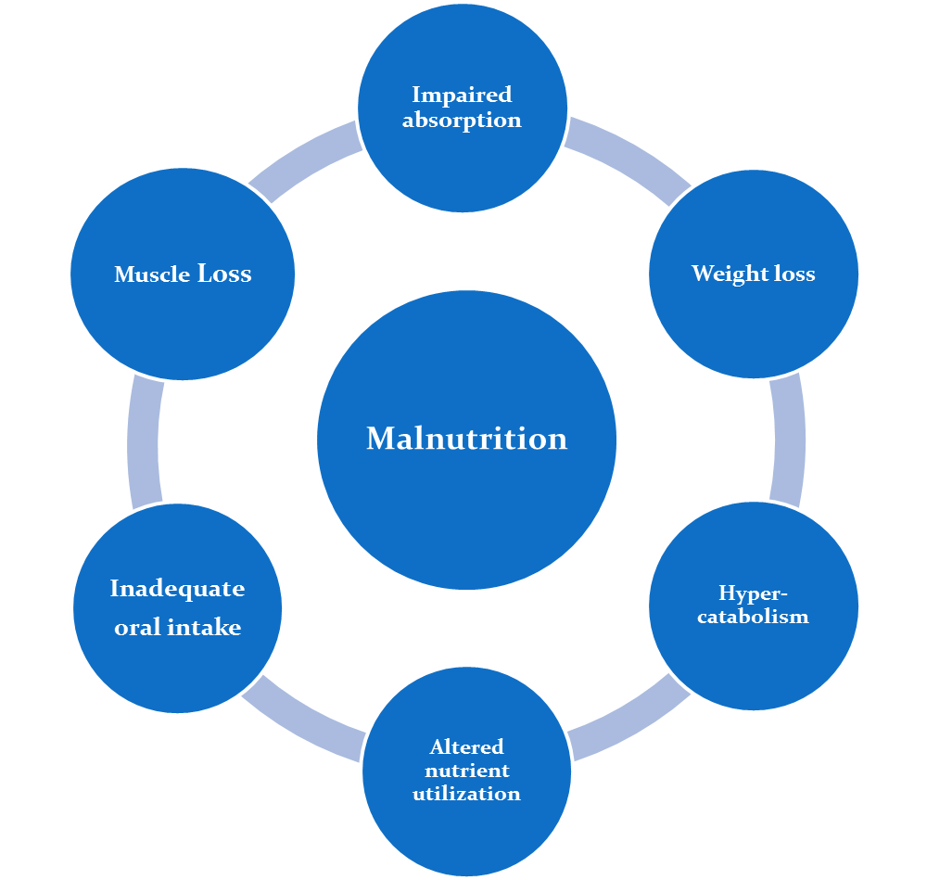
Malnutrition
Notes:
Malnutrition is one of the main burdens of disease in cystic fibrosis (CF) along with lung disease

