Slide 1
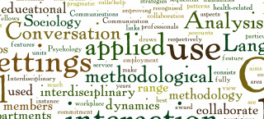
Conversation Analysis

Slide 2
Conversation Analysis History
Conversation Analysis has been researched since the 1960s by hundreds of professors or just those interested in how speech works. However, there are some researchers that are seen as more important than the rest. Harvey Sacks, Emanuel A. Schegloff , Gail Jefferson, Ervin Goffman and Harold Garfinkel

Slide 3
Conversation Analysis History
CA was started by Harvey Sacks and his co-workers – most importantly Emanuel Schegloff and Gail Jefferson at the University of California in the 1960s. The initial formation of Sacks’s ideas is documented in his lectures from 1964 to 1972 (Sacks 1992a, 1992b). CA was developed in an intellectual environment shaped by Goffman's work on the moral underpinnings of social interaction and Garfinkel's ethnomethodology focusing on the interpretive procedures underlying social action. Sacks started to study the real-time sequential ordering of actions: the rules, patterns, and structures in the relations between actions. Thereby, he made a radical shift in the perspective of social scientific inquiry into social interaction: instead of treating social interaction as a screen upon which other processes (moral, inferential, or others) were projected, Sacks started to study the very structures of the interaction itself.

Slide 4
Conversation Analysis History
The origins of conversation analysis are to be found in the work of two great American scholars: Ervin Goffman and Harold Garfinkel. Conversation analysts begin with the notion that conversation interaction represents an institutional order in which interactional rights and obligations are linked not only to personal face and identity, but also to macrosocial institutions.

Slide 5
What Is Conversation Analysis?
Conversation analysis (CA) is a method for investigating the structure and process of social interaction between humans. It focuses primarily on talk, but integrates also the nonverbal aspects of interaction in its research design. As their data, CA studies use video or audio recordings made from naturally occurring interaction.

Slide 6
What Is Conversation Analysis?
Conversation Analysis” (CA): an approach within the social sciences that aims to describe, analyze and understand talk as a basic and constitutive feature of human social life. CA is a well-developed tradition with a distinctive set of methods and analytic procedures as well as a large body of established findings. (Sidnell,J. 2010)
The underlying principle of conversation analysis is the notion that social contexts are fluid and are constantly being constructed by participants through the use of language in interactions, and the ways in which turn taking, opening and closing, the sequencing of acts, adjacency pairs, and so on are locally managed (Walsh,2006)

Slide 7
What Is Conversation Analysis?
Central focus: talk in interaction (both verbal and non-verbal, in situations of everyday life), the organization of social activities in interaction. social phenomena are realized in and through talk in interaction.
-Looking for recurring patterns in the realization of social phenomena in interaction (e.g. Sequence of advice-giving or of news delivery)
-Orderly ways of knowing what to do next in interaction.
-Implementation of institutions through talk where institutional roles are maintained.

Slide 8
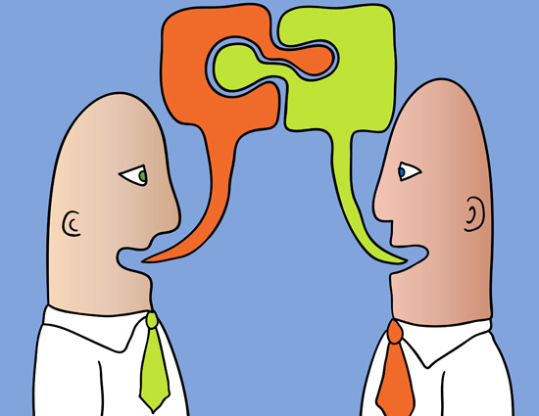
Conversation Features
Conversation has the following features:
Opening
Turn- Taking
Adjacency Pairs
Sequencing
Topics
Closing
Feedback
Repair

Slide 9
Conversation Features: Opening
Opening deals with how you initiate a conversation which is currently bound. Generally speaking, a conversation can be split into three parts:
a) Opening
b) Maintaining
c) Closing

Slide 10
Conversation Features: Opening
For example: A private telephone conversation
Recipient : Hello.
Caller: Hi Reza.
R.: Yeah.
C.: Hi. This is Mehdi.
R.: Hi Mehdi.
C.: How are You?
R.: Okay.
NOTE: The dominant structure in this conversation opening is a) Identification and recognition sequence b) Greeting sequence c) Sequencing

Slide 11
Conversation Features: Turn-Taking
The second characteristic of conversation is turn-taking, the way in which each speaker takes a turn in conversation.
The turn taking machinery operates utterance by utterance. In turn-taking, pauses are meaningful, sometimes they are indicative of getting yourself prepared and thinking for further ideas, or you want to give the turn to the other party.
For instance, the distribution of turns is organized at points where there is a ‘transition-relevance’ place, so the selection of a speaker to speak next is not random but rule-governed, or how turns open and close are very systematic.

Slide 12
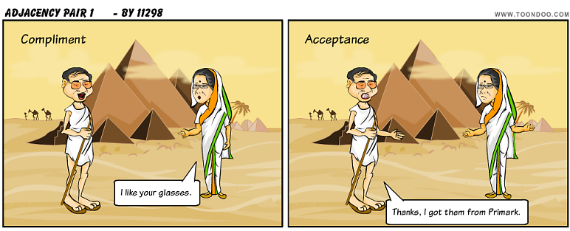
Conversation Features: Adjacency Pairs
Those are pairs of utterances that commonly co-occur, such as question-reply, introduction-greeting.
Example: A: Michael, I’d like you to meet Angela.
B: How do you do?!
Adjacency pairs, or in Shegloff’s terminology ‘nextness’ , are two turns which occur sequentially in a conversation, and play a central and key role in the organization of sequence of talks.

Slide 13
Conversation Features: Adjacency Pairs
These pairs are composed of two parts; the two parts are sequential; they are spoken by different speakers; the parts are ordered; they are spoken by different speakers; both parts should be appropriate.
Typical pairs are: question-answer, rejection-acceptance, complaint- apology, blame-deny, proposal-agreement, and many more.
E.g. Research has shown that to reject an offer, politeness should have to be taken into consideration.

Slide 14
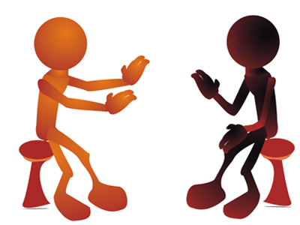
Conversation Features: Sequencing
Sequencing guarantees the maintenance of conversation, but sequences are not always orderly organized. Sometimes we have pre-sequencing (where one precedes the sequencing of conversation), and sometimes insertion-sequencing (where one question-answer pair is embedded within another). Also we may have pre-announcements (speakers start off with a ‘pre’ right before the actual announcement).
Example:
A: ….hhhh oh guess what.
B: What?!
A: Professor Ellis came in, ‘n he put another book on ‘is order.

Slide 15
Conversation Features: Topics
Topics can be the reasons why conversations take place. They arise either before you enter a conversation or in the middle of a conversation (when, for example you make a topic shift).
Topic shifts occur in the vicinity of short silence.
Topic shifting and avoidance may be affected through both verbal and non-verbal signals.

Slide 16
Conversation Features: Closing
A closing section turns out to have begun when none of the parties to a conversation care or choose to continue it. In other words, both parties do not show any motivation to go on; they show reluctance to go on with the topic, so they wish to terminate the conversation.
When a conversation comes to an end, this ending happens with two major steps:
1) Pre-Closing 2)Closing

Slide 17
Conversation Features: Closing
Pre-Closing: This step immediately precedes the closing section. In pre-closing you manage to close the conversation. Expressions like “OK”, “Alright”, and “So” show that you want to leave the conversation.
Closing: In closing you make a statement indicating you are going to leave the conversation (e.g. bye). Closing may include making arrangements with varieties such as giving directions, arranging later meetings, invitations, and the like.

Slide 18
Conversation Features: Feedback
Feedback might be given either linguistically or para-linguistically.
“Linguistically” by using lexical items, response tokens (e.g. yeah, really, hmmm), or passing judgments by paraphrasing the other parties’ words.
“Para-linguistically” by using body movements, gestures, using eye contact or for instance, twisting of the face, nodding the head, etc. which are indicative(s) of your reflection on someone's ideas.

Slide 19
Conversation Features: Repair
As a result of teacher feedback, a learner correct an ill-formed utterance, either through ‘self-repair’ or as a result of ‘peer-repair’.

