Slide 1
Database Outsourcing:
Secure Data Management in Untrusted Environments
به نام خدا
Mohammad Ali Hadavi
September 3, 2016

Slide 2
Outline
1
Introduction
2
Solutions for Data Confidentiality
Solutions for Correctness Verification of Query Results
4
Summary and Remaining Challenges
3

Slide 3
Part 1
Introduction

Slide 4
Relational Data Model
SELECT *
  FROM Courses
  WHERE StudentId = 1234
SELECT COUNT(StudentId)
  FROM Student
  WHERE GPA > 18
SELECT Name
  FROM StudentCourse AND Course
  WHERE AVG(Grade) > 17
  GROUPBY Name

Slide 5
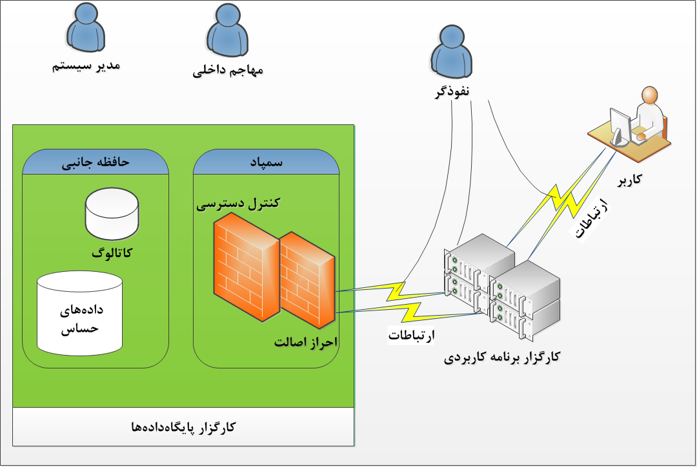
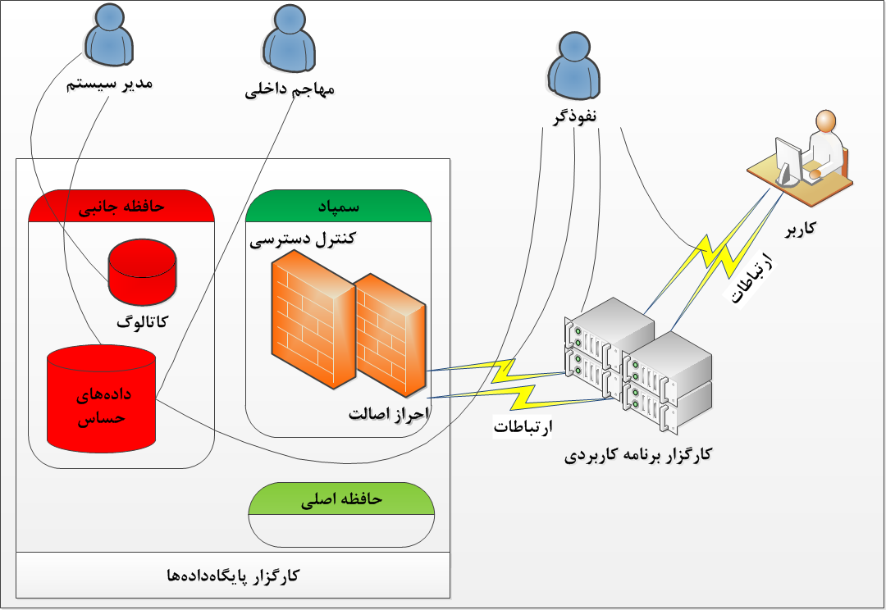
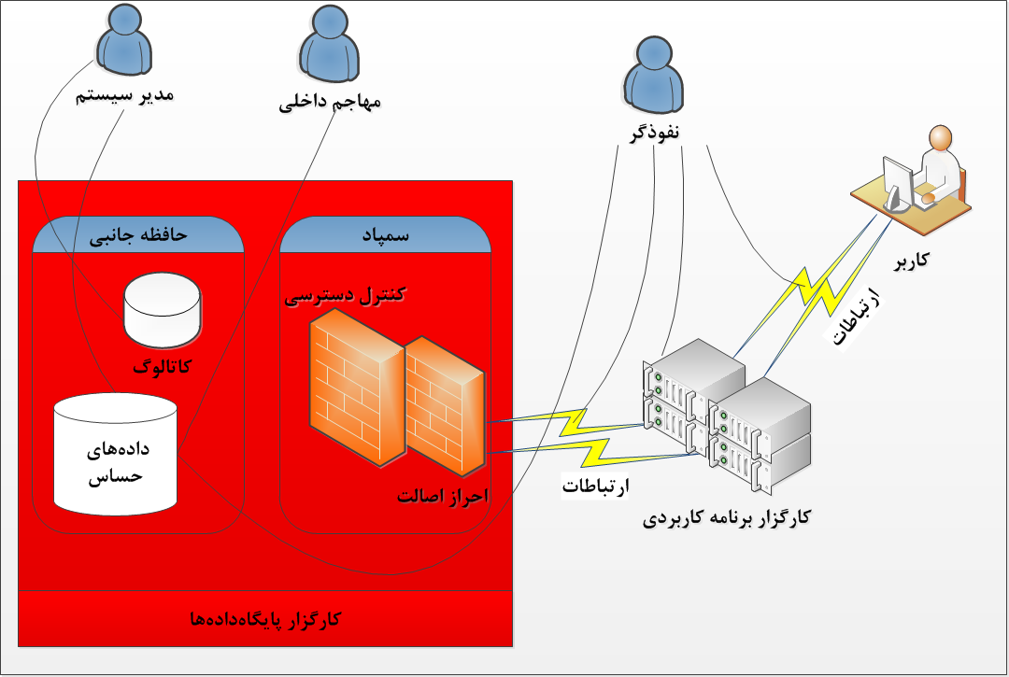
سطح اعتماد به کارگزار
Fully trusted
Semi trusted
Untrusted
Notes:
Data management when data is stored encrypted in disks was less understood at the time (and to date has not been fully addressed). It led to a variety of challenges such as what granularity should the data be encrypted at (e.g., page level, record level, field level), what type of encryption technique should be used to encrypt data, how should key management be performed, how should the pages/files be organized, how should indices be built upon encrypted data, what are the performance implications of encryption, what are the impacts on query optimization and processing, etc. Many of these challenges were addressed by us in subsequent papers [15, 10–12].

Slide 6
Secure Data Outsourcing
Data outsourcing
  Data is managed out of the territory of its owner
Advantages
  Benefits of cloud computing
Disadvantages
  Security
History
Examples of database as a cloud service
  Microsoft SQL Azure, Amazon Relational Database Service
    Neither offer any security
Data as a Service (DaaS)
ICDE 2002
Secure Data Outsourcing
Data Management on the Cloud
Notes:
Our first paper on the topic appeared in the ICDE 2002 conference that raised multiple challenges in supporting the DAS model. In particular, we identified three challenges: a) appropriate user interfaces through which database services and data is presented to the end-user - the interface must be easy to use, yet be sufficiently powerful to allow users to build complex application; b) hiding the additional latencies that arise due to remote data access that sits across the network at the service provider sites; and c) most importantly, the challenge of data confidentiality – it was (and still is) well recognized that organizations view data to be amongst their most valuable assets
This paper (SIGMoD) was a result of a successful collaboration between IBM Silicon Valley Laboratory and the University of California, Irvine that explored the idea of outsourcing database management to third-party service providers. Our collaboration started on a fateful SIGMOD Conference meeting that brought authors of this paper together.
Unlike the earlier attempts:
Distributed Computing
Distributed Databases
Grid Computing
Cloud Computing is likely to persist:
Organic growth: Google, Yahoo, Microsoft, and Amazon
Poised to be an integral aspect of National Infrastructure in US and other countries
چرا می گوییم سرویس دهنده قابل اعتماد نیست. مگر SLA نداریم؟ نکته روش تضمین است.
Benefits of cloud computing environment
کنجکاوی در مورد داده‌ها
دستکاری هدفمند داده
نفوذگران، بدافزارها و ...
Microsoft SQL Azure
Amazon RDS

Slide 7
What is the Problem?
Servers are not trusted → Security is the first concern
  Untrusted service provider, Curious DB administrators, Hackers, Physical attacks, …
Data management community concerns with functionality and efficiency issues
  To date, fully homomorphic system to be of practical value, remains illusive
  No provable security!
Cryptographers’ community concern with security issues
  Encryption is a magic tool
The key question
  what is the best guaranteed security that can be achieved without compromising general efficiency and functionality?
Functional Requirements
Communication and Computation
Efficiency
Security Requirements
Notes:
For example, consider encrypting the data with a secure encryption scheme that hides all information and is always randomized (i.e. same messages yields completely different ciphertexts). This does not allow the user to even form a query about any set of records smaller than the whole database. it turns out that even addressing just the basic exact-match (point) queries is a non-trivial task if one wants to treat security in a systematic, not ad-hoc, way.
عموما روش هایی که اطلاعاتی از داده ی برون سپاری شده را افشا نمی کنند، مگر الگوی دسترسی کاربران، جستجو را با کارایی کم انجام می دهند.

Slide 8
The generic DAS Model
Client
Unified owner-querier
Multi querier
Multi owner
Untrusted Server
1. User Query
Query Transformation
2. Client Query
Query Processing
Server Result Refinement
4. Final Response
3. Server Response
User
Metadata
Metadata
Outsourced Data
Metadata
Outsourcing Data
Data Owner

Slide 9
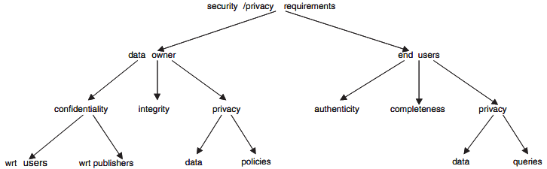
Security Requirements
E. Ferrari, Database as a Service: Challenges and Solutions for Privacy and Security, IEEE Services Computing Conference 2009 (APSCC 2009), pp: 46-51.

Slide 10
Part 2
Solutions for Data Confidentiality

Slide 11
Confidentiality Objectives
Data Confidentiality
  Confidentiality of the data being outsourced
Access Confidentiality
  Confidentiality of an access aims at a specific data
Access Pattern Confidentiality
  Confidentiality of the fact that two accesses aim at the same data
Access Policy Confidentiality
  Access control policies may reveal information about data and accesses
Notes:
What we really need to ensure is that not only is the encrypted database itself secure, but that the act of processing queries against the database does not reveal information. In addition to the tuple indistinguishability, queries must be indistinguishable.
The cryptography community has produced the concept of oblivious RAM[12]: a method to obscure the program even to someone watching the
memory access patterns during execution. They provide a solution such that the distribution of memory accesses does not depend on input. This implies that execution of queries can be made indistinguishable if they access the same number of tuples and have the same result size.
In their main result, they show that if a program and its input with total size y uses memory size m and has a running time t, then it can be simulated by using m · (log2m)2 memory in running time O(t(log2 t)3) without revealing the memory access patterns of the original program (assuming t > y).
PIR and Symmetric PIR
In the working of the system, the client can hide the actual request within cover (fake) requests, cache nodes, and shuffle the content among blocks stored at the server. Our solution combines cover, caching, and shuffling techniques in an effective way to provide confidentiality.
PIR approaches typically work on a different problem setting. As a matter of fact, in most proposals, the external database being accessed is in plaintext (i.e., content confidentiality is not an issue). Regardless of whether the external database is plaintext or encrypted, PIR solutions have high computational complexity and are therefore not applicable to real systems. It has been proved [Sion, NDSS 2007] that the execution of information-theoretic PIR protocols require more resources than those required for a complete transfer of the database from the server to the client.

Slide 12
Data Confidentiality Solution Landscape
Two approaches
  Data encryption
    How to search/compute over encrypted data?
    Different queries, data types, granularity, …
  Data fragmentation
    Departing from encryption
    Multi server case / Collaborative computing
What about anonymization?
Data Confidentiality Solutions
Data Encryption
Data Fragmentation

Slide 13
Encryption based Solutions
Data is encrypted before being outsourced
  The server is not allowed to see the plain-text values.
    No decryption at the server side
  How to perform query processing directly over encrypted data?
Two techniques for search/compute over encrypted data
  Directly search/compute over encrypted data
    Designing special encryption functions
    Metadata/index based method (for search)
  Use a secure location for computation
Encryption Based Solutions
Directly search/compute over encrypted data
Secure Location
for Computation
Special Enc. Function
Metadata

Slide 14
Designing special encryption functions
Depending on the type of query
  Deterministic encryption (for equality queries)
  Searchable Encryption (for search on encrypted character data)
  Homomorphic encryption (for direct computation on outsourced data (aggregation queries))
    Somewhat/partial homomorphic encryption
    Fully homomorphic encryption
  Order Preserving Encryption (OPE) (for range queries)
  Attribute Based Encryption (ABE) (for access control enforcement)
Directly search/compute …
Special Encryption Functions
Search on
Metadata
…
OPE
SE
HE

Slide 15
HE and OPE in Practice
Efficiency is a challenge
  Efficient ones ae mainly vulnerable to CPA
  OPE leaks (at least) the order of values
  Homomorphic encryption is of much interest in research but still far from practice
Notes:
Arvind Arasu, Querying Enc. Data , ICDE & SIGMOD 2014

Slide 16
Using Metadata
Meta data is a description of data by which server can search
  For Search not for computation
  Metadata is a source of information leak
Meta data (index) is stored at server side beside the encrypted data
How to construct such metadata to provide efficient query processing?
  Different kinds of queries as well as different data types
Directly search/compute …
Special Encryption Functions
using
Metadata
…
OPE
SE
HE
Notes:
روش های شاخص مبنا بر اساس روش تولید شاخص تفاوتند
efficiency. While index-based methods have been considerably investigated, they suffer from several disadvantages including:
The lack of support for execution of aggregation queries at server side.
The existence of false hits in returned results of the server. This leads to more communication cost as well as computational cost at the client side to refine the results.
Being vulnerable to the inference exposure that results in partial disclosure of the correspondence between the indices and the plain data.
There are some research activities focusing on the trade-off between security and efficiency, mainly on bucketing index-based methods

Slide 17
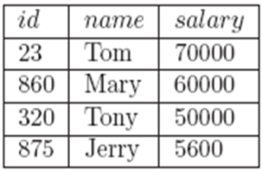
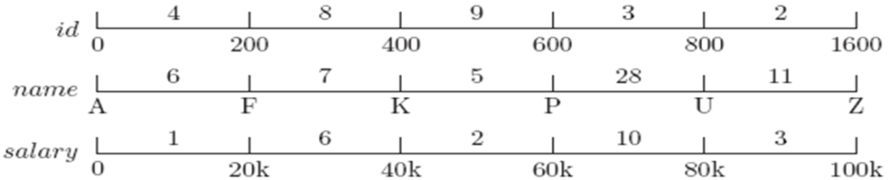
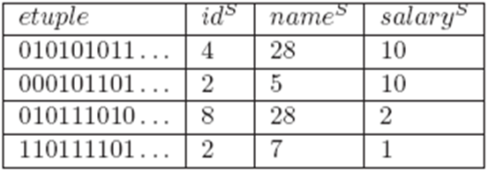
Bucket-Based Metadata
Examples of index construction methods
  Bucket-based
  Hash-based
  B⁺ tree indexing
  …
Notes:
Even to date, such techniques are not efficient enough to be considered as a general solution that works well under most/all conditions. Instead, we devised an information theoretic approach which we called bucketization that allowed us to evaluate predicates though at the technique could admit false positives. This led us directly to partitioned computation of SQL queries collaboratively between the service provider and the client side wherein part of the predicate evaluation would be done at the service provider with some filtering at the client side to determine the true answer

Slide 18
Secure Location Solution
Secure In-Cloud Processing
Trusted Client Architecture
Encryption Based Solutions
Directly search/compute over encrypted data
Secure Location
for Computation
Special Enc. Function
Metadata
In-Cloud Computation
Trusted Client Architecture
Notes:
Our work on database as a service naturally fits the cloud model but the cloud offers many new challenges and opportunities that we did not originally explore as part of our work on DAS.
First, unlike our assumption in DAS, where the resources were assumed to be very limited on the client side, in the cloud setting organizations may actually possess significant resources that meets majority of their storage and computational needs. For instance, in the cloud setting data may only be partially outsourced, e.g., only non-sensitive part of the data may be kept on the cloud. Also, it may be only at peak query loads that the computation needs to be offloaded to the cloud. This has implications from the security perspective since much of the processing involving sensitive data could be performed at the private side. In DAS, since the goal was to fully outsource the data and computation, the focus of the solutions was on devising mechanism to compute on the encrypted representation (even though such techniques may incur significant overhead). In contrast, in the cloud environments, since local machines may have significant computational capabilities, solutions that incur limited amount of data exposure of sensitive data (possibly at a significant performance gain) become attractive.
Second, while our DAS work primarily dealt with database query workload, in a cloud setting, we may be interested in more general computation mechanisms (i.e. not only database workloads). For instance, map-reduce (MR) frameworks are used widely for large-scale data analysis in the cloud. We may, thus, be interested in secure execution of MR jobs in public clouds.

Slide 19
Secure Location Solution
Secure In-Cloud Processing
  Trusted (tamper-proof) hardware
    TrustedDB
    CorrectDB
    …
Trusted Client Architecture
  In contrast to the generic DaaS Model
  Proxy-based (middleware) solutions
    CryptDB
Notes:
Our work on database as a service naturally fits the cloud model but the cloud offers many new challenges and opportunities that we did not originally explore as part of our work on DAS.
First, unlike our assumption in DAS, where the resources were assumed to be very limited on the client side, in the cloud setting organizations may actually possess significant resources that meets majority of their storage and computational needs. For instance, in the cloud setting data may only be partially outsourced, e.g., only non-sensitive part of the data may be kept on the cloud. Also, it may be only at peak query loads that the computation needs to be offloaded to the cloud. This has implications from the security perspective since much of the processing involving sensitive data could be performed at the private side. In DAS, since the goal was to fully outsource the data and computation, the focus of the solutions was on devising mechanism to compute on the encrypted representation (even though such techniques may incur significant overhead). In contrast, in the cloud environments, since local machines may have significant computational capabilities, solutions that incur limited amount of data exposure of sensitive data (possibly at a significant performance gain) become attractive.
Second, while our DAS work primarily dealt with database query workload, in a cloud setting, we may be interested in more general computation mechanisms (i.e. not only database workloads). For instance, map-reduce (MR) frameworks are used widely for large-scale data analysis in the cloud. We may, thus, be interested in secure execution of MR jobs in public clouds.

Slide 20
Data Fragmentation
The idea
  The associations between values are confidential rather than values themselves
    Association between persons and their addresses
    Relation between persons and their diseases
    …
  departing form encryption unless an attribute value is confidential
Data Confidentiality Solutions
Data
Encryption
Data Fragmentation
Vertical
Hybrid
Horizontal
Value

Slide 21
Fragmentation Types
Vertical Fragmentation
  associations between values in different columns
  Privacy/security constraints are defined over attributes
Horizontal Fragmentation
  associations between tuples caused by functional dependencies
  Tuples can be confidential based on security constraints defined over contents of tuples
Value (cell level) Fragmentation
Hybrid approach
Notes:
رؤیت­پذیری بیشینه بدین معنی است که هر صفتی که جزو قیود محرمانگی تک­عضوی بشمار نمی­رود حداقل در یکی از زیررابطه­ها به صورت متن ساده وجود داشته باشد. کمینه بودن بخش بندی یعنی نتوان دو زیررابطه را با هم ترکیب کرد تا بخش­بندی جدیدی با حفظ دو شرط فوق پدید آید.

Slide 22
Vertical Fragmentation - Example
Fragmentation Properties
  Lossless
  Constraint satisfaction
Optimization factors
  minimize the query execution cost
  maximize the attributes visibility
  minimize the number of fragments
  minimize the imposed costs to the data owner
  …
Illness | Treatment | Zip | DoB | Name | SSN
Flu | Actifed | 90012 | 1969/01/01 | Ali | 123-456-789
Heart disease | Altace | 90022 | 1980/01/10 | Hasan | 123-432-899
Cold | Actifed | 90010 | 1971/11/27 | Hossein | 870-122-455
Osteoporosis | alendronate | 90005 | 1950/11/22 | Bahram | 111-879-354
The set of Security Constraints over the above relation:
p₀ = {SSN}, p₁ = {Name, Treatment},
p₂ = {Name, Illness}, p₃ = {Treatment, Illness},
p₄ = {DoB, Zip, Treatment}, p₅ = {DoB, Zip, Illness}

Slide 23
Part 3
Solutions for Correctness Verification of Query Results

Slide 24
The adversary becomes Active!
Till now we talked about passive adversary. Now, we move on to the more powerful adversary, Active adversary!
  Malicious Cloud Server!
    A server compromised by an active adversary
    Virus attacks and data curroption/loss
  When you pose a query and receive a result, are you sure about the Correctness of the result?

Slide 25
What to do with active adversaries?
Is C a correct answer?
Data Owner
SELECT Name FROM Employees WHERE Salary >7000
Name | Salary
A | $5000
B | $3500
C | $9000
D | $6000
Service Provider
User
C

Slide 26
Correctness Assurance of Query Results
Correctness
  Integrity and authenticity
  Completeness
  Freshness → for dynamic environments
Main idea: to send extra information (verification object) together with the query result
What we need?
  The result is definitely correct
    Pay more
  The result is probabilistically correct
Notes:
Query result correctness has not been investigated as much as confidentiality in database outsourcing.
Using authentication data structure → MHT-based approach
There is a Probabilistic approach using faked tuples.
Security attack against correctness → replay attack.

Slide 27
Guaranteeing Correctness
Authenticstion Data Structures (ADS)
  Merkle Hash Tree (MHT)
  Chained Signatures
  Chained Massage Authentication Codes
  Bloom Filter
  Skip Lists
  …
Correctness verification of Query results
ADSs for guaranteed correctness
Probabilistic Correctness Verification
…
MHT
Chained Digital Signature
Chained MACs
Skip lists
Notes:
MHT -> Merkel Hash Tree
Besides MHT, another notable (Authenticated Data Structures) ADS is the authenticated skip-lists structure presented by Goodrich and Tamassia [3SCN]. Their scheme introduced the notion of commutative hashing and showed how to embed the commutative hashing in the nodes of skip lists [16SCN]. This scheme can support the insertion and deletion of elements in logarithmic time. The main problem of data structures such as chained signatures and MHT is that they can be used. Wang et al. proposed an authenticated scheme based on the authenticated skip-lists structure [17SCN], which supports authentication of range queries both in static and dynamic scenarios. Other schemes based on the authenticated skip-lists structure have been proposed in [18SCN] and [19SCN].

Slide 28
Signature-Based Verification
Signature is used to verify data integrity
The data owner signs data in a granularity in which it should be verified
  The granularity level affects performance
    Too Fine granularity → high computation overhead
    Too Broad granularity → high communication overhead
    Tuple-level signature seems suitable
Sign(H(-|-∞))
SELECT Name FROM Employee WHERE Salary > 7000
Sign(H(B|3500))
Name | Salary
A | $5000
B | $3500
C | $9000
D | $6000
Authenticate this set with digital signature
Sign(H(A|5000))
Sign(H(D|6000))
(C,9000)
Sign(H(C|9000))
Sign(H(-|+∞))
Notes:
کارپذیر با دریافت درخواست کاربر، جواب را تولید کرده و به همراه جواب، امضاهای مورد نیاز برای درستی­یابی جواب را به عنوان شیء وارسی برای کاربر می­فرستد. کاربر با استفاده از امضاهای مالک داده، درستی پاسخ بازگشتی از کارپذیر را ارزیابی می­کند.
Generally, signature-based techniques impose more storage overhead at thedisa server side rather than MHT-based approaches as a signature is usually larger than a hash value. Signature aggregation was proposed to reduce the communication and verification overhead as the verification of an aggregated signature is equivalent to the verification of all its constituent signatures. Narasimha and Tsudic [17] proposed a solution to provide the correctness assurance of query results based on signature aggregation. They utilized the signature chaining to verify the completeness of results. While their approach supports Selection, Join, Projection, and Update queries, it is vulnerable to the replay attack.

Slide 29
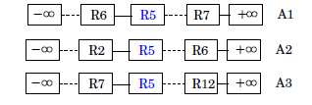
Signature Chaining
Signature chaining for completeness verification
  A₁, A₂, and A₃ are searchable dimensions
  Tuples are sorted based on A₁, A₂, and A₃
  Sign(R₅) = h(h(R₅)||h(R₆)||h(R₂)||h(R₇))
While verification check if the chain has broken
Signature aggregation to reduce communication and computation ovrheads
  Example: Condensed RSA
What to do for freshness?
Notes:
در این­گونه روش­ها، چون تولید امضا فرایندی زمان­بر است، سربار محاسباتی مالک داده برای برپایی اولیه­ی سیستم بالا است. از طرف دیگر امضای رقمی نسبت به چکیده، اندازه­ی بزرگ­تری دارد. بنابراین، سربار ذخیره­سازی در سمت کارپذیر نیز بیشتر از روش­های مبتنی بر درخت چکیده­ساز مرکل است. برای کمتر کردن سربارها از امضای تجمعی استفاده می­شود. در روش امضای تجمعی، امضاهای مورد نیاز برای درستی­یابی جواب بازگشتی در قالب یک امضا مجتمع شده و برای کاربر ارسال می­شود. در این روش­ها تأیید امضای مجتمع شده معادل با تأیید کردن تمام امضاهای اولیه است.

Slide 30
MHT Based Correctness Verification
Tuples are sorted based on the searchable attribute
  Sorting is for Completeness verification
An MHT is made over the sorted values
The owner signs the root of MHT
In response to a query:
  The Server sends a verification object so that the querier can reconstruct the root and verify it using the owner’s signature.
What about the freshness?

Slide 31
MHT-based Verification - Example
R = H (N5 || N6)
N5 = H (N1 || N2)
N6 = H (N3 || N4)
N1 = H (H (C1) || H (C2))
N2 = H (H (C3) || H (C4))
N3 = H (H (C5) || H (C6))
N4 = H (H (C7) || H (C8))
In Outsourcing Scenario:
  R is signed by the owner
  C is a searchable attribute
R
N5
N6
N1
N2
N3
N4
H(C1)
H(C2)
H(C3)
H(C4)
H(C5)
H(C6)
H(C7)
H(C8)
C1
C2
C3
C4
C5
C6
C7
C8
Notes:
R is kept in the trusted zone if the freshness is important or sent to the untrusted zone and sent back by the query result.
با امضا کردن ریشه­ی درخت، کارپذیر نمی­تواند مقادیر موجود در پایگاه داده را تغییر دهد.

Slide 32
MHT-based Verification – Pros & Cons
Advantages
  Making verification object is easy
  Freshness
Disadvantages
  Large verification object (bandwidth wasting)
  Cumbersome data updates
  Verification time depends on the size of database
A good survey and comparison
  S. Bajaj, R. Sion, “CorrectDB: SQL engine with practical query authentication”, VLDB 2013, pp: 529-540.
Notes:
مالک داده ساختار احراز اصالت را تولید کرده و به همراه پایگاه داده­ی اصلی در کارپذیر ذخیره می­کند. واضح است که در این حالت کارپذیر خراب­کار می­تواند علاوه بر داده­های پایگاه داده، ساختمان داده­ی احراز اصالت را نیز تغییر دهد. برای جلوگیری از این عمل، مالک داده فراداده­هایی را در سمت کارپذیر ذخیره می­کند تا با استفاده از آن­ها اصالت ساختار را ارزیابی نماید.
از مزایای استفاده از ساختار احراز اصالت برای درستی­یابی پاسخ بازگشتی سربار کم برپایی اولیه­ی ساختار، ذخیره­سازی آن و تولید سریع شیء وارسی اشاره کرد. مشکل اصلی این روش، بزرگ بودن نسبی شیء وارسی و هزینه­ی زیاد بهنگام‏سازی پایگاه داده است.

Slide 33
Probabilistic Correctness
Fake tuples
  The focus is on completeness verification
  The server can not distinguish fake tuples with the real ones
  The ratio of fake tuples → The probability of correctness
Replication and Redundancy
  Some tuples are encrypted twice by distinct keys
  The ratio of tuple redundancy → The probability of correctness
Correctness verification of Query results
ADSs for guaranteed correctness
Probabilistic Correctness Verification
MHT
Chained Digital Signature
Chained MACs
Skip lists
Fake tuples
Redundancy
Notes:
MHT -> Merkel Hash Tree
Besides MHT, another notable (Authenticated Data Structures) ADS is the authenticated skip-lists structure presented by Goodrich and Tamassia [3SCN]. Their scheme introduced the notion of commutative hashing and showed how to embed the commutative hashing in the nodes of skip lists [16SCN]. This scheme can support the insertion and deletion of elements in logarithmic time. The main problem of data structures such as chained signatures and MHT is that they can be used. Wang et al. proposed an authenticated scheme based on the authenticated skip-lists structure [17SCN], which supports authentication of range queries both in static and dynamic scenarios. Other schemes based on the authenticated skip-lists structure have been proposed in [18SCN] and [19SCN].

Slide 34
Part 4
Summary and Remaining Challenges

Slide 35
Summary
Data outsourcing to cloud may have lots of benefits BUT …
A challenging question
  what is the best guaranteed security that can be achieved without compromising general efficiency and functionality?
Narrowing the gap between
  query-processing-efficient but ad-hoc schemes with unclear security and
  schemes with strong security guarantees but with unsuitable functionality

Slide 36
Some Remaining Challenges
Supporting SQL queries on encrypted data
  Existing solutions are very limited
    Efficient Join
    Handling different data types (Floats, Boolean, negative numbers, characters, multimedia data)
    Simultaneous use of Computation and Comparison
      SELECT * FROM T WHERE ColumnA + 2 < ColumnB
Notes:
Knowledge of the order in correctness focused approaches is inconsistent with the confidentiality point of view
Existing fragmentation methods are inconsistent with access control and correctness approaches
Trustiness assumption in applying access policy updates
…
Difficulties in supporting aggregation queries
Concentrating on numeric data type
Not to focus on join operation between two relations
…
بیشتر روش­های ارائه شده برای حفظ محرمانگی که مبتنی بر رمزنگاری اطلاعات محرمانه هستند، قادر به پشتیبانی از
اجرای پرس­وجوهای تجمعی در سمت
کارگزار نمی­باشند. این مسأله در بیشتر روش­های ارائه شده برای تضمین درستی پاسخ­ها نیز وجود دارد.
روش­های ارائه شده برای کنترل دسترسی تنها مجوز خواندن اطلاعات برون­سپاری شده را درنظر گرفته­اند.
تولید درخت شاخص B⁺ بر اساس [8] با این­که امنیت قابل توجهی را فراهم می­کند، سربار بسیار زیاد آن در اجرای پرس­وجو، مانع بزرگی در بکارگیری آن است.
بخش­بندی روابط با این­که قابلیت­های نسبی در پشتیبانی از پرس­وجوهای متنوع دارد، ضعف­های آشکاری در بهنگام­سازی اطلاعات و همچنین حملات مبتنی بر فرکانس مقادیر دارد.
بیشتر روش­های ارائه شده در حوزه­ی تضمین درستی پاسخ­، تنها داده­های عددی را در نظر داشته­اند. این مسأله برای روش­های حفظ محرمانگی نیز، هرچند کمتر، وجود دارد.
در برخی روش­های ارائه شده برای تضمین درستی پاسخ­ها، مانند [34]، نیاز است که کارپذیر مقدار صفت مورد ارزیابی در اولین چندتایی قبل از مجموعه­ی جواب و اولین چندتایی بعد از مجموعه­ی جواب را برای کاربر ارسال کند (برای تضمین کامل بودن مجموعه­ی جواب) که می­تواند ناقض خط­مشی­های کنترل دسترسی روی داده­های برون­سپاری شده باشد.
ترکیب روش­های ارائه شده برای تضمین درستی پاسخ­های بازگشتی از کارپذیر با روش­های مبتنی بر بخش‏بندی روابط در حوزه­ی محرمانگی داده­ها، هرچند که غیرممکن نیست، اما بار محاسباتی و ارتباطاتی روش­های تضمین درستی را تا چندین برابر (وابسته به تعداد زیرروابط تولید شده از رابطه­ی اصلی) افزایش می­دهد. این مسأله با توجه به این که روش­های ارائه شده برای تضمین درستی به خودی خود دارای سربارهای قابل توجهی هستند باعث می­شود که نتیجه­ی ترکیب این روش­ها در محیط­های عملیاتی نیز کارایی قابل قبولی نداشته باشد.
روش­های ارائه شده برای کنترل دسترسی عموماً فرض را بر درست­کار بودن کارپذیر گذاشته­اند. در حالی­که اگر کارپذیر را درست­کار ندانیم، باید روش­هایی برای اطمینان از اِعمال خط­مشی­های امنیتی در کارپذیر داشته باشیم که بیشتر روش­ها توجهی به آن نداشته­­اند.

Slide 37
Some Remaining Challenges (2)
Immaturity of correctness verification
  Correctness assurance of aggregate queries
  Correctness verification of Multi dimensional queries
  Inefficient verification processes
    Can we have On demand (more-efficient) verification?
    Can we have Verification as a Service?

Slide 38
Some Remaining Challenges (3)
Integrating security requirements into a practical system is far from practice
  We focus on data confidentiality but what about access/pattern confidentiality?
    Violation of access confidentiality may result in violating data confidentiality
  Some assumptions for different security requirements are contradictory
  No change to existing DBMSs / Applications
Notes:
We need a solution in which security requirements (confidentiality, correctness and access control) be considered in the same framework
اگر داده ها را با یک کلید رمز کنیم می توانیم از رمزنگاری حافظ ترتیب استفاده کنیم. اگر از روش های رمزنگاری انتخابی تبعیت کنیم، منابع با کلیدهای مختلف رمز می شوند. حال باید جستجو و جستجوی بازه ای چه کنیم. یعنی این که روش های رمزنگاری انتخابی که ارائه شده اند فرضشان این استکه از ساختارهای شاخص مبنا برای جستجو استفاده شده است و این روش الزام خط مشی صرفا با این نوع روش پرس وجو روی داده رمز شده هماهنگی دارد. به طریق مشابه اگر بخواهیم از یک تابع رمزنگاری همومورفیک استفاده کنیم، دیگر به الزام خط مشی ها روی رمز شده ی همومورفیک با مفروضات جاری مقدور نیست.
در برخی روش­های ارائه شده برای تضمین درستی پاسخ­ها، مانند [34]، نیاز است که کارپذیر مقدار صفت مورد ارزیابی در اولین چندتایی قبل از مجموعه­ی جواب و اولین چندتایی بعد از مجموعه­ی جواب را برای کاربر ارسال کند (برای تضمین کامل بودن مجموعه­ی جواب) که می­تواند ناقض خط­مشی­های کنترل دسترسی روی داده­های برون­سپاری شده باشد.
روش­های ارائه شده برای کنترل دسترسی عموماً فرض را بر درست­کار بودن کارپذیر گذاشته­اند. در حالی­که اگر کارپذیر را درست­کار ندانیم، باید روش­هایی برای اطمینان از اِعمال خط­مشی­های امنیتی در کارپذیر داشته باشیم که بیشتر روش­ها توجهی به آن نداشته­­اند.

Slide 39
End
Thank you for your attention

