Slide 1
The Concept of Discourse Analysis Discourse Vs. Pragmatics

Slide 2
Discourse Analysis History
Its started during the 19660s and 70s. Zellig Harris (1952) was the first person who coined Discourse Analysis. Hymes, Searl and Grice were of those philosophers affected mainly on the discourse analysis.
British discourse analysts Halliday, Sinclair (IRF), Coulthard
American discourse analysts Goffman, Sacks, Hymes, Labov
Text-Grammarians Van Dijk, De Beaugrande, Halliday and Hasan (Working mostly on written language)

Slide 3
Discourse Analysis History
British discourse analysis :
It was generally influenced by Halliday's Systematic Functional Approach to language, which in turn has connections with the Prague school of linguistics. Halliday’s framework emphasizes the social functions of language and the thematic and informational structure of speech and writing, for example: Teacher-to-Pupil talk, Doctor-to-Patient talk, and business negotiations.

Slide 4
Discourse Analysis History
American discourse analysis:
It emphasizes the research method of close observation of groups of people, communicating in natural setting. It examines types of speech event such as story-telling, greeting rituals and verbal duels in different cultural and social settings. What is often called “Conversation Analysis” within the American tradition can also be included the under general heading of Discourse Analysis. In C.D.A., the emphasis is not upon building structural model (British D.A.) but on the observation of behavior of participants in talk and on patterns which reoccur over a wide range of natural data, for example: Turn taking and Conversational norms.

Slide 5
Why do gorillas have big nostrils?

Slide 6
Discourse, Pragmatics, and Semantics
Q: What is Discourse Analysis?
A(s):
Yule(2010): D.A. is the study of language beyond the sentence, in text and conversation.
McCarthy (1991): D.A. is concerned with the study of the relationship between the language and contexts in which it is used.
Brown & Yule (1983): D.A. is necessarily the analysis of language in use; form and function have to be taken into account.

Slide 7
Q: What is Discourse Analysis?
Shokouhi and Kamyab (2004): D.A. is concerned with the study of language in use in all cognitive, socio-cultural and contextual dimensions.
Halliday and Hasan (1976) : Define discourse in terms of “text” and “texture”.
Stubbs (1983): Considers discourse as any language organization above the sentence level, whether it is an exchange of ideas in conversation or written texts in socially acceptable context.

Slide 8
Q: What is Discourse Analysis?
Van Dijk (1977): Discourse is systematically related to communicative action. It implies that pragmatic components should specify appropriate conditions: both the sentences and discourse.
Fairclough (2010): Discourse is not simply an entity we can define interdependently: we can only arrive at an understanding of it by analyzing sets of relations. We can say what it is in particular that discourse brings into the complex relations which constitute social life: meaning and making meaning.

Slide 9
Q: What is Discourse Analysis?
Schiffrin (1987): language always occurs in some context, including cognitive contexts in which past experience and knowledge are stored and drawn upon, cultural contexts, consistency of shared meaning and world views, and social contexts which both self and others draw upon institutional and interactional orders to construct definitions of situation and action.
Jalilifar (2014): Discourse has got to do with text organization at above sentence level, by incorporating contextual, social and political motivations and information into our account. The selection of that language is appropriate in context it self.

Slide 10
Discourse Analysis
Consider the following examples:
1) Tills closed Meaning that you can’t give or take money because the counter is closed.
2) River of plenty Refers to Nile river, people who live in this place ( Egypt ) know about the meaning.
Discourse deals with these areas: meaning, society, and context. It deals with the interpretation of language in society, in context in which it appears. D.A. studies language in use: written texts of all kinds, and spoken data, from conversation to highly institutionalized forms of talk.

Slide 11
Discourse Analysis
Discourses: Refers to usage of thinking and talking that form ideologies and serve power.
Analysis : Not discousology or discousography, because Discourse Analysis typically is an analytical process in an explicit way. This analysis is both mental and mechanical.

Slide 12
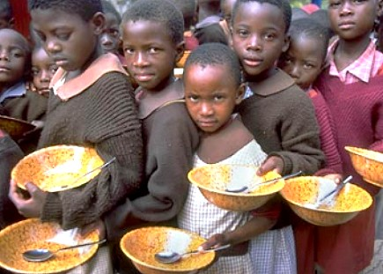
Discourse Analysis
Each of the following words has a special meaning attached to it, and as you read them some ideas might come to your mind:
Food Hunger Meal Delicious
Can you define the word delicious?
What does delicious mean to you?

Slide 13
Discourse vs. Discourses
Discourse: It can be any kind of text when we say discourse.
Discourses: Refers to each type of discourse. For example : a piece of poetry, a questionnaire.
Discourses refers to each kind of discourse, each representation of discourse, but discourse refers to all kinds of text, all kinds of discourses.

Slide 14
Discourse Analysis
Text Vs. Discourse:
Text: Refers to purely linguistic materials, while
Discourse: Refers to language in use and includes text and context.
Text linguistic studies are more concerned with the “text internal factors”(coherence and cohesion)
Discourse Analysis in addition to text internal factors, focuses more on the “text external factors” (Intentionality, Acceptability, Informativity, Situationality, Intertextuality)

Slide 15
Text Internal Factors
1) Cohesion:
The relationship between text and syntax (Conjunction, Ellipsis, Anaphora, Cataphora, Recurrence).
2) Coherence:
The meaning of the text, elements of knowledge or the cognitive structures that influence the reception of the message by interlocutor.

Slide 16
Text External Factors
1) Intentionality:
The attitude and purpose of the speaker or writer.
2) Acceptability:
The preparation of the hearer or reader to assess the relevance or usefulness of a given text.
3) Informativity:
The quantity and quality of new or expected information.

Slide 17
Text External Factors
4) Situationality:
The situation in which the text is produced, plays a crucial role in the production and reception of the message.
5) Intertextuality:
Text is always related to some preceding or simultaneous discourse and also linked and grouped by formal criteria in particular text varieties or genres, such as narrative, argumentative and descriptive.

Slide 18
Chomsky’s View of Meaning
His theory gives a marginal role to meaning.
Grammar is independent as a mental organ or faculty.
Chomsky’s distinction of competence vs. performance.
Pragmatics deals with performance.

Slide 19
Chomsky’s View of Meaning
Three types of meaning:
1) Expression meaning: Refers to the meaning of expression, means dictionary meaning and linguistic meaning.
2) Utterance meaning: It is the meaning of expression but in a sentence or in an utterance, but not beyond that (has no functional focus)
3) Communicative or Pragmatic meaning: It is the implication of the meaning.

Slide 20
Pragmatics
Yule:
It is concerned with the study of meaning as communicated by a speaker or writer and interpreted by listener or reader.
It is the study of speakers meaning, contextual meaning and how more gets communicated than is said; what determines the choice between said and unsaid (study of expression of relative distance).

Slide 21
Pragmatics
This is the area of pragmatics, this is the area of discourse analysis but the content would be semantically concerned.
Example:
A: Did you do it?
B: Heh, who wouldn’t!
What is meant by this utterance occurring between two people?
What does it refer to?

Slide 22
Pragmatics
“ Towards the end, with the light, it was though”
Pragmatics is concerned not just with who we are as human beings, but with how we use language to do all things that enable us to relate, understand, and possibly influence other people.
At one end we have semantics that is the study of meaning without any consideration of context. At the other extreme is pragmatics which is contextual study of language, in observation from particular situations. Meaning in pragmatics is defined relative to speaker or user of a language.
Pragmatic is concerned with “utterances”, but semantic is concerned with “Sentence”.

Slide 23
Pragmatics
Pragmatics is waste basket of linguistics.
Pragmatic is marginalized in mainstream of core linguistics (phonology, morphology, syntax and semantics) that is the study of language in a formal and isolated system, in it own right with specific linguistics component.
Ben-Hillel(1971): calls it Waste-basket because it deals with themes and how's and bits and pieces of language as data.
Birner : Pragmatic knowledge is rule-governed. It is also implicit and subconscious knowledge of appropriate language use.

Slide 24
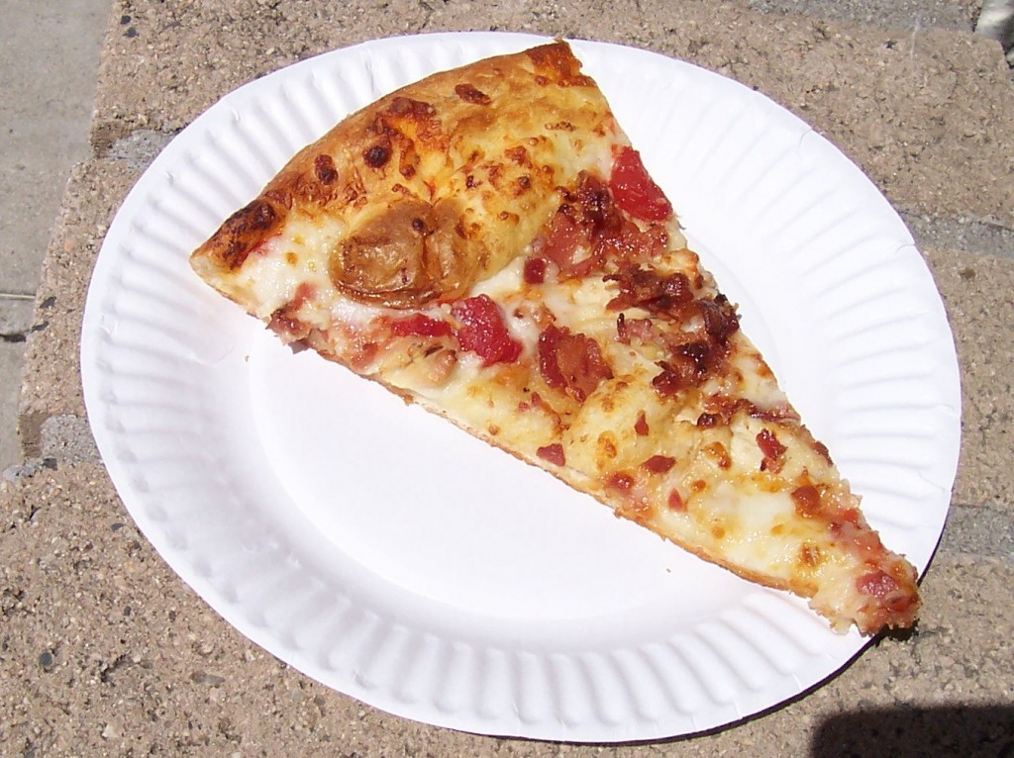
Pragmatics
Pragmatics has to do with slippery type of meaning that is not in dictionary, different from context to context. It has to do with meaning that is:
1) Non-literal 2)Context-dependent
3) Inferential 4) Non truth-conditional
The same utterance will mean different things in different context and will even mean different things to different people.
Example:
-There is one piece of pizza left
-My day was a nightmare

Slide 25
Types of Pragmatics
1) Theoretical (Anglo- American school of thought)
2) Social (European continental)

Slide 26
Theoretical Pragmatics
Theoretical pragmatics: Focuses on particular aspects of meaning and explains them with formal accounts of language use.
It is concerned with what can be communicated in general and with what people do in specific situations.

Slide 27
Social Pragmatics
Social Pragmatics: Focuses on various aspects of the relationship between language use and general social and cultural factors.

Slide 28
Sentence Vs. Utterance
Sentences are linguistic entities and any semantic description must explain them, but pragmatics rules are not part of a language. They differ between cultures and societies. An utterance is an instance of production of a sentence or a fragment of a sentence. They are incomplete sentences, but they are complete as utterance because they are created in actual contexts by actual speakers (for example advertisements).
Utterances have both linguistic and spatio-temporal characteristics.
Sentences are abstract linguistic structures. They don’t have contexts.
Sentences are grammatical, but utterances are acceptable.
This acceptability (utterance) can vary from an occasion to another but grammatically is not subject to variation.

Slide 29
Discourse Analysis Vs. Pragmatics
Pragmatics uses discourse as data and seeks to draw generalizations that have predictive power, concerning linguistic competence.
Discourse Analysis focuses on individual discourse, using the findings of pragmatic theory to see how interlocutors use and interpret language in a specific context.

Slide 30
Semantics Vs. Pragmatics
They are like two neighboring countries, the border is identified but disputed, but some people disagree with this distinction. It is wrong to think of them as discrete areas of study of meaning. It is hard to think some aspects of meanings are semantic and some others pragmatic.
It is the distinction between language usage and language use. Both are concerned with meaning.
What does X mean? What is meant by X?
In semantic, meaning is defined as a property of expressions.

