Slide 1
In the name of god
subject:fc perspolis
Arsalan saffari

Slide 2
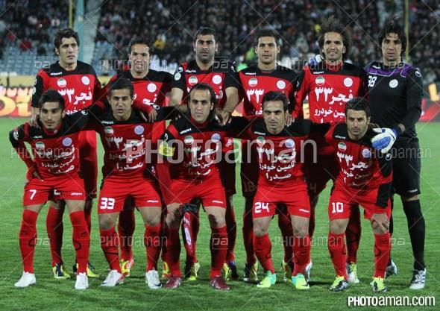
666 Fc perspolis 666
Fc prspolis in 1394&1395 have been kild
24&33
Godbay captain

Slide 3
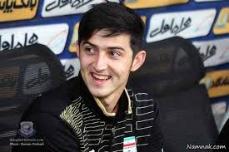
Fcperspolis now have one star in the team.
mehdi taromi
he shot 16 goals since first of the ligue.
His best friend is sardar azmoun :he play in rostof in russia
Rostof & perspolis is first in own ligue

Slide 4
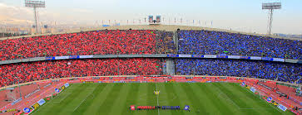
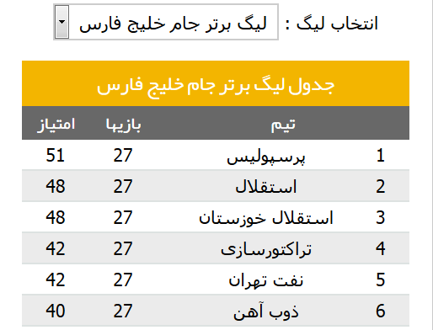
The fc perspolis has won the derbi and the this team is first of the ligue.
4
2

