Slide 1
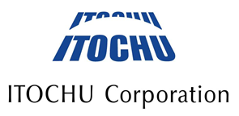
Corporate Brochure 2018

Slide 2
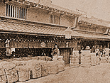
ITOCHU History
1858 ITOCHU's founder, Chubei Itoh, commenced linen trading operations. (ITOCHU Corporation founded)
1893 Chubei Itoh establishes Itoh Itomise (Thread and Yarn Store), to which ITOCHU traces its roots.
1949 C.Itoh Co., Ltd. established.
1950 The Company lists on the Osaka Securities Exchange and the Tokyo Stock Exchange.
1972 The Chinese government welcomes C. Itoh as a friendly trading company.
1977 The Company acquires Ataka & Co., Ltd., a sogo shosha involved primarily in steel-related business.
1992 The Company announces a new English name (ITOCHU Corporation) and a new corporate logo.
1997 Division Company system introduced.
ITOCHU becomes the first sogo shosha to receive environmental certificate ISO14001.
2009 The Company announces the ITOCHU Mission, Values & 5 self-tests.
2014 The Company formulated the Corporate Message, "I am One with Infinite Missions."
2015 Strategic alliance and capital participation with CITIC Limited (China) and Charoen Pokphand Group Company Limited (Thailand).
2018 The Company posted consolidated net income of over 400 billion yen.
The Company launches its new medium-term management plan
“Brand-new Deal 2020”.
Itoh Itomise (Thread and Yarn Store)

Slide 3
Corporate Profile
The history of ITOCHU Corporation dates back to 1858 when the Company's founder Chubei Itoh
commenced linen trading operations. Since then, ITOCHU has evolved and grown over 150 years.
With approximately 99 bases in 62 countries (included Japan), ITOCHU, one of the leading sogo shosha, is engaging in domestic trading, import/export, and overseas trading of various products such as textile, machinery, metals, minerals, energy, chemicals, food, general products, realty, information and communications technology, and finance, as well as business investment in Japan and overseas.
Company Name : ITOCHU Corporation
Founded : 1858
Incorporated : December 1, 1949
Representative : Masahiro Okafuji,
: Chairman & Chief Executive Officer
Headquarters : Tokyo / Osaka
Common Stock : \253.4 billion
Net profit attributable to ITOCHU : \400.3 billion (FY2018)
Number of Group Companies : 300(including overseas trading subsidiaries
Number of Employees : 4,380
（ Non-consolidated ）
Website : https://www.itochu.co.jp/en/
*As of March. 31, 2018
< TOKYO >
< OSAKA＞

Slide 4
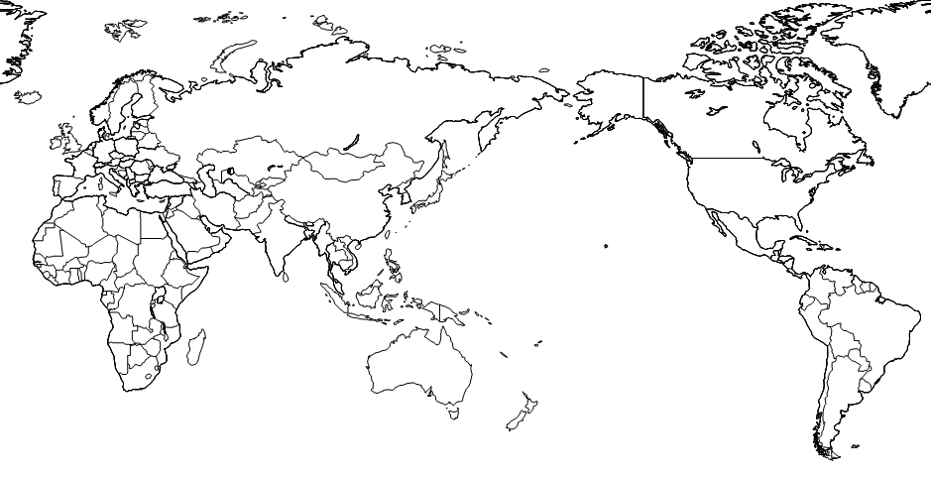
Global Network
Overseas Offices
Offices: 9 Domestic, 99 Overseas
*Number of offices (Number of countries / excluded Japan)
CIS
7 (5)
Europe
17 (15)
North America
9 (3)
East Asia
18 (4)
Africa
6 (6)
Asia &
Oceania
22 (12)
Latin America
10 (8)
Middle East
10 (9)
(Offices：As of Apr. 1, 2017)
Notes:
18/7/4 10時40分
3

Slide 5
Subsidiaries & Associates
Textile Company
- JOI‘X Corporation - SANKEI CO., LTD.
- ITOCHU Textile Prominent (ASIA) Ltd.
ITOCHU TEXTILE (CHINA) CO., LTD
Energy & Chemicals Company
ITOCHU Enex Co., Ltd.
ITOCHU CHEMICAL FRONTIER CORPORATION
ITOCHU PLASTICS INC. - C.I. TAKIRON Corporation
ITOCHU Oil Exploration (Azerbaijan) Inc.
- ITOCHU PETROLEUM CO., (SINGAPORE) PTE. LTD.
Machinery Company
- JAPAN AEROSPACE CORPORATION
- ITOCHU Construction Machinery Co., Ltd.
- ITOCHU MACHINE-TECHNOS CORPORATION
- Century Medical, Inc. - YANASE & CO., LTD.
- JAMCO Corporation - Tokyo Century Corporation
- SUNCALL CORPORATION
Food Company
- ITOCHU SHOKUHIN Co., Ltd. - NIPPON ACCESS, INC.
- Dole International Holding - Japan Foods Co., Ltd.
- FUJI OIL CO., LTD. - FamilyMart UNY Holdings Co.,Ltd.
- Prima Meat Packers, Ltd.
General Products & Realty Company
ITOCHU Kenzai Corporation - ITOCHU Pulp & Paper Corporation
- ITOCHU Property Development, Ltd.
- ITOCHU LOGISTICS CORPORATION
- European Tyre Enterprise Limited - ITOCHU FIBRE LIMITED
- DAIKEN CORPORATION
Metals & Minerals Company
ITOCHU Metals Corporation - Brazil Japan Iron Ore Corporation
- ITOCHU Minerals & Energy of Australia Pty Ltd.
- ITOCHU Coal Americas Inc. - Marubeni-Itochu Steel Inc.
ICT & Financial Business Company
- ITOCHU Techno-Solutions Corporation - CONEXIO Corporation
- ITOCHU Huji Partoners, Inc. - Bellsystem24 Holdings, Inc.
- Orient Corporation - POCKET CARD CO., LTD.
- EGUARANTEE,INC.
Overseas trading subsidiaries
ITOCHU INTERNATIONAL INC. (U.S.A.) - ITOCHU Europe PLC (U.K.) - ITOCHU (CHINA) HOLDING CO., LTD.
- ITOCHU HONG KONG LTD. - ITOCHU AUSTRALIA LTD. - Orchid Alliance Holdings Limited
- C.P. Pokphand Co. Ltd.

Slide 6
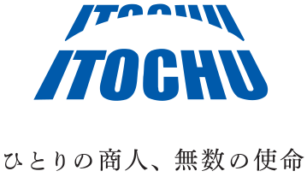
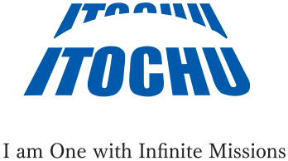
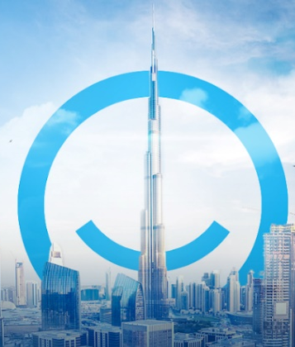
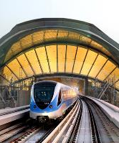
POTENTIAL SECTORS
RENEWABLE ENERGY
AI & IOT
INFRASTRUCTURE
RENEWABLE ENERGY
AI & IOT
INFRASTRUCTURE
SMART GOVERNMENTS, SEAMLESS BUSINESS, FINTECH SOLUTIONS
SECURITY, TRANSPORTATION, AND OTHERS
IPP, IWP, HYDROGEN
AI & IOT

Slide 7
PRESENT & FUTURE
WORLD’S LARGEST LNG EXPORTING COUNTRY’S NATIONAL GAS COMPANY
1 OF THE WORLDS LARGEST
OIL FIELDS
SOLE JAPANESE TRADING FIRM INVESTMENT IN IRAN, AND FIRST AFTER THE REVOLUTION*
QATAR
IRAQ
RAS LAFFAN LIQUEFIED NATURAL GAS COMPANY LTD
IRAN
CIECO
WEST QURNA 1
ASSALUYAH
HDPE PROJECT
* As of date
WORLD’S LARGEST METHANOL COMPLEX
LARGEST REVERSE OSMOSIS
PLANT IN OMAN
SAUDI ARABIA
OMAN
AL RAZI
METHANOL FACTORY
BARKA DESALINATION PLANT
EQUITY VALUE OVER
$10
BILLION
WORLD’S LARGEST
WASTE TO ENERGY PLANT
DUBAI
DUBAI
EGA
I.P.O.
WASTE TO ENERGY
Notes:
CIECO
20 BILLION BARREL RESERVES
LEAD CONTRACTOR : EXXON MOBILE
AR RAZI METHANOL FACTORY
SINCE 1979
ITOCHU 2.5% SHARE
PRODUCTION: 4.7 MILLION TONS / YEAR
WASTE to ENERGY:
LARGEST W2E Project in the WORLD
FIRST IS SHARJAH BEEAH
5,000 M/T Per Day
BARKA:
Partners: SUEZ, Engie, WJ Towell & CO
281,000 cubic meters per day
EGA:
…

