Slide 1
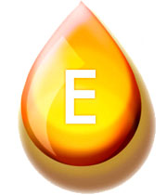
In the name of God
Vitamin E
Presented by: Mohammad Khademalhosseini
Biochemistry, Dr. Mir
Designed by:M.Khademalhosseini

Slide 2

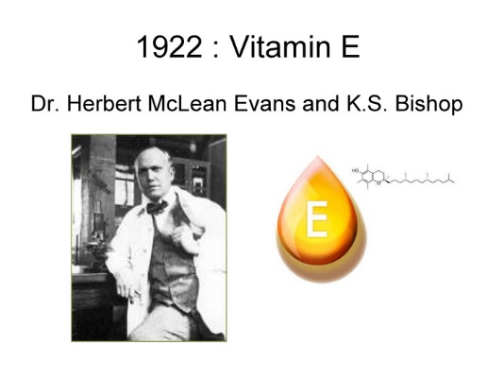

History
Vitamin E was discovered: 1922, Herbert McLean Evans and Katharine Scott Bishop
The first use for vitamin E as a therapeutic agent: 1938 by Widenbauer, who used wheat germ oil supplement on 17 premature newborn infants suffering from growth failure. Eleven of the original 17 patients recovered and were able to resume normal growth rates.

Slide 3

Forms
1- tocopherols
Vitamers
2- tocotrienols
alpha- (α-), beta- (β-), gamma- (γ-), and delta- (δ-).

Slide 4
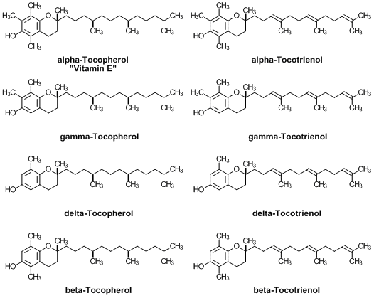
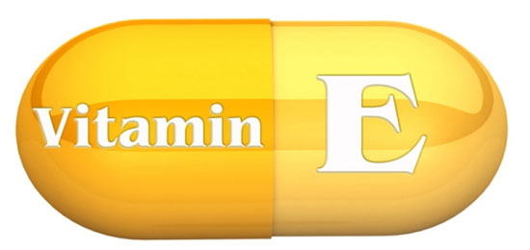

Slide 5
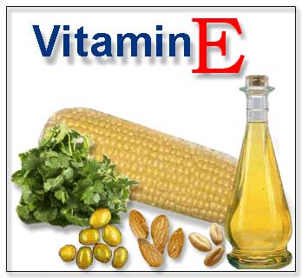

Vitamin E Is the Major Lipid-Soluble
Antioxidant in Cell Membranes
& Plasma Lipoproteins
The most common form found in the North American diet: γ-tocopherol
Sorces of γ-Tocopherol: corn oil, soybean oil, margarine, and dressings
α-tocopherol, the most biologically active form of vitamin E, is the second-most common form of vitamin E in the diet. This variant can be found most abundantly in wheat germ oil, sunflower, and safflower oils.

Slide 6

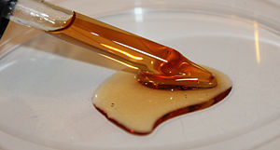
α-Tocopherol
alpha-Tocopherol is an important lipid-soluble antioxidant.
the most active is D-α-tocopherol. Synthetic DL-α-tocopherol does not have the same biologic potency as the naturally occurring compound.

Slide 7
Functions
Bestknown: antioxidant function :hence reduces the effects of aging, although clinical trials have shown that this is not the case.
Other functions: enzymatic activities, gene expression, and neurological function, inhibition of platelet coagulation, protects lipids and prevents the oxidation of polyunsaturated fatty acids
Vitamin E also increases the expression of two enzymes that suppress arachidonic acid metabolism

Slide 8
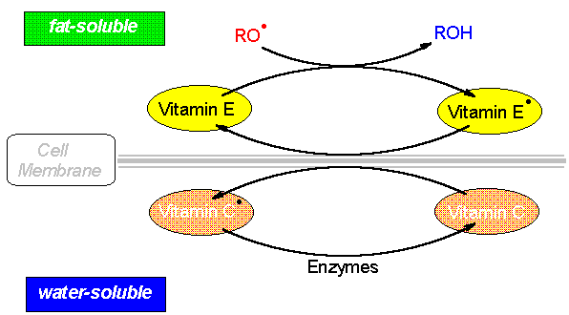
It performs its functions as antioxidant in the glutathione peroxidase pathway, and it protects cell membranes from oxidation by reacting with lipid radicals produced in the lipid peroxidation chain reaction. This would remove the free radical intermediates and prevent the oxidation reaction from continuing. The oxidized α-tocopheroxyl radicals produced in this process may be recycled back to the active reduced form through reduction by other antioxidants, such as ascorbate, retinol or ubiquinol.

Slide 9
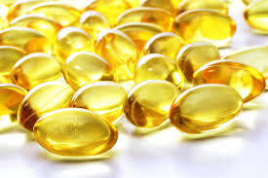
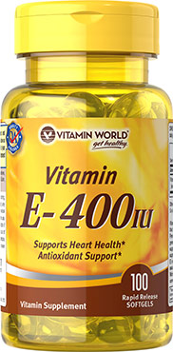
Consumption
Recommended Dietary Allowances (RDAs) for Vitamin E (Alpha-Tocopherol)
Age | Males | Females | Pregnancy | Lactation
0–6 months* | 4 mg (6 IU) | 4 mg (6 IU)
7–12 months* | 5 mg (7.5 IU) | 5 mg (7.5 IU)
1–3 years | 6 mg (9 IU) | 6 mg (9 IU)
4–8 years | 7 mg (10.4 IU) | 7 mg (10.4 IU)
9–13 years | 11 mg (16.4 IU) | 11 mg (16.4 IU)
14+ years | 15 mg (22.4 IU) | 15 mg (22.4 IU) | 15 mg (22.4 IU) | 19 mg (28.4 IU)
*Adequate Intake (AI)
Sources of Vitamin E

Slide 10
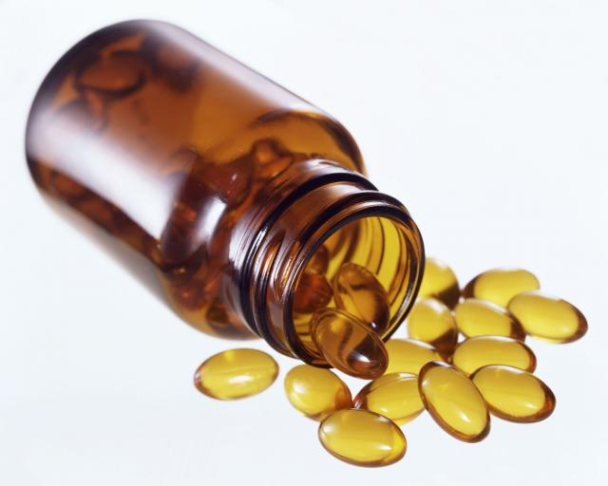
Toxicities
Regular consumption of more than 1,000 mg (1,500 IU) of tocopherols per day may be expected to cause hypervitaminosis E, with an associated risk of vitamin K deficiency and consequently of bleeding problems.

Slide 11
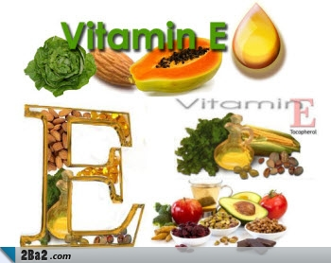
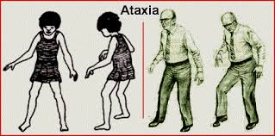
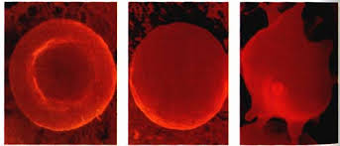

Deficiency
In experimental animals: resorption of fetuses and
testicular atrophy.
ataxia
myopathies
peripheral neuropathy
retinopathy
impairment of the immune response
red blood cell destruction (esp. in Premature infants) hemolytic anemia
Atherosclerosis

Slide 12
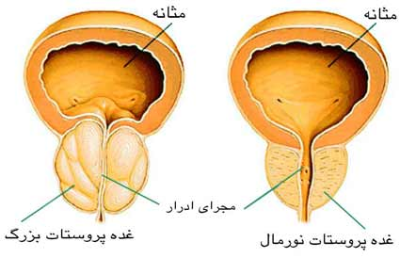
Clinical applications
Vitamin E and its analogs are used to prevent and repair cell and tissue damage during radiation therapy.
The use of vitamin E in the treatment of some cancers is beneficial. Treatment with 400 IU/day are associated with a 71% decrease in the risk of advanced prostate cancer.

Slide 13


References
Harpers illustrated Biochemistry
Devlin Biochemistry
https:// Wikipedia.org
https:// Webmd.com
https://ods.od.nih.gov (U.S. Department of Health & Human Services)

Slide 14

Thanks for your attention

