Slide 1
The name of God
LESSON3
FESTIVALS AND
CEREMONIES

Slide 2
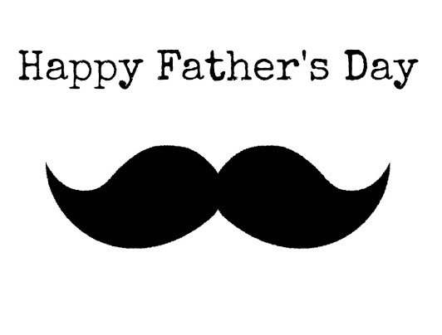
father's Day
Father's Day is a day to celebrate fathers. In many countries, Father's Day, the third Sunday of June Shdhast.dr considered pre-revolutionary Iran, Reza Shah on 24 Esfand Birthday Father's Day was called on the Iranian calendar days after the Islamic Revolution Imam Ali ibn Abi Talib birthday (as ) get changed.

Slide 3
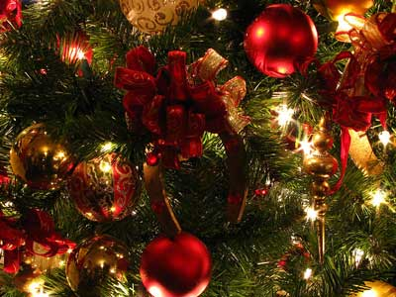
What is Christmas?
Christmas (in English:
Christmas) or clause.
(in French: Noël) is the name of the festival, celebrating the birth of Christ in the Christian faith to be held. Many members of the Roman Catholic Church and followers of Protestantism, Christmas is celebrated
on December 25 and many hold it on the evening of December 24.

Slide 4
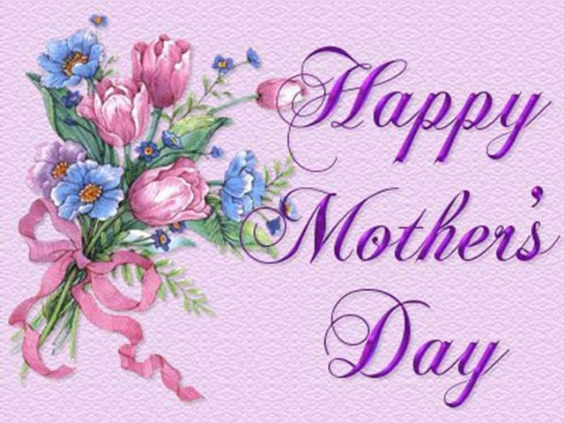
Women's Day
The most obvious horizon victory She is the brightest horizon victory, the most glorious crowning achievement is the highest peak of triumph is if your actual position, if at the height of arrogance and kindness October this year, if in the midst of your pain does not get tired, leave their say, as it is to believe and to know the wonders of creation, the brightest horizon victory.

Slide 5
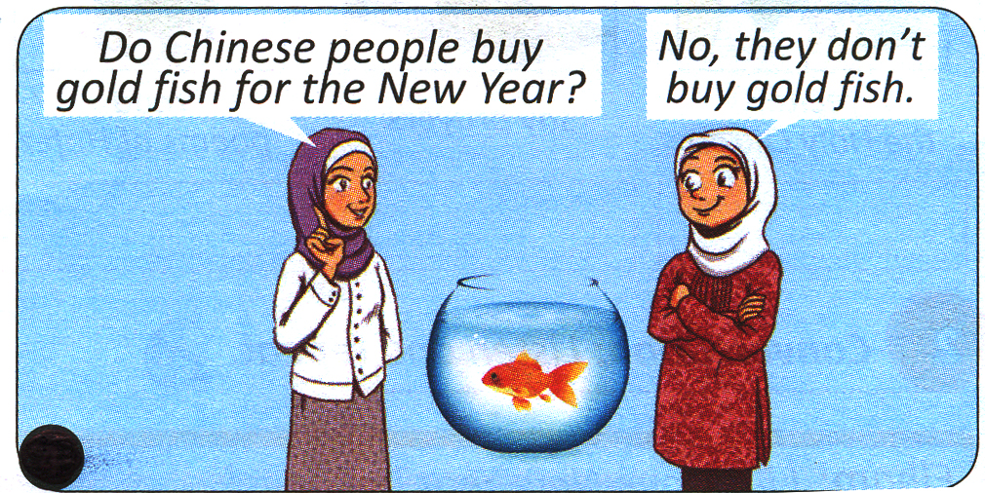
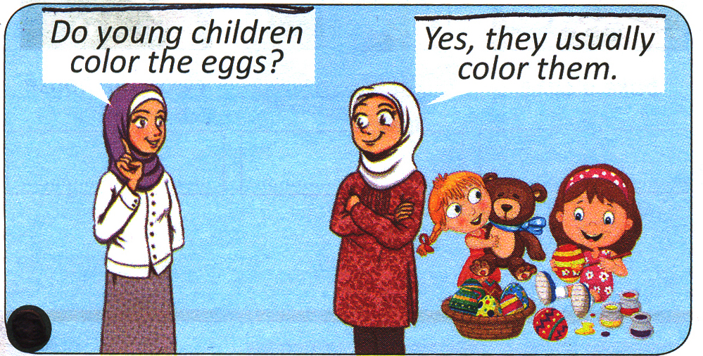

Slide 6
