Slide 1
Improving outcomes of infections in the era of CFTR modulators
Hossein Sadeghi, M.D. Columbia University Medical Center Director, Sue & John L. Weinberg Cystic Fibrosis Center

Slide 2
Objectives for today’s Session
Identify ongoing challenges in the treatment of infections in people with CF and discuss the potential impact of CFTR modulators on infections
Update you on the results of ongoing work to improve our understanding of CF microorganisms including detection, diagnosis, and optimal treatment
Discuss current strategies that will result in the new anti-infective therapies of tomorrow

Slide 3
Identify ongoing challenges in the treatment of infections in people with CF and discuss the potential impact of CFTR modulators on infections

Slide 4
Different microorganisms are problematic in different age groups

Slide 5
Patient : CC
17 year old Male
CF with Pancreatic Insufficiency
Sweat Chloride – 115, 118
CFTR – G542X, N1303K
Moderate persistent asthma

Slide 6
CF Medications & Supplements
Albuterol – 3 to 4x a day
Hypertonic Saline 7% - 2x a day
Pulmozyme (2.5mg) – x1 a day
Chest PT 3-4x a day (exercise x1 a day)
Colistin neb (every other month)
Creon supplementation
ADEK vitamin + Vit D and E suppl.
Ensure shakes
Flonase nasal spray
Symbicort inhaler (80/4.5)
Spiriva inhalation 1.25 mcg

Slide 7
Weight vs Time
Lung Function vs Time

Slide 8
Nontuberculous mycobacteria (NTM) is increasing

Slide 9
M. abscessus as common as M. avium through young adulthood

Slide 10
What questions are emerging for treating infections in the era of CFTR modulators?
What will happen to microbiology among individuals with:
established lung disease already infected
less severe lung disease and positive cultures
without documented infections
Some individuals may not tolerate or respond to existing modulators.
All need monitoring of microbiology to guide treatment.
We still need antimicrobials!!!

Slide 11
What does the future look like?
Ivacaftor is highly effective for responsive mutations
Lumicaftor/iva & Tezacaftor/iva provide therapy for ~50% of individuals with CF (∆F∆F and ∆F other)
Trikafta (Elexacaftor/Tezacaftor/iva) is highly effective for people with only one ∆F
Strategies for rare mutations underway
New cases remain constant: e.g., ~900 cases /year in U.S.
People with CF will be living longer than ever before

Slide 12
Modulator Therapy is Predicted to Dramatically Change the Course of CF
For people with mutations that do not respond to modulators, prevention of complications is critical.
Nearly 40% of people on modulators will continue to need treatment for complications.
Treating and preventing CF complications remain among the highest priorities for the CF community
Treatment for respiratory infections is a great concern
Inflammation remains the major cause of lung damage

Slide 13
Effect of CFTR modulators on population health
68% Adults
61%
57%
52% Adults
Continued need
Advanced disease/
lung transplant
Some decline in lung function
Healthy
End of 2016 | ~5 year vision | ~10 year vision | ~20 year vision
Note: Healthy = FEV1 >90%, Moderate =FEV1 40-90%, and Advanced disease =FEV1 <40%
Source: Revised Model for July 2018 CFF Medical Strategy Retreat

Slide 14
What have we learned so far about the impact of CFTR modulators on CF microbiology?

Slide 15
Restoring CFTR function associated with decreased P. aeruginosa
Participants > 6 years old
G551D mutation
Decreased P. aeruginosa
6 months
12 months
p < 0.001
P. aeruginosa detected
Ivacaftor
started
Rowe SM et al. Am J Respir Crit Care Med. 2014 ;190(2):175-84

Slide 16
Restoring CFTR function associated with other microbiology changes
Decreased P. aeruginosa,
mucoid P. aeruginosa, and Aspergillus
Increased H. influenzae
Heltshe SL, et al Clin Infect Dis 2015; 60(5):703–12

Slide 17
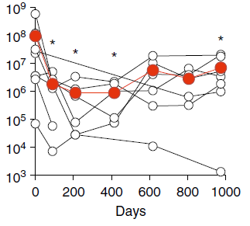
Restoring CFTR function associated with decreased density of P. aeruginosa -> rebounded within 2 years
Adult participants
G551D
8/12 chronic P. aeruginosa
Initially density decreased
Rebounded within 2 years
Hisert KB et al. Am J Resp Crit Care Med 2017;195:1617-28.

Slide 18
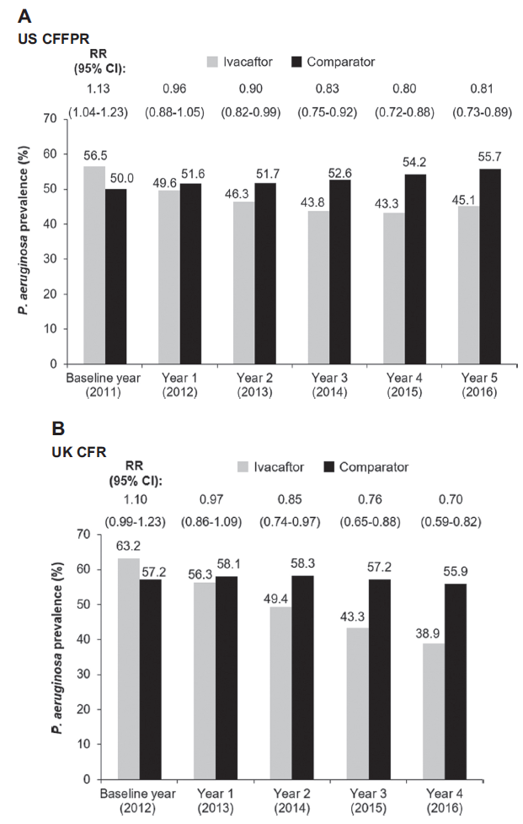
Restoring CFTR function associated with decline in Pseudomonas Prevalence
Observational safety study using registry data to assess disease progression in ‘the real-world’
Pseudomonas decreased in those treated with ivacaftor and increased in comparator group
Mechanism of action unclear
ivacaftor-mediated increases in mucociliary clearance
immunologic involvement
Other mechanisms?
N. Volkova, K. Moy, J. Evans, et al. https://doi.org/10.1016/j.jcf.2019.05.015

Slide 19
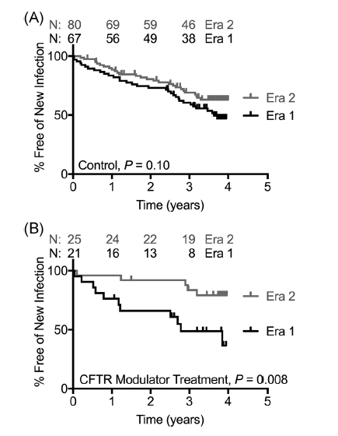
Restoring CFTR function associated with fewer new infections with CF Pathogens
Time to new infection compared: 2008-11 (pre-CFTR modulators vs. 2012-15
Group A –no modulators; Group B– modulators
Composite endpoint: new infection with MSSA, MRSA, and/or Pseudomonas
 | 2008-2011 | 2012-2015 | P | CI 95%
Group A | 49% | 34% | 0.06 | 0.53 (0.27-1.04)
Group B | 52% | 29% | 0.02 | 0.23 (0.06-0.78)
Singh SB et al, Pediatric Pulmonology. 2019;54:1200–1208
Notes:
(2012- ivacaftor, 2015 – lumacaftor/ivacactor)

Slide 20
Prioritization Survey of Research Topics
Notes:
From the CF Community Survey: Which of the following research topics should be prioritized?

Slide 21
Update you on the results of ongoing work to improve our understanding of CF microorganisms including detection, diagnosis, and optimal treatment

Slide 22
Natural History of Acquisition of Pseudomonas aeruginosa
Mucoid P. aeruginosa
2nd Pa +
culture
Persistently Pa + cultures
Birth
1st Pa + culture
Pa negative culture
Intermittent infection
Chronic infection
Eradication
Pulmonary Exacerbations
Chronic Suppressive Therapy
Notes:
Our understanding of Pseudomonas has been expanding. We were learning about when it appeared and its different growth characteristics and how to address these differences with therapeutic strategies like early eradication and chronic suppressive therapy
This figure illustrates the natural history of acquisition of Pseudomonas aeruginosa. First acquisition of Pseudomonas occurs during infancy and early childhood. This can be intermittent as follow-up cultures can be negative. Unfortunately, with time, cultures become persistently positive for this pathogen and chronic infection is established. Initial infection occurs with non-mucoid Pseudomonas and after years of chronic infection, mucoid strains predominate.
Over the past several years, it has been increasingly appreciated that CF pathogens exist in biofilms. Initially, we believe that Pseudomonas attach within the respiratory tract using pili and other adhesins. Attached bacteria then grow first as microcolonies and ultimately to mature biofilms consisting of a community of bacteria embedded within an extracellular matrix. Such bacteria communicate to each other by quorum sensing and are physiologically resistant to conventional antibiotics. Thus, biofilms are likely to become a potential target for new antibiotics.
There are different indications for antibiotic treatment during the natural history of CF. Antibiotics can be used during early infection in efforts to eradicate pathogens. Antibiotics are used to treat pulmonary exacerbations, and antibiotics can be used as chronic suppressive therapy in efforts to improve lung function and potentially to slow the decline in lung function and reduce the incidence of pulmonary exacerbations.

Slide 23
CF lung is a complex microbial ecology
Unique growth conditions, available nutrients and metabolism can affect the activity of antibiotics
These interactions may impact progression of CF, response to therapy and clinical outcomes
P. aeruginosa biofilm enhanced by RSV co-infection. What is the proposed mechanisms:
Dysregulation of host immunity
Normally, host sequesters iron
RSV infection: induces release of iron-bound transferrin by airway epithelial cells mediated by interferon (IFN)
More iron -> increased biofilm growth
Hendricks MR et al. Prot Nat Acad Sci 2016;113:1642-7
Notes:
Work from Jennifer Bomberger’s lab
Nutrient iron is tightly regulated in the host through
complex interactions among uptake, storage, and use in the cell.
Nutritional immunity postulates that, because iron is required for
microbial growth, respiration, and metabolism, the host employs
many regulatory pathways to sequester free iron (14). InCF, elevated
levels of iron in the airways of infected patients are correlated with
frequency of exacerbation and have been proposed to play a role in
airway colonization

Slide 24
Optimizing Current Treatments
Notes:
It needs cooperation of parents and patients.
Agreement-based care.

Slide 25
THE OPTIMIZE Trial
Add azithromycin to inhaled tobramycin
Reduce exacerbations in children undergoing eradication of P. aeruginosa
Azithromycin group
44% reduction in exacerbations
1.27 kg weight gain
No impact on microbiology
Mayer-Hamblett N et al. Am J Resp Crit Care Med June 11 2018

Slide 26
STOP2 Trial: IV Antibiotic Treatment Duration Based on Early Response
Everyone in trial starts here
V3
Early responders
V3
Primary Endpoint: Improvement in FEV₁
at 2 weeks after
end of treatment
V1
V2
V3
Delayed responders
V3
D0
D7
D14
D21
D28
D35
Notes:
Another such study at our center that focuses on the duration of IV antibiotic therapy during pulmonary exacerbation.
STOP 2 prospectively compares different IV antibiotic treatment durations
Treatment duration was a high priority in PEx management based on the authors’ survey of CF physicians, patients/caregivers asking them to rank current interest in the items in table on the left

Slide 27
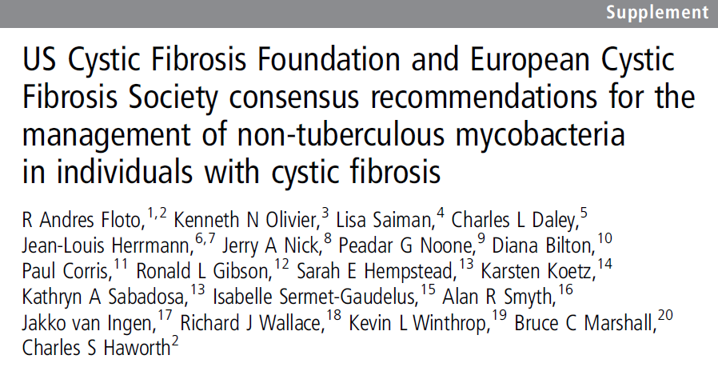
Improving the Management of NTM (PREDICT AND PATIENCE studies)
Clinical observations
NTM can be transient
Remain indolent
Accelerate progression of lung disease
International effort to write and disseminate diagnostic and treatment consensus guidelines

Slide 28
Prospective Evaluation of NTM Disease in Cystic Fibrosis (PREDICT Study) – Preliminary Conclusions
42% of PREDICT subjects met criteria for NTM disease after median of 5 months
Participants diagnosed with NTM disease had:
Significantly lower FEV₁ at enrollment
Significant and rapid decline in FEV₁
More frequent constitutional symptoms, severe exacerbations, and acute decline in BMI

Slide 29
Prospective Algorithm for Treatment of NTM in Cystic Frobsis (PATIENCE)
Inclusion Criteria:
Age > 7 years
MAC or M. abscessus
Judgment of CF physician that person with CF may benefit
Person with CF and/or parent agrees with proposed treatment
Preliminary conclusion:
Improved culture conversion rates (compared to historic rates) may in part be due to optimizing CF care first (PREDICT).

Slide 30
These studies provide framework for future investigations
Standardize approach to diagnosing different disease-causing microorganisms
Serve as comparator arm for investigating new treatment approaches

Slide 31
Evaluating Long-Term Antimicrobial Use
Important to revisit long term impact of drugs we use chronically
Inadvertent drug interactions, intolerance, toxicity
Only target single microorganisms, but may impact other microorganisms
Could improve care through improving personalized medicine
Notes:
Work from Jennifer Bomberger’s lab
Nutrient iron is tightly regulated in the host through
complex interactions among uptake, storage, and use in the cell.
Nutritional immunity postulates that, because iron is required for
microbial growth, respiration, and metabolism, the host employs
many regulatory pathways to sequester free iron (14). InCF, elevated
levels of iron in the airways of infected patients are correlated with
frequency of exacerbation and have been proposed to play a role in
airway colonization

Slide 32
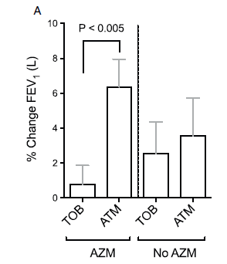
Is there antagonism between azithromycin and tobramycin?
Secondary analysis of clinical trial
Participants on tobramycin + azithromycin had less improvement in lung function than those on inhaled aztreonam + azithromycin
Biologic plausibility for antagonism
Azithromycin upregulated MexXY efflux pump
This is the central mechanism of inducible aminoglycoside resistance.
Both Aminoglycosides and macrolide antibiotics target the bacterial ribosome. This overlap can lessen the antimicrobial effectiveness of tobramycin.
Need for clinical trial: Testing the Effect of Adding CHronic Azithromycin to Inhaled Tobramycin: TEACH trial
Nichols DP et al. J Cyst Fibrosis. 2017 May;16(3):358-366.
Notes:
Azithromycin when combined with Tobramycin greatly increased gene expression of a Pseudomonas efflux pump, MexXY, which is a central mechanism of inducible aminoglycoside resistance.
Both Aminoglycosides and macrolide antibiotics target the bacterial ribosome. Overlap in the bacterial response to ribosomal perturbation from each antibiotics may explain how chronic azithromycin can lessen the antimicrobial effectiveness of tobramycin.

Slide 33
Current strategies that will result in the new anti-infective therapies of tomorrow

Slide 34
What are some approaches to developing new therapies?
Alter existing agents to become inhaled agents
Inhaled itraconazole for ABPA
Inhaled vancomycin for MRSA
Repurpose drugs used for non-infectious conditions with unique mechanisms of action
Gallium for Pseudomonas and others – replaces Fe in bacteria
Ca-EDTA for several pathogens and biofilms – sequesters Mg, Ca, Zinc, Fe
Inhaled NO for Pseudomonas and NTM – smooth muscle relaxant
GM-CSF for NTM – stimulates WBC production

Slide 35
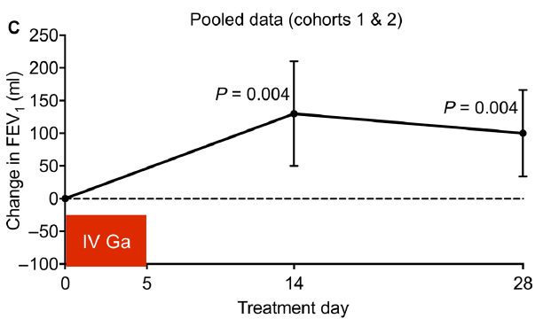
Mechanism of Action for Gallium
Bacteria use iron for DNA synthesis, oxidative stress response, other metabolic functions
Gallium and iron are same size (ionic radius)
Fool bacteria to use Gallium instead of iron
Proof-of-concept Phase 1b Study
20 adults with CF and chronic Pseudomonas
Improved lung function that persisted
Goss et al., Sci. Transl. Med. Sept 28 2018

Slide 36
What are future questions for treating infections with increasing access to CFTR modulators?
If CFTR modulators are used prior to infection:
Will people remain infection-free?
Will infections occur later?
Will emerging pathogens become problematic?
Our current treatment paradigms may change.

Slide 37
Study Design, Objectives, Population
2 year prospective observational study of short- and long-term clinical effectiveness of next generation modulators
Objectives:
Impact on lung function, sweat Cl⁻, symptoms, BMI
Focused sub-studies, e.g., microbiology, inflammation, gastrointestinal issues
Biobank for future studies

Slide 38
Please do NOT forget the basics of infection control guidelines

Slide 39
Infection Control Guidelines
Contact precautions for all CF patients regardless of pathogen status
Mask use by patients in common areas in health care settings
A minimum 6-foot distance between patients
Auditing the cleaning and disinfection of environmental surfaces
PFTs should be performed in one of the following settings:
In the exam room at the beginning of the clinic visit
In a negative-pressure room
In a PFT lab with either portable or integrated high-efficiency portable air filters (HEPA)
In a PFT lab without HEPA filtration, allowing 30 minutes to elapse before the next patient with CF enters the PFT lab.
Saiman L, et al. Infection Prevention and Control Guidelines for Cystic Fibrosis: 2013 Update. Infection Control Hosp Epidemiol. 2014 Aug;35 Suppl 1:S1-S67.

Slide 40
Only one person with CF should attend any camp or educational retreat

Slide 41
IP & C Guidelines
Inpatient Setting
Outpatient Setting
Placement in a single-patient room
Handheld disposable nebulizers:
After each use, rinse out residual volume with sterile water and wipe the mask or mouthpiece with an alcohol pad
Discard the nebulizer every 24 hours
Mask use by patients in common areas in health care settings
Minimize time in common areas of CF clinic:
Use staggered clinic schedules to minimize time in common waiting areas
Place patients with CF immediately into an exam room
Use a pager system to alert people with CF that an exam room is available
Keep patients with CF in their exam room while the care team rotates into the room
Saiman L, et al. Infection Prevention and Control Guidelines for Cystic Fibrosis: 2013 Update. Infection Control Hosp Epidemiol. 2014 Aug;35 Suppl 1:S1-S67.

Slide 42
CF is life time of care
Delivery of this integrated care allows patients with CF enjoy normal lives
CF = Cure Found for all patients

