Slide 1

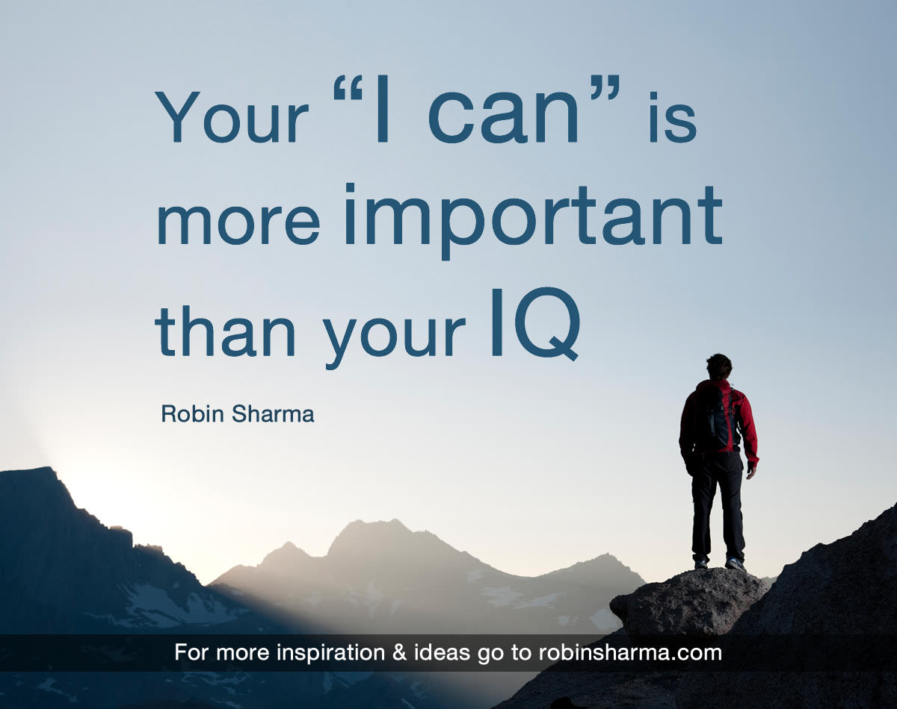
My

Slide 2
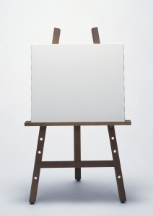
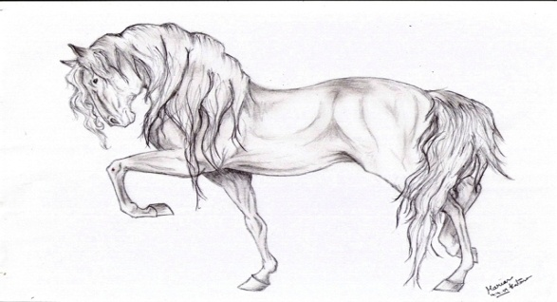
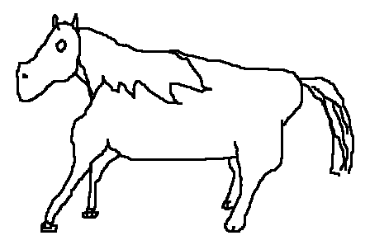
Is he/she good at drawing?

Slide 3
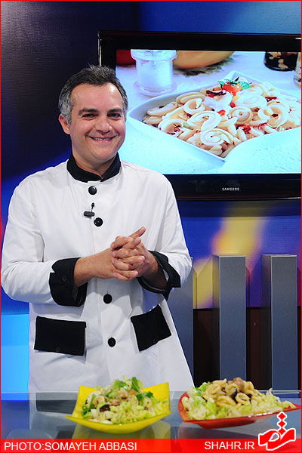
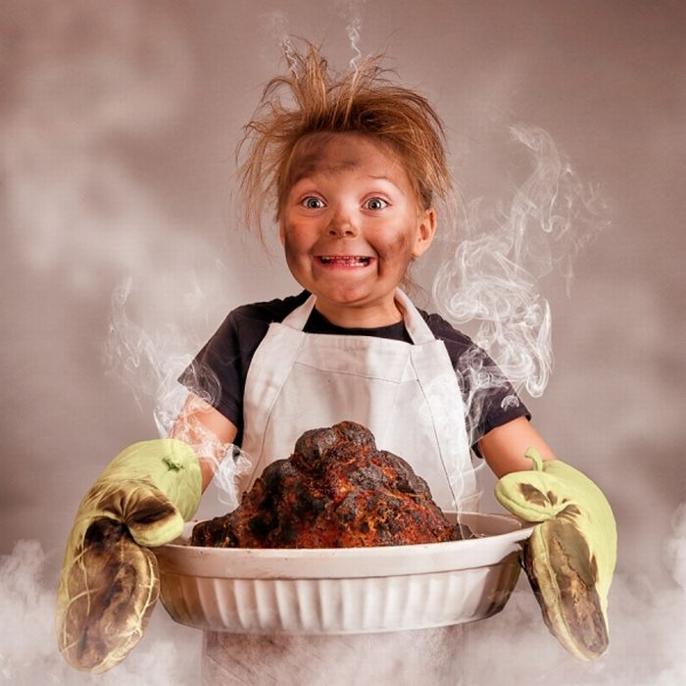
Is he/she good at cooking?

Slide 4
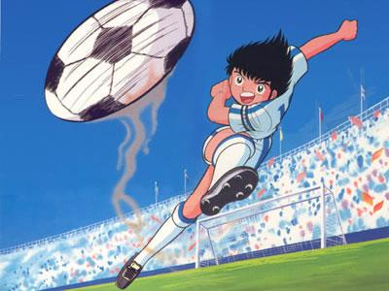
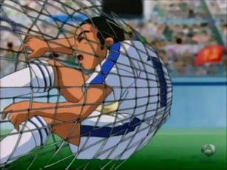
Is he good at playing football?

Slide 5



Is he/she good at searching web?

Slide 6
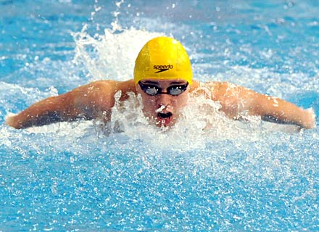
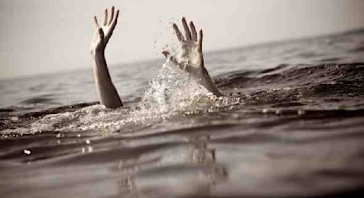
Is he/she good at swimming?

Slide 7
What about you?
Are you good at…..?

Slide 8
Can you …?
make a cake
ride a bicycle
search the web
Play basketball
do a puzzle

Slide 9
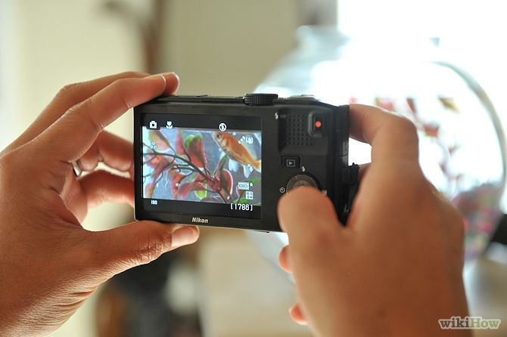

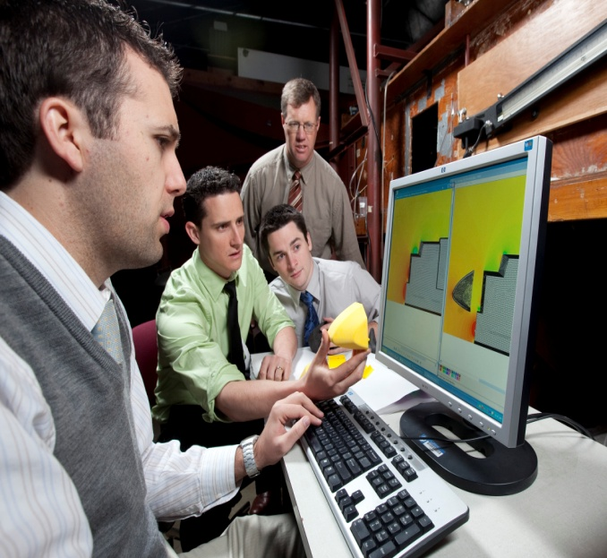
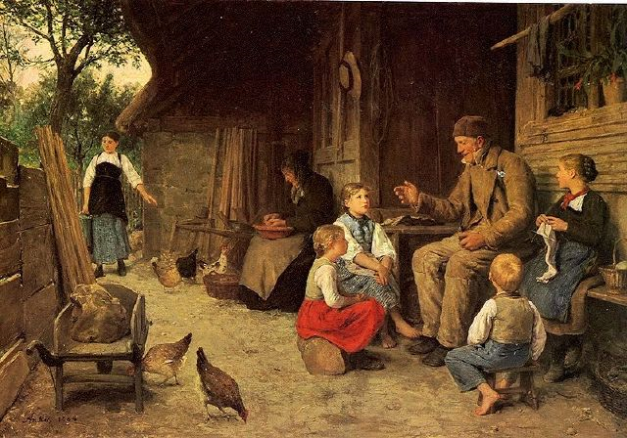
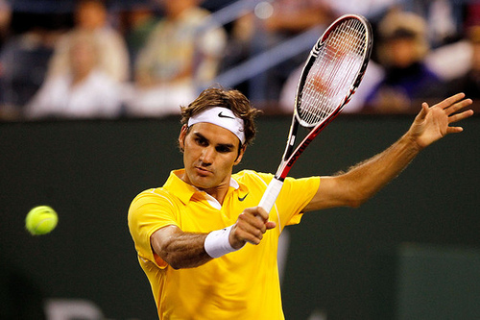
Who can……..?
Who is good at……..?

Slide 10
Let’s Play Guess what?
He is good at ………. .

Slide 11
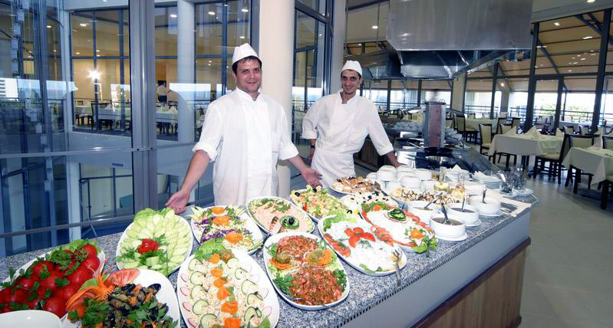
Let’s Play Guess what?
He is good at ………. .

Slide 12
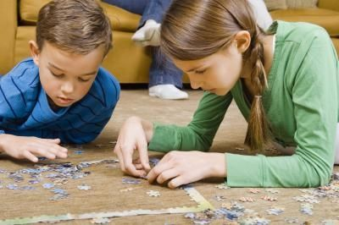
Let’s Play Guess what?
He is good at ………. .

Slide 13
Let’s Play Guess what?
He is good at ………. .

