Slide 1
Android Programming
By Mohsen Biglari
Part1: Introduction

Slide 2
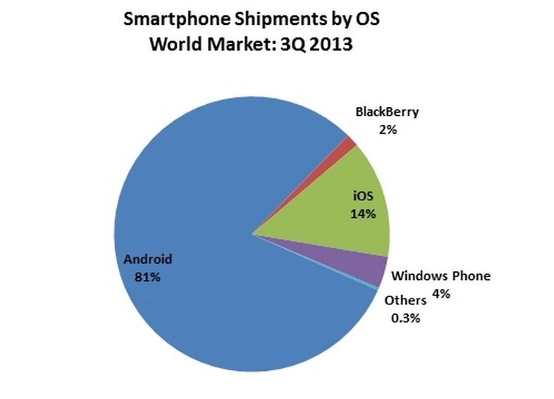

Slide 3
Why use Linux for a phone?
Linux kernel is a proven core platform
Reliability is more important than performance when it comes to a mobile phone, because voice communication is the primary use of a phone
Linux provides a hardware abstraction layer, letting the upper levels remain unchanged despite changes in the underlying hardware
As new accessories appear on the market, drivers can be written at the Linux level to provide support, just as on other Linux platforms

Slide 4
Dalvik Virtual Machine
User applications, as well as core Android applications, are written in Java programming language and are compiled into byte codes
Android byte codes are interpreted at runtime by a processor known as the Dalvik Virtual Machine.
Dalvik VM is optimized to run on slow-CPU, low-RAM, low-power devices

Slide 5
Android Programming
Android uses a customized version of Java
Primarily Java 5, some Java 6 and 7
Inner Classes, Event Handlers, …
Other languages:
Python
Phonegap: HTML 5, JavaScript, CSS
Xamarin technology: C# by mono
…

Slide 6
Android Components
Application Framework Enabling reuse and replacement of components
Dalvik Virtual Machine optimized for mobile devices
Integrated Browser Based on the open source WebKit engine
Optimized Graphics Powered by a custom 2D graphics library; 3D graphics based on the OpenGL ES specification
SQLite for structured data storage
Media support for common audio, video, and still image formats
GSM Telephony (hardware dependent)
Bluetooth, EDGE, 3G, 4G, and Wi-Fi (hardware dependent)
Camera, GPS, compass, and accelerometer (hardware dependent)
Rich development environment including a device emulator, tools for debugging, memory and performance profiling

Slide 7
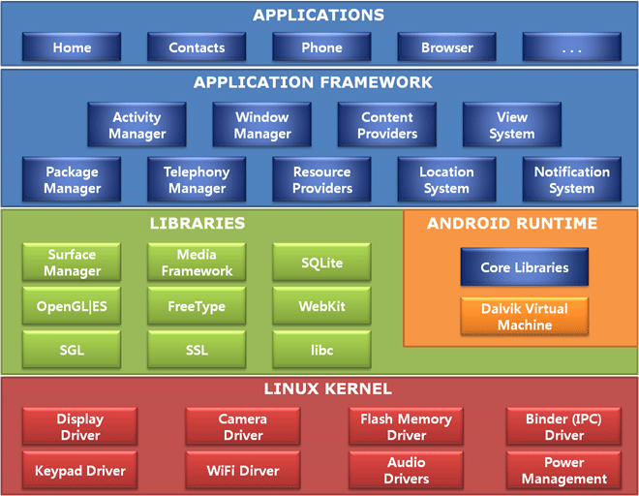

Slide 8
Tools
JDK (Java Development Kit)
http://www.oracle.com/technetwork/java/javase/downloads/jdk8-downloads-2133151.html
Android SDK (Software Development Kit)
http://developer.android.com/sdk/index.html
ADT (Android Development Tools)
Eclipse Plug-in!
Android Studio
Google official IDE
+ HAXM (Hardware Accelerated Execution Manager)

Slide 9
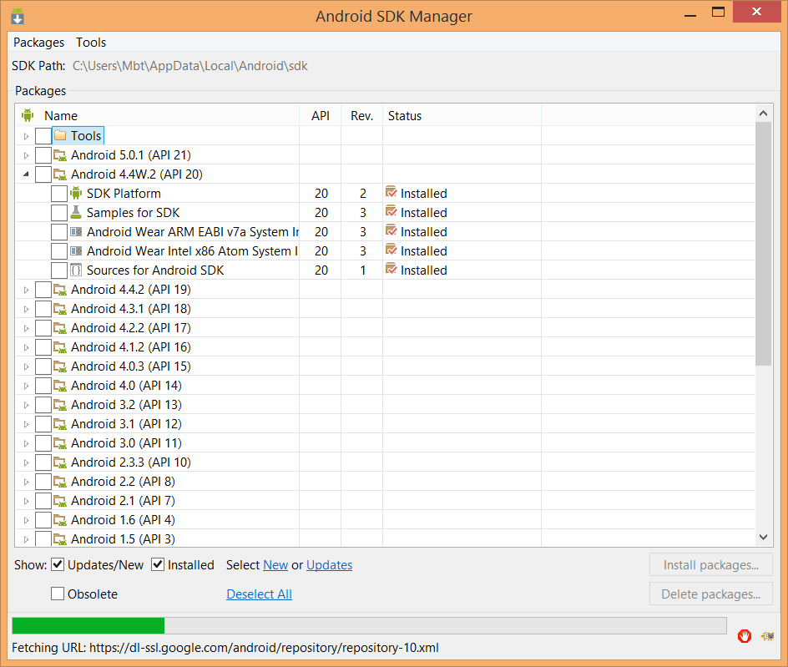
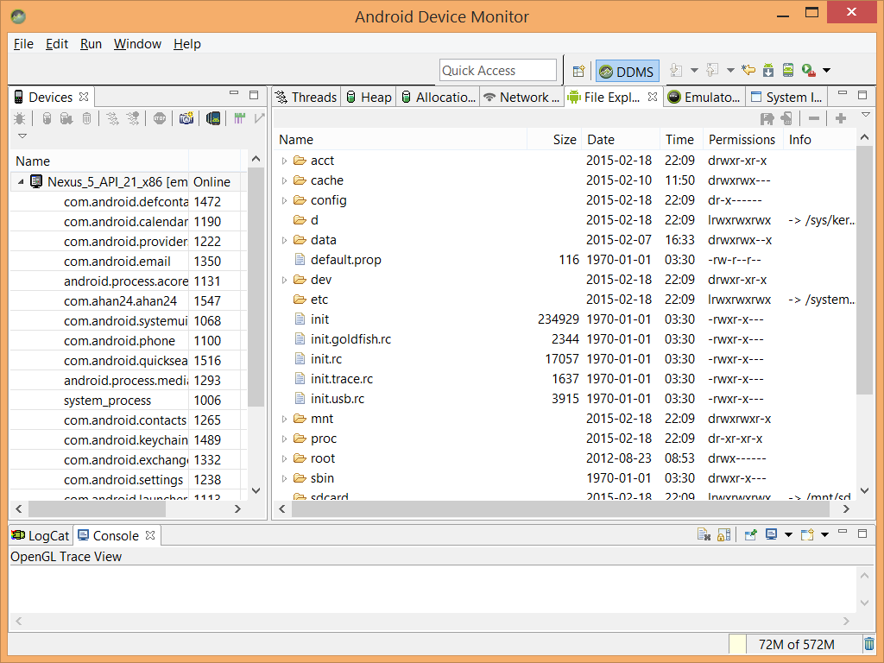
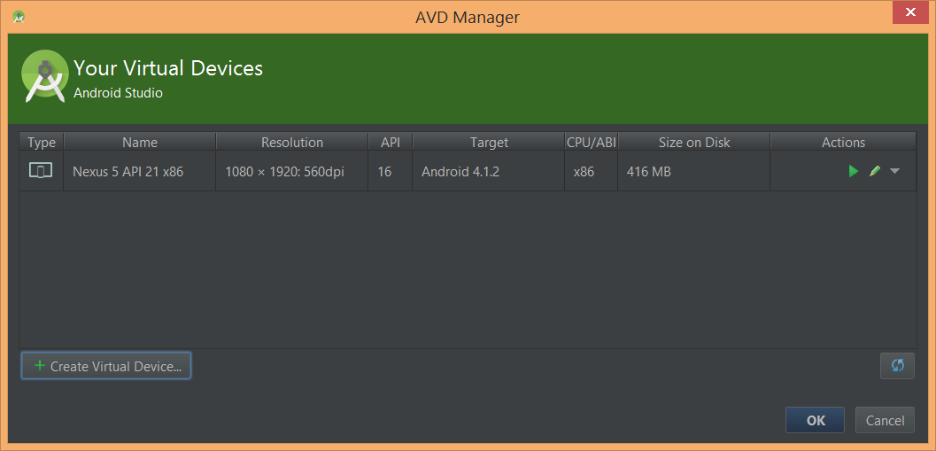
Android SDK
Includes development tools, emulator, required libraries, sample projects, …
SDK Manager
AVD Manager (Virtual Device Manager)
Device Monitor

Slide 10
Android Studio
Android Studio is the official IDE for Android application development, based on IntelliJ IDEA
Gradle-based build system
Eclipse Ant is replaces with Android Gradle
Several settings from manifest file have been moved to build.gradle: versions, API min/max, …
One project at a time
There is no workspace like eclipse
Projects (components and libraries) are replaced with a new concept called “Modules” and “Library Modules”
Each module has it’s own Gradle build file
ProGuard and app-signing capabilities

Slide 11
Android SDK
Build-tools: tools for compiling, signing, …
Platforms: core libraries for different android versions
Platform-tools: contains adb
System-images: emulators core
Tools: some useful tools like emulator itself and …

Slide 12
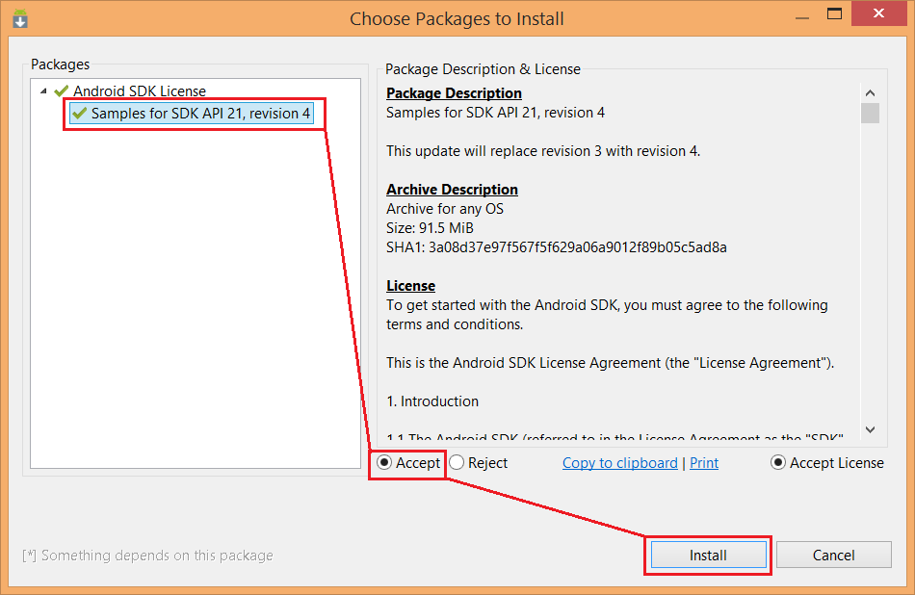
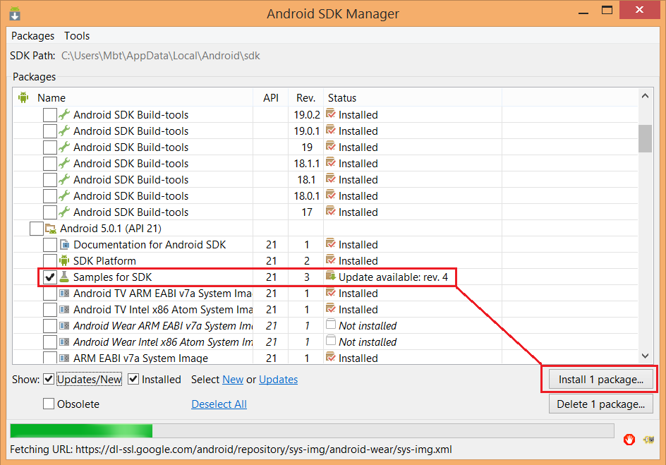
SDK Manager

Slide 13
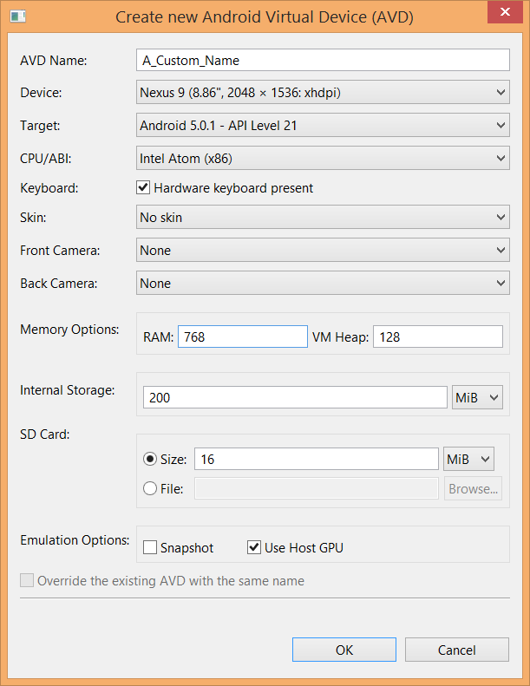
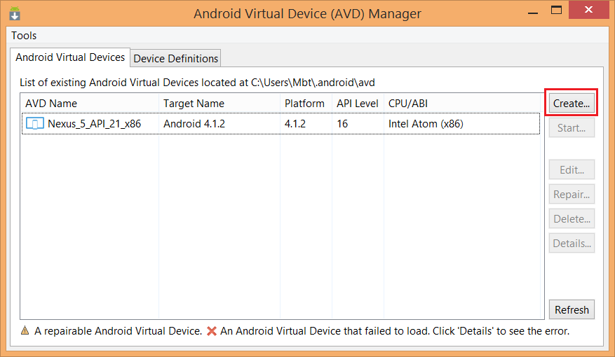
AVD Manager

Slide 14
Manifest File
Manifest file is a resource file which contains all the details needed by the android system about the application
It is like a bridge between the android developer and the android platform
It is an xml file which must be named as AndroidManifest.xml
It contains package name, version, min/max api version, permissions, features (camera, …), windows, services, …

