Slide 1
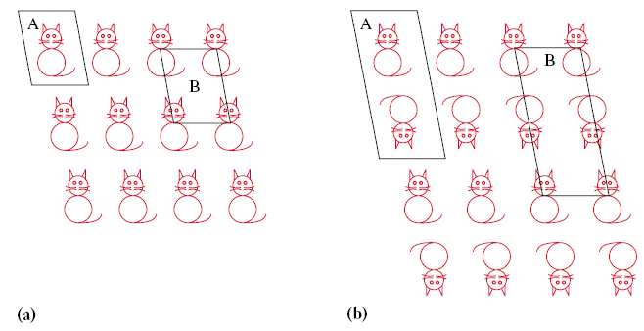
The Concept of a Unit Cell

Slide 2
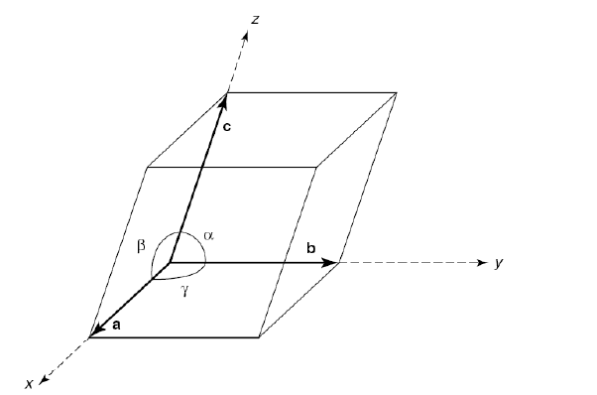

Slide 3
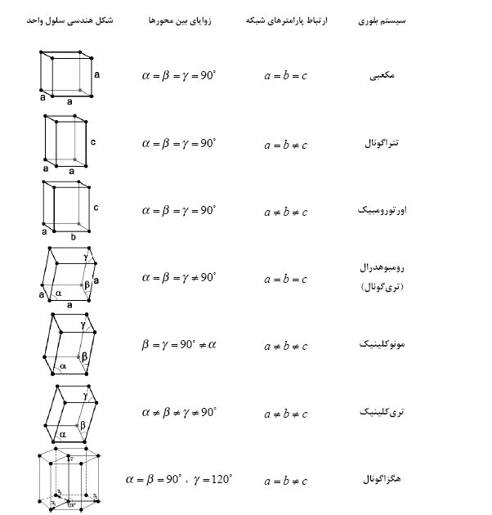

Slide 4
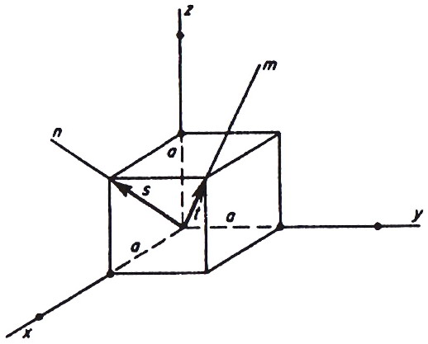
An Example of Miller Indices for a Direction
[111]
[101]

Slide 5
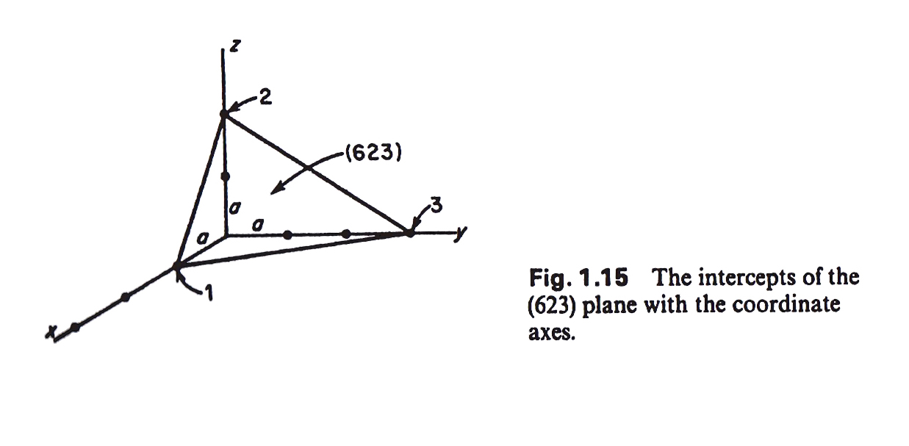
An Example of Miller Indices for a Plane

Slide 6
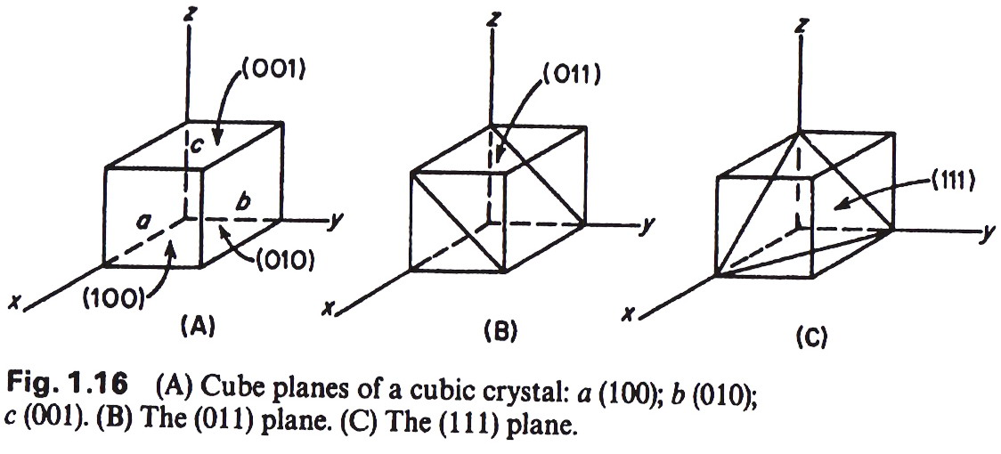
An Example of Miller Indices for a Plane
Octahedral Plane

Slide 7
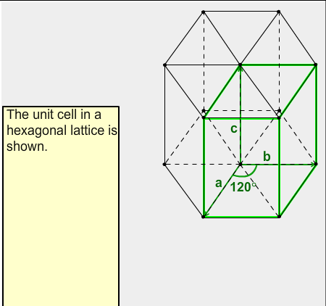
Miller Indices in Hexagonal Systems

Slide 8
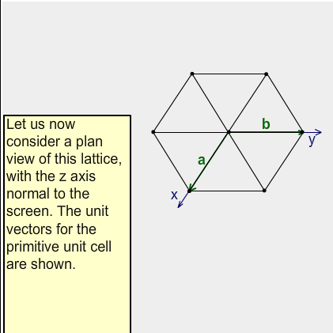
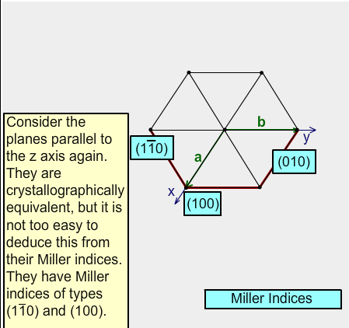
Miller Indices in Hexagonal Systems

Slide 9
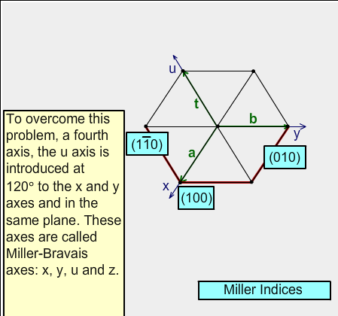
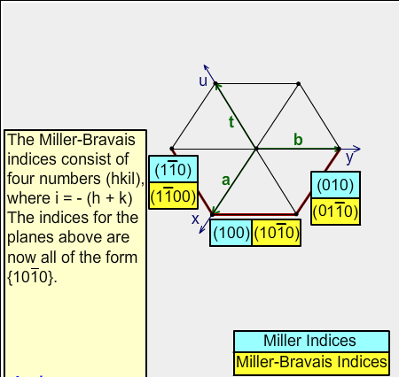
Miller Indices in Hexagonal Systems

Slide 10
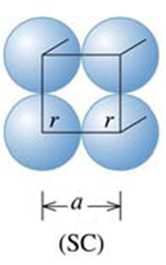
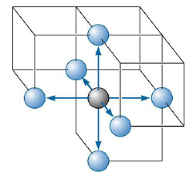
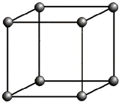
Simple Cubic (SC) Structure

Slide 11
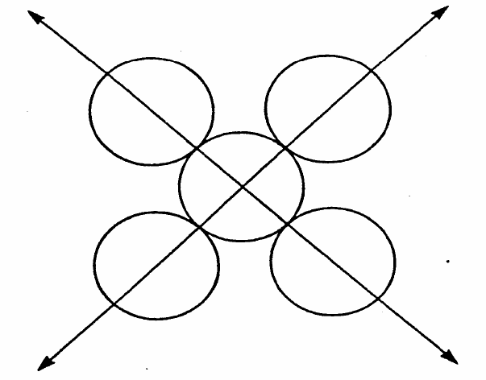
Body Centered Cubic (BCC) Structure
Atomic arrangement in (110) planes in BCC structures and the <111> directions

Slide 12
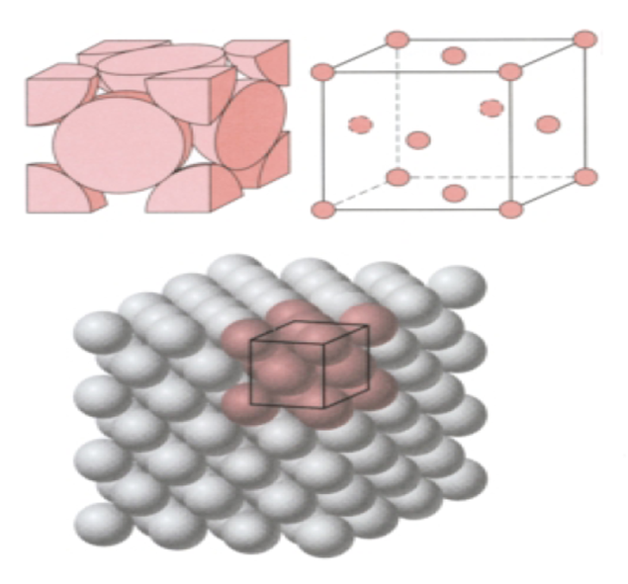
Face Centered Cubic (FCC) Structure

Slide 13
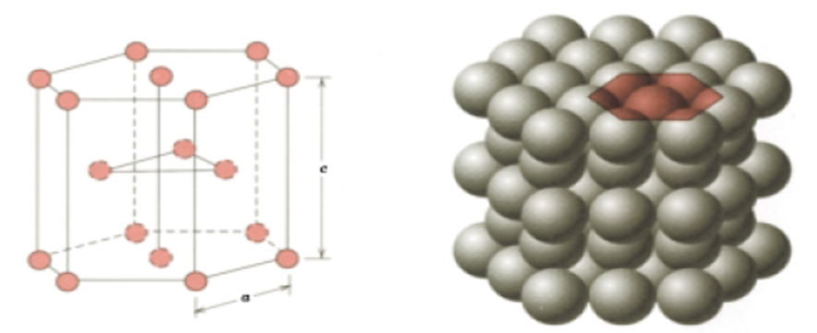
Hexagonal Close-Packed (HCP) Structure

Slide 14
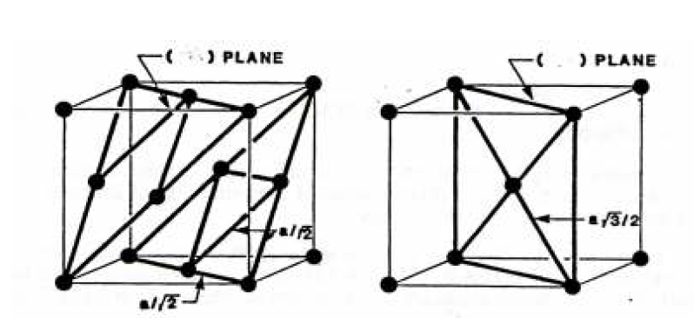
Close-Packed Structures
(111) Plane
(110) Plane

Slide 15
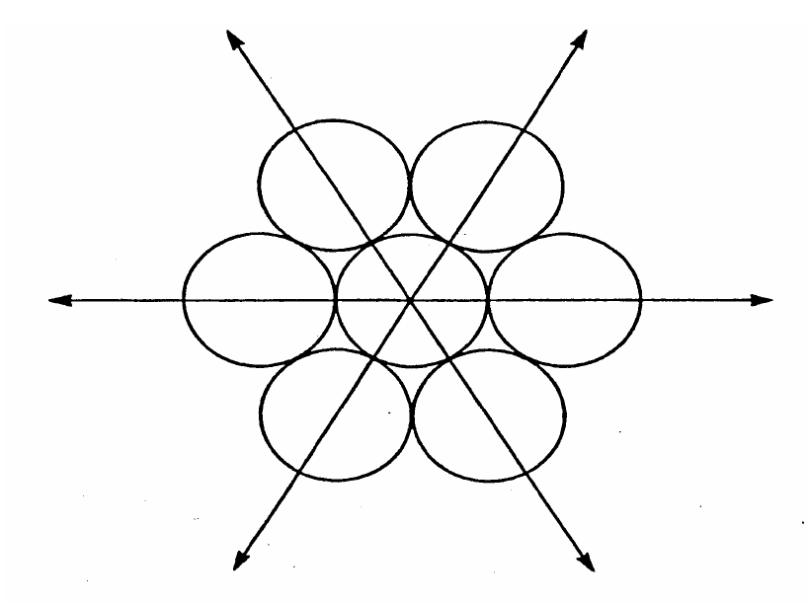
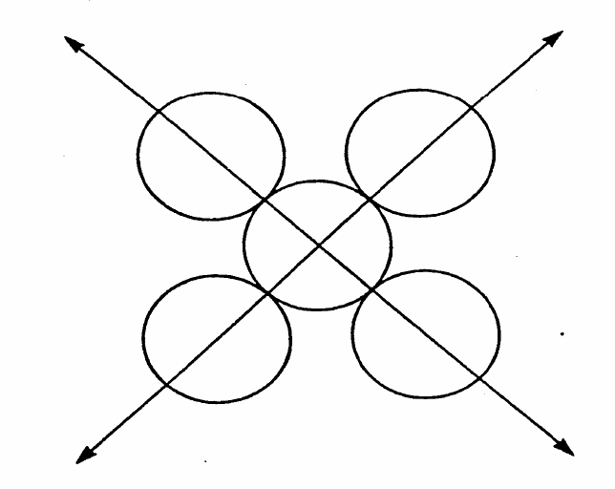
Close-Packed Structures
Atomic arrangement in (111) close-packed planes in FCC structures and the <110> directions
Atomic arrangement in (110) planes in BCC structures and the <111> directions

Slide 16
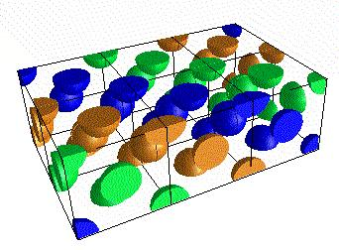
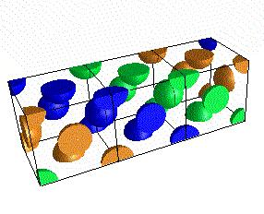
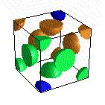
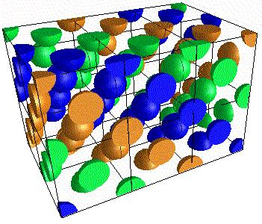
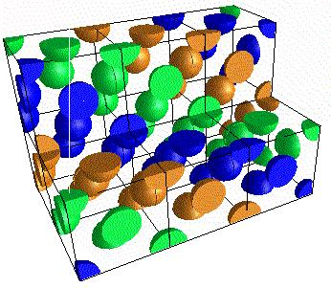
FCC Close-Packed Structure

Slide 17
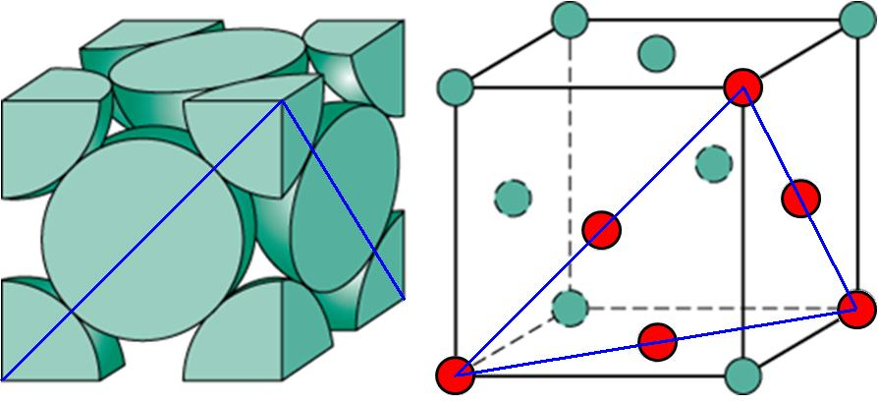
Close-Packed Structures
(111) Plane

Slide 18
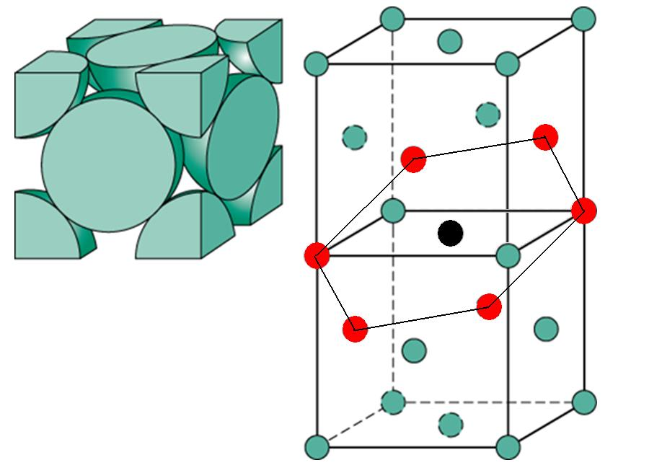
Close-Packed Structures
2
2
1
1
4
4
3
7
3
1
2
6
3
4
5
7
5
6

Slide 19
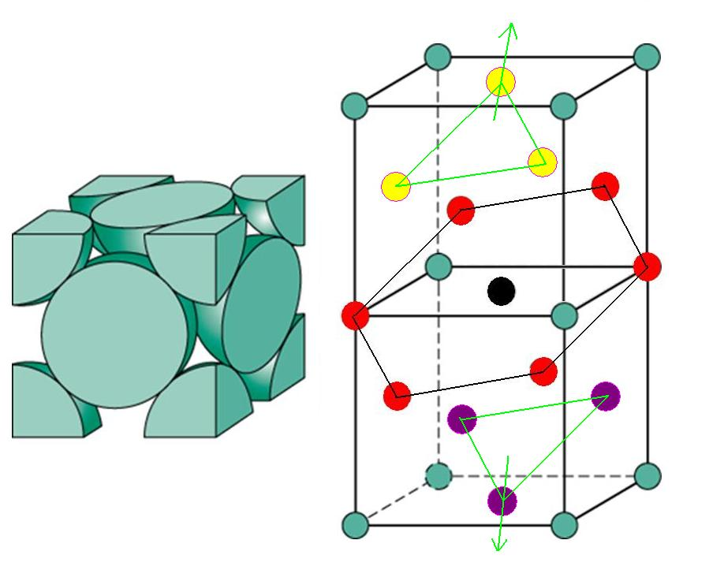
Close-Packed Structures

Slide 20
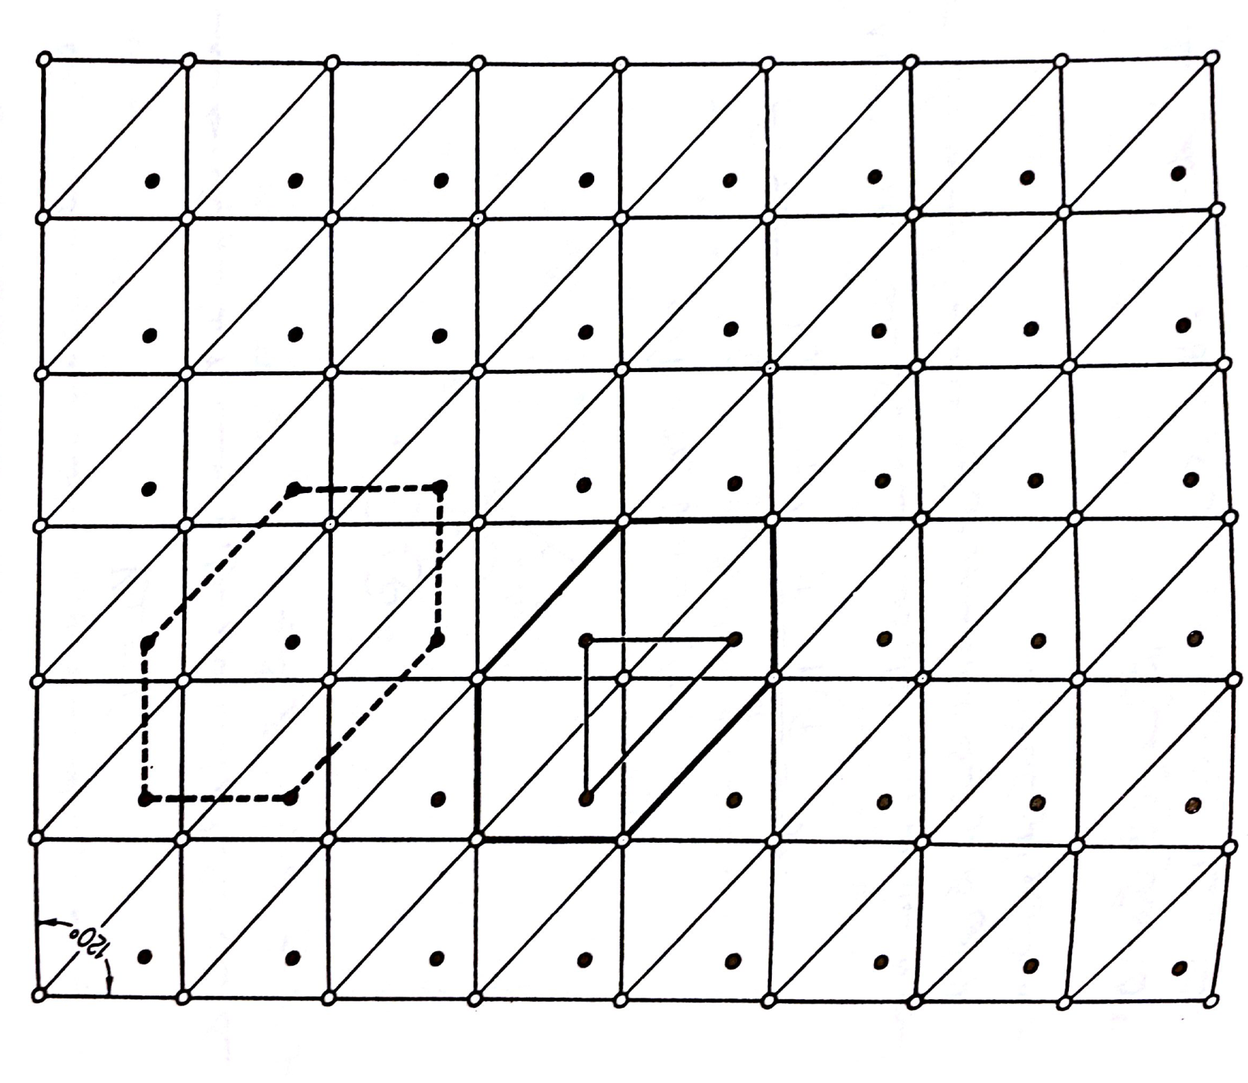
Hexagonal Close-Packed (HCP) Structure

Slide 21
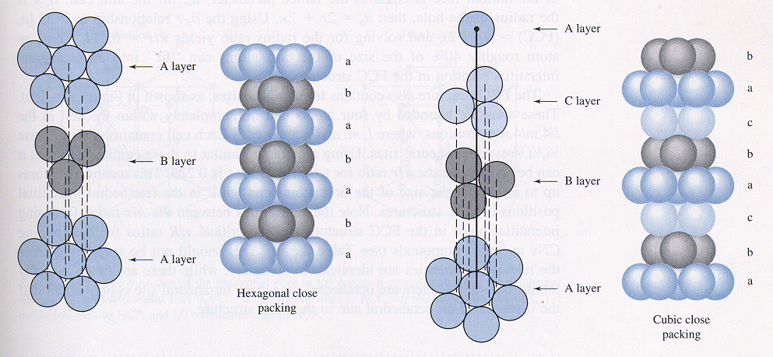
Close-Packed Structures

Slide 22
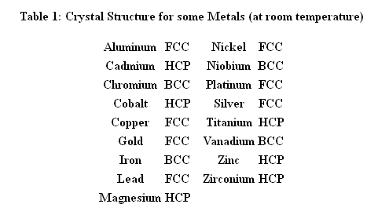
Crystalline Structure of Some Metals

Slide 23
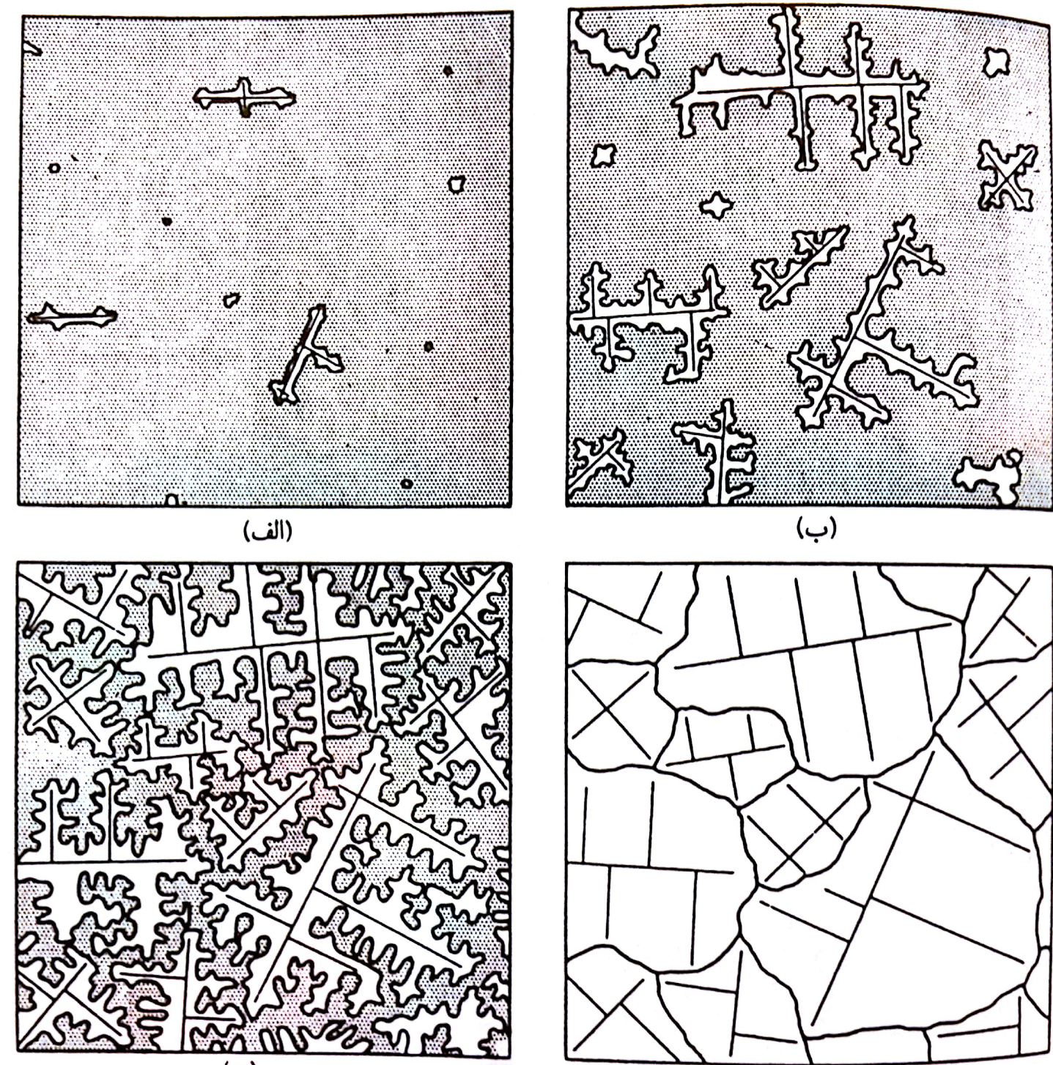
Crystallization

Slide 24
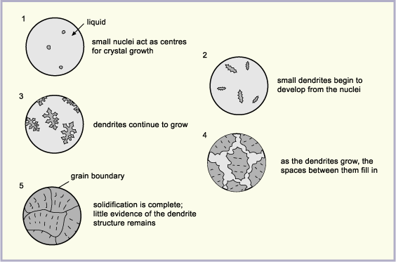
Crystallization

Slide 25
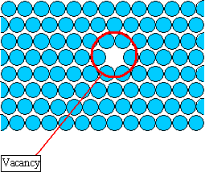
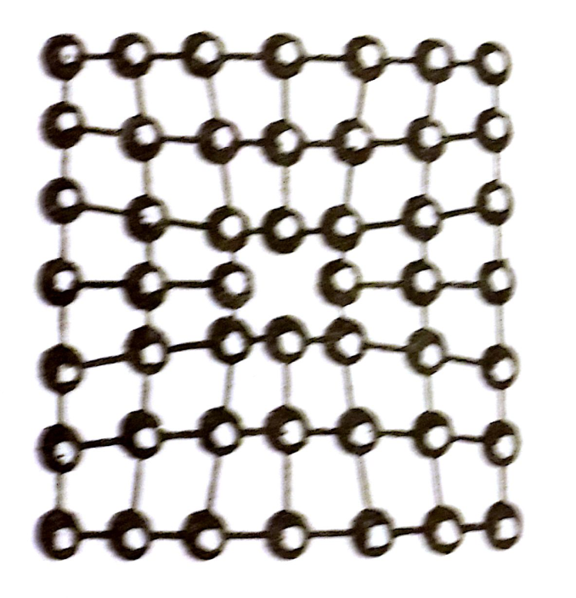
Metal Deficiencies
is the equilibrium number of vacancies for a given quantity of material
is the total number of atomic sites
is the energy required for the formation of a vacancy
is the absolute temperature
Tensile Stress
is the gas or Boltzmann’s constant

Slide 26
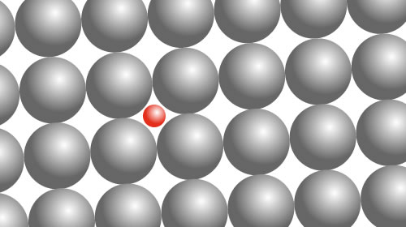
Metal Deficiencies
Interstitial Defect

Slide 27
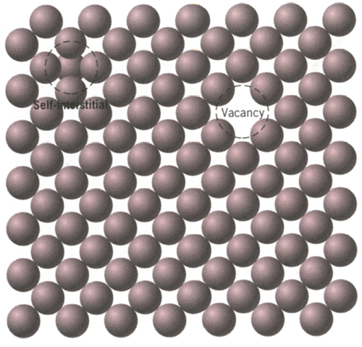
Metal Deficiencies
A self-interstitial is an atom from the crystal that is crowded into an interstitial site, a small void space that under ordinary circumstances is not occupied.

Slide 28
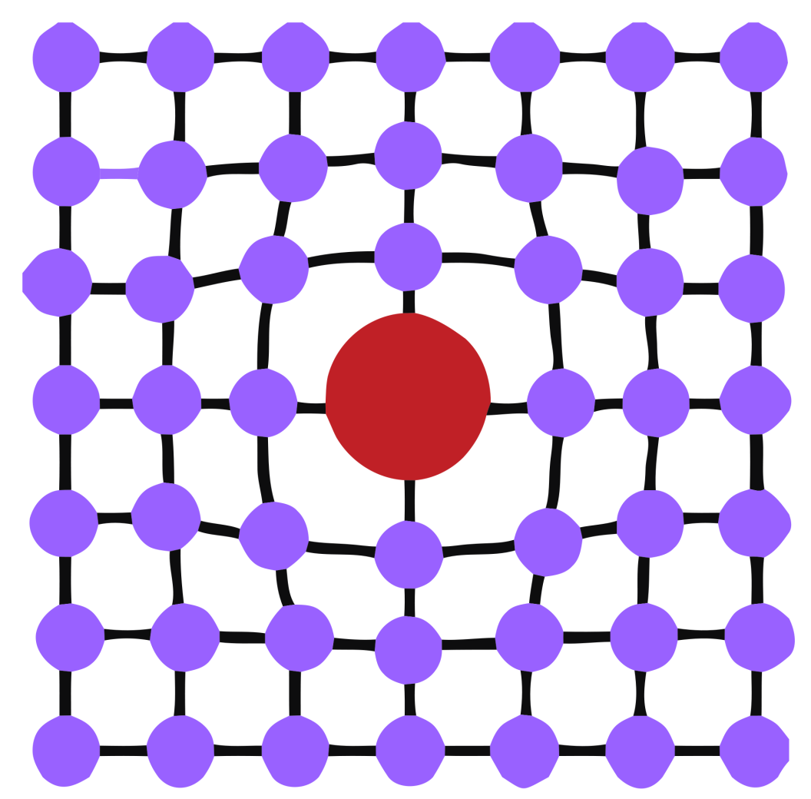
Metal Deficiencies
Substitutional Defect
Compressive Stress

Slide 29
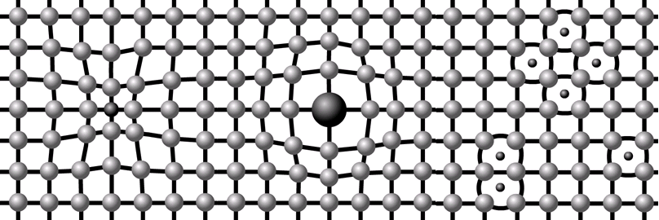
Metal Deficiencies
Tensile Stress
Compressive Stress
Interstitial Defect

Slide 30
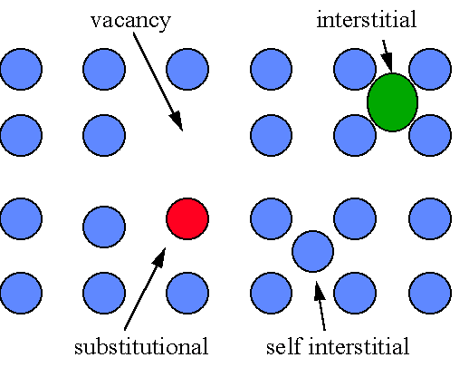
Metal Deficiencies

Slide 31
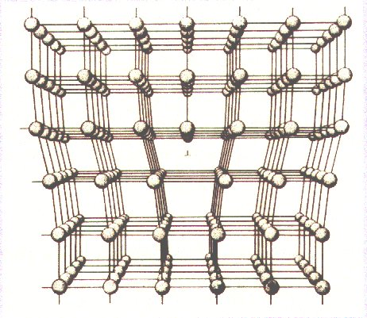
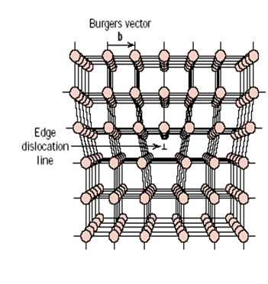
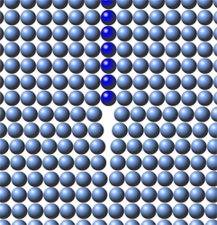
Metal Deficiencies
Edge Dislocation

Slide 32
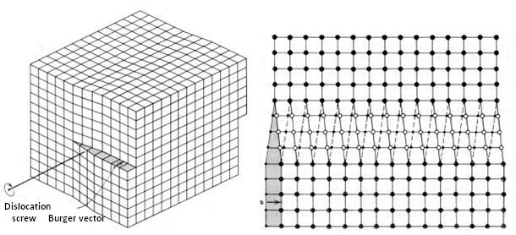
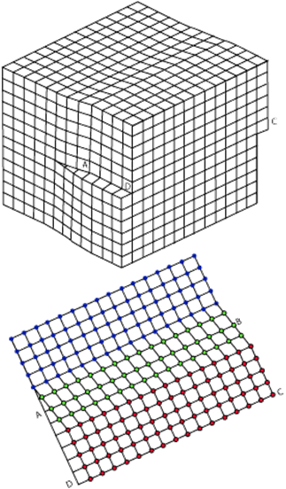
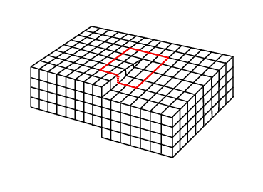
Metal Deficiencies
Screw Dislocation

Slide 33
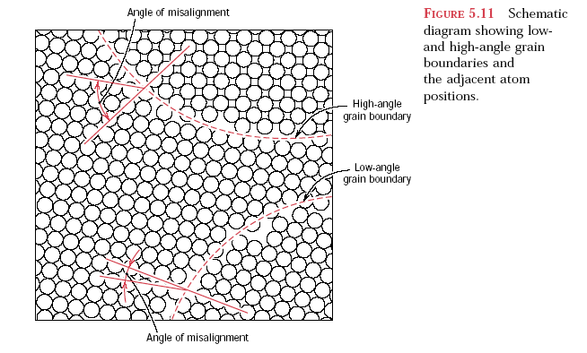
Metal Deficiencies
Grain Boundaries and angle of misalignment

Slide 34
Plastic Deformation

Slide 35
Plastic Deformation

Slide 36
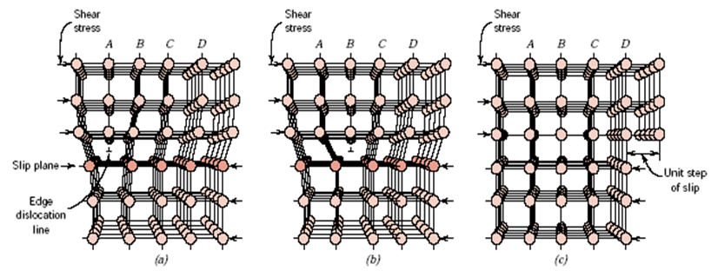
Plastic Deformation

Slide 37
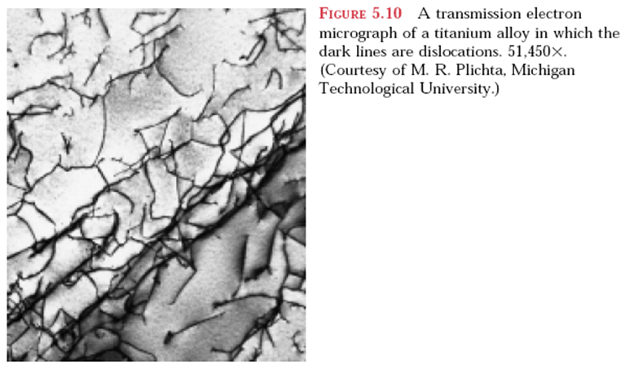
Plastic Deformation

Slide 38
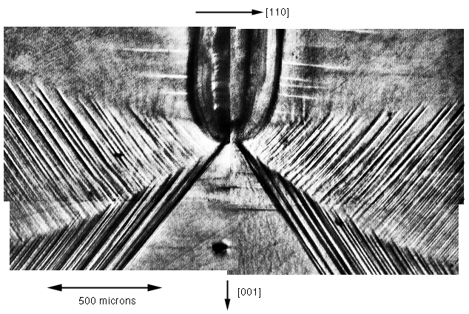
Plastic Deformation
Slip lines in plastic deformation

Slide 39
Plastic Deformation
Elongated Crystals

Slide 40
Plastic Deformation
Schematic drawing of twinning

Slide 41
Plastic Deformation
Unlike slipping which appears as slip lines, twinning appears as twinning bands

Slide 42
Plastic Deformation
Slip and Twinning
Twin Bands in Zinc
Slip lines in Copper

Slide 43
Diffusion

Slide 44
Diffusion
Vacancy Diffusion
Interstitial Diffusion

Slide 45
Diffusion

Slide 46
Phase Diagrams

Slide 47
Phase Diagrams

Slide 48
Phase Diagrams

Slide 49
Phase Diagrams

Slide 50
Phase Diagrams

Slide 51
Phase Diagrams

Slide 52
Phase Diagrams

Slide 53
Phase Diagrams

Slide 54
Phase Diagrams

Slide 55
Steels
آستنیت
فریت

Slide 56
Steels
پرلیت
بزرگنمایی 3500
پرلیت
بزرگنمایی 17000

Slide 57
Steels

Slide 58
Steels
فولاد با 0/2 درصد کربن آهسته سرد شده، (الف) بزرگنمایی 100 و (ب) بزرگنمایی 500

Slide 59
Steels
فولاد با 0/2 درصد کربن آهسته سرد شده، بزرگنمایی 100
فولاد یوتکتوئید (0/8 درصد کربن)، بزرگنمایی 500

Slide 60
Heat Treatment
مارتنزیت

Slide 61
Heat Treatment

Slide 62
Heat Treatment

Slide 63
Heat Treatment

