Slide 1
In The Name Of Allah excitons in single – walled carbon nanotubes nasim moradi graduate student of atomic and molEcular physics under supervision of : dr. Fazeli and dr. mozaffari qom University

Slide 2
outline
Introduction to Carbon’s Structures
Structure of Carbon Nanotubes
Excitons
Bethe - Salpeter Equation

Slide 3
Introduction to Carbon’s Structures

Slide 4
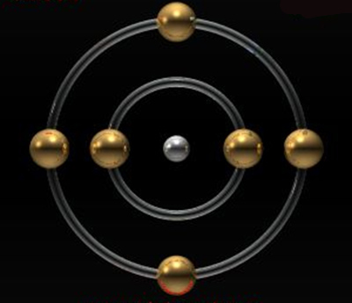
CARBON
The Carbon atom has six electrons . .
$${\text{1}\text{s} }^{2}{ \text{2}\text{s} }^{2}{ \text{2}\text{p} }^{2}$$
Until the mid-1980’s pure solid carbon was thought to
exist in only two physical forms : diamond and graphite.

Slide 5
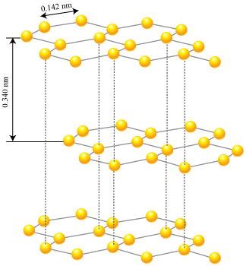
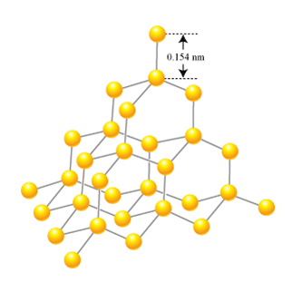
Diamond
Graphite

Slide 6
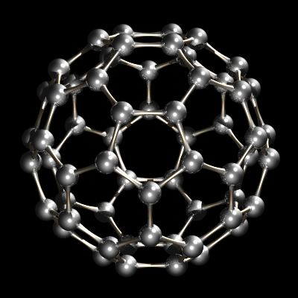
In 1985 , Richard Smalley and group of researchers
made an interesting discovery : $C_{60}$

Slide 7
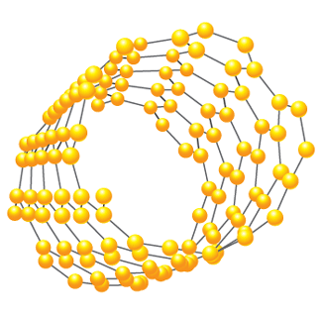
Nanotubes
Graphene

Slide 8
Structure Of Carbon Nanotubes

Slide 9
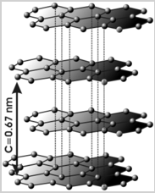
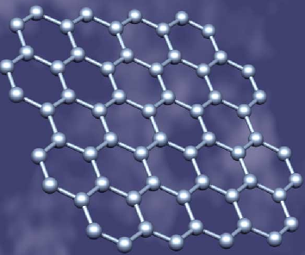
Carbon nanotubes were discovered in 1991 by Iijima.
Graphite
A single layer of graphite, graphene

Slide 10
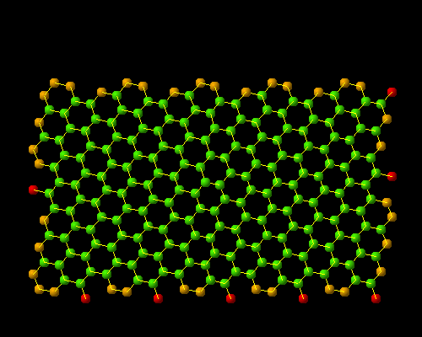
a carbon nanotube made of a single graphite layer rolled up into a hollow cylinder
Animation from S. Maruyama’s carbon nanotube site
with diameter as small as nm
Length: few nm to microns

Slide 11
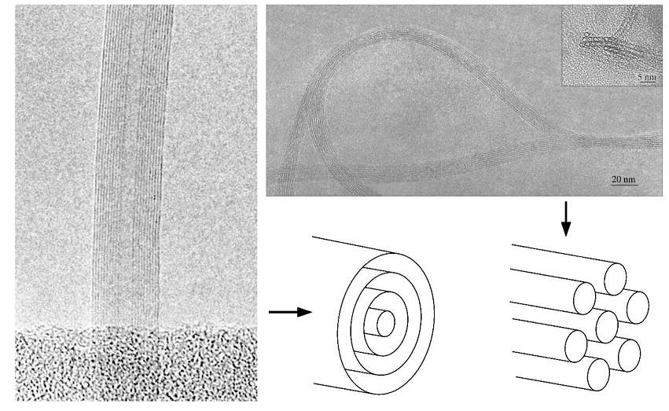
Images of nanotubes
multi-walled nanotube (mwnt)
Diameter ~ 10 – 50 nm
Single -walled nanotube (swnt)
Diameter ~ 0.5 - 2nm
J.Charlier and X. Blase ,” electronic properties of nanotubes” , Rev . Mod . Phys .79 ( 2007 ).

Slide 12
SWNT’s geometry
specified by a pair of integers (n , m)
$$C_{h}=na_{1}+ma_{2}$$
$$d_{t}={|c_{h}|}/π=\frac{a}{π}\sqrt{n^{2}+nm+n^{2}}$$
lrsm.upenn.edu
Chiral vector
diameter
a = lattice constant of the honeycomb network
a = $\sqrt{3}×a_{cc}$ ($a_{cc}≅1.4A^{0}$ , the C-C bond length)

Slide 13
Chiral angle ($θ$) = angle between $C_{h}$ and $a_{1}$.
Tube axis
Rev . Mod . Phys.79 ( 2007) , p:680
(n , 0) ($θ$= 0) zigzag
(n , n) ($θ$= 30) armchair
(n , m$≠$n$≠$0) chiral

Slide 14
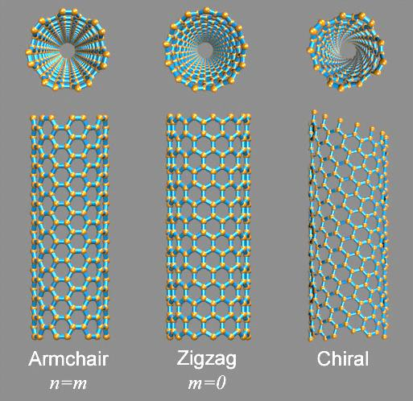
www.nanodic.com

Slide 15
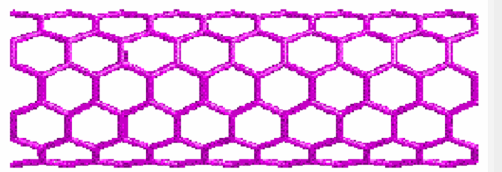
Bonding
Graphitic$sp^{2 }$c-c bonds
$sp^{2}$ c=c 152 Kcal/mole
$sp^{2}$ bonds with three
nearest carbon atoms

Slide 16
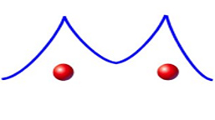
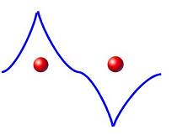
Tight – binding model
The tight-binding model , we imagine how the wave functions
of atoms or ions will interact as we bring them together.
$$ψ_{A}$$
$$ψ_{B}$$
$$ψ_{A}+ψ_{B}$$
$$ψ_{A}−ψ_{B}$$

Slide 17
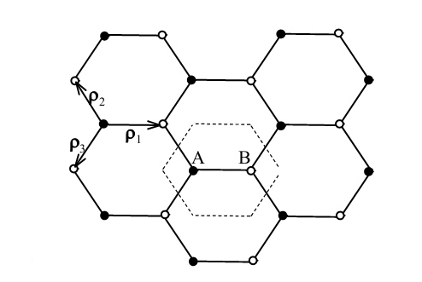
Bloch function :
$$\left.ψ_{k}(r+T)=e^{ik.T}ψ_{k}(r\right)$$
$$\begin{matrix}\begin{aligned}〈φ_{n}|H|φ_{n}〉=−α \\ \end{aligned} \\ \begin{aligned}〈φ_{m}|H|φ_{n}〉=−γ \\ \end{aligned} \\ 〈φ_{m}|H|φ_{n}〉=0\end{matrix}$$
Charles Kittel , introduction to solid state physics , ( Wiley ,1983)

Slide 18
Tight – binding model of graphene
$$φ^{A}(k,r)=\frac{1}{\sqrt{N}}\sum_{l}{\left.e^{ik.l}φ(r−r_{A}−l\right)}$$
Rev . Mod . Phys .79 , p:684
$${\vec{a}}_{1}=a\left(\frac{\sqrt{3}}{2},\frac{1}{2}\right)$$
$$\left(\begin{matrix}H_{AA} & H_{AB} \\ H_{BA} & H_{BB}\end{matrix}\right)$$
$${\vec{a}}_{2}=a\left(\frac{\sqrt{3}}{2},−\frac{1}{2}\right)$$
$$H_{AA}=H_{BB}=0$$
$$H_{AB}=\frac{1}{N}\sum_{l,l^{′}}{e^{\left.ik.(l^{′}−l\right)}}〈φ^{A,l}|H|φ^{B,l^{′}}〉$$

Slide 19
$$\begin{matrix}\begin{aligned}H_{AB}(k)=〈φ^{A,0}|H|φ^{B,0}〉+e^{−ik.a_{1}}〈φ^{A,0}|H|φ^{B,−a_{1}}〉 \\ \end{aligned} \\ \left.+e^{−ik.a_{2}}〈φ^{A,0}|H|φ^{B,−a_{2}}〉=−γ_{0}α(k\right)\end{matrix}$$
$$\left(\begin{matrix}−E & H_{AB} \\ H_{BA} & −E\end{matrix}\right)$$
$$α(k)=1+e^{−ik{.a}_{1}}+e^{−ik.a_{2}}$$
$γ_{0}$ = 2.9 eV
$$E^{±}(k)=±γ_{0}\sqrt{\left.3+2cos(k.a_{1})+2cos(k.a_{2})+2cos[k.(a_{1}−a_{2})\right]}$$

Slide 20
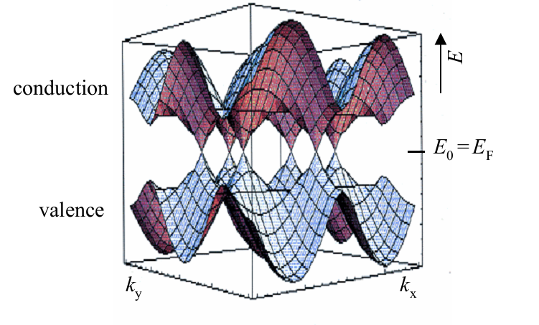
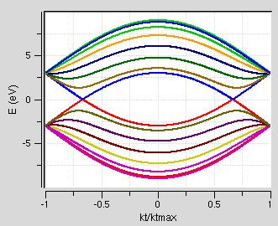
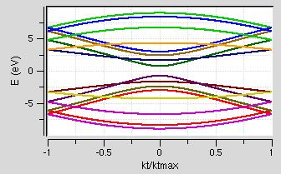
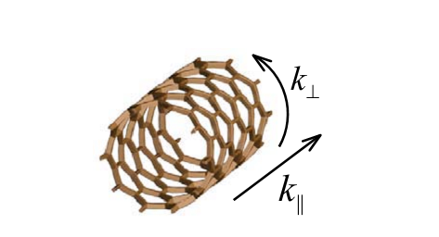
(7,7)
(7,0)
ethan minot , Tuning the band structure of cnt , PhD Thesis , cornell univ (2004 ) , paper : 28
Periodic boundary conditions along the circumferential direction
$$ψ_{k}(r+c_{h})=e^{ik.c_{h}}{ ψ}_{k}(r) =ψ_{k}(r)$$
From the Bloch theorem
$$k_{⊥}=\frac{2πl}{|c_{h}|}$$

Slide 21
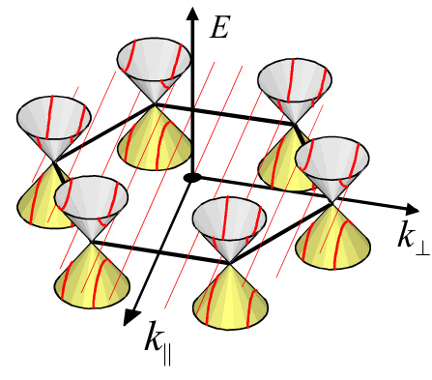
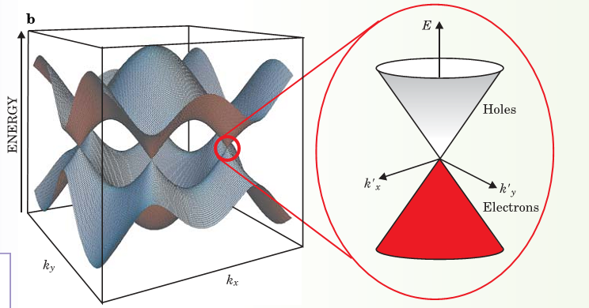
K
ethan minot , PhD Thesis , cornell univ (2004 ) , paper : 32

Slide 22
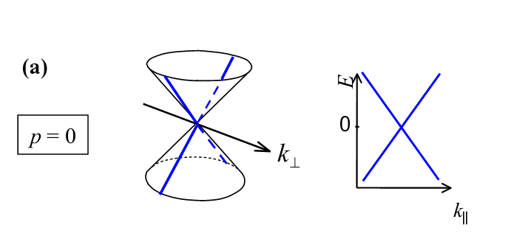
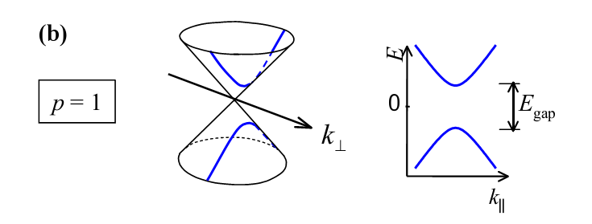
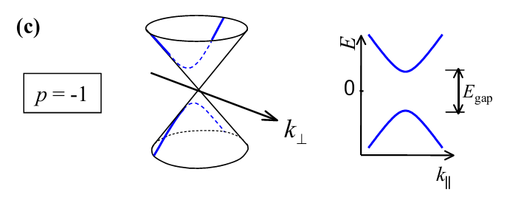
ethan minot , Tuning the band structure of cnt , PhD Thesis , cornell univ (2004 ) , paper : 33

Slide 23
Metallic nanotubes
Semiconducting nanotubes

Slide 24
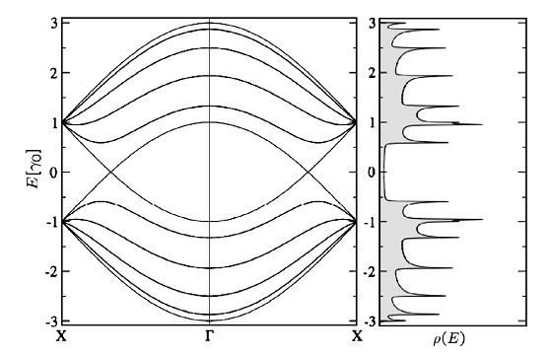
For a (5,5) Armchair
Density of states
Electronic band structure
Rev.Mod.Phys . 79 , p: 686

Slide 25
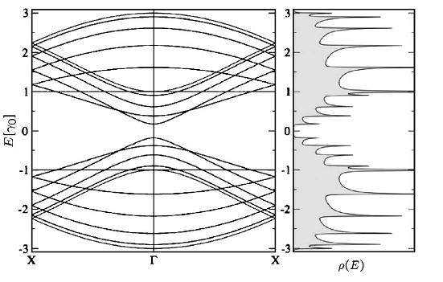
For a (10,0 ) zigzag
An energy gap opens at$Γ.$
DOS have a zero value at the fermi energy .
Rev.Mod.Phys . 79 , p: 687

Slide 26
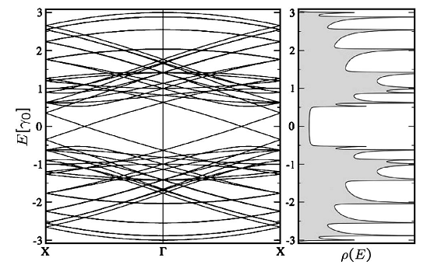
For a (8,2 ) Chiral
Exhibits a metallic behavior.
In semiconducting zigzag or chiral nanotubes the
Band gap is independent of the chiral angle and :
Rev.Mod.Phys . 79 , p: 688

Slide 27
applications
Electrical
Capacitors
Diodes and transistors
Flat panel displays
Data storge

Slide 28
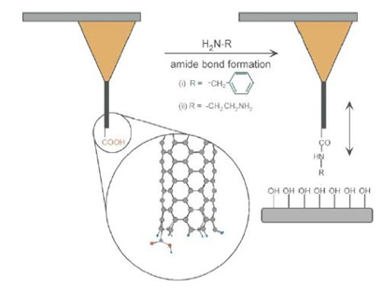
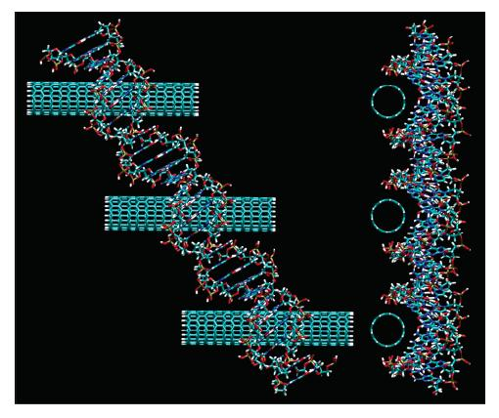
Energy storage
Lithium batteries
Hydrogen storage
Biological
Bio-sensors
Functional AFM tips
DNA sequencing

Slide 29
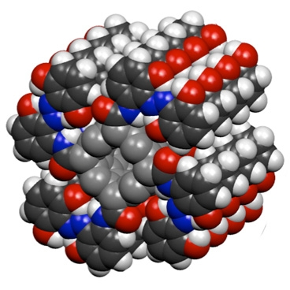
Optical properties
Solar cells
Quantum information processing
Optical communication
Credit: Grossman/Kolpak
Quantum cryptography
Carbon nanotubes could be used as a source of single photons for
applications in quantum cryptography.
Ch.Galland ,et al , “ Photon Antibunching in the Photoluminescence Spectra of a
Single Carbon Nanotube”, Phys. Rev. Lett. 100, 217401 (2008).

Slide 30
Optical Properties And Excitons

Slide 31
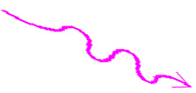
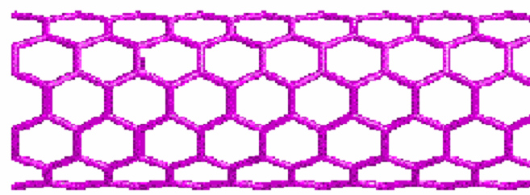
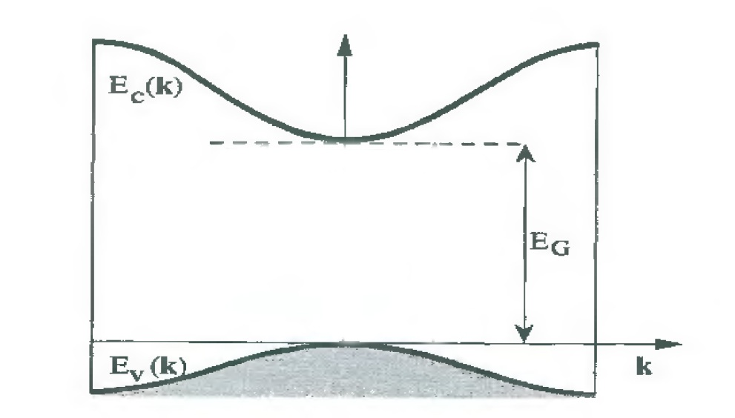
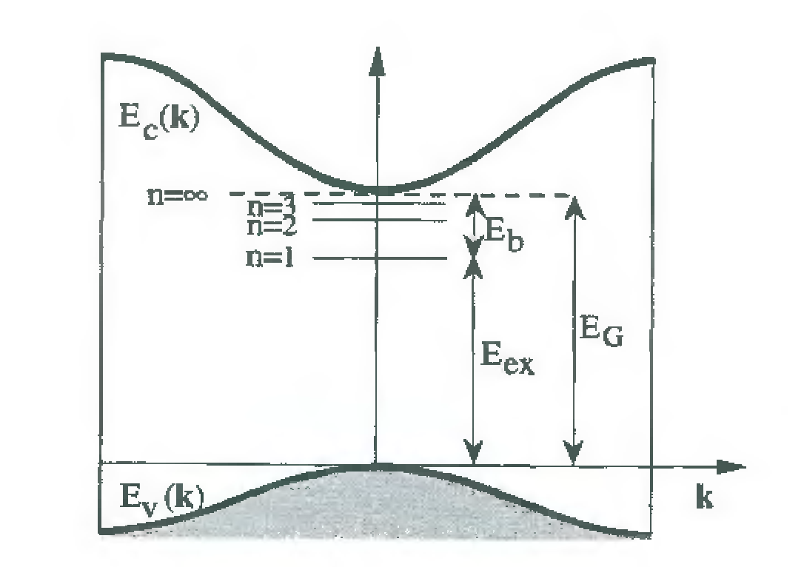
Grosso , Solid state physics , paper : 233
An exciton is a bound state of an electron and hole which are attracted to each other by the electrostatic coulomb force.

Slide 32
exciton
” exciton ” was introduced by Frenkel in 1931 .
Frenkel
Wannier - Mott
Charge transfer
Andre Moliton , solid state physics for electronics , paper : 364

Slide 33
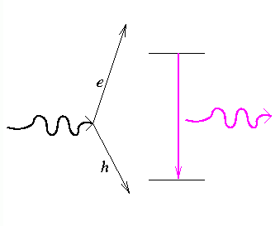
No charge
S = 0 , 1 [singlet , triplet]
Boson
exciton
Bright and Dark

Slide 34
Bethe – Salpeter Equation

Slide 35
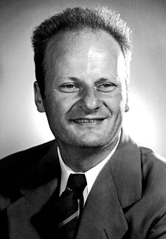
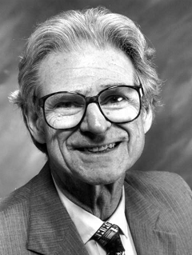
Bethe – Salpeter Equation
The equation was actually first published in 1951.
describes the bound states of a two-body (particles) system in a formalism.
Hans Bethe
Edwin Ernest Salpeter
1906 - 2005
1924 - 2008
Nobel Prize for Physics (1967)
Original article : A Relativistic Equation for Bound-State Problems
E.E.Salpeter and H.Bethe , Phys.Rev. 84 , 1232-1242 (1951)
C.Spataru , S.Ismail Beigi “ Excitonic Effects of SWNT ” , Phys.Rev.Lett.92 , ( 2004 )

