Slide 1
In the name of Allah
Lesson : 3
Student: Fatemeh Mohammadi
Teacher : Miss. Kamali
The relevant lesson : English language
Class : 9/4

Slide 2
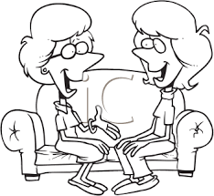
Oh, yes, me too. It’s really great.
I just love New Year holidays!

Slide 3
Do you get New Year gifts too?
We normally visit our relatives in Norooz. It’s fun!

Slide 4
Sure! We usually get money. I really like it.
Well…, We always go to my grandparents’ houses.

Slide 5
Actually, she doesn’t. My mother makes it.
That’s nice! Does your grandmother cook the New
Year meal?

Slide 6
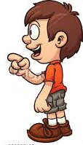
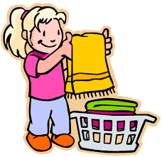
Yes, I do
Do you buy new clothes
for the New Year?

Slide 7
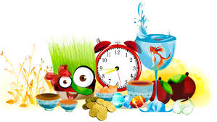
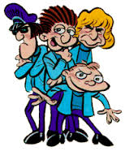
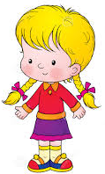
Do you and your cousins
set the Haft Seen table?
No, we don’t.

Slide 8
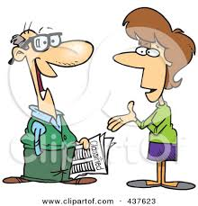
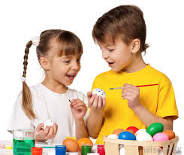
Yes, they usually color them.
Do young children color the
eggs?

Slide 9
Do Chinese people buy gold
fish for the New Year?
No, they don’t buy gold fish.

Slide 10
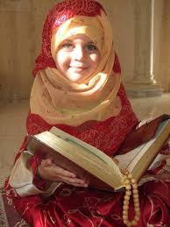
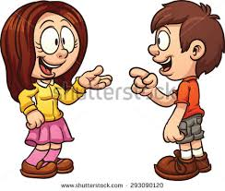
Yes, she does.
Does she recite the Holy
Quran at the turn of the year?

Slide 11
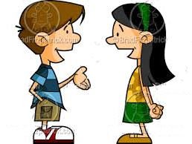
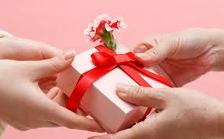
Does your father give you
New Year gifts?
No, he doesn’t.

Slide 12
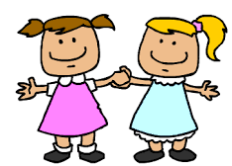
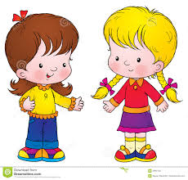
Yes, she has many friends.
Does she have many friends?

Slide 13
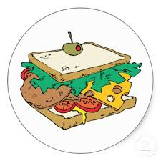
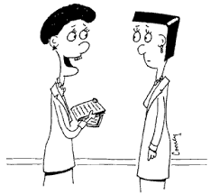
No, she doesn’t make a
special food.
Does your mom make a special
food for Norooz?

Slide 14
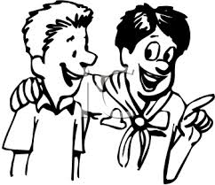
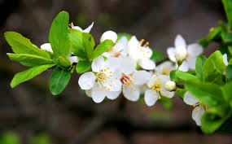
Shayan, do you like spring?
Yes, I like spring a lot.

Slide 15
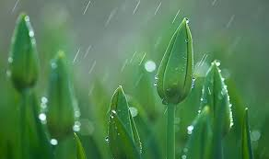
Oh yes! But not on Nature Day.
Do you like rainy weather?

Slide 16
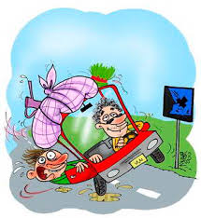
Because we always go out on 13 of Farvardin.
Why not?

Slide 17
Affirmative
I We You They | like | New Year holidays.
He She | likes
Ali reads a newspaper.
Mina and Zahra study their lessons.

Slide 18
Negative
I We You They | do | not | buy | new clothes.
He She | does
I don’t play tennis.
Zahra doesn’t wash the dishes.

Slide 19
Negative
Do | I we you they | buy | gold fish | ?
Does | he she Hamid

Slide 20
I read my book.
You wash your car
He cleans his room.
She studies her lessons.
The cat drinks its milk.
We paint our house.
They eat their lunch.
See also
I
you
he
she
it
we
they
my
your
his
her
its
our
their

Slide 21
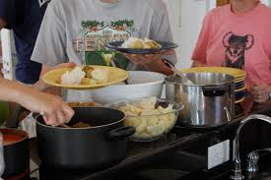
make lunch/dinner

Slide 22
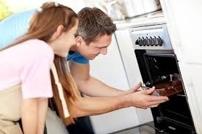
bake a cake

Slide 23
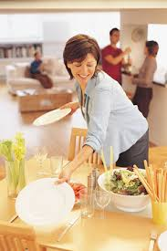
set the table

Slide 24
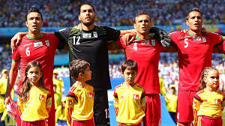
sing the national anthem

Slide 25
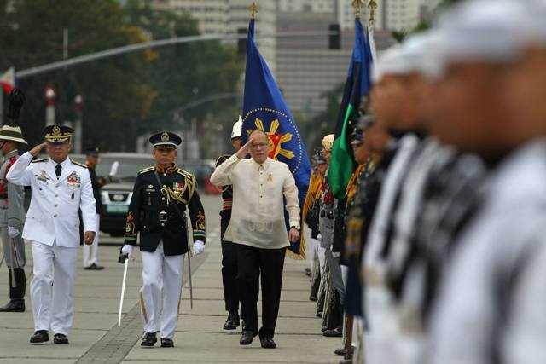
hold a ceremony

Slide 26
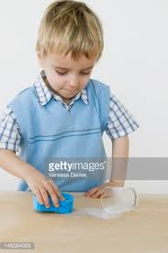
clear the table

Slide 27
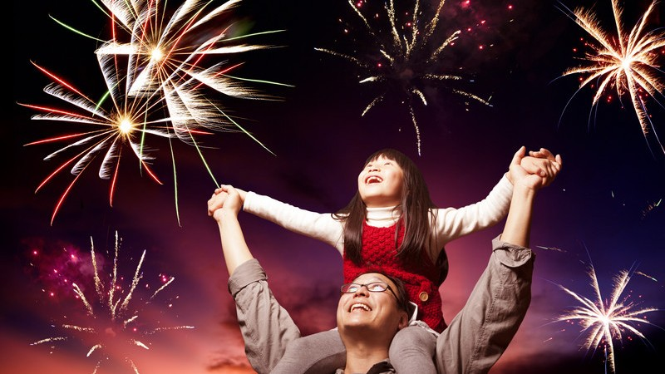
watch fireworks

Slide 28
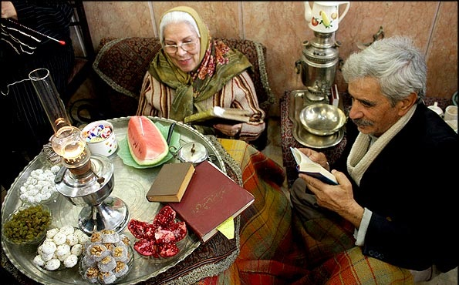
read poems of Hafez

Slide 29
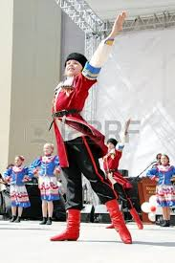
wear special clothes

Slide 30
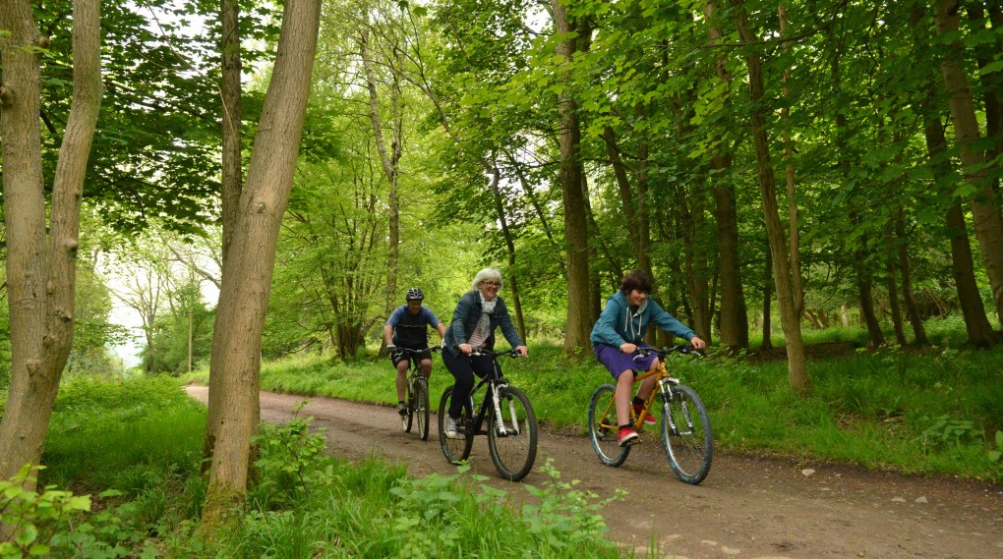
go out on Nature Day

Slide 31
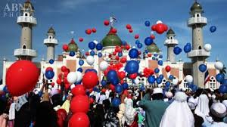
celebrate a religious holiday

Slide 32
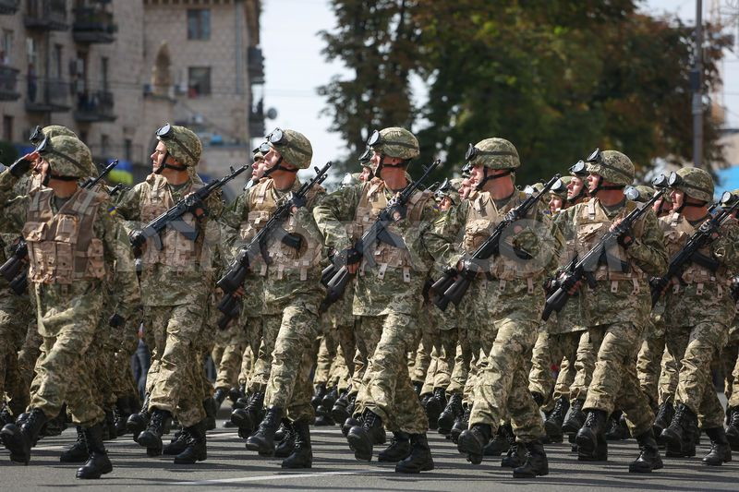
watch military parade

Slide 33
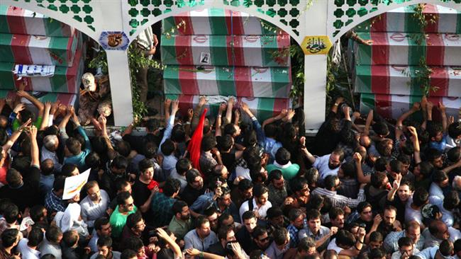
commemorate NE* martyrs
*NE: Nuclear Energy

Slide 34
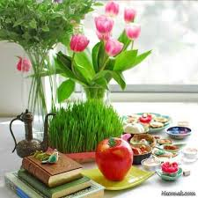
Islamic-Iranian culture

Slide 35
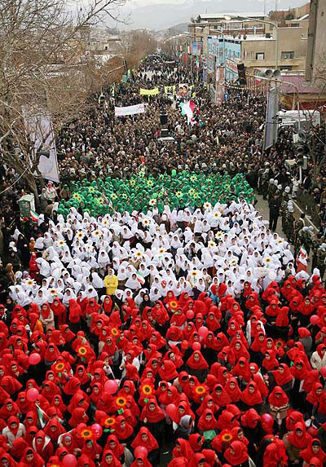
Islamic revolution anniversary

