Slide 2
Vitamin A
2

Slide 3
Brief History:
The earliest clues to be discovered that led to the identification of Vitamin A and its deficiency date back as far as 1819, when a physiologist called Magendiefound that malnourished dogs tended to develop corneal ulcers and their risk of death was increased. Vitamin A is required to maintain specialized epithelia (such as in the cornea and conjunctiva)
In 1912, an English biochemist called Frederick Gowland Hopkins found unknown factors present in milk that were not fats, proteins or carbohydrates, but were required to aid growth in rats. Hopkins was later awarded the Nobel Prize (in 1929) for this discovery. In 1917, Elmer McCollum from the University of Wisconsin–Madison along with Lafayette Mendel and Thomas Burr Osborne from Yale University discovered one of these substances while researching the role of dietary fats. In 1918, these “accessory factors” were described as fat soluble and in 1920, they were referred to as vitamin A.¹
1. www.wikipedia.org
3

Slide 4
Classification:
a.Retinoids (found in animal foods):
Retinoids comprise retinol, retinaldehyde, and retinoic acid
b.Carotenoids (found in plant foods):
Carotenoids comprise carotenes and related compounds, known as
provitamin A, as they can be cleaved to yield retinaldehyde
and thence retinol and retinoic acid.
4

Slide 5
Structures:
5

Slide 6
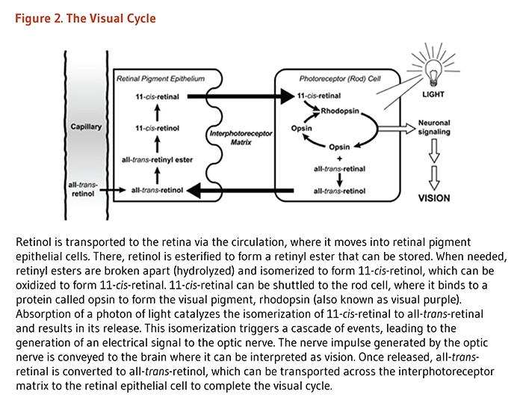
Functions:
1)Visual system and eyesight
6

Slide 7
2)Regulation of gene expression
7

Slide 8
3)Immunity:
Vitamin A was initially coined “the anti-infective vitamin” because of its importance in the normal functioning of the immune system. Retinoic acid (RA) is produced by antigen-presenting cells (APCs), including macrophages and dendritic cells, found in mucosal interfaces and associated lymph nodes. RA appears to act on dendritic cells themselves to regulate their differentiation, migration, and antigen-presenting capacity.RA is required for the differentiation of T-lymphocytes into induced regulatory T- lymphocytes (Tregs). It affects production of CYTOKINES by T-lymphocytes in response to infection. There is also evidence to suggest that RA may help prevent the development of autoimmunity.
8

Slide 9
Deficiency & Clinical Symptoms:
-Nyctalopia (night blindness)
-Xerophthalmia
-Keratomalacia
-Vitamin A is critical to achieving Millennium Development Goal 4 to reduce child mortality.
-VAD also contributes to maternal mortality and other poor outcomes in pregnancy and lacation.
-VAD also diminishes the ability to fight infectious diseases like measles.
-Anemia
9

Slide 10
Toxicity:
Since vitamin A is fat-soluble, disposing of any excesses taken in through diet takes much longer than with water-soluble B vitamins and vitamin C. This allows for toxic levels of vitamin A to accumulate.
Excessive, chronic intake of some forms of this fat soluble vitamin, specifically retinol or retinoic acid, can be toxic.
In general, acute toxicity occurs at doses of 25,000 IU/kg of body weight,(1IU=0.3 μg retinol).Children can reach toxic levels at 1,500 IU/kg of body weight.
Excessive vitamin A consumption can lead to nausea, irritability, anorexia (reduced appetite), vomiting, blurry vision, headaches, hair loss, muscle and abdominal pain and weakness, drowsiness, and altered mental status.
10

Slide 11
Other Benefits:
1)Prenatal and postnatal development
2)Cell division
11

Slide 12
Dietary Recommendation(1):
12

Slide 13
Dietary recommendation(2):
Retinoids:
Carotenoids:
Liver
Yolk
Fish
Butter
Milk
Carrots
Pumpkins
Green leafy vegetables
Apricots
13

Slide 14
Sources:
1.Devlin Biochemistry
2.Harper Biochemistry
3.www.wikipedia.org
4.www.webmd.com
5.www.who.int
6.www.ajcn.nutrition.org
7.www.lpi.Oregonstate.edu
8.www.whfoods.com
14

Slide 15
Presenters:
Nona hossein nezhad
Meisam abolvardi

Slide 16
With great gratitude toward our dear professor:
Dr.Mir

Slide 17
The end
Thanks for your
time and attention

