Slide 1
Introduction to Real-Time Systems
Lecture 6
By:
Mohammad hajibegloo
hajibegloo@gmail.com

Slide 2
Scheduling
Real-time Tasks on
Multi-processors

Slide 3
System model
Platform with m identical processors
Task set with n periodic or sporadic tasks τ_{i}
Period or minimum inter-arrival time T_{i}
Worst-case execution time C_{i}
Deadline D_{i}
Utilization U_{i}=C_{i}/T_{i}
Notes:
Define sporadic and periodic.
Define synchronous.

Slide 4
Problems addressed
Feasibility problem
Run-time scheduling problem: find a schedule that meets all timing constraints
Schedulability problem :find if the produced schedule violates any deadline.
CPU1
τ₁
?
τ₂
CPU2
τ₃
τ₄
τ₅
CPU3
a given task model
Notes:
The run-time scheduling problem: given a set of tasks with real-time requirements, find a schedule that meets all timing constraints.
The schedulability problem: given a set of tasks and a scheduling algorithm, find in a reasonable amount of time if the produced schedule violates any deadline.

Slide 5
Assumptions
Independent tasks
Job-level parallelism prohibited
the same job cannot be simultaneously executed on more than one processor
Preemption and Migration support
For global schedulers, a preempted task can resume its execution on a different processor
Cost of preemption/migration integrated into task WCET
Notes:
The independence assumtion can be later removed, considering blocking times and shared resource protocols.

Slide 6
Muliprocessors are difficult
Root of all evil:
“The simple fact that a task can use only one processor even when several processors are free at the same time adds a surprising amount of difficulty to the scheduling of multiple processors” [Liu’69]
CPU1
CPU2
CPU3

Slide 7
Multiprocessor RT Systems
First theoretical results starting from 2000
Many NP-hard problems
Few optimal results
Heuristic approaches
Simplified task models
Only sufficient schedulability tests
Limited RTOS support

Slide 8
Multiprocessor scheduling
Partitioned scheduling
Static allocation – Static task assigment
Each task only execute on a fixed processor
No task migration
Semi- partitioned scheduling
Static allocation- Static task assigment
Each instance (or part of it) of a task is assigned to a fixed processor
Task instance or part of it may migrate
Global scheduling
dymanic allocation- dymanic task assigment
Any instance if any task may execute on any processor
Task migration

Slide 9
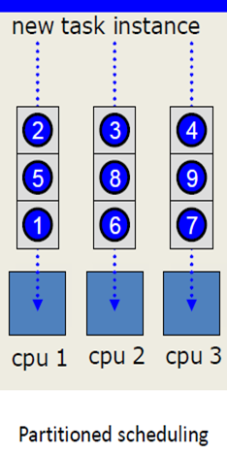
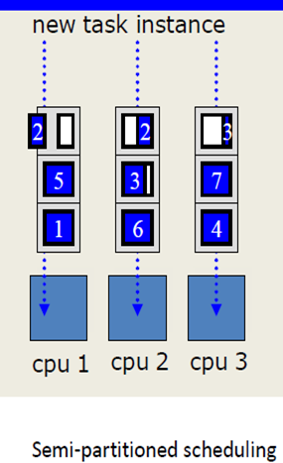
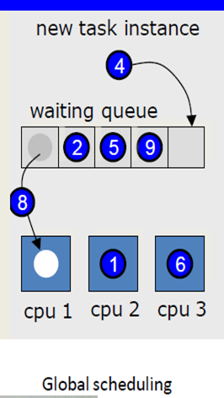
Multiprocessor scheduling

Slide 10
Global vs partitioned scheduling
Single system-wide queue instead of multiple per-processor queues:
Global scheduling
Partitioned approach
CPU1
τ₁
CPU1
τ₁
τ₅
τ₄
τ₁
τ₅
τ₄
τ₃
τ₂
τ₁
CPU2
τ₂
τ₃
τ₂
CPU2
τ₂
CPU3
τ₃
CPU3
Notes:
From Queueing theory: lower AVERAGE response time for global schedulers than for partitioned approaches.
When there is no precise information on the tasks, a global approach seems more efficient.
Other advantages:
- Number of preemptions
- Simple implementation
- Easy rescheduling
- Reclaiming
Disadvantages:
- Cache affinity: HW mitigates migration cost

Slide 11
Partitioned scheduling
Tow steps:
Determine a mapping of tasks to processors(Bin packing problem)
Perform run time scheduling
Example: Portioned with EDF
Assign tasks to the processors such that no processor’s capacity is exceeded(utilization bound by 1)
Schedule each processor using EDF

Slide 12
Partitioned Scheduling
The scheduling problem reduces to:
Global (work-conserving) and partitioned approaches are incomparable
Bin-packing
problem
+
Uniprocessor
scheduling
problem
τ₁
τ₃
τ₅
τ₂
τ₄
NP-hard in the
strong sense
Well known
Various heuristics used:
FF, NF, BF, FFDU, BFDD, etc.
EDF
U_{tot} ≤ 1
RM
(RTA)
...

Slide 13
Bin packing algorithms
The problem concerns packing objects of variety size in boxes (“bins”) with the objective of minimizing number of used boxes.
NP Hard problem
Heuristic solutions: next fit and first fit
Application to multiprocessor systems:
Bins are represented by processors and objects by tasks.
The decision whether a processor is “full” or not is derived form utilization-based schedulability test

Slide 14
Partitioned Scheduling
Advantages:
Most techniques for single-processor scheduling are also applicable here
partitioning of tasks can be automated
Solving a bin-backing algorithm,
Disadvantages:
Cannot exploit/share all unused processor time

Slide 15
semi- partitioned scheduling
High resource utilization
High overhead (due to task migration)

Slide 16
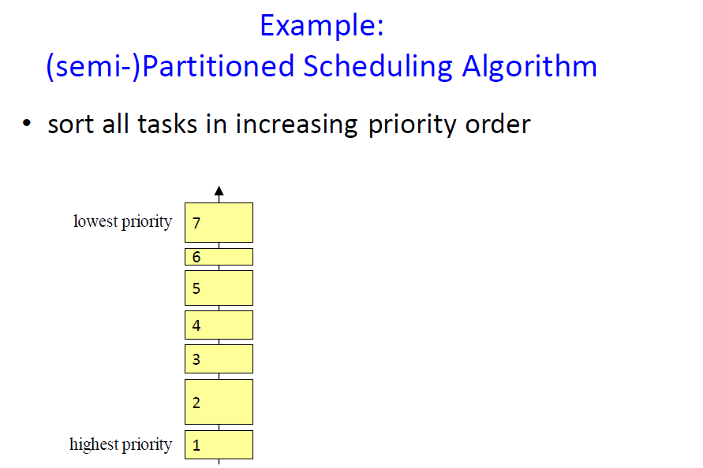

Slide 27
Global scheduling on SMP
CPU1
τ₁
Global queue
(ordered according to a given policy)
CPU2
τ₅
τ₄
τ₃
τ₂
τ₁
τ₂
CPU3
τ₃
The first m tasks are scheduled upon the m CPUs
Notes:
There is a global queue in which ready tasks ready are placed, according to a certain policy. When there is a free CPU the first task is removed from the queue and is scheduled. When a new task arrives with priority higher than one of the executing tasks, it preempts the executing task with lowest priority. If a task on a different CPU finishes its execution, the preempted task can “migrate” to the free CPU and continue its execution.

Slide 28
Global scheduling on SMP
CPU1
τ₁
Global queue
(ordered according to a given policy)
CPU2
τ₅
τ₄
τ₂
τ₅
τ₃
τ₃
τ₄
τ₂
τ₂
τ₁
τ₁
CPU3
τ₃
τ₄
When a task finishes its execution, the next one in the queue is scheduled on the available CPU

Slide 29
Global scheduling on SMP
CPU1
τ₁
Global queue
(ordered according to a given policy)
CPU2
τ₅
τ₅
τ₂
τ₄
τ₃
τ₄
τ₃
τ₃
τ₂
τ₂
τ₁
τ₁
τ₃
CPU3
τ₄
τ₃
When a higher priority task arrives, it preempts the task with lowest priority among the executing ones

Slide 30
Global scheduling on SMP
CPU1
τ₁
τ₄
Global queue
(ordered according to a given policy)
CPU2
τ₅
τ₄
τ₂
τ₅
τ₃
τ₄
τ₃
τ₃
τ₄
τ₂
τ₃
τ₁
τ₂
Task τ₄ “migrated” from
CPU3 to CPU1
CPU3
τ₄
τ₃
When another task ends its execution, the preempted task can resume its execution

Slide 31
Global scheduling
The m highest priority ready jobs are always the one executing
Work-conserving scheduler
No processor is ever idled when a task is ready to execute.
CPU1
τ₁
CPU2
τ₂
τ₅
τ₄
τ₃
τ₂
τ₁
CPU3
τ₃

Slide 32
Algorithms for global scheduling
EDF- unfortunately not optimal!
No simple schedulability test known (only sufficient)
RM
Difficult to find optimal order
Difficult to check the schedulability
Any algorithm for single processor scheduling may work, but schedulability analysis is non-trivial

Slide 34
Global scheduling: advantages
Advantage:
automatically Load balanced
Support by most multiprocessor operating systems (windows,solaris,linux,..)
Easier re-scheduling (dynamic loads, selective shutdown, etc.)
Lower average response time (see queueing theory)
More efficient reclaiming and overload management Number of preemptions
Notes:
No need for heavy load balancing routines
More efficient when there is no precise information on the tasks
More robust to overload conditions
Cache affinity and thrashing
Snoop Control Unit with DDI
-----------------
-Load intrinsically balanced.
-Andersson (to partition or not): with a good dispatcher the number of preemptions is lower with the global approach.
(SUCCESS RATIO: Among same priority class algorithm, comparing the top schedulers, also the success ratio is higher with the global method. But the classes are “incomparable”: for both of them there are task sets that can be scheduled only by one of the classes. Moreover, with both the partitioning and non-partitioning methods, the problem of deciding whether a (synchronous) task set is feasible on m processors is NP-hard in the strong sense!
-The implementations of most non-partitioned schedulers have just a global queue that feeds every single CPU.
-When a task join/leaves the system, the complexity of rescheduling a task set with the best ranked partitioned approaches is higher than the global ones: rescheduling frequently is not convenient.
-When a task executes less than its Worst Case Execution Time, the unused bandwidth can easily be reclaimed by other tasks without needing to reschedule-->better responsiveness for soft real time processes.
-Cache affinity is a measure of how many cache misses suffer an architecture. With a good dispatcher the cache misses typical of the global scheduling, can be significantly decreased, so that it doesn’t suffer a great disadvantage compared to the partitioned solution (in some situation can even be better! Consider a situation in which the unbalanced load, with partitioning, causes the tasks running on only the first CPU: if the tasks have high-fingerprint compared to the cache dimension, there will be a lot of cache misses/refills. With the global scheduling and a good dispatcher this can be avoided). The task presences (number of different CPUs on which each tasks executes) and the migrations are usually a few. In any case, when the number of tasks is high compared to the number of CPU, the number of migrations increases lowering the global scheduling performances due to cache misses. But there are already many architecture that allow to avoid also this situation: ARM’s MPCore has, among other migration-features, a “Direct Data Intervention” mechanism that allows a processor to read directly the data out of the cache of another processor. Moreover the parallelism of the new FPGAs allows to bypass the bus contention bottle-neck (ALTERA’s Avalon switch fabric interconnect).
In order to reduce the migration costs (cache coherency, context switching (register saving and kernel queues), cache fill with the context of the task) solution are given by FPGAs features (Altera’s Avalon switch fabric interconnect bypasses bus contention) and new chips like ARM’s MPCore (cache-2-cache transfers reducing need for cache misses to access main memory, and allow data to stream between processors)

Slide 35
Global Scheduling problem
No optimal algorithm known except iedal assumption(pfair)
Classic schedulers are not optimal: Dhall’s effect
Poor resource utilization for hard deadline
No more than 50% of utilization guranteed
Suffers from scheduling anomailies
adding resource and decrease compution time decrese performance
Migration cost
Few schedulability tests → Further research needed
Notes:
No optimal algorithms is known for constrained and arbitrary deadlines.
GPS optimal as pfair for implicit.

Slide 36
Dhall’s effect
Example: m processors, n=m+1 tasks, D_{i} = T_{i}
τ₁ ,…, τ_{m} = (1,T-1) τ_{m+1} = (T,T)
m light tasks
1 heavy task
U_{tot}→1
DEADLINE
MISS
T
EDF can fail at very low utilizations
Notes:
EDF fails to schedule some feasible task set with low utilization (down to 1)
Simulations with typical task sets showed that this situation is not so common: bound is very much tighter than average scheduling performances.
There are known scheduling algorithms based on EDF (EDF(k), priD, EDFfp) that allow to overcome the Dhall’s effect, reaching a higher utilization bound:
-(EDF(k) and EDFfp are incomparable with EDF)
-(priD is a little more complex)
-(EDFfp=EDF-US(1/2) reaches m+1/2 which is the class limit: Andersson et al. proved that no static or job-level dynamic scheduling algorithms can have schedulability bounds higher than m+1/2)

Slide 37
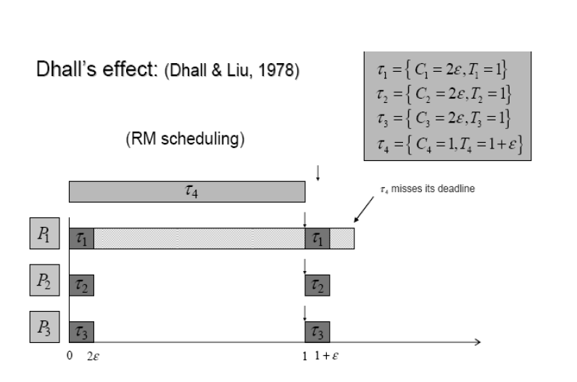
EDF can fail at very low utilizations

Slide 38
