Slide 1
Prospect 3 Travel
Molana Miri

Slide 2
“The world is a book and those who do not travel read only one page.”
St. Augustine

Slide 3
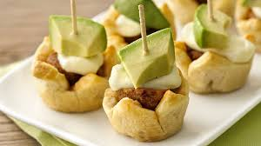
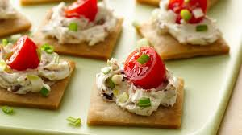
Pre-listening or appetizer
What are the main goals of pre-listening?
How can we achieve these goals?

Slide 4
Main Purpose/s | Suggested Strategies/ techniques
To activate background/world knowledge of Ss | brainstorming through concept/mind maps
To motivate the Ss or whet their appetites | A short role play or pantomime related to the theme of the lesson
To Set the context (i.e. Where and when is the listening occurring? who is talking to whom and about what?) | reading a simple text about the theme of the lesson
 | Drawing students’ attention toward the picture or title of the lesson Tell your students what they are going to listen and what the objective of the task is
 | Pre-teaching some of the key forms (i.e., words, phrases etc.)
 | Researching (i.e., looking up a word in a dictionary, surfing the net etc.)
 | prediction: Getting the students to predict the events of the audio file)

Slide 5
A mini-drama or role play
Setting 1: at home
S1 (father) is booking a hotel.
S2: (mother) is packing for a trip.
S3 (son) is buying a ticket online
They are driving to airport

Slide 6
Setting 2: at the airport
They are checking the timetable
The officer is checking their passports
Setting 3: at the hotel
The receptionist is welcoming them.
They are checking in.
Father is filling out a form.

Slide 7
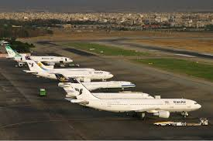
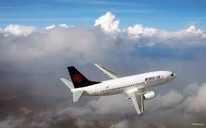
Brainstorming through mind/concept map
travel
سفر
at home
at the airport
at the hotel
Pack for a trip
Buy a ticket
Book a hotel
check the timetable
Check the passport
Check in at the hotel
Talk to a receptionist
Fill out a form

Slide 8
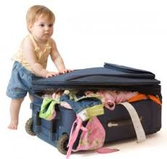
at home
He is packing for a trip.
Father is buying a ticket.
Mother is booking a hotel.

Slide 9
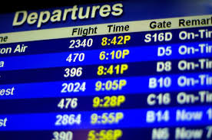
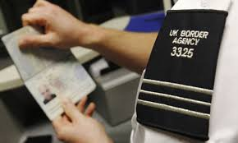
at the airport
He is checking the passport.
They are checking the timetable.

Slide 10
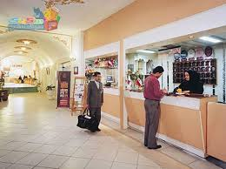
He is talking to a receptionist.
He is checking in.
Father is filling out the form.

Slide 11
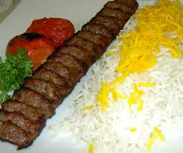
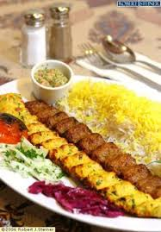
While-listening or the main dish
What are the main objectives of while listening?
How can we achieve these objectives?

Slide 12
Main Purpose/s | Suggested Strategies/ techniques
1. To expose students to comprehensible input | Clarify the objectives of listening (first objective is getting the gist of the audio text; for example, we can ask our students to listen and tell “what was the audio text about?” (first display of the audio)
2. Comprehension | Second objective can be looking for some details of the text. We can pose some questions about specific segments of the audio text, not too many since we may overload them. (second display)
3. To contextualize target forms and functions of the lesson | Note: For a more focused attention, you can write a couple of the questions on the board before listening

Slide 13
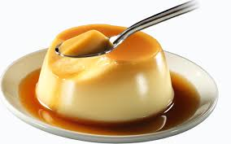
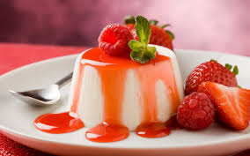
Post-listening or dessert
What are the main goals of post-listening?
How can we meet the objectives?

Slide 14
Main Purpose/s | Suggested Strategies/ techniques
To checking students’ comprehension | Asking different types of questions such display, inference and opinion
To focus on form (to draw students’ attention to some forms, especially those related to the theme of the lesson) | For example, The teacher ask the students to find the words or phrases related to the topic/theme of the lesson.
Evaluation (i.e., the students learn about their strength and weaknesses during listening. Also, the teacher can identify students’ listening problems) | The teacher can ask students to talk/write about the problems they had during listening (problems with words, structure, accent, pronunciation, background knowledge, rate of speech) (This objective can be sought either through English or Persian.)
To enhance learners awareness of helpful listening strategies | Group/pair work: students share the ways or strategies they used to induce the gist of the lesson (e.g., paying attention to key words) Whole class: The teacher can collect the strategies the students share in group work and then complement them. (Refer to TG for a nice list of strategies)

Slide 15
First play of CD
What did you get? What are they talking about?
Second play of CD
What’s the tourist’s name? (display questions)
Where is he from? (display questions)
Where is her wife standing? (display questions)
Where are they visiting? (display questions)
Which room are they staying in? (display questions)
Is the receptionist helpful? (inference)
Is Tehran beautiful? (opinion)

Slide 16
Grammar
Teaching grammar within communicative approach
Enriching teaching grammar through whole person activities

Slide 17
helping students “use the language accurately, meaningfully, and appropriately” (Larsen-Freeman, 2014, p. 258)

Slide 18
Problems with teaching grammar
In most cases grammar instruction is not integrated into the four skills but given in isolation.
Mostly it is teachers that formulate the grammar rules. Grammar rules will be clearer and be remembered better when students formulate them themselves (inductive learning) than when teachers formulate them (deductive learning).
Learners need repeated input of a grammar item. Just one grammar presentation is not enough.

Slide 19
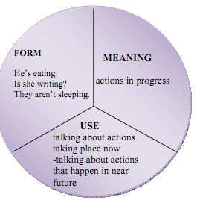
Grammar pie chart

Slide 20
Pre-grammar or the appetizer
Set the context or scene for the grammar
Use pictures/flashcards
Use realia
Pantomime
A short role play

Slide 21
While-teaching or main dish
Affirmative sentences
I | am | speaking | Persian.
He | is |  | Arabic.
She | are |  | English

Slide 22
While-teaching grammar
Use whole-person activities. For instance, use hopping grammar to engage learners’ bodies and hearts
Also, pantomime can engage the learners’ mind, bodies and hearts in grasping grammar
Making use of flashcards can also help the learners to actively elicit the rules of grammar

Slide 23
You can get students to elicit or induce the rules.
Discovery or inductive learning

Slide 24
Post-grammar
Find it
Tell your classmates
LRW
RSLW
Role play

Slide 25
Yes/No questions

Slide 26
Pre-grammar or appetizer
A picture
Pantomime
A clip

Slide 27
While-grammar or main dish
Yes/No questions
Is | he | reading | a novel?
 | she |  | a short story?
 | Sara |  | a newspaper?
Are | you |  | a poem?
 | they |  | a letter?
Am | I |  | a newspaper?

Slide 28
Post-grammar or dessert
Find it
Tell your classmates
LRW
RSLW
Role play

Slide 29
Wh questions

Slide 30
Pre-grammar or appetizer
Set the context by a picture, pantomime, role-play, etc.

Slide 31
While-grammar or main dish

Slide 32
Wh Questions |  |  |  | answer
What | is | he | Reading? | A novel A newspaper A short story A poem
 |  | she
 |  | Sara
 | are | they
 |  | you
 | am | I
Wh Questions
Where | is | he | Reading? | In the park at school At home
 |  | she
 |  | Sara
 | are | they
 |  | you
 | am | I

Slide 33
Wh Questions answers
How | is | he | travelling? | By train By car By plane
 |  | she
 |  | Sara
 | are | they
 |  | you
 | am | I
Wh Questions answers
who | is | reading | a book? a newspaper? a novel? | Ali Sara My father
 | are
 | am

Slide 34
Using poetry
What are you reading Tom?
I am reading a novel mom?
A boy is travelling to Tehran.
He is visiting Golestan.
Where is he staying Tom?
He is staying at a hotel mom.
He is in room number seven!
It’s the best! It’s heaven!

Slide 35
Post-grammar or dessert
Find it
Tell your classmates
LRW
RSLW
Role play

Slide 36
See also
Treat this section as a grammatical section

Slide 37
Speaking

Slide 38
Pre-speaking or the appetizer
Objective | Strategies/techniques
Setting the scene or context | Brainstorming through a concept map/mind map
Activating students’ background/world knowledge | Brainstorming through wh-questions
Motivating the students to get engaged in the task wholeheartedly | Show them a picture or video clip about the topic to prepare them mentally
Eliciting some of the required forms (i.e., words, grammar etc.) from the students. We should elicit the forms which are closely related to the speaking task with regard to theme or function etc. | Raise an issue and have them discuss it either in Persian or English

Slide 39
While-Speaking or main dish
objectives | Strategies/activities
Students are supposed to produce either a monologue or dialogue. | Pair/group work
 | The teacher should move around and assist the students, if needed.
 | Firstly, we should ask some volunteers o carry out their task and then get others to do it. The teacher should let students talk and note own errors.

Slide 40
Post-speaking or dissert
objectives | Strategies
feedback | Focused/unfocused feedback Graduated feedback
Evaluation and planning for next speaking task

Slide 41
You see a silent movie about a family travelling to Tehran. Try to report it.
You should answer the following questions:
What are they doing at home/airport/hotel?
How are they travelling?
What is their home like?
What is the hotel like?
What are Iranian people like?

Slide 42
Thanks for your warm attendance and rapt attention

