Slide 1
آشنایی با نرم افزار Microsoft Access
گروه کامپیوتر دانشگاه صفاهان
@Safahan_IT
محمد صمدیه
Moh.Samadieh@gmail.com

Slide 2
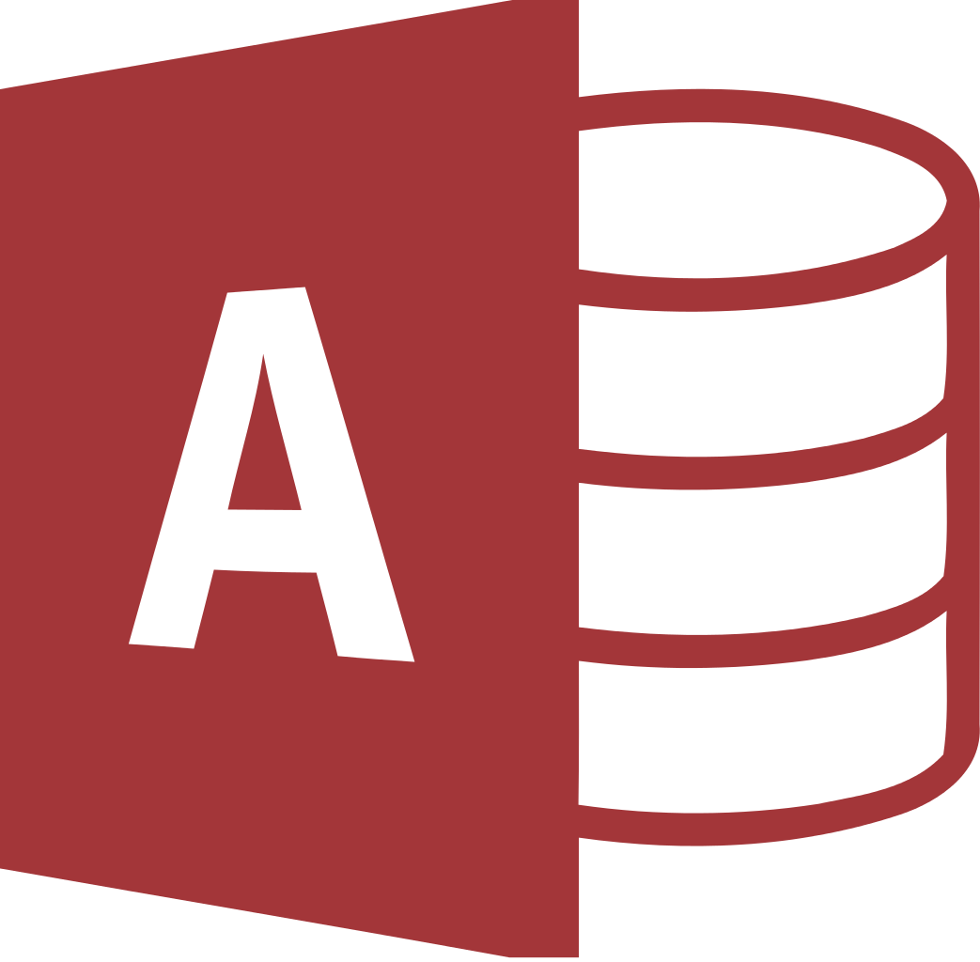
معرفی Access
Microsoft Access is a database management system (DBMS) from Microsoft
that combines the relational Microsoft Jet Database Engine with a graphical user interface and software-development tools.
It is a member of the Microsoft Office suite of applications, included in the Professional and higher editions or sold separately.
Microsoft Access stores data in its own format based on the Access Jet Database Engine. It can also import or link directly to data stored in other applications and databases.
Software developers, data architects and power users can use Microsoft Access to develop application software.
Like other Microsoft Office applications, Access is supported by Visual Basic for Applications (VBA), an object-based programming language that can reference a variety of objects including DAO (Data Access Objects), ActiveX Data Objects, and many other ActiveX components. Visual objects used in forms and reports expose their methods and properties in the VBA programming environment, and VBA code modules may declare and call Windows operating system operations.

Slide 3
تاریخچه Access
1992: Microsoft released Access version 1.0 on November 13, 1992, and an Access 1.1 release in May 1993 to improve compatibility with other Microsoft products and to include the Access Basic programming language.
1994: Microsoft specified the minimum hardware requirements for Access v2.0 as: Microsoft Windows v3.1 with 4 MB of RAM required, 6 MB RAM recommended; 8 MB of available hard disk space required, 14 MB hard disk space recommended. The product shipped on seven 1.44 MB diskettes. The manual shows a 1994 copyright date.
With Office 95, Microsoft Access 7.0 (a.k.a. "Access 95") became part of the Microsoft Office Professional Suite, joining Microsoft Excel, Word, and PowerPoint and transitioning from Access Basic to VBA. Since then, Microsoft has released new versions of Microsoft Access with each release of Microsoft Office. This includes Access 97 (version 8.0), Access 2000 (version 9.0), Access 2002 (version 10.0), Access 2003 (version 11.5), Access 2007 (version 12.0), Access 2010 (version 14.0), and Access 2013 (version 15.0).

Slide 4
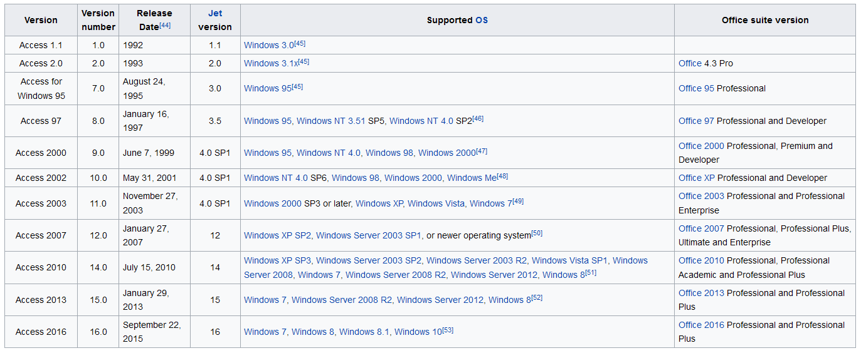
تاریخچه Access

Slide 5
امکانات Access
Users can create tables, queries, forms and reports, and connect them together with macros.
Advanced users can use VBA to write rich solutions with advanced data manipulation and user control.
The import and export of data to many formats including Excel, Outlook, ASCII, dBase, Paradox, FoxPro, SQL Server and Oracle
There is also the Jet Database format (MDB or ACCDB in Access 2007) which can contain the application and data in one file. This makes it very convenient to distribute the entire application to another user, who can run it in disconnected environments.

Slide 6
امکانات Access
One of the benefits of Access from a programmer's perspective is its relative compatibility with SQL (structured query language) — queries can be viewed graphically or edited as SQL statements, and SQL statements can be used directly in Macros and VBA Modules to manipulate Access tables. Users can mix and use both VBA and "Macros" for programming forms and logic and offers object-oriented possibilities. VBA can also be included in queries.
Microsoft Access is a file server-based database. Unlike client–server relational database management systems (RDBMS), Microsoft Access does not implement database triggers, stored procedures, or transaction logging.

Slide 7
Import or link sources
Microsoft Access
Excel
SharePoint lists
Plain text
XML
Outlook
HTML
ODBC-compliant data containers, including:
Microsoft SQL Server
Oracle
MySQL
PostgreSQL
IBM Lotus Notes
AS 400 DB2

