Slide 1
Cohesion and Coherence

Slide 2
TEXT
In real life, a sentence is rarely used in isolation. Normally, sentences- whether spoken or written- appear in a sequence, such as a dialogue, a speech, a letter, or a book. Any set of sentences which ‘cohere’ in this way is called a text which applies to both spoken and written material.
Texts are stretches of language treated only formally. It is the combination of formal features in our minds regardless of the contextual features outside the physical realization of language.
Cohesive Device: Cohesion device is the grammatical and lexical relationship within a text or sentences. It is used to connect ideas together. They are formal links between clauses.

Slide 3
Cohesion
Halliday and Hasan take the view that the primary determinant of whether a set of sentences do or do not constitute a text depends on cohesive relationships within and between the sentences, which create texture.
Texture: A text has texture and this is what distinguishes it from something that is not a text. The texture is provided by cohesive relation.

Slide 4
Cohesion
Cohesive relationships within a text are set up ‘ where the interpretation of some element in the discourse is dependent on that of another. The one presupposes the other in the sense that it cannot be effectively decoded except by resource to it. Consider Following sentence:
Of this text they say (Halliday & Hasan): ‘ It is clear that ‘them’ in the second sentence refers back to the ‘six cooking apples’ in the first sentence. This function gives cohesion to the two sentences, so that we interpret them as a whole that two sentences together constitute a text.
“Wash and core six cooking apples. Put them into a fire-proof dish.”

Slide 5
Cohesion
Halliday and Hasan outlined a taxonomy of types of relationships which can be formally established within a text, providing cohesive ties which bind a text together.
A familiar type of explicitly marked cohesive relationship in texts is indicated by formal markers which relate what is about to be said to what has been said before- markers like and, but , so and then.

Slide 6
Cohesion
The Taxonomy of Types of Explicit Markers of Conjunctive Relations:
Type | Examples
Adversative | but, however, on the other hand
Casual | so , consequently, for this reason
Temporal | then, finally, at last, after that
Additive | and, or, furthermore, in addition

Slide 7
Lexical and Grammatical Cohesion
Cohesion can be achieved through lexical items and meaning and also through grammar. Lexical cohesion can happen through word repetition, synonyms, super-ordinates, opposites and collocation. Grammatical cohesion happens through substitutes, ellipsis, reference words and connectives.

Slide 8
Lexical Cohesion
Word Repetition: It is one thing that makes texts cohesive and coherent. It includes both function words and content words, specially the latter. Repetition of patterns is another device, often used in speeches, poetry and prayers.
Example:
A: Oh, are you playing the recorder too
B: I play the recorder too and I find this quite amusing…

Slide 9
Lexical Cohesion
Synonyms: Synonyms and words with a related meaning are another device but it is hard to find two words with exact meaning (sofa and couch). Using synonyms adds variety. We can use words of different parts of speech (hammer, hammering). Different synonyms are used in different registers (bye, farewell).
Example:
I did well on the hard science test because I studied the difficult material.
We will find the way if we stay on the right path.

Slide 10
Lexical Cohesion
Superordinate:
These are words with general meanings (Brazil-Country). The general word is superordinate and the other specification is hyponym. Other related hyponyms are called co-hyponyms. A hyponym has a fuller and richer meaning than its superordinate. The usual pattern is for the hyponym to come first in text, followed by superordinate.
Example:
We learned Esperanto, but it was not a good language.

Slide 11
Lexical Cohesion
Opposites:
Words with opposite meanings are another device. Opposites are words that lie in an inherently incompatible binary relationship.
Types of opposites:
Binary Opposites: either or type: example: male/ female
Absolute Opposites: You can’t be partly male or female. You are 100% male/ female. These words are incompatible with each other. Example: Dead/ alive
Multiple Opposites: Where there are more than two alternatives.
Example: Colors
Antonyms: They are on a scale. Example: Simple vs. complex
Converses: Parents and children. X is the parent of Y and conversely.

Slide 12
Lexical Cohesion
Collocation:
A collocation is two or more words that often go together. These combinations just sound "right" to native English speakers, who use them all the time. On the other hand, other combinations may be unnatural and just sound "wrong".
Example:
Natural English | Unnatural English
the fast train fast food | the quick train quick food
a quick shower a quick meal | a fast shower a fast meal

Slide 13
Grammatical Cohesion
Substitutes:
It is substituting words which have already been used. The most common are (one, do and so). Substitutes can be for nouns verbs and clauses.
Ellipsis:
In some contexts, it is possible to leave out a word or phrase rather than repeating it. This word ellipsis comes from the Greek word “ellespian”, meaning to leave out. Ellipsis can also be for nouns, verbs or clauses.
Substitution and ellipsis are very similar, but in substitution a particular word refers back to something existing in the text, while in ellipsis a gap in the text is refered back to.

Slide 14
Grammatical Cohesion
Reference Words:
These are words whose meaning is understood in their environment. They don’t have meaning on their own. They depend on the surrounding text and the real world. The first one is “ text reference” and second one is “situation reference”.
* Reference words include “personal pronouns”, “demonstratives” and “comparative constructions”. Reference can be exophoric outside the text (look at that(……….)) or endophoric inside the text.

Slide 15
Grammatical Cohesion
Endophoric:
Endophoric references are either anaphoric (referring back in text) or cataphoric (refers forward in text) for their interpretation.
Example:
a)Look at the sun. It’s going down quickly.
anaphoric
b) It’s going down quickly, the sun.
cataphoric

Slide 16
Grammatical Cohesion
Type | Example
Repeated form | The Prime Minister recorded her thanks to the Foreign Secretary. The Prime Minister was most eloquent.
Partially repeated form | Dr. E.C.R. Reeve chaired the meeting. Dr. Reeve invited Mr. Phillips to report on the state of the gardens.
Lexical replacement | Ro’s daughter is ill again. The child is hardly ever well.
Pronominal form | Ro said she would have to take Sophie to the doctor.
Substituted form | Jules has a birthday next month. Elspeth has one too.
Elided form | Jules has a birthday next month. Elspeth has too.
Co-reference relationships:

Slide 17
Grammatical Cohesion
Connectives or Conjunctions:
They are represent specific connection between parts of a text. They presuppose a textual sequence. They can be explicit or implicit; The most comprehensive category is by Halliday:
TYPE | SUBTYPES | EXAMPLES
Elaboration | Apposition | In other words
 | Clarification | Or, rather
Extension | Addition | and, but
 | Variation | Alternatively
Enhancement | Spatio-temporal | there, previously
 | Casual- Conditional | consequently

Slide 18
Q: Should cohesive markers exist in a text?
A:
Halliday and Hasan believe that it is the underlying semantic relation which actually has the cohesive power, rather than the particular cohesive marker. In other words, the relation can be held to exist in the absence of formal markers. But they insist that it is the presence of the cohesive markers which constitute textness.
We should make a distinction between meaning relations which hold between items in a text and the explicit expression of these meaning relations within a text.
It is the “underlying semantic relation” which has the cohesive power.

Slide 19
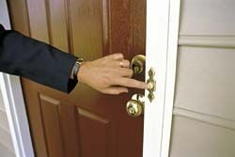
Q:Should these relations be explicit?
A:
Halliday and Hasan insist on this explicit representation relations for a text to have texture. However, it is easy to find texts which we easily co-interpret, display few, if any, explicit markers of cohesive relations.
Examples:
A: There is the doorbell. B: I am in the bath.
Or
A:Thank you very much for your comments about voicing. I will eventually get back to that lesson.
Here, there are semantic relations in the sentence, in the absence of any explicit representation.
Texture, in the sense of explicit realization of semantic relations, is not critical to the identification and co-interpretation of texts.

Slide 20
Q: Is formal cohesion sufficient to guarantee identification as a text?
A: Clearly, formal cohesion will not guarantee identification as a text, nor does answering our question guarantee textual coherence. An obvious test here would be to take out any narrative text and, leaving the first sentence, scramble the next few sentence. Does what follows constitute a text?
Texts are what hearers or readers treat as text, they depend on interpretations and expectations.

Slide 21
Q: Is formal cohesion sufficient to guarantee identification as a text?
Formal links reinforce textness and unity, but they cannot create it on their own. They are neither necessary nor sufficient.
Example:
A: The window is open.
B: Go back to sleep, will you? (or)
B: Don’t worry. (or)
B: Holmes! It was the gardener!

Slide 22
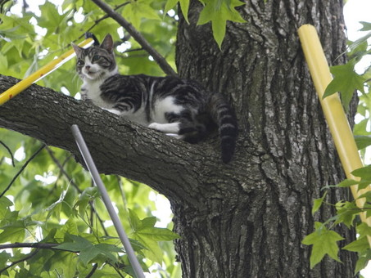
Functions and Coherence
We should look beyond the literal and formal meaning of what is said and consider the message, its function.
People interpret functions of what others say and expect other people to interpret their own.
Example:
Old woman: Sorry, love. I saw you were home. There is a cat stuck on the tree.

Slide 23
Main aspects of interpreting the intended meaning
1) Computing the communicative function (how to take the message)
2) Using general socio-cultural (world) knowledge
3) Determining the inferences to be made

Slide 24
Interpreting the intended meaning
Labov (1970) argues that there are rules of interpretation which relate what is said to what is done and it is on the basis of such social, but not linguistic, rules that we interpret some conversational sequence as coherent and others as non-coherent. As an example of a non coherent conversational sequence, Labov quotes the following example of a doctor talking to a schizophrenic patient, from Laffal (1985).
A: What’s your name?
B: Well, let’s say you might have thought you had something from before, but you haven’t got it anymore.
A: I’m going to call you Dean.

Slide 25
Interpreting the intended meaning
Labove points out that the recognition of coherence or incoherence in conversational sequences is not based on a relationship between utterances, but “between the actions performed with those utterances”

Slide 26
Coherence
What language users have in mind is an assumption of coherence, that what is said or written will make sense in terms of their “ normal experience” of things. That normal experience will be locally interpreted and will be tied to the familiar and the expected:
Example: 1) Plant Sale vs. 2) Garage Sale
. We need to make instant interpretations of familiar material and tend not to see possible alternatives:
Example: How many animals of each type did Moses take on the ark?

Slide 27
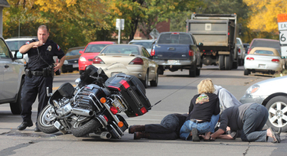
Coherence
Example:
A motor vehicle accident was reported
involving a male and a female.
* We automatically ‘fill in’ details to create coherence. We also construct familiar scenarios, in order to make sense of what might have happened.
Example:
Headline: Man Robs Hotel with Sandwich.

Slide 28
Scheme
It refers to the storage and use of background knowledge.(plural: schemata). A scheme is pre-existing knowledge structure in memory.
In a strong view, schemata are considered to be deterministic, to predispose the experiencer to interpret his experience in a fixed way.
Schemata can be seen as the organized background knowledge which leads us to expect or predict aspects in our interpretation of discourse. There is also evidence that such expectations influence what type of discourse we produce.

Slide 29
Frames
Our knowledge is stored in memory in the form of data structures, which is called ‘frames’, and which represent stereotyped situations. They are used in the following way:
When one encounters a new situation (or makes a substantial change in one’s view of the present problem) one selects from memory a structure called a Frame. This is a remembered framework to be adopted to fit reality by changing details as necessary.

Slide 30
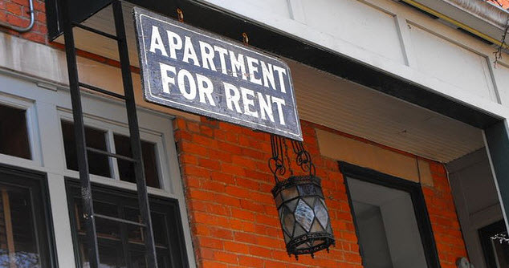
Frames
If there is a fixed, static pattern to schemata, it is called frame.
A frame shared by every one within social group would be something like a prototypical version:
Example:
Advertisement: Apartment for rent,500$.

Slide 31
Script
When more dynamic types of schemata are considered, they are often described as scripts. It is a pre-existing knowledge structure involving event sequences
We use frames and scripts to build interpretations of account of what happened, for example in doctor’s office, restaurant, etc.
Because most details of a script are assumed to be known, they are unlikely to be stated. Shared scripts allow much to be communicated that is not shared.

Slide 32
Scenarios
It is the extended domain of reference which is used in interpreting written texts, since one can think of knowledge of settings and situations as constituting the interpretive scenario behind a text.
According to the scenario account, a text about Going to a Restaurant automatically brings a waiter slot into the representation.
Example:
A | B
Title: In court | Title: Telling a lie
Ss: Fred was being questioned. He had been accused of murder. | Ss: Fred was being questioned. He couldn’t tell the truth.
Target: The lawyer was trying to prove his innocence | Target: The lawyer was trying to prove his innocence

