Slide 1
VITAMIN ```K```

Slide 2
History of discovery in 1929,Danish scientist Henrik dam investigated the role of cholesterol by feeding chickens a cholesterol-depleted diet.after several weeks,the animals developed hemorrhages and started bieeding.these defects could not be restored by adding purified cholesterol to the deit.it appeared that-thogether with the cholesterol-a second compound had been extracted from the food,and this compound was called the coagulation vitamin.the new vitamin received the letter k beacause the initial discoveries were reported in a German journal,in which it was designated as koagulationsvitamin.Edward Adelbert Doisy of Saint Louis University did much of the structure and chemical nature of vitamin k.Dam and Doisy shared the 1943 Nobel prize for medicine for their work on vitamin k published in 1939.several laboratories synthesized the compound in1939.

Slide 3
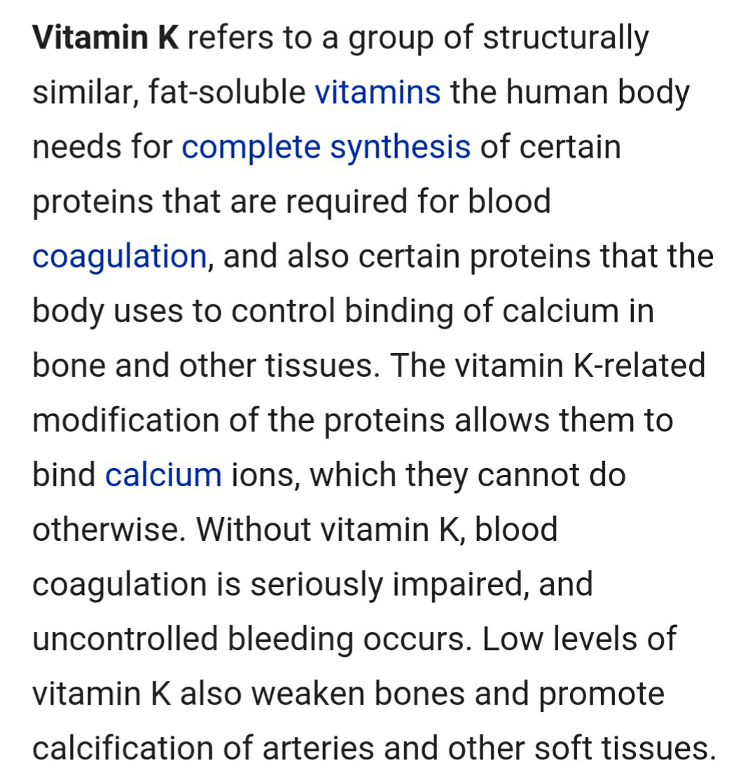

Slide 4
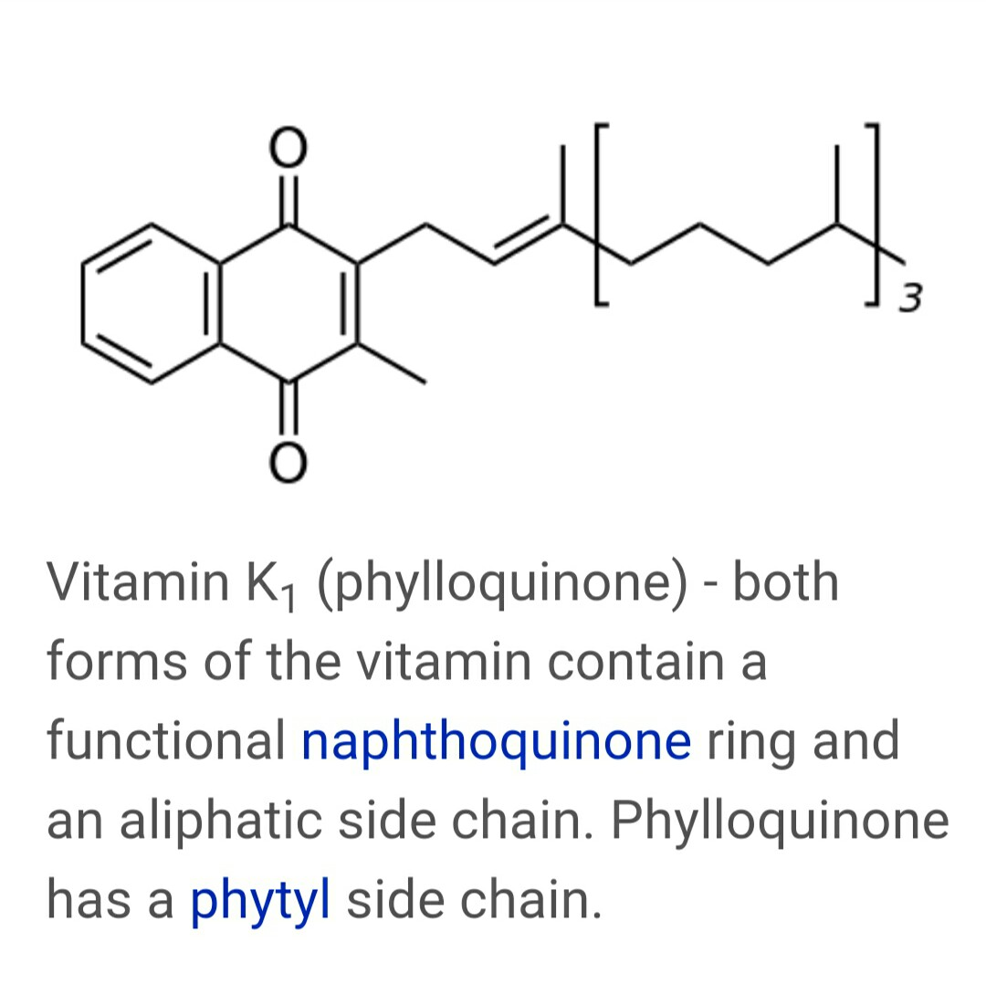

Slide 5
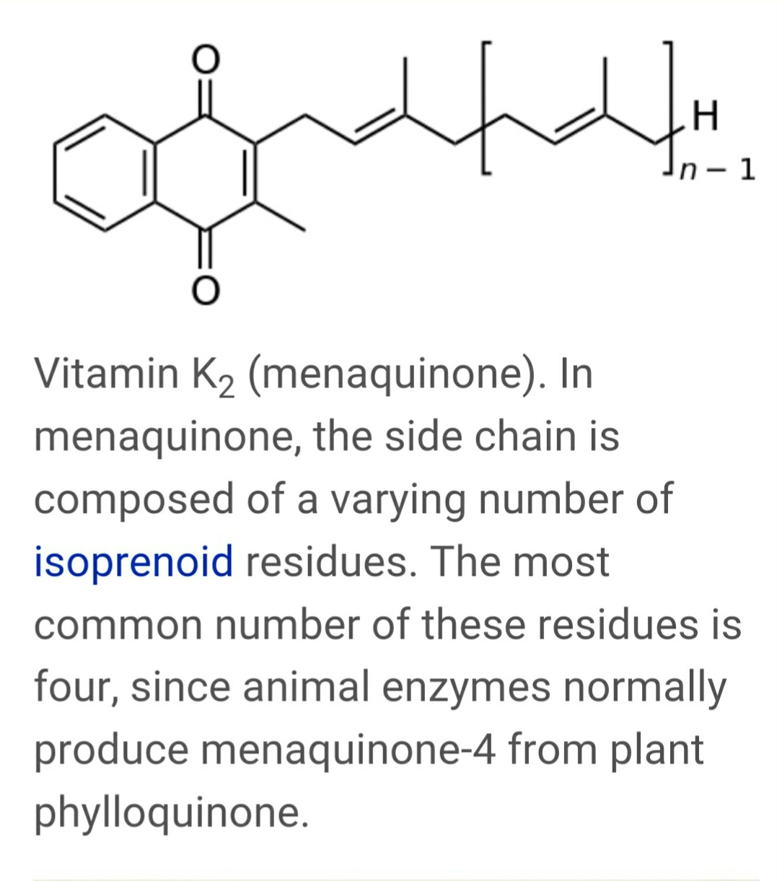

Slide 6
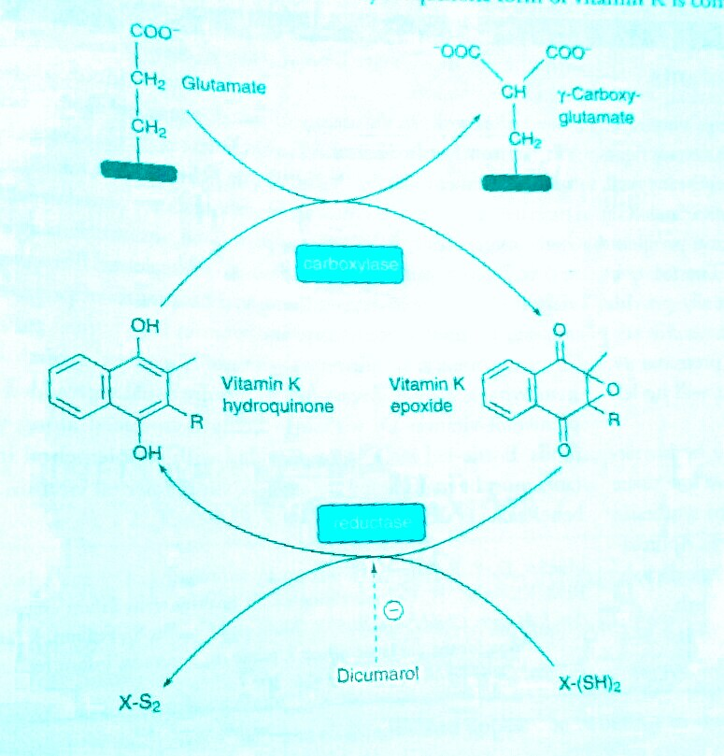
Blood coagulation

Slide 7
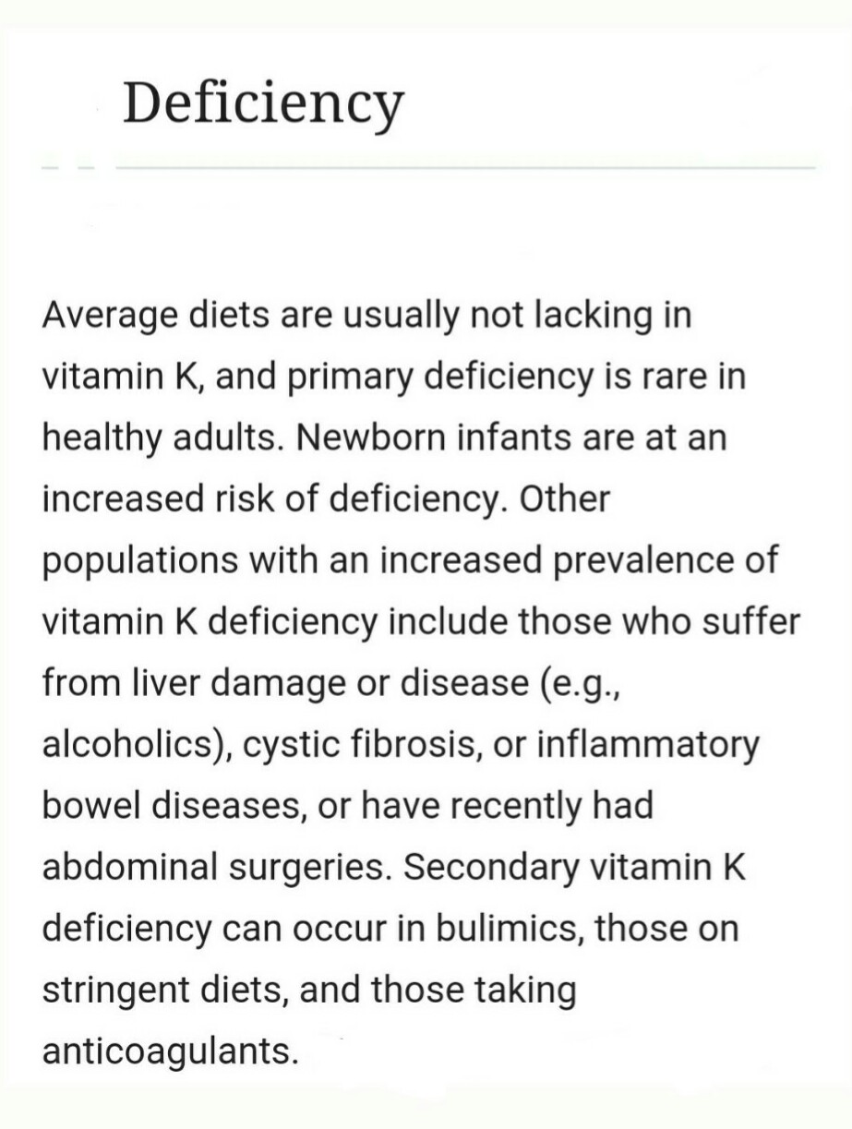

Slide 8
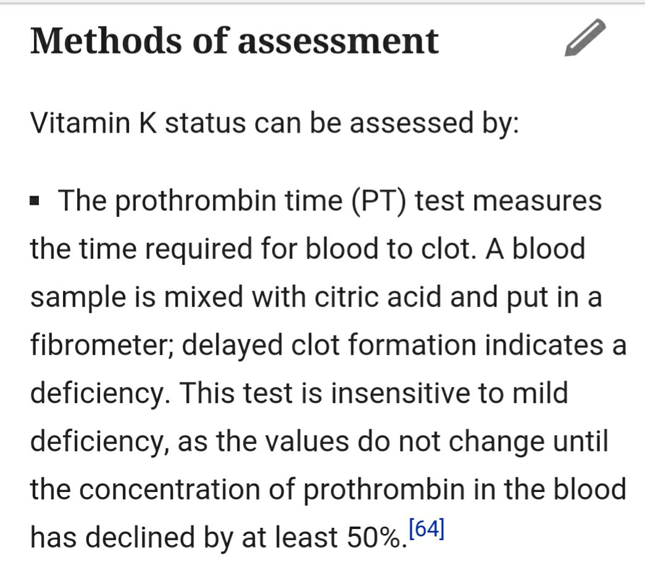

Slide 9
arthritis

Slide 10
osteoporosis

Slide 11
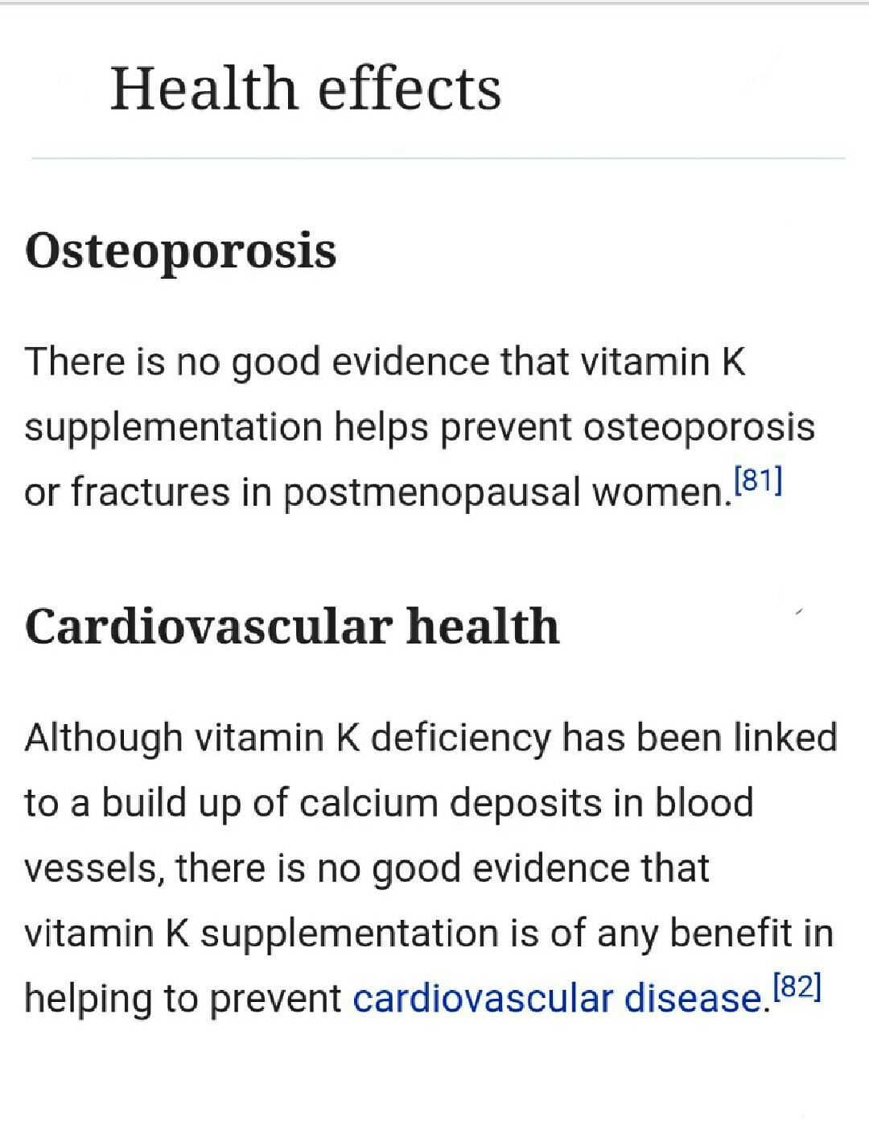

Slide 12
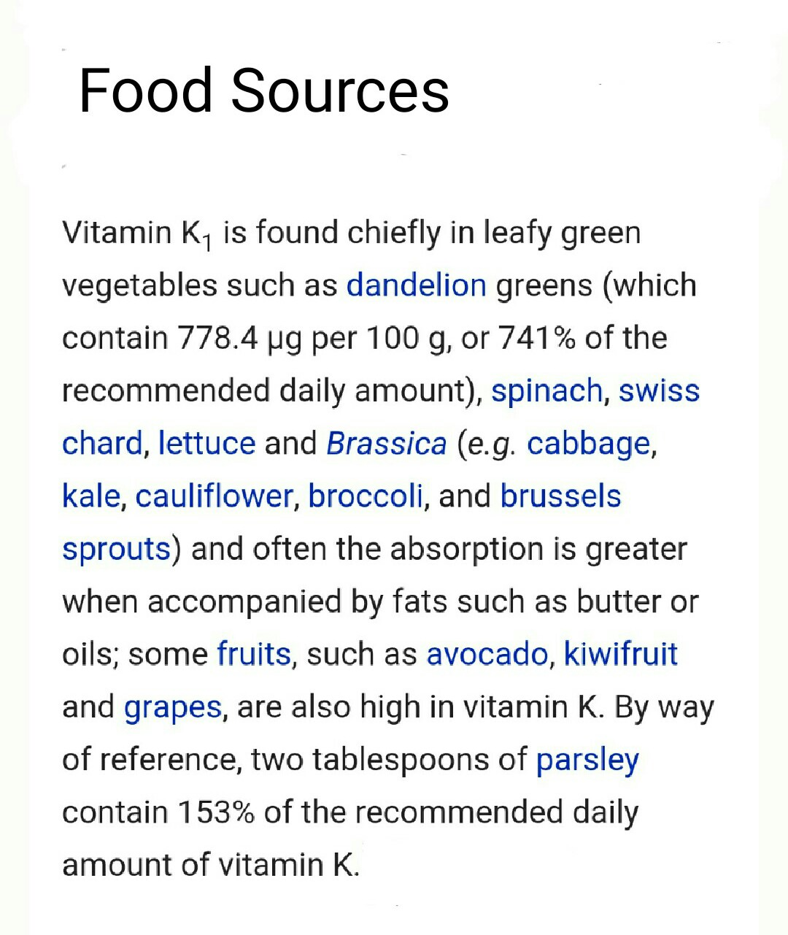

Slide 14
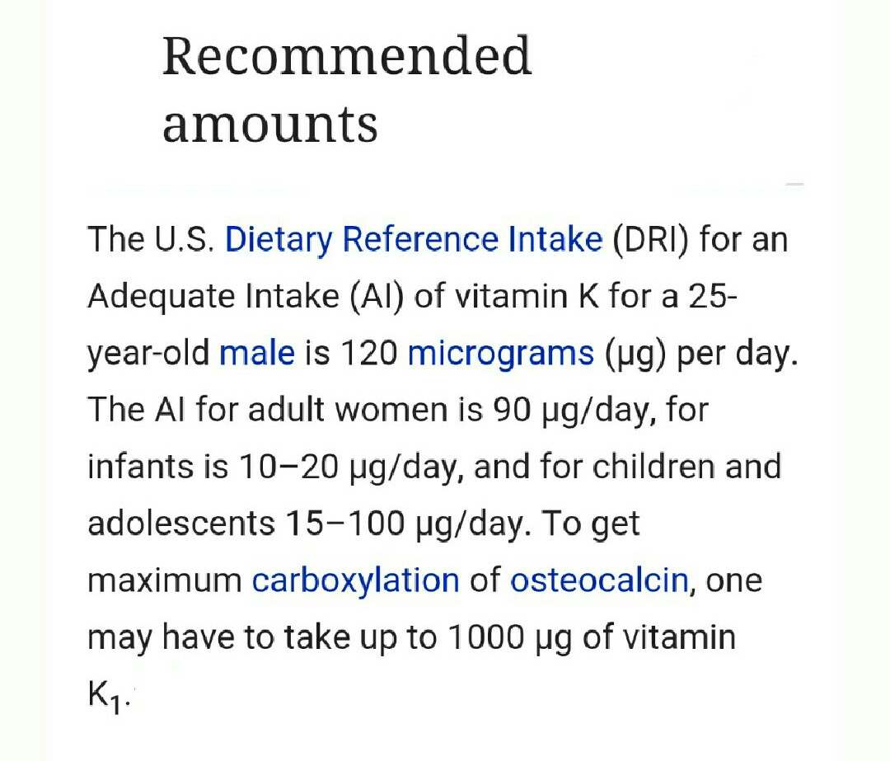

Slide 15
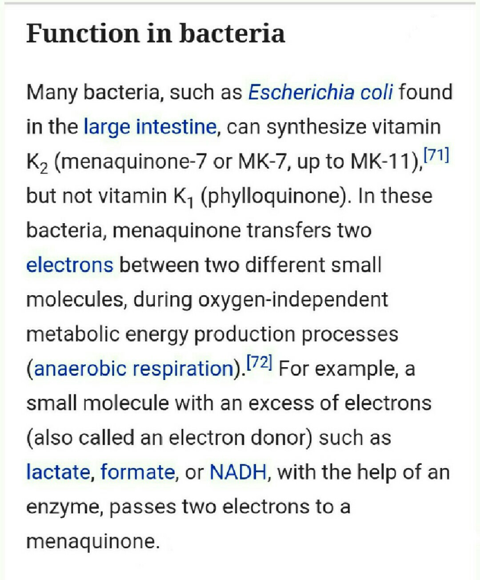

Slide 16
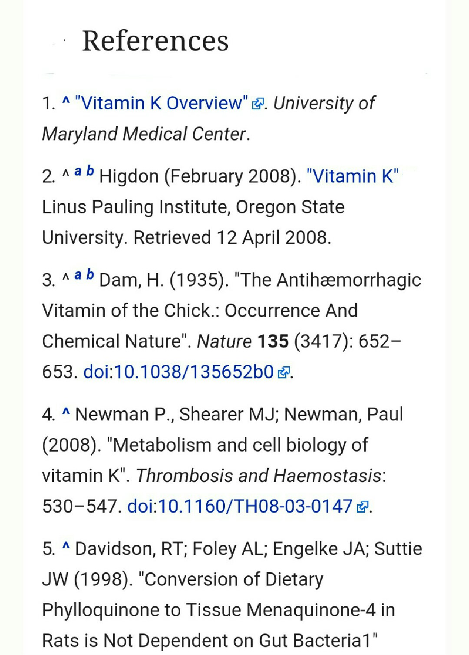

Slide 17
شاد کامی برای همگان

