Slide 1
Wireless Sensor Networks
6.1
Advanced Computer Networks
By: Mahdi Sadeghizadeh

Slide 2
What is Wireless Sensor Networks ?
Wireless Sensor Network
WSN
Wireless Network
Technology
Computational
Power
Sensor
Technology

Slide 3
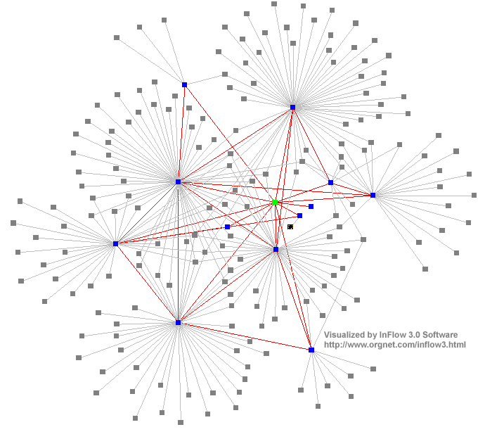
Network
In general, the term network can refer to any interconnected group or system.
A network is any method of sharing information between two systems.

Slide 4
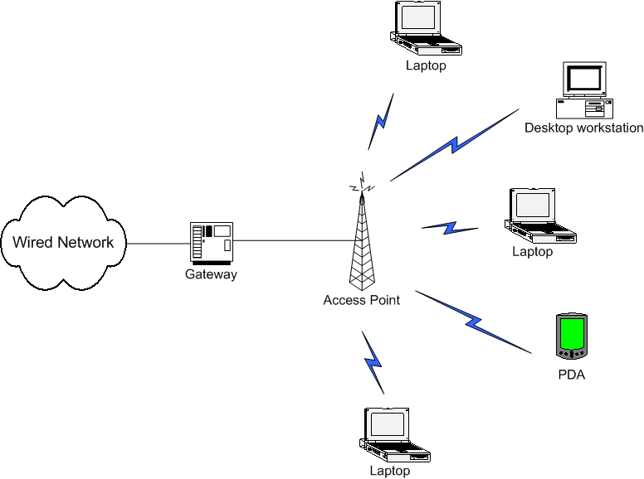
Wireless Networking

Slide 5
Deployment Challenges - Wireless
Transmission Medium
  Vegetation vs desert
  High vs low humidity etc
Coverage
  What is the range of the mote?
  Break vs Re-associate distance
Connectivity
  How stable is the connection?
  How is it affected by the change in battery voltage?
Power consumption
  How much power does the radio use?
  What happens when the voltage drops?

Slide 6
Types of Wireless Networks
Infrastructure-based Wireless Networks
Infrastructure-free Wireless Networks (Ad hoc Networks)

Slide 7
Infrastructure-based Wireless Networks
Typical wireless network: Based on infrastructure
  E.g., GSM, UMTS, …
  Base stations connected to a wired backbone network
  Mobile entities communicate wirelessly to these base stations
  Traffic between different mobile entities is relayed by base stations and wired backbone
  Mobility is supported by switching from one base station to another
  Backbone infrastructure required for administrative tasks
IP backbone
Further networks
Gateways
Server
Router

Slide 8
Infrastructure-based Wireless Networks
What if …
  No infrastructure is available? – E.g., in disaster areas
  It is too expensive/inconvenient to set up? – E.g., in remote, large construction sites
  There is no time to set it up? – E.g., in military operations
  ?

Slide 9
Solution: (Wireless) Ad hoc Networks
Try to construct a network without infrastructure, using networking abilities of the participants
  This is an ad hoc network – a network constructed “for a special purpose”
Simplest example: Laptops in a conference room –
a single-hop ad hoc network

Slide 10

Possible Applications for Infrastructure-free Networks
Factory floor automation
Disaster recovery
Car-to-car communication
Military networking: Tanks, soldiers, …
Finding out empty parking lots in a city, without asking a server
Search-and-rescue in an avalanche
Personal area networking (watch, glasses, PDA, medical appliance, …)
…

Slide 11
Problems/challenges for ad hoc networks
Without a central infrastructure, things become much more difficult
Problems are due to
  Lack of central entity for organization available
  Limited range of wireless communication
  Mobility of participants
  Battery-operated entities

Slide 12
No central entity ! self-organization
Without a central entity (like a base station), participants must organize themselves into a network (self-organization)
Pertains to (among others):
  Medium access control – no base station can assign transmission resources, must be decided in a distributed fashion
  Finding a route from one participant to another
Notes:
Depend on

Slide 13
Limited range ! multi-hopping
For many scenarios, communication with peers outside immediate communication range is required
  Direct communication limited because of distance, obstacles, …
  Solution: multi-hop network
?

Slide 14
Mobility ! Suitable, adaptive protocols
In many (not all!) ad hoc network applications, participants move around
  In cellular network: simply hand over to another base station
In mobile ad hoc networks (MANET):
  Mobility changes neighborhood relationship
  Must be compensated for
  E.g., routes in the network have to be changed
Complicated by scale
  Large number of such nodes difficult to support
Notes:
Attention to

Slide 15
Battery-operated devices ! energy-efficient operation
Often (not always!), participants in an ad hoc network draw energy from batteries
Desirable: long run time for
  Individual devices
  Network as a whole
! Energy-efficient networking protocols
  E.g., use multi-hop routes with low energy consumption (energy/bit)
  E.g., take available battery capacity of devices into account
  How to resolve conflicts between different optimizations?

Slide 16
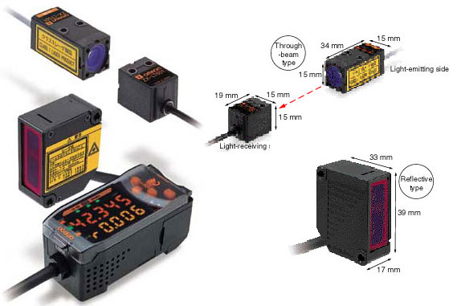
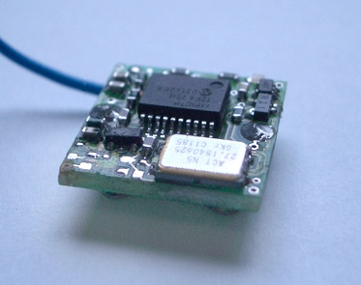
Sensor
A SENSOR is a device which measures a physical quantity and converts it into a signal which can be read by an observer or by an instrument.
Technological progress allows more and more sensors to be manufactured on a microscopic scale as microsensors using MEMS (Micro-Electro-Mechanical Systems) technology.

Slide 17
Types of Sensor
Thermal
Electromagnetic
Mechanical
Chemical
Optical radiation
Ionizing radiation
Acoustic

Slide 18

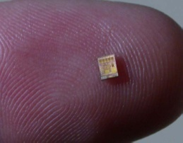
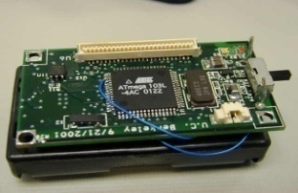
Types of Sensor-Actuator Hardware Platforms
RFID equipped sensors
Smart-dust tags
  typically act as data-collectors or “trip-wires”
  limited processing and communications
Mote/Stargate-scale nodes
  more flexible processing and communications
More powerful gateway nodes, potentially using wall power

Slide 19
Deployment Challenges - Sensor
What kind of sensor modality should be used? – PIR, acoustic, magnetic, seismic…
What is the range of the sensor?
How reliable is the sensor?
What is the resolution of the sensor?
How much power does the sensor use?
What is the cost of the sensor?

Slide 20
Wireless Sensor Networks
A wireless sensor network (WSN) is a wireless network consisting of spatially distributed autonomous devices using sensors to cooperatively monitor physical or environmental conditions, such as temperature, sound, vibration, pressure, motion or pollutants, at different locations.
Wireless Sensor Networks are networks that consists of sensors which are distributed in an ad hoc manner.
These sensors work with each other to sense some physical phenomenon and then the information gathered is processed to get relevant results.
Wireless sensor networks consists of protocols and algorithms with self-organizing capabilities.
Notes:
Events- situable

Slide 21
Wireless Sensor Networks
Participants in the previous examples were devices close to a human user, interacting with humans
Alternative concept:
Instead of focusing interaction on humans, focus on interacting with environment
  Network is embedded in environment
  Nodes in the network are equipped with sensing and actuation to measure/influence environment
  Nodes process information and communicate it wirelessly
! Wireless sensor networks (WSN)
  Or: Wireless sensor & actuator networks (WSAN)

Slide 22
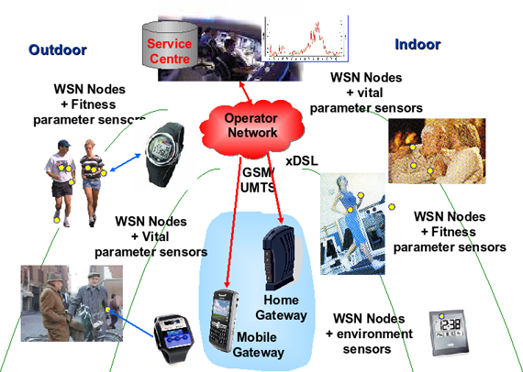
Example of WSN

Slide 23
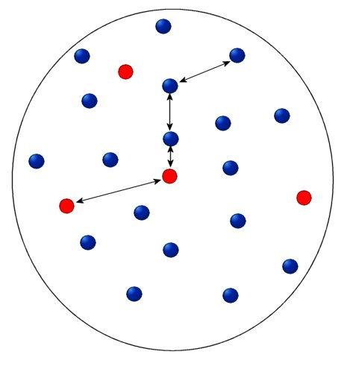

WSN Communications Architecture
Sensing node
Sensor nodes can be
data originators and
data routers
Internet
Sink
Manager Node
Sensor nodes
Sensor field

Slide 24
Roles of participants in WSN
Sources of data: Measure data, report them “somewhere”
  Typically equip with different kinds of actual sensors
Sinks of data: Interested in receiving data from WSN
  May be part of the WSN or external entity, PDA, gateway, …
Actuators: Control some device based on data, usually also a sink

Slide 25
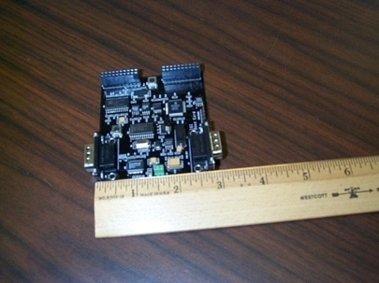
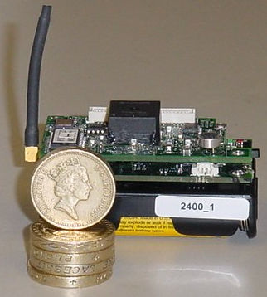
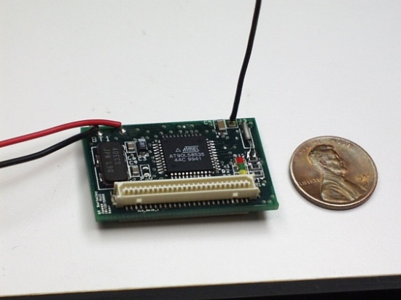
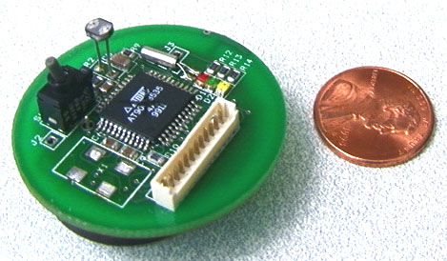
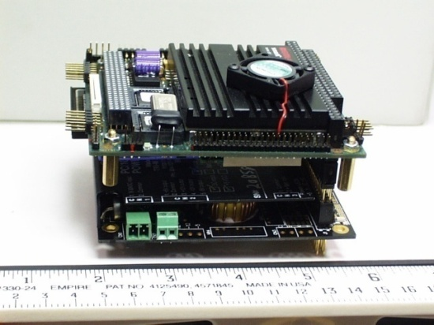
Sensor Node
Sensing
Computing
Communication

Slide 26
WSN Node Components
Networks of typically small,
battery-powered, wireless devices.
  On-board processing,
  Communication, and
  Sensing capabilities.
In addition to one or more sensors, each node in a sensor network is typically equipped with a radio transceiver or other wireless communications device, a small microcontroller, and an energy source, usually a battery.
Sensors
P
O
W
E
R
Storage
Processor
Radio
WSN device schematics

Slide 27
WSN Node Components
Low-power processor.
  Limited processing.
Memory.
  Limited storage.
Radio.
  Low-power.
  Low data rate.
  Limited range.
Sensors.
  Scalar sensors: temperature, light, etc.
  Cameras, microphones.
Power.
Sensors
P
O
W
E
R
Storage
Processor
Radio
WSN device schematics

Slide 28
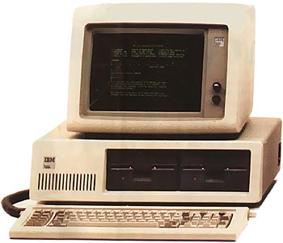
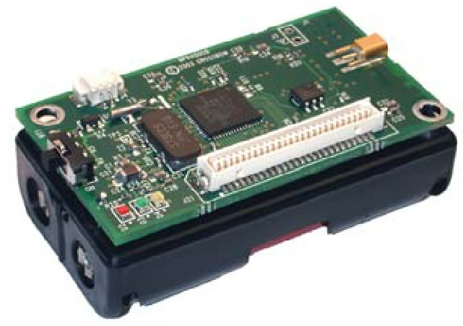
Computer Revolution
Original IBM PC (1981)
MICAZ Mote (2005)
4.77 MHz
4 MHz
16-256 KB RAM
128 KB RAM
160 KB Floppies
512 KB Flash
~ $6K (today)
~ $35
~ 64 W
~14 mW
25 lb, 19.5 x 5.5 x 16 inch
0.5 oz, 2.25 x 1.25 x 0.25 inch

Slide 29
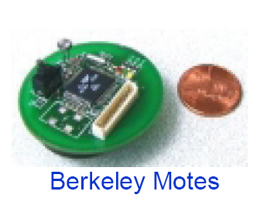
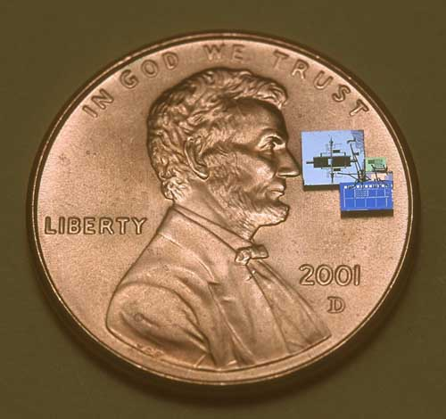
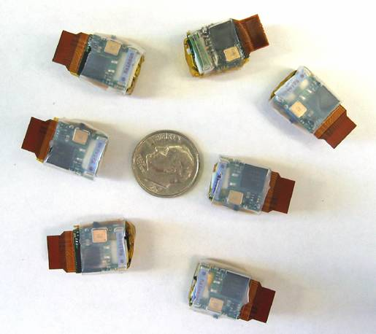

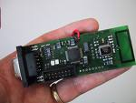
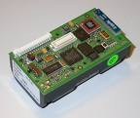
Some Example of Sensor Nodes
Smart Dust
Eco Motes
EYES Node
Scatterweb
BTnode

Slide 30
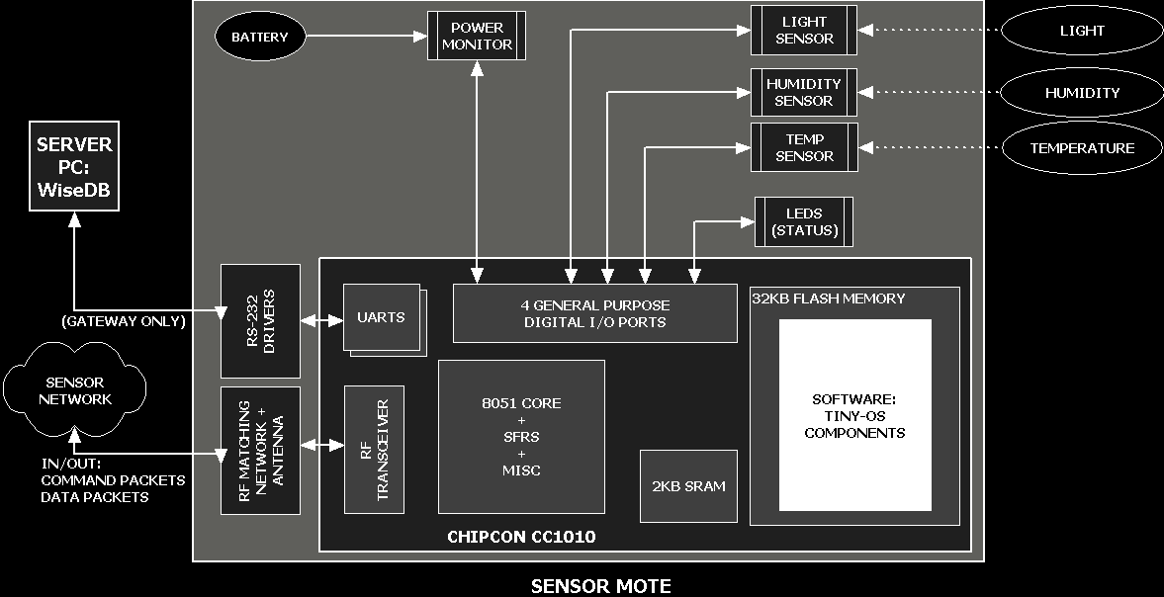
Block Diagram – Mote

Slide 31
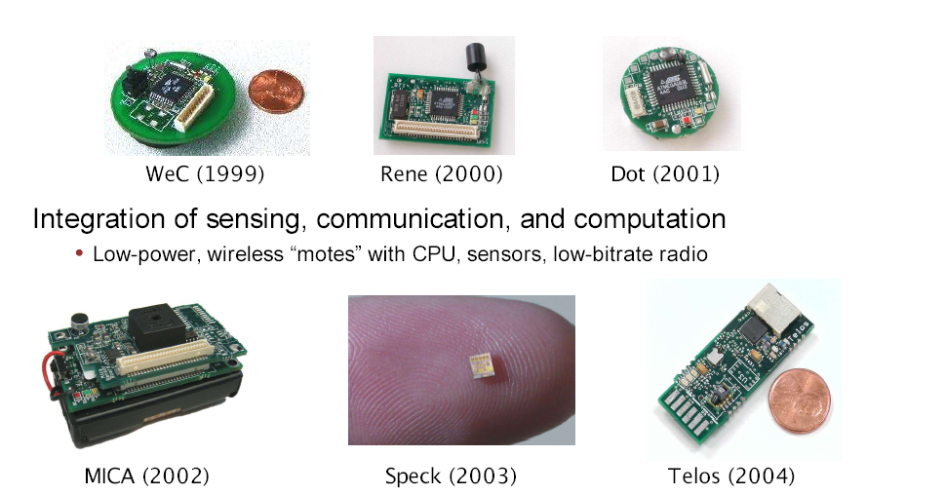
WSN: “Motes”

Slide 32
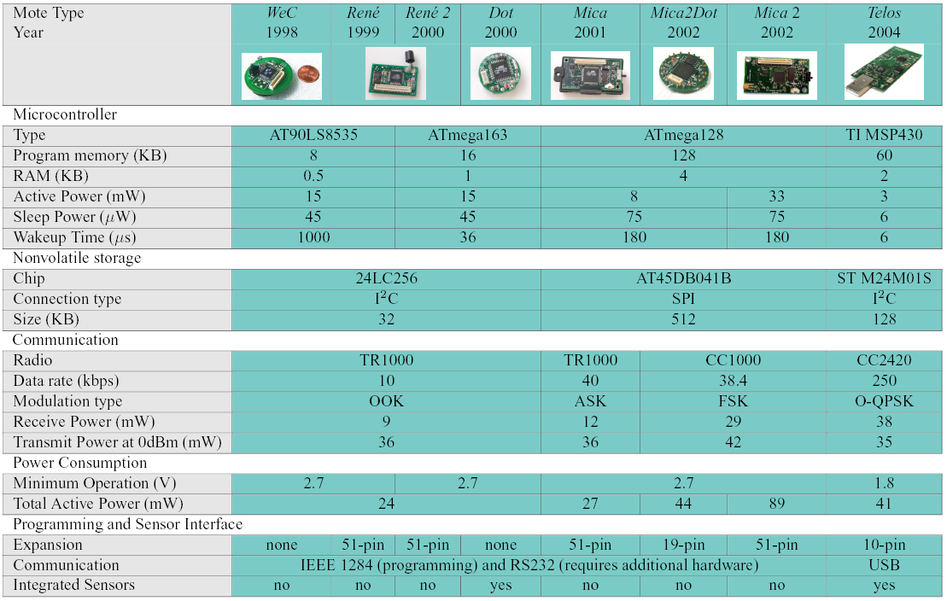
Mote Evolution

Slide 33
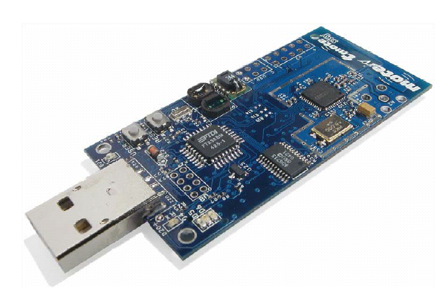
TMote (Telos)
Standards Based
  USB
  IEEE 802.15.4
    CC2420, 250kbps at 2.4GHz
Features:
  TI MSP430:
    10kB RAM, 4Mhz 16-bit RISC, 48K Flash
    12-bit ADC and DAC (200ksamples/sec)
    DMA transfers while CPU off
  Integrated antenna
  Standard IDC connectors

Slide 34
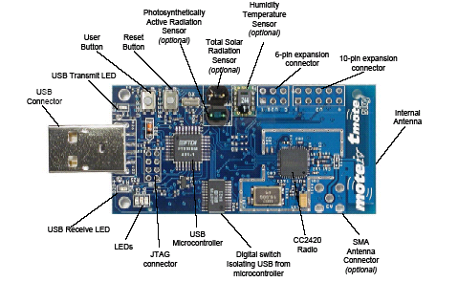
Front of Mote

Slide 35
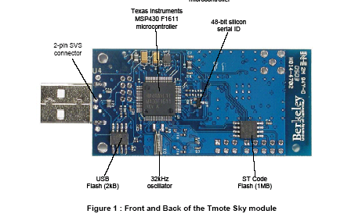
Back of Mote

Slide 36
How Did We Get Here?
Advances wireless technology
  MEMS, VLSI
  Bandwidth explosion
Changes in regulation
Cultural changes
  Wireless devices are everywhere and people are receptive to new applications
  The concept of networks are ingrained in culture
  Open source
Computer Science
  Operating system theory, network theory
  Inexpensive compilers

Slide 37
Challenges
Challenges
  Limited battery power
  Limited storage and computation
  Lower bandwidth and high error rates
  Scalability to 1000s of nodes
Network Protocol Design Goals
  Operate in self-configured mode (no infrastructure network support)
  Limit memory footprint of protocols
  Limit computation needs of protocols -> simple, yet efficient protocols
  Conserve battery power in all ways possible

Slide 38
Typical Features of WSN
A very large number of nodes, often in the order of thousands
Asymmetric flow of information, from the observers or sensor nodes to a command node
Communications are triggered by queries or events
At each node there is a limited amount of energy which in many applications is impossible to replace or recharge
Almost static topology

Slide 39
Typical Features of WSN (cont.)
Low cost, size, and weight per node
Prone to failures
More use of broadcast communications instead of point-to-point
Nodes do not have a global ID such as an IP number
The security, both physical and at the communication level, is more limited than conventional wireless networks

Slide 40
Design Considerations
Fault tolerance – The failure of nodes should not severely degrade the overall performance of the network
Scalability – The mechanism employed should be able to adapt to a wide range of network sizes (number of nodes)
Cost – The cost of a single node should be kept very low
Power consumption – Should be kept to a minimum to extend the useful life of network
Hardware and software constraints – Sensors, location finding system, antenna, power amplifier, modulation, coding, CPU, RAM, operating system
Topology maintenance – In particular to cope with the expected high rate of node failure
Deployment – Pre-deployment mechanisms and plans for node replacement and/or maintenance
Transmission media – ISM bands, infrared, etc.
Environment – Busy intersections, Bottom of an ocean, Inside a twister, Surface of an ocean during a tornado, Biologically or chemically contaminated field, Battlefield, Home , Large warehouse, Animals , …

Slide 41
Comparison with Ad Hoc Wireless Networks
Both consist of wireless nodes but they are different.
  The number of nodes is very large
  Being more prone to failure, energy drain
  Not having unique global IDs
  Data-centric, query-based addressing vs. address-centric
  Resource limitations: memory, power, processing
  Wireless sensor networks mainly use broadcast communication while ad hoc networks use point-to-point communication.

Slide 42

Thank You

