Slide 1
BioMar & BioFarm Technical support service
Iran Cage Culture – July 2018
Bruno Noguerra – BioFarm manager West Med

Slide 2
BioMar key figures 2017
Approx. 1400 employees
100 % dedicated to high performance aqua feeds
1 out of 5 farmed fish produced in Europe and Chile are fed with BioMar feed
Turnover approx. 1.3 b €
EBIT 76 m€
Production volume approx. 1.2 million tons
Providing feed to more than 45 species
Supplying feed to around 80 countries

Slide 3
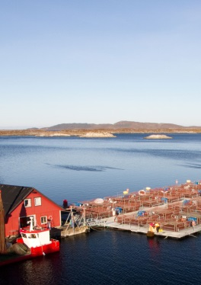
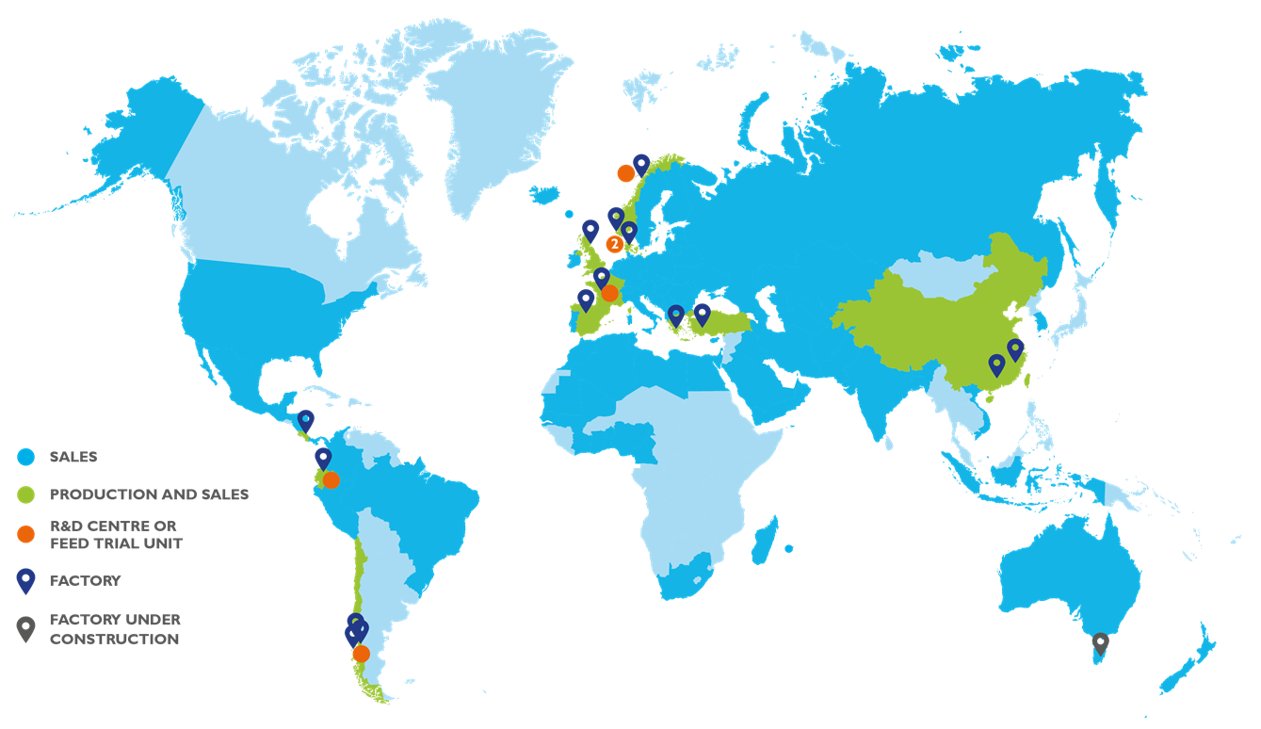
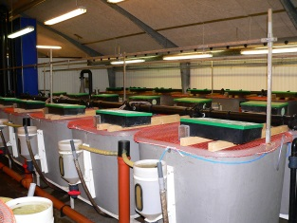
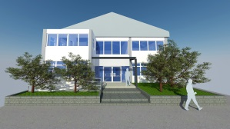
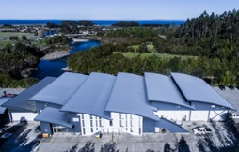
BioMar Global Operations
EMEA
Europe Middle East Africa
Emerging Markets
Emerging Markets
BioMar Americas
Notes:
3

Slide 4
A Global Research Organisation
To achieve that, BioMar has set up a truly global research organisation with highly skilled researchers and experts in their field.
We make our contribution by utilising cutting edge technology at state-of-the-art research facilities around the world.
BioMar’s R&D organisation is structured in three units which have different focus areas.
The units have a close cooperation in order to ensure that BioMar’s overall R&D goals and objectives are achieved.
NUTRITION UNIT
Nutrition Unit works on identifying nutritional requirements and raw material knowledge by building biological models to support customers performance targets.
HEALTH UNIT
Health Unit focuses on active components and nutrition to increase fish and shrimp health.
PROCESS UNIT
Process Unit concentrates on opening new doors and possibilities by developing knowledge on process and process effects on different raw materials.

Slide 5
Commercial organization: BioFarm is a local customer service - WM unit inside EMEA division
Commercial manager WM
Sales people WM
Technical support
BioFarm WM

Slide 6
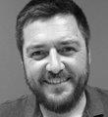
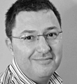
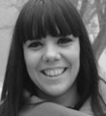
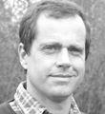
WM BioFarm people
Elena Planas, DVM marine WM
Juan Zamora, Benchmarking & technical support fresh water WM
Bruno Noguerra, BioFarm manager key account clients WM
Miguel Sotelo, DVM fresh water & technical support flat fish WM
Paco Honrado, technical support cage farming WM
Commercial diver
Fernando Alonso , technical support feeding strategy WM and key account clients SP, TN
Rocio Alvaro, Biosustain program
Notes:
BNO speaking, MSO & YMO also on fresh water

Slide 7
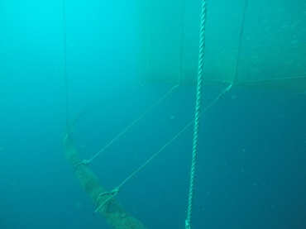
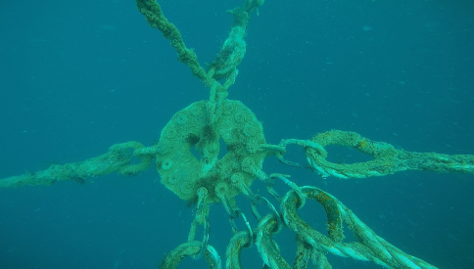
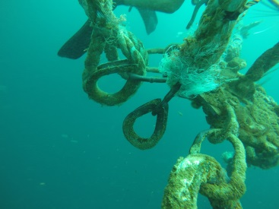
Possible matters for technical support…..
Classical pathology & sanitary support.
Feeding prevention strategy
Combination of vaccination and feeding strategy
Technical support mooring, cages & nets

Slide 8
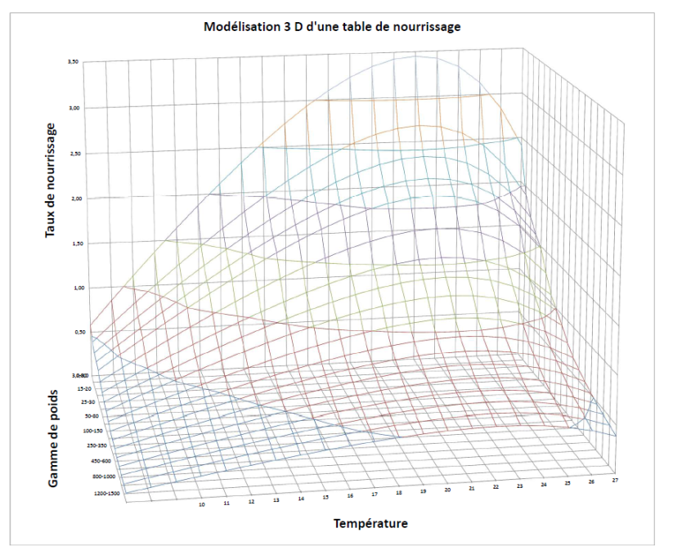
Other matters
Production support
SFR table, pellet number/fish/meal
Growth forecast
Key Performances Index analysis (KPI)
Analyse KPI XXXX mai 2018.pptx

Slide 9
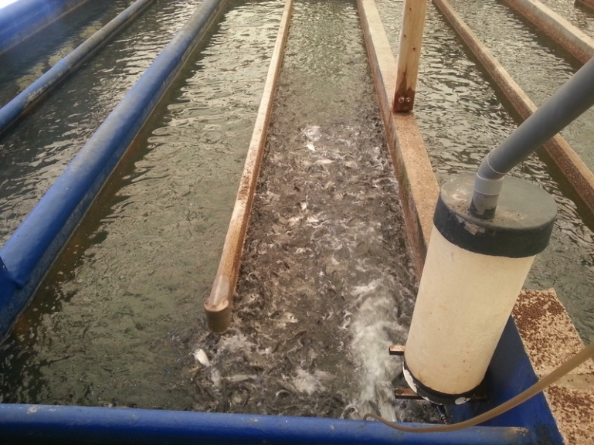
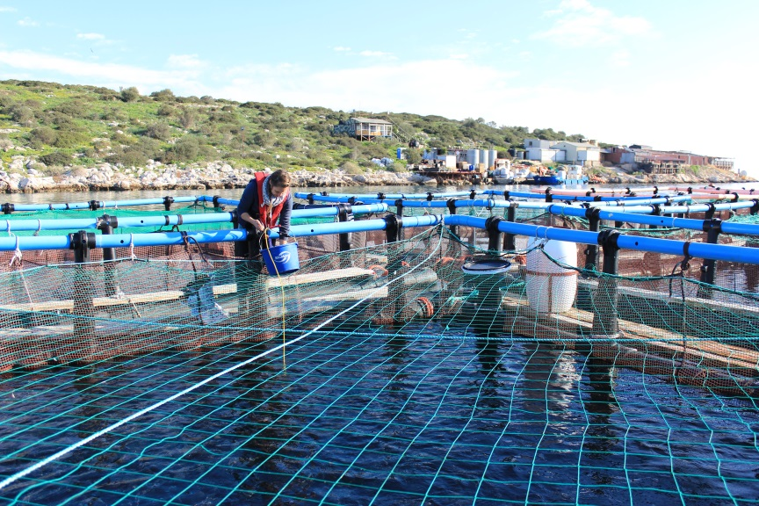
FTU Aquanord + FTU Selonda
FTU’s
34 tanks x 25m3
15 tanks x 4 m3
From 2014
18 cages x 200 m3
Originally with Dias in 2010-2013, then with Selonda from 2017
The size of cages or tanks in FTU’s are closer to the commercial scale found in farms. It is a super good tool to confirm RD results (proof of concept)

Slide 10
Forage Fish Dependency Ratio (FFDR)
FFDR is the quantity of wild fish used per quantity of cultured fish produced. This measure can be calculated based on fishmeal (FM) and/or fish oil (FO). Trimmings FM&O is weighted with a score of zero in the FFDR calculation. This formula calculates the dependency of a single site on wild forage fish resources, independent of any other farm.
FFDRm=$\frac{ \% fishmeal in feed from foragefisheries x eFCR }{24}$
FFDRm=( % 𝒇𝒊𝒔𝒉𝒎𝒆𝒂𝒍 𝒊𝒏 𝒇𝒆𝒆𝒅 𝒇𝒓𝒐𝒎 𝒇𝒐𝒓𝒂𝒈𝒆𝒇𝒊𝒔𝒉𝒆𝒓𝒊𝒆𝒔 𝒙 𝒆𝑭𝑪𝑹 )/𝟐𝟒
FFDRo= $\frac{\% fishoil in feed from forage fisheries x eFCR}{5 or 7 (depending on sourcing of fish)}$
FFDRo= (% 𝒇𝒊𝒔𝒉𝒐𝒊𝒍 𝒊𝒏 𝒇𝒆𝒆𝒅 𝒇𝒓𝒐𝒎 𝒇𝒐𝒓𝒂𝒈𝒆 𝒇𝒊𝒔𝒉𝒆𝒓𝒊𝒆𝒔 𝒙 𝒆𝑭𝑪𝑹)/(𝟓 𝒐𝒓 𝟕 (𝒅𝒆𝒑𝒆𝒏𝒅𝒊𝒏𝒈 𝒐𝒏 𝒔𝒐𝒖𝒓𝒄𝒊𝒏𝒈 𝒐𝒇 𝒇𝒊𝒔𝒉))
Calculation based on ASC Salmon standard

Slide 11
FIFO RATIO: SEA BREAM
FCR: 2,3
Feed: EFICO YM 854
YYYYYYYYYY
FCR:1,89
Feed: EFICO KAPPA 856F
XXXXXXXX
25-500 gr
FFDRm: 0,98
FFDRo: 0
FIFO Ratio: 0,98
25-500 gr
FFDRm: 0,44
FFDRo: 0,59
FIFO Ratio: 0,59
Only 24 % of the fishmeal are trimmings
All the fish oil are trimmings
70 % of the fishmeal are trimmings
80 % of fishoil are trimmings

Slide 12
FIFO RATIO : SEA BASS
FCR: 2,1
Feed: EFICO YM 858
YYYYYYYYYYY
FCR: 2,12
XXXXXXXXX
25-500 gr
FFDRm: 0,95
FIFO Ratio: 0,95
25-500 gr
FFDRm: 0,59
FFDRo: 0,50
FIFO Ratio: 0,59
FFDRo: 0
Feed: EFICO KAPPA 866F
42% of fishmeal are trimmings
All the fishoil are trimmings
61% of the fishmeal are trimmings
80% of the fishoil are trimmings

Slide 13
SBR growth data from southern med farm (from may to may – 3 year class)

Slide 14
Biosoft version 2017 P:\BioSoft TEST Packs64\TRIAL VERSION - Batch Growth and Feed Plan -64bit.exe

Slide 15
Model vs. real data (SGR correction ranging from 0,95 to 1,00 – Maturation intensity 1 and 2)

Slide 16
Perspectives for new projects in Iran
Size of the 1st step is key (not to much cages, not too big….)
Make the right location, species and cage technology choice. Take your time, use assistance
Qualified human resources will always make your better investment and assets
The more qualified and trained people the most effective will be our technical support

Slide 17
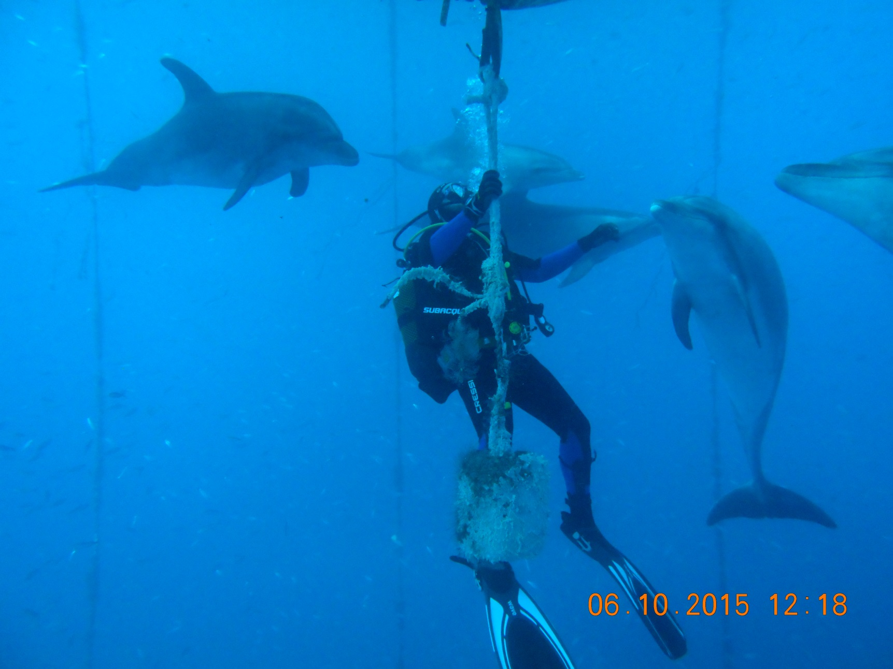
Thank you for your attention ☺

