Slide 2
VITAMIN
Uses,Side Effects,Interactions and Warnings

Slide 4
Brief History of Discovering Vitamin D
Sir Edward Mellanby was concerned about developing Rickets in Great Britain
Especially in Scotland and he was trying to find a cure for it
He tested the diet of people was living there on dogs that he was accidently keeping them indoors and those dogs showed the symptoms of Rickets as well
When he added the cod liver oil in the diet he saw that the Rickets was cured
He knew that there is high level of vitamin A in the oil liver so he theorized that maby vitamin A is a cure for Rickets

Slide 5
Brief History of Discovering Vitamin D
Later professor Elmer McCollum followed mellanby’s research
He destroyed the vitamin D that was in the cod liver oil and use it on some patients with a diet with lack of vitamin A
He observed that they showed symptoms of diseases related to lack of vitamin A but it still could cure their rickets
So he realized that there must be another material that can cure that and he called it vitamin D
With later discoveries scientists have discovered it and found out everything about it and solved the Rickets issue in Great Britain

Slide 6
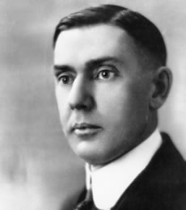
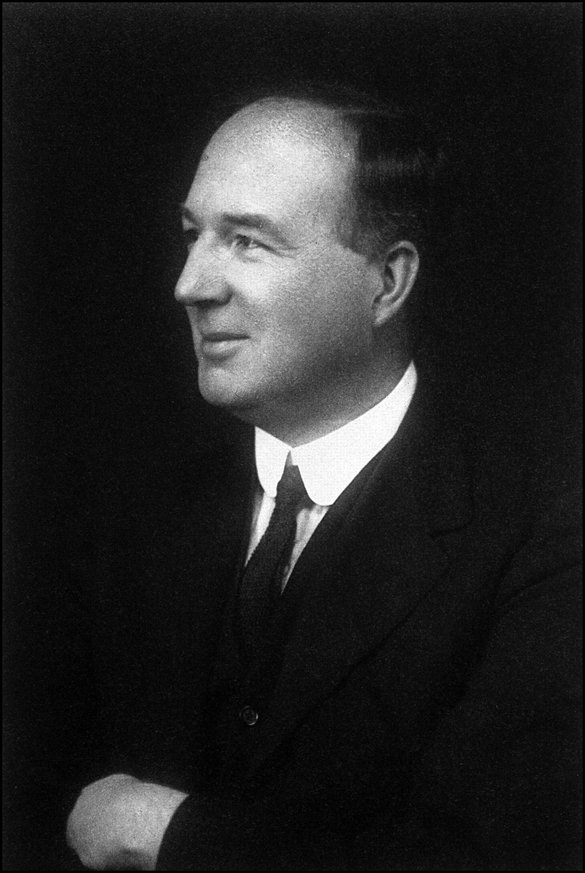
Elmer McCollum Edward Mellanby
(1879-1967) (1884-1955)

Slide 7
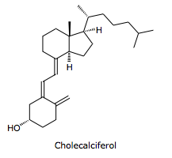
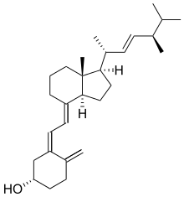
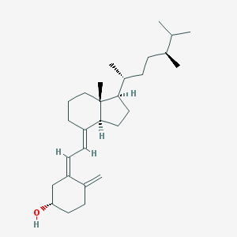
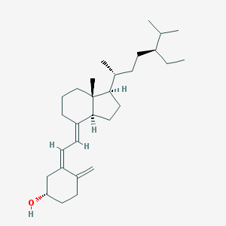
Classification and Structures
D
Colecalciferol Ergocalciferol 22-dihydroergocalciferol Sitocalciferol
(D3) (D2) (D4) (D5)

Slide 8
Vitamin D1 is a combination of D2 and Lumisterol
Lumicerol

Slide 9
Classification and functions
Vitamin D3 (Colecalciferol) plays an important role in our body and other animals that is why it is also known as the type of vitamin D special for animals
On the other side vitamin D2 (Ergocalciferol) is the important D type in plants

Slide 10
Synthesis of Vitamin D 1. Sun exposure to our skin caused changing 7-dehydrocholsetrol to D3 2 . D3 will then change into 25-hydroxyD3 by a hydroxylase enzyme in our liver 3. It goes to our vessels and wait for become active 4. In the right time parathyroid hormones (PTH) will stimulate some kind of our kidney cells and they secret another type of hydroxylase hormone witch will make 1,25-dihydroyD3 from 25-hydroxyD3 5. this is the active form of vitamin D in our body and also known as Calcitriol and do some important things in our body

Slide 11
Functions of Vitamin D
Calcitriol affects on epithelial cells of our intestine by attaching to its receptor (VDR) and going inside the cell and its nucleos , it will then make RNA polymerase to synthesize a protein witch is essential to absorb calcium in our intestine canal
It is also helps osteoblasts to store calcium with phosphorus or helps osteoclasts to synthesize more calcium
It can be inhibited by changing into 24,25-dihydroxyD3 instead of calcitriol this happens in our kidneys
It is also important in our immune system or curing diseases like cancer or rickets
We will discuss about them later

Slide 12
Deficiency and Diseases
Groups particular may be at risk of vitamin D deficiency, this people include:
People with age of 65 or above
Pregnant women and lactating mothers
People that are not getting enough sunlight

Slide 13
Deficiency and Diseases
Groups particular may be at risk of vitamin D deficiency, this people include:
People with darker skin
Babies and children under 5

Slide 14
Deficiency and Diseases Vitamin D deficiency
Vitamin D deficiency may lead to accelerated aging of bones and causes damage to the brain
And also recent studies shows that the women that the level of vitamin D quantity in 26 weeks first pregnancy may increase the risk of the Pre-eclampsia in them more

Slide 15
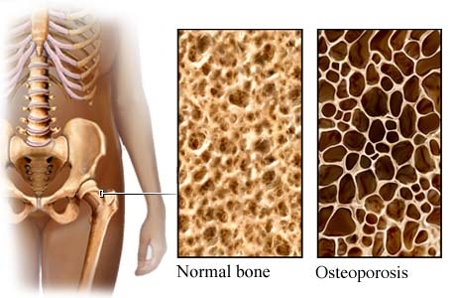
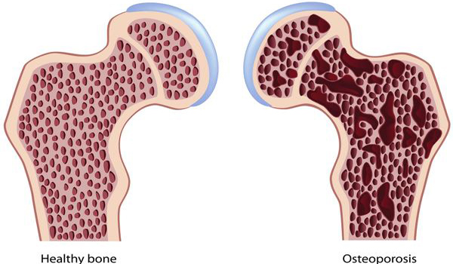
Osteoporosis is one of the diseases that many seniors especially women , that with
In this condition the bone from the inside of the drain, the bone salts decreases
The main factor influencing humoral changes the body
In this disease the amount of vitamin D have much of an impact. Only be advised for the prevention of risk from adolescence the amount of calcium and phosphorus along with vitamin D consumed

Slide 16
Deficiency and Diseases Vitamin D and its effects on MS
Based on previous studies also observed was that the prevalence of MS in areas where vitamin A deficiency there is a higher
Disease MS or Multiple sclerosis from of the disease the nerves that at a young age in the paralysis of sensory and motor patients will appear can Siri intensify lubricating and fatal or satiety slow and chronic
the cause of this disease is deposition of some kind of protein in the parts of the brain
Intake of vitamin D in the treatment and also in preventing the disease plays a role

Slide 17
Deficiency and Diseases
This side can include decreased appetite weight loss , vision , pain , vomiting , diarrhea , problems , neuromuscular and hypercalcemya
This situation causes that the person feels nausea and dizziness and fatigue

Slide 18
Deficiency and Diseases Vitamin D and Rickets
Rickets or osteomalacia is called off the common complications of vitamin D deficiency in all ages of the signs of the rickets can be attributed to joint pain bone and muscle
The fragility of the bones and bending of the bones noted

Slide 19
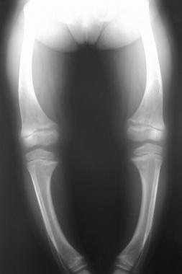
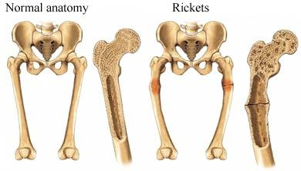
Deficiency and Diseases
Symptomes of Rickets occurs in this people :
Special treatment is K them enough exposed to
light the sun do not fall
Infants beginning special treatment is K sufficiency exposed to
sunlight the not people who due to disability,
to digest lactose whole milk do not eat

Slide 20
Rickets in infants and children can be taking 4000 IU daily for the pregnant mother or 500 IU daily for the baby, prevention and even treatment. Consumption of calcium and phosphorus is also important. Rickets in adults as well can heal with this reliable method of prevention and treatment.
Disease and effects of vitamin D higher the amount of vitamin D, rarely seen, but in the body,the incidence of complications such as higher blood pressure, etc. Osteoporosis, blue, body,vomiting, constipation, decreased appetite, irritability, fatigue, muscle weakness, calcificated texture, soft, premature aging, and such complications caused by the high fat.

Slide 22
THANKS FOR YOUR TIME AND ATTENTION
WITH A SPECIAL THANKS TOWARD OUR DEAR PROFESSOR
Dr.Mir

