Slide 1
Single Node Architecture
6.3
Advanced Computer Networks
By: Mahdi Sadeghizadeh

Slide 2
Single Node Architecture
Sensor node architecture
Energy supply and consumption
Runtime environments for sensor nodes
Case study: TinyOS

Slide 3
Sensor node architecture
Main components of a WSN node
  Controller
  Communication device(s)
  Sensors/actuators
  Memory
  Power supply
Memory
Communication
device
Sensor(s)/
actuator(s)
Controller
Power supply

Slide 4
Controller (Processing Subsystem)
Main options:
  Microcontroller – general purpose processor, optimized for embedded applications, low power consumption, sleep state
  DSPs – optimized for signal processing tasks, not suitable here
  FPGAs – may be good for testing
  ASICs – only when peak performance is needed, no flexibility
Example microcontrollers
  Texas Instruments MSP430
    16-bit RISC core, up to 4 MHz, versions with 2-10 kbytes RAM,
    several DACs, RT clock, prices start at 0.49 US$
  Atmel ATMega
    8-bit controller, larger memory than MSP430, slower
general purpose
Single purpose
Notes:
FPGA=Field Programmable Gate Array

Slide 5
Communication device (Communication Subsystem)
Which transmission medium?
  Electromagnetic at radio frequencies?
  Electromagnetic, light?
  Ultrasound?
Radio transceivers transmit a bit- or byte stream as radio wave
  Receive it, convert it back into bit-/byte stream
ü

Slide 6
Transceiver characteristics
Capabilities
  Interface: bit, byte, packet level?
  Supported frequency range?
    Typically, somewhere in 433 MHz – 2.4 GHz, ISM band
  Multiple channels?
  Data rates?
  Range?
Energy characteristics
  Power consumption to send/receive data?
  Time and energy consumption to change between different states?
  Transmission power control?
  Power efficiency (which percentage of consumed power is radiated?)
Radio performance
  Modulation? (ASK, FSK, …?)
  Noise figure? NF = SNR_{I}/SNR_{O}
  Gain? (signal amplification)
  Receiver sensitivity? (minimum S to achieve a given E_{b}/N₀)
  Blocking performance (achieved BER in presence of frequency-offset interferer)
  Out of band emissions
  Carrier sensing & RSSI characteristics
  Frequency stability (e.g., towards temperature changes)
  Voltage range
Notes:
لاية بالا، MAC layer است.
امكان re-use كردن از باندهاي فركانسي؟
RSSI براي تخمين فاصله استفاده مي‌شود؛ اما دقيق نيست.

Slide 7
Transceiver states
Transceivers can be put into different operational states, typically:
  Transmit
  Receive
  Idle – ready to receive, but not doing so
    Some functions in hardware can be switched off, reducing energy consumption a little
  Sleep – significant parts of the transceiver are switched off
    Not able to immediately receive something
    Recovery time and startup energy to leave sleep state can be significant
Research issue: Wakeup receivers – can be woken via radio when in sleep state (seeming contradiction!)

Slide 8
Wakeup receivers
Major energy problem: RECEIVING
  Idling and being ready to receive consumes considerable amounts of power
When to switch on a receiver is not clear
  Contention-based MAC protocols: Receiver is always on
  TDMA-based MAC protocols: Synchronization overhead, inflexible
Desirable: Receiver that can (only) check for incoming messages
  When signal detected, wake up main receiver for actual reception
  Ideally: Wakeup receiver can already process simple addresses
  Not clear whether they can be actually built, however

Slide 9
Sensors (Sensor Subsystem)
Main categories
  Any energy radiated? Passive vs. active sensors
  Sense of direction? Omidirectional?
  Passive, omnidirectional
    Examples: light, thermometer, microphones, hygrometer, …
  Passive, narrow-beam
    Example: Camera
  Active sensors
    Example: Radar
Important parameter: Area of coverage
  Which region is adequately covered by a given sensor?

Slide 10
Energy supply of mobile/sensor nodes
Goal: provide as much energy as possible at smallest cost/volume/weight/recharge time/longevity
  In WSN, recharging may or may not be an option
Options
  Primary batteries – not rechargeable
  Secondary batteries – rechargeable, only makes sense in combination with some form of energy harvesting
Requirements include
  Low self-discharge
  Long shelf live
  Capacity under load
  Efficient recharging at low current
  Good relaxation properties (seeming self-recharging)
  Voltage stability (to avoid DC-DC conversion)

Slide 11
Battery examples
Energy per volume (Joule per cubic centimeter):
Primary batteries
Chemistry | Zinc-air | Lithium | Alkaline
Energy (J/cm³) | 3780 | 2880 | 1200
Secondary batteries
Chemistry | Lithium | NiMHd | NiCd
Energy (J/cm³) | 1080 | 860 | 650

Slide 12
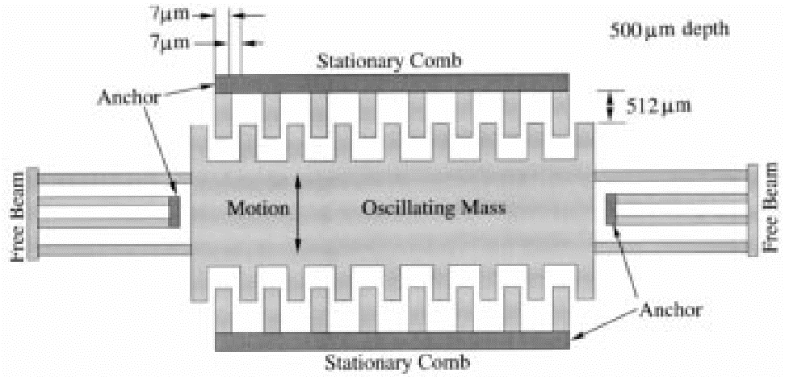
Energy scavenging
How to recharge a battery?
  A laptop: easy, plug into wall socket in the evening
  A sensor node? – Try to scavenge energy from environment
Ambient energy sources
  Light ! solar cells – between 10 μW/cm² and 15 mW/cm²
  Temperature gradients – 80 μ W/cm² @ 1 V from 5K difference
  Vibrations – between 0.1 and 10000 μ W/cm³
  Pressure variation (piezo-electric) – 330 μ W/cm² from the heel of a shoe
  Air/liquid flow
  (MEMS gas turbines)

Slide 13
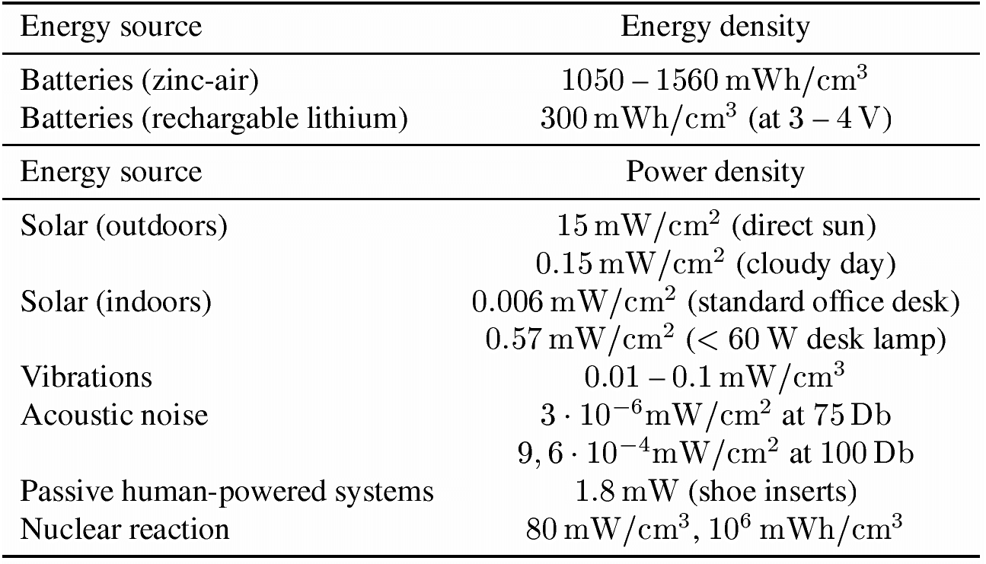
Energy scavenging – overview

Slide 14
Energy consumption
A “back of the envelope” estimation
Number of instructions
  Energy per instruction: 1 nJ
  Small battery (“smart dust”): 1 J = 1 Ws
  Corresponds: 10⁹ instructions!
Lifetime
  Or: Require a single day operational lifetime = 24¢60¢60 =86400 s
  1 Ws / 86400s ¼ 11.5 μW as max. sustained power consumption!
Not feasible!

Slide 15
Multiple power consumption modes
Way out: Do not run sensor node at full operation all the time
  If nothing to do, switch to power safe mode
  Question: When to throttle down? How to wake up again?
Typical modes
  Controller: Active, idle, sleep
  Radio mode: Turn on/off transmitter/receiver, both
Multiple modes possible, “deeper” sleep modes
  Strongly depends on hardware
  TI MSP 430, e.g.: four different sleep modes
  Atmel ATMega: six different modes

Slide 16
Some energy consumption figures
Microcontroller
  TI MSP 430 (@ 1 MHz, 3V):
    Fully operation 1.2 mW
    Deepest sleep mode 0.3 μW – only woken up by external interrupts (not even timer is running any more)
  Atmel ATMega
    Operational mode: 15 mW active, 6 mW idle
    Sleep mode: 75 μW

Slide 17
Switching between modes
Simplest idea: Greedily switch to lower mode whenever possible
Problem: Time and power consumption required to reach higher modes not negligible
  Introduces overhead
  Switching only pays off if E_{saved} > E_{overhead}
Example:
Event-triggered
wake up from
sleep mode
Scheduling problem
with uncertainty
(exercise)
E_{saved}
E_{overhead}
P_{active}
P_{sleep}
t₁
t_{event}
time
τ_{down}
τ_{up}

Slide 18
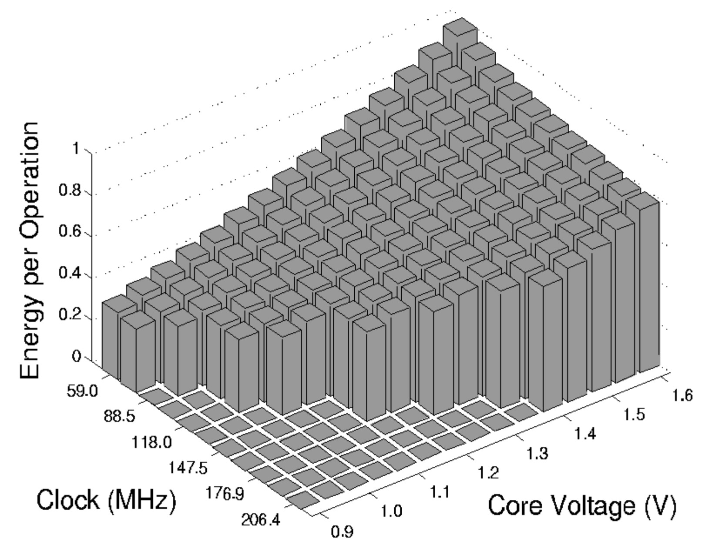
Alternative: Dynamic voltage scaling
Switching modes complicated by uncertainty how long a sleep time is available
Alternative: Low supply voltage & clock
  Dynamic voltage scaling (DVS)
Rationale:
  Power consumption P
  depends on
    Clock frequency
    Square of supply voltage
    P / f V²
  Lower clock allows
  lower supply voltage
  Easy to switch to higher clock
  But: execution takes longer

Slide 19
Memory power consumption
Crucial part: FLASH memory
  Power for RAM almost negligible
FLASH writing/erasing is expensive
  Example: FLASH on Mica motes
  Reading: ¼ 1.1 nAh per byte
  Writing: ¼ 83.3 nAh per byte

Slide 20
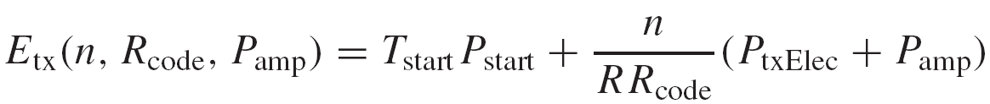
Transmitter power/energy consumption for n bits
Amplifier power:
  P_{tx} radiated power
  α_{amp}, β_{amp} constants depending on model
  Highest efficiency (η = P_{tx} / P_{amp} ) at maximum output power
In addition: transmitter electronics needs power P_{txElec}
Time to transmit n bits: n / (R × R_{code})
  R nomial data rate, R_{code} coding rate
To leave sleep mode
  Time T_{start}, average power P_{start}
Simplification: Modulation not considered

Slide 21
Receiver power/energy consumption for n bits
Receiver also has startup costs
  Time T_{start}, average power P_{start}
Time for n bits is the same n / (R × R_{code})
Receiver electronics needs P_{rxElec}
Plus: energy to decode every bit E_{decBits}

Slide 22
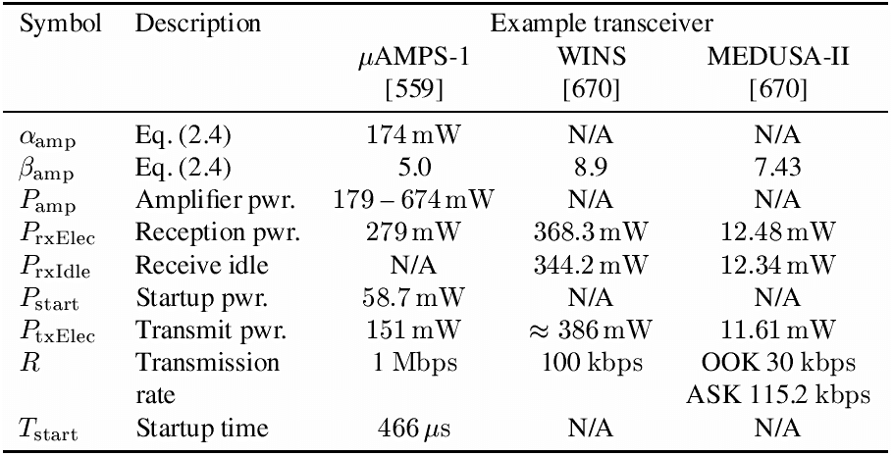
Some transceiver numbers

Slide 23
Controlling transceivers
Similar to controller, low duty cycle is necessary
  Easy to do for transmitter – similar problem to controller: when is it worthwhile to switch off
  Difficult for receiver: Not only time when to wake up not known, it also depends on remote partners
  ! Dependence between MAC protocols and power consumption is strong!
Only limited applicability of techniques analogue to DVS
  Dynamic Modulation Scaling (DSM): Switch to modulation best suited to communication – depends on channel gain
  Dynamic Coding Scaling – vary coding rate according to channel gain
  Combinations

Slide 24
Computation vs. communication energy cost
Tradeoff?
  Directly comparing computation/communication energy cost not possible
  But: put them into perspective!
  Energy ratio of “sending one bit” vs. “computing one instruction”: Anything between 220 and 2900 in the literature
  To communicate (send & receive) one kilobyte over 100 m
  = computing three million instructions!
Hence: try to compute instead of communicate whenever possible
Key technique in WSN – in-network processing!
  Exploit compression schemes, intelligent coding schemes, …

Slide 25
Operating system challenges in WSN
Usual operating system goals
  Make access to device resources abstract (virtualization)
  Protect resources from concurrent access
Usual means
  Protected operation modes of the CPU – hardware access only in these modes
  Process with separate address spaces
  Support by a memory management unit
Problem: These are not available in microcontrollers
  No separate protection modes, no memory management unit
  Would make devices more expensive, more power-hungry

Slide 26
WSN: Open Source Tools
Simulators
  NS-2
  TOSSIM
  Avrora
  NCTUns
  OMNET++
  J-Sim
  Ptolemy
Programming Languages
  Assembly
  C
  Giotto
  Esterel
  Lustre
  Signal
  E-FRP
  nesC
Operating Systems
  TinyOS
  YATOS
  Contiki
  MANTIS
  SOS
Application Tools
  Localization Tools
  TinyDB
  Surge
  TOSBase

Slide 27
Operating system challenges in WSN
Possible options
  Try to implement “as close to an operating system” on WSN nodes
    In particular, try to provide a known programming interface
    Namely: support for processes!
    Sacrifice protection of different processes from each other
    ! Possible, but relatively high overhead
  Do (more or less) away with operating system
    After all, there is only a single “application” running on a WSN node
    No need to protect malicious software parts from each other
    Direct hardware control by application might improve efficiency
Currently popular verdict: no OS, just a simple run-time environment
  Enough to abstract away hardware access details
  Biggest impact: Unusual programming model

Slide 28
Main issue: How to support concurrency
Simplest option: No concurrency, sequential processing of tasks
  Not satisfactory: Risk of missing data (e.g., from transceiver) when processing data, etc.
  ! Interrupts/asynchronous operation has to be supported
Why concurrency is needed
  Sensor node’s CPU has to service the radio modem, the actual sensors, perform computation for application, execute communication protocol software, etc.
Poll sensor
Process
sensor
data
Poll transceiver
Process received
packet

Slide 29
Traditional concurrency: Processes
Traditional OS:
processes/threads
  Based on interrupts, context switching
  But: not available – memory overhead, execution overhead
But: concurrency mismatch
  One process per protocol entails too many context switches
  Many tasks in WSN small with respect to context switching overhead
And: protection between processes not needed in WSN
  Only one application anyway
Handle sensor
process
Handle packet
process
OS-mediated
process switching

Slide 30
Event-based concurrency
Alternative: Switch to event-based programming model
  Perform regular processing or be idle
  React to events when they happen immediately
  Basically: interrupt handler
Problem: must not remain in interrupt handler too long
  Danger of loosing events
  Only save data, post information that event has happened, then return
  ! Run-to-completion principle
  Two contexts: one for handlers, one for regular execution
R
a
d
i
o
S
e
n
s
o
r
e
v
e
n
t
e
v
e
n
t
I
d
l
e
/
R
e
g
u
l
a
r
R
a
d
i
o
e
v
e
n
t
h
a
n
d
l
e
r
p
r
o
c
e
s
s
i
n
g
S
e
n
s
o
r
e
v
e
n
t
h
a
n
d
l
e
r

Slide 31
Components instead of processes
Need an abstraction to group functionality
  Replacing “processes” for this purpose
  E.g.: individual functions of a networking protocol
One option: Components
  Here: In the sense of TinyOS
  Typically fulfill only a single, well-defined function
  Main difference to processes:
    Component does not have an execution
    Components access same address space, no protection against each other
  NOT to be confused with component-based programming!
API to an event-based protocol stack

Slide 32
Case study embedded OS: TinyOS & nesC
TinyOS developed by UC Berkely as runtime environment for their “motes”
nesC as adjunct “programming language”
Goal: Small memory footprint
  Sacrifices made e.g. in ease of use, portability
  Portability somewhat improved in newer version
Most important design aspects
  Component-based system
  Components interact by exchanging asynchronous events
  Components form a program by wiring them together (akin to VHDL – hardware description language)

Slide 33
TinyOS components
Components
  Frame – state information
  Tasks – normal execution program
  Command handlers
  Event handlers
Handlers
  Must run to completion
  Form a component’s interface
  Understand and emits commands & events
Hierarchically arranged
  Events pass upward from hardware to higher-level components
  Commands are passed downward
init
start
stop
fired
TimerComponent
Command
handlers
Frame
Tasks
Event
handlers
setRate
fire

Slide 34
Handlers versus tasks
Command handlers and events must run to completion
  Must not wait an indeterminate amount of time
  Only a request to perform some action
Tasks, on the other hand, can perform arbitrary, long computation
  Also have to be run to completion since no non-cooperative multi-tasking is implemented
  But can be interrupted by handlers
  ! No need for stack management, tasks are atomic with respect to each other

Slide 35
Structuring commands/events into interfaces
Many commands/events can add up
nesC solution: Structure corresponding commands/events into interface types
Example: Structure timer into three interfaces
  StdCtrl
  Timer
  Clock
init
start
stop
fired
StdCtrl
Timer
Build configurations by wiring together corresponding interfaces
TimerComponent
Clock
setRate
fire

Slide 36
Building components out of simpler ones
Wire together components to form more complex components out of simpler ones
New interfaces for the complex component
StdCtrl
Timer
CompleteTimer
StdCtrl
Timer
TimerComponent
Clock
Clock
HWClock

Slide 37
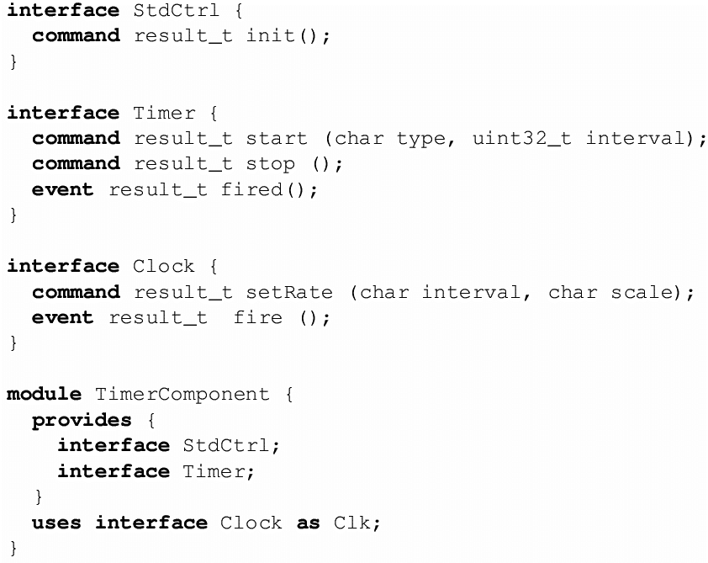
Defining modules and components in nesC

Slide 38
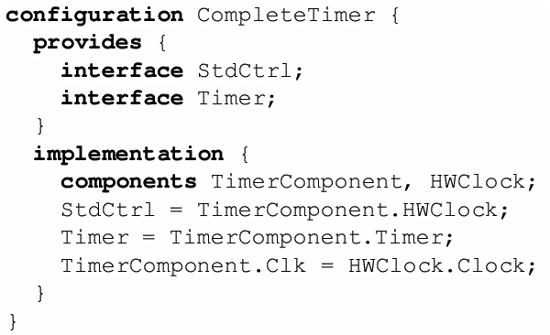
Wiring components to form a configuration

Slide 39

Thank You

