Slide 1

Automotive production Systems and
standardization
YASERAMIRI.BLOG.IR
THE BEST OR NOTHING
Presentation 1
Chapter 4 :
The case of the Mercedes Benz production system
Presented by Yaser Amiri
Nov 2015

Slide 2



Contents
Section | Slide number | section | Slide number
4-1 introduction | 3 | 4.8 Implementing the MPS: the cascade training | 28
4.2 Case study focus, approach and structure | 4 | 4.9 The MPS-audit | 32
4.3 Case study background | 5 | 4.10 The structure and content of the MPS | 47
4.4 Pre-merger production organisation at Mercedes-Benz | 6 | 4.11 The Mercedes-Benz Production System and REFA methods | 6
4.5 Pre-merger production organisation at Chrysler | 13 | 4.12 The Mercedes-Benz Production System and the Toyota Production System | 13
4.6 The DaimlerChrysler Operating Model | 15
4.7 The Mercedes-Benz Production System | 23
YASERAMIRI.BLOG.IR

Slide 3
4-1 introduction
The introduction of a unified, plant-wide production system resulted from the merger between Daimler-Benz and Chrysler in 1998.

Slide 4
4.2 Case study focus, approach and structure
Three core aspects of this study :
1-Examine the form and function of standards within the MPS, particularly the nexus between the TPS and the MPS.
2-the process of the institutionalization of standards within one particular Mercedes-Benz plant.
3-the effect the implementation of the MPS has particularly in terms of learning and control on the actors on the shop floor.

Slide 5
4.3 Case study background

Slide 6
4.4 Pre-merger production organization at Mercedes-Benz
In the mid 1980s positive sales forecasts led to the decision to set up new plants, such as for example, the Mercedes-Benz plant in Rastatt.
At the time, the previously predominant view of the high-tech fully automated factory lost its vigor and the soft factors of corporate and social organization gained momentum.
The focus now was on the intention to use the innovation, motivation and skills of staff more efficiently.
the planning for the Rastatt plant was modelled after the Swedish example, especially the Uddevalla plant.

Slide 7
4.4 Pre-merger production organization at Mercedes-Benz
Attempting to transfer the experience of their colleagues in Sweden, the German union representatives proposed to abandon the assembly line concept at Rastatt and to restructure work based on autonomous working teams.
Workers were able to set their own cycle time by pressing release buttons for the next car.
The individual groups were not only responsible for the complete assembly task in their sector but also for the related pre-assembly and material commissioning within their working area.

Slide 8
4.4 Pre-merger production organization at Mercedes-Benz
the production system at Rastatt failed to incorporate two of the core innovations of the Swedish plant:
It did not fully abolish the assembly line ,
and
the competence of small teams of workers to build complete cars was not realised.

Slide 9
4.4 Pre-merger production organization at Mercedes-Benz
In 1995, the formerly decoupled assembly box/team layout was abandoned and the full assembly line reintroduced. The long working cycles were cut and the job enrichment through the inclusion of indirect tasks was reversed.
As the human-centred, modular production approach was abandoned and instead the lean production based new assembly line system was introduced, the term "Rastatt Production System" was coined.
In 1997, the Mercedes-Benz plant Untertürkheim introduced its production system Prosys.

Slide 10
4.4 Pre-merger production organization at Mercedes-Benz
Labour management : "labour management organises the relationship between workforce, machinery and organisation“.
goals of labour management : to improve and safeguard productivity and quality and to improve working conditions“.
Labour management components:
"Teamwork, Continuous Improvement, Agreement on performance standards and targets, Organisation of working hours/operating times, and remuneration“.

Slide 11
4.4 Pre-merger production organization at Mercedes-Benz
Team tasks : It consists of "direct tasks regarding the product, indirect tasks, planning and organisation of tasks, and ongoing improvement (product, productivity, quality)".
These tasks are described more specifically, such as for example the task to "safeguard quality and productivity", "machinery care", "fulfilling production schedules", and "materials requisitioning“.
other aspects of teamwork: team responsibility to organise its own training , "rotation“ , "the selection of a team spokesperson" , "the responsibilities of the team spokesperson" , and the "function and guidelines of team meetings“.

Slide 12
4.4 Pre-merger production organization at Mercedes-Benz
"Rotation" is only generally and very simplistically defined as "team members change their job in the team at specific times. The skills and know-how of each individual are taken into account . the team is responsible for ensuring that the flexibility acquired through training is preserved or extended".
"responsibilities of the team spokesperson" are defined as "the team spokesperson, as representative of the team, is the appropriate contact for managers and other teams".

Slide 13
4.5 Pre-merger production organisation at Chrysler
The COS consists of three core elements:
1. Just-in-time delivery and buffer minimisation
2. Team organisation and responsibility for quality
3. Error analysis/quality problem solving activities.
the COS contains, for example, standards for operating procedures such as work instructions, standardised operation sheets, preventive maintenance standards and statistical process control (SPC) standards .

Slide 14
4.5 Pre-merger production organisation at Chrysler
one core aspect is the slow approach reflecting that the necessity for change has to be understood and comprehended by all associates.
Training took place in two ways. First, based on the cascade training format, superiors trained their staff in COS methods.
Second,Instead of drawing on the external expertise of consultants, learning thus took place inside Chrysler and actually on the shop floor.
In addition to the cascade training, active learning took place in so-called learning lines . These were set up in the production plants for workers to experiment and experience the COS standards hands on through learning by doing.

Slide 15
4.6 The DaimlerChrysler Operating Model
"Post Merger Integration" (PMI) project units
under one roof, twelve topic coordinators are responsible for bringing together the 29 "Issue Resolution Teams" with 69 working teams to form in total 98 project teams working on 98 different topics.
The intention of these teams is to determine (both in quantitative and qualitative terms) the synergies to be exploited from the merger.

Slide 16
4.6 The DaimlerChrysler Operating Model
the PMI-team was divided into five multi-functional teams responsible for the following 5 working areas: "Human Infrastructure, Standardisation, Quality Focus and Robust Processes and Products, Just-in-time, Continuous Improvement“.
Each team drew on a body of experts from the departments of Change Management, Logistics, Human Resources, Planning, Work Policy, and the Chrysler Continuous Improvement Group .
Both production systems share the same four goals: safety quality, delivery, cost, moral/motivation.

Slide 17
4.6 The DaimlerChrysler Operating Model
After the PMI team had thus determined the five core sub-systems for the DaimlerChrysler Operating Model, the PMI team set forth to fill these five subsystems with best practice examples.
By definition a bench mark represents standard reference point and the purpose of conducting bench mark studies is to identify a list of potential standards which are then evaluated and compared upon a previously established list of criteria they have to fulfil.

Slide 18
4.6 The DaimlerChrysler Operating Model
the DaimlerChrysler Operating Model consists of three levels: 5 subsystems divided into 15 operating principles defined by 83 best practice methods, so-called tools .
For example, "Leadership", "Role Clarity" and "Work Group Organizational Structures" (amongst others) represent operating principles and are grouped together in the subsystem "Human Infrastructure". The operating principles "Production Smoothing", "Pull Production" and "Continuous Flow Processing", (amongst others) are grouped together in the subsystem "Just-in-time".
At the level of the tools, for example, "Policy Deployment", "Employee Feedback", "Employee Opinion Surveys", amongst others, are grouped under the operating principle "Leadership", which in turn is part of the subsystem "Human Infrastructure".

Slide 20
4.6 The DaimlerChrysler Operating Model
the purpose of the five subsystems is explained in very general terms such as, "for the corporation to succeed in the world economy our processes must be continuously improved to higher levels of quality in both products and processes. To enable continuous improvement waste must be eliminated“.
Four months after starting the project, the PMI project team had finished its task and presented the description of all DCOM tools, operating principles and subsystems in a systems description/handbook called the "DaimlerChysler Operating Model" to management in May 1999.

Slide 21
4.6 The DaimlerChrysler Operating Model
DaimlerChrysler Production Systems Overview

Slide 22
4.7 The Mercedes-Benz Production System
The major difference between the two production systems are issues concerning work policy.
First problem :
From the perspective of the works council, the DCPS was criticised for two reasons: one, it had been created under considerable time pressure, two, its American heritage was clearly visible .
The works council feared that by introducing formal standards regulating production procedures and processes, the principles of Taylor would be revived leading to shorter work cycles, a subsequent decrease in work content and a deskilling of the workforce.

Slide 23
4.7 The Mercedes-Benz Production System
The final version of the MPS "Systems Description" which started to be implemented in January 2000 is structurally identical to the DCPS, with the difference that taking into account existing work policy agreements at Mercedes-Benz , the MPS contains in total 92 tools instead of 83 in the DCPS.
Second problem :
the issue of how to account for the differences in operations of Mercedes-Benz plants, say between assembly and purely manufacturing plants.

Slide 24
4.7 The Mercedes-Benz Production System
To account for the differences in production focus, the 90-10 rule was introduced.
Thus plants are requested to implement a minimum of 90% of the MPS tools with the remaining 10% of tools depending on the particular production environment and plant specifications (assembly plant or production plant).

Slide 25
4.7 The Mercedes-Benz Production System
Organisational levels of MPS organization

Slide 26
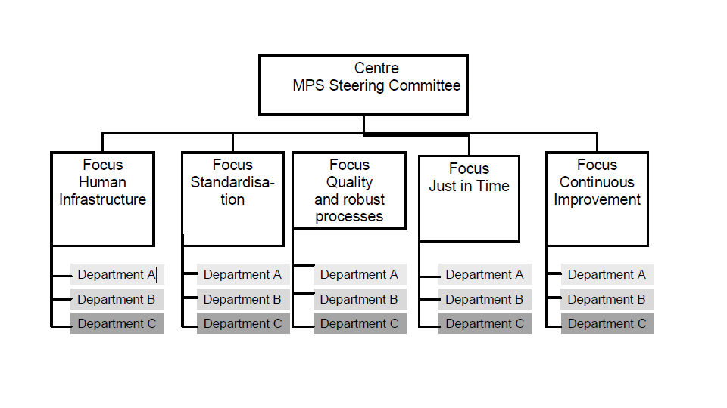

4.7 The Mercedes-Benz Production System
The MPS: central organisation
MPS: plant level organisation
The MPS: centre level organisation

Slide 27
4.8 Implementing the MPS: the cascade training
Similarly to the COS, the implementation of the MPS was based on a cascade training concept.
E1 = Plant Managers, E2 = Centre Managers, E3 = Department Managers, E4 = Team leaders, E5 = Supervisors

Slide 28
4.8 Implementing the MPS: the cascade training
Compared to the COS, the implementation of MPS was far more concerned with providing theoretical standards, rather than allowing workers to experience and experiment with MPS standards on the job.
For example, during the cascade training all 92 MPS tools which are contained in the MPS "Systems Description“ were individually read out and discussed, instead of examining their practical use on the shop floor.

Slide 29
4.8 Implementing the MPS: the cascade training
The observations reflect that despite the attempt to use a standard format and content for the Cascade training, it is important how the content of the MPS is actually communicated.
Supervisors are responsible for communicating and implementing the MPS on the shop floor.
To support the work of the supervisors, the central MPS team organised a supervisor forums ‘ where delegations of supervisors from each Mercedes-Benz centre were invited to meet management at the DaimlerChrysler Conference Centre Lämmerbuckel .

Slide 30
4.8 Implementing the MPS: the cascade training
a survey was conducted before the conference asking supervisors in all centres to evaluate their experience with implementing the MPS.
Amongst the positive aspects reported by the supervisors of Centre Z were that through the implementation of the MPS, workers on the shopfloor are more integrated into the organisation of work.
processes have become more transparent, for example through the application of the 5A tool “Sift, Sort, Sanitize, Sweep and Sustain”. The work place is cleaner, tidier and thus work can be done faster and more efficiently”.

Slide 31
4.9 The MPS-audit
three types of audits conducted to control the progress of implementation and to check the adherence of MPS methods :
E3 audit
The intention of conducting audits at this level is to give the supervisors and teams direct feedback about how their superior rates their effort of implementing the MPS.

Slide 32
4.9 The MPS-audit
self-audit
Workers stated that they favour this self-audit method across teams for several reasons. The most obvious factor is that the degree of control is reduced as fellow workers conduct the audit and not superiors.
Without the inherent threat underlying the inspection by superiors, the audit process is not perceived as control mechanism but as an opportunity for improvement.

Slide 33
4.9 The MPS-audit
MPS-audit
the MPS-audit is conducted once a year throughout all plants of the Mercedes-Benz passenger car division.
The reasons for establishing the MPS-audit were twofold: to control and check the correct implementation of MPS tools during the implementation phase and beyond it.
a group of audit experts proposed socalled principles for the MPS audit prescribing three core points: standardized processes, openness and honesty of all participants, and a policy of nonaccusation.

Slide 34
4.9 The MPS-audit
MPS-audit
the four corner stones of the MPS audit were defined clarifying:
1 - the audit will check the degree and extent of the MPS implementation.
2 - the audit method is analogous to that of VDA 6.1.
3 - during the implementation phase of the MPS, audits are conducted at intervals progressively auditing an increasing number of MPS tools.
4 - the first MPS audit should take place at the end of 2000.

Slide 35
4.9 The MPS-audit
4.9.1 Auditors and the audit procedure
An audit team consists of 3 members: the "lead-auditor" - member of the Quality Management department of the plant to be audited, a co-auditor - MPS specialist from another plant , and audit observer(s) - the MPS specialist(s) of the plant to be audited .
a selection of MPS tools to be audited was made. The selection criteria are based on three objectives. First, MPS methods audited have to be clearly visible and tangible. Second, they should contribute to the economic efficiency of Daimler- Chrysler's production. Third, they represent key measures which fulfil necessary preconditions for the implementation of other MPS tools.

Slide 36
4.9 The MPS-audit
4.9.1 Auditors and the audit procedure
During this process particular attention is placed on the collaboration of workers from the shop floor as well as the proof of the economic and qualitative improvement of processes and results.
Once all questions are thus rated, the auditor then looks at the overall feedback to the questions and then rates how and with what effect the MPS methods have been implemented. Similarly to the VDA 6.1. audit, the auditor uses a scoring instrument to express his rating quantitatively. As pointed out above, the implementation level is evaluated according to a scale ranging from zero to 10 points.

Slide 37
4.9 The MPS-audit
4.9.2 MPS-audit observations
the auditors continue the audit by examining to what extent the MPS tools have been put into practice on the shop floor. With their MPS audit-lists they go through production, physically checking the implementation.
Auditors also asked workers to explain how they had implemented (or why they had failed to implement) the MPS methods to be audited.
Concluding their audit, the auditors presented their findings and the department audit result to the team leaders, supervisors and group speakers of the audited department, giving indications about any shortcomings and necessary improvements.

Slide 38
4.9 The MPS-audit
4.9.2 MPS-audit observations
One part of this final presentation also outlined the difference between the MPS-audit result and the results of the self-evaluation which had been conducted previously.
The table below summarises the results as follows: the average percentage ratings of these self-evaluations is presented in the first line below. The second line states the average percentage results of the actual MPS audit; the variation betweenthe results is presented in the third line.

Slide 39
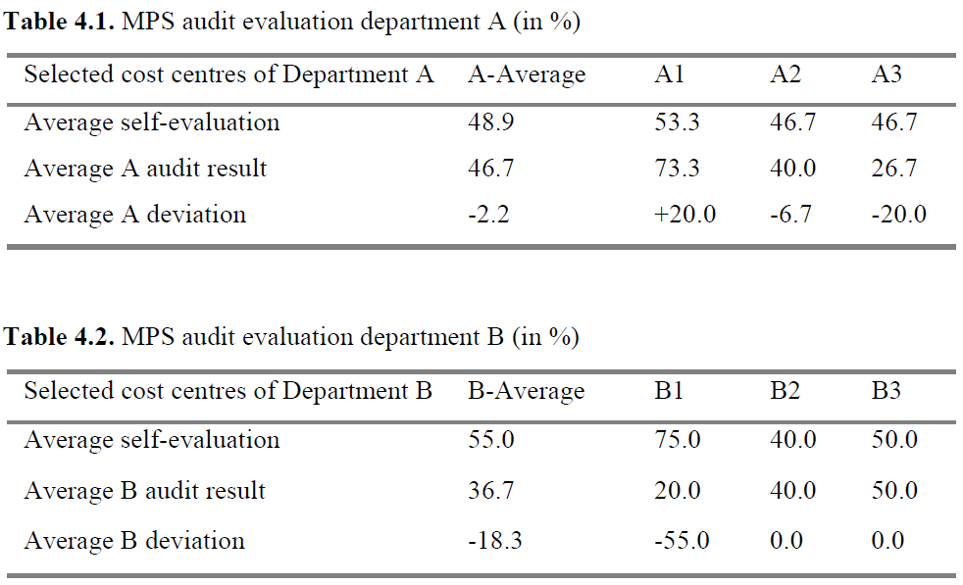

Slide 40
4.9 The MPS-audit
4.9.2 MPS-audit observations
The results show three distinct cases: the results of the self evaluation are in line with the actual MPS audit results (A2,B2, B3, C2);12 the MPS audit results are considerably lower than the initial self-evaluation (A3, B1); the MPS audit results are considerably higher than the initial self-evaluation (A1, C1, C3).
These latter two categories of cases are grouped in the table below.

Slide 41
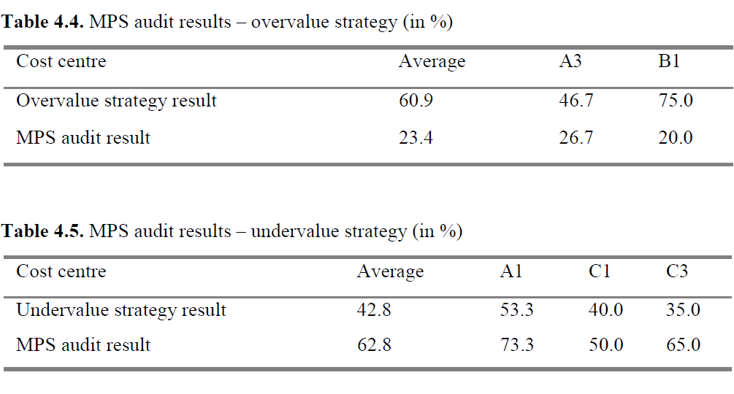

Slide 42
4.9 The MPS-audit
4.9.2 MPS-audit observations
the significant deviation between MPS audit results and the self-evaluation can be explained by the following two self-evaluation tactics which the shop floor actors deployed:
1 - actors deliberately used very stringent self-evaluation measures
thus undervaluing their MPS implementation efforts. The intention behind this tactic being that the actual MPS audit results will provide higher results and thus the cost centre would "look better" than assumed.

Slide 43
4.9 The MPS-audit
4.9.2 MPS-audit observations
2 - actors overestimated their MPS implementation efforts considerably,
thus the MPS-audit result was considerably lower than the selfe-valuation result.
two factors might have affected their overrate evaluation :
1 - The first reason is that for a department producing the "cash cow", and running on a three-shift production schedule, it is difficult to take away manpower resources from the production process to conduct self-evaluations for the MPS audit.

Slide 44
4.9 The MPS-audit
4.9.2 MPS-audit observations
two factors might have affected their overrate evaluation :
2 - A second reasoning behind these high self-evaluation results is that particularly in department A, the opinion prevails that the MPS does not necessarily introduce something new, and that this department had been the first to develop and implement standards which are now being implemented throughout the organisation as MPS tools.

Slide 45
4.9 The MPS-audit
4.9.2 MPS-audit observations
The influence actors hence have on the audit outcome is not restricted to the tactics of the auditees alone but even the supposedly "neutral" auditor, as pointed out above is not entirely subjective and particularly does not necessarily have the know-how and practical expertise to understand what he actually audits.
auditors failed to comprehend that what is ideal in theory is often impossible to actually implement in the real context of production.

Slide 46
4.9 The MPS-audit
4.9.3 The effectiveness of audits: theory versus practice
does the MPS merely represent a structural façade or is it actually lived on the shop floor ?
there is a difference between what the MPS "preaches“ and how actors live the MPS on the shop floor.
Providing standards for calculating productivity does not necessarily mean they are correctly calculated.
A similar discrepancy between the theoretical, formalised routines and actual shop floor practice is seen in the process of instructing novices.

Slide 47
4.10 The structure and content of the MPS
The MPS consists of three tiers:
(5) Subsystems
(15) Operating principles
(92) Tools

Slide 48
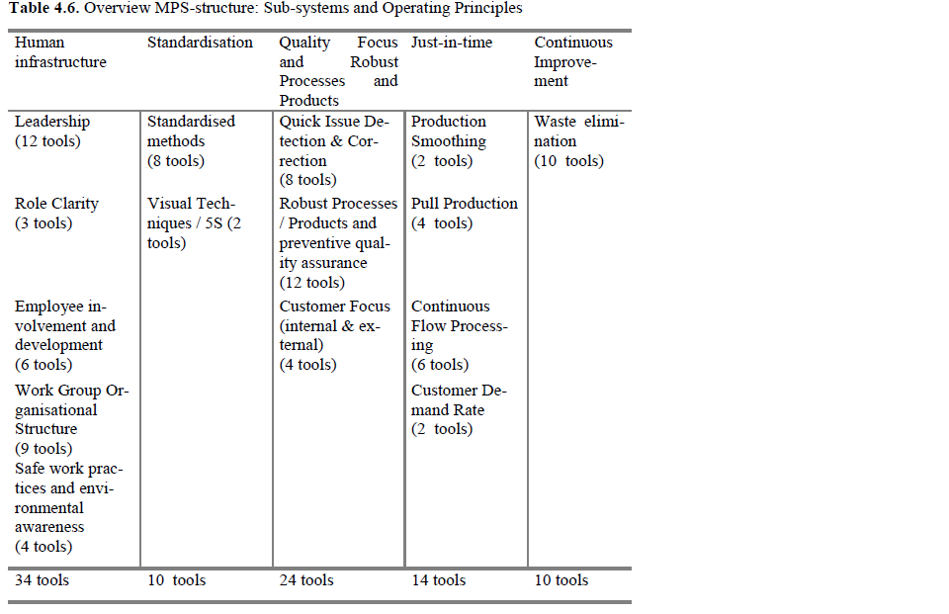

Slide 49
4.10 The structure and content of the MPS
the subsystem "Human Infrastructure" with a total of 5 operating principles and 34 tools seems to receive particular attention. Also the subsystem "Quality Focus and Robust Processes and Products" which consists of 3 operating principles" and 24 tools.
the MPS is based on a structure of seemingly independent parts.
Toyota Production System consists of a highly interrelated structure.

Slide 51
4.10 The structure and content of the MPS
4.10.1 The MPS tools
Description of KITTING (4.3.1):
Filling one bin or container with the parts required to complete a work element or task.
Used with CMA or "supermarket" located near the point of use.
Used with tuggers, mixed load conveyance, for part conveyance.
Benefits :
delivers multiple parts for assembly in one container, reduces walk and reach for the operator and line side floor space, improves visual control by avoiding excessive storage at the work station, allows for error proofing.

Slide 52
4.10 The structure and content of the MPS
4.10.1 The MPS tools
Description of KITTING (4.3.1):
Filling one bin or container with the parts required to complete a work element or task.
Used with CMA or "supermarket" located near the point of use.
Used with tuggers, mixed load conveyance, for part conveyance.
Benefits :
delivers multiple parts for assembly in one container, reduces walk and reach for the operator and line side floor space, improves visual control by avoiding excessive storage at the work station, allows for error proofing.

Slide 53
4.10 The structure and content of the MPS
4.10.1 The MPS tools
Description of "Integration of Tasks" (1.4.1):
- the group is responsible for direct and indirect defined tasks (e.g maintenance, quality, time studies and parts replenishment)
- indirect tasks are part of the in-group rotation system
-indirect tasks are done by trained operators within the team“.
Benefits:
"reduce overhead costs, to improve responsibility and involvement of employees, to promote employee development and to provide ergonomic relief“.

Slide 54
4.11 The Mercedes-Benz Production System and REFA methods
REFA : Reichsausschuss für Arbeitszeitermittlung
(Reich Committee for work time determination)
Today REFA : Verband für Arbeitsstudien und Betriebsorganisation
(Association for Labour Studies and operational organization)
German Association for Work Design / Work Structure
the REFA is rooted in the tradition of Taylorist Industrial Engineering .

Slide 55
4.11 The Mercedes-Benz Production System and REFA methods
the basic principles underlying the organisation of companies, components of the work system, work place ergonomics, the role of motivation for work and group work in production, and the legal context of work such as for example labour law.
What is generally referred to as so-called "REFA-Methods", consist of a set of principles regulating work which are published in a series of books under the umbrella term REFA-method training.

Slide 56
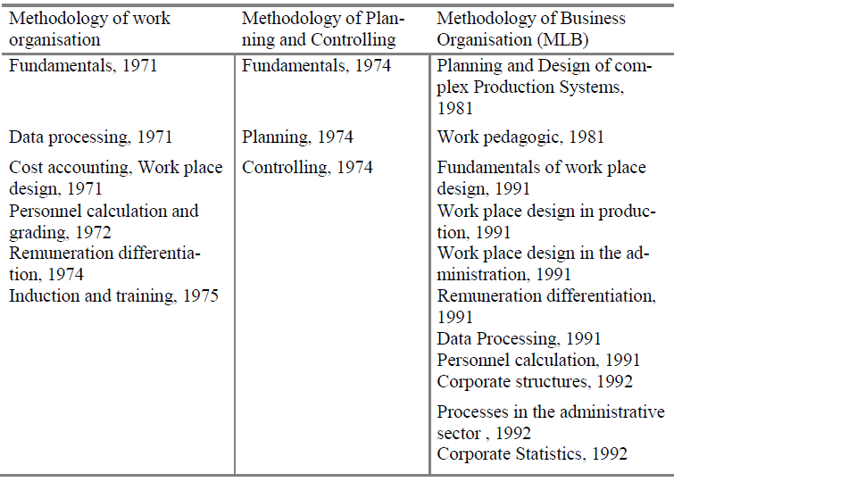
Table 4.7. Overview REFA-publications

Slide 57
4.11 The Mercedes-Benz Production System and REFA methods
The REFA proposes :
job enlargement, job enrichment, job rotation, group work/team organisation.
use of longer cycle times which could contribute to higher levels of job satisfaction.
use of buffers to decouple work in the assembly into sub-lines.
The REFA methods provide far more detail than the description of the MPS tools.

Slide 58
4.12 The MPS and the TPS
the core principles of the MPS are identical with those of the TPS.
the MPS does not reflect the highly integrated structure of interrelated elements of the TPS.
whereas Toyota standardised all tasks concerning the number of tasks, their sequence, the MPS focuses on the standardisation of work in areas of direct manual work.

Slide 59
4.12 The MPS and the TPS
Another difference between the MPS and the TPS concerns the role of the group speaker.
in both the MPS and the TPS workers are responsible for the design of their work system, their performance and the continuous improvement of their work and work processes.
"Just-in-time.
The flow of material controlling.
"Standard Work Instructions (SWIs)"

Slide 60
4.12 The MPS and the TPS
The difference between the TPS and the MPS is that whilst Toyota strictly applies a few principles, the Mercedes needs a variety of methods, regulations und descriptions.

Slide 61
Automotive production Systems and
standardization
YASERAMIRI.BLOG.IR
THE BEST OR NOTHING
Presentation 2
Chapter 5 :
The results of implementing the Mercedes-Benz Production System
Presented by Yaser Amiri
Nov 2015

Slide 62
Contents
Section | Slide number | section | Slide number
5.1 introduction | 63
5.2 Research scope and methodology | 65
5.3 Statistics | 69
5.4 The MPS questionnaire design and content | 71
5.5 Significances | 73
5.6 Analysis and interpretation | 97

Slide 63
5.1 introduction
This chapter continues the case study of the MPS by presenting the results of two surveys conducted.
The intention was to quantitatively analyse the impact of implementing a standardized production system on the shop floor.
do actors confirm that standards increase the degree of control over work processes?
How far can actors influence standards?
To what extent can actors contribute their own know-how and experience into standards?

Slide 64
5.1 introduction
First, the function of standardisation to control the work on the shop floor is linked to the alienation image of work.
Second. the impact of standardisation on organisational learning.
"essential precondition for learning" (Adler 1993:104).
Does Adler and Cole's argument apply in the case of the MPS?

Slide 65
5.2 Research scope and methodology
Fig. 5.1. Longitudinal research period of present study and empirical measure points

Slide 66
5.2 Research scope and methodology
The research location was the Mercedes-Benz plant Untertürkheim.
The empirical research was conducted at one of these centres, henceforth referred to as Z.
One head of department (management level 3 – E3)
Depending on the size of the sub-centre:
between 4 - 6 team leaders (management level 4 – E4)
between 9 – 26 supervisors (Meister: management level 5 – E5)
between about 350 – 1100 workers (including direct, indirect and temporary workers)

Slide 67
5.2 Research scope and methodology
Fig. 5.2. Sample composition according to hierarchical groups

Slide 68
5.2 Research scope and methodology
During both survey waves, the same sample size and population was used.
Of the 643 questionnaires sent out twice, at the end of the first survey period in November 2000, 28.5% were filled out and returned; one year later in November 2001, the return rose to 39.5%.

Slide 69
5.3 Statistics
To measure attitudes and opinions, first a pool of items was created. Using the Varimax method these items were then pre-tested and a reliable questionnaire design was developed. Depending on the distribution of this probability variable, a range of parametrical and nonparametrical tests, such as the t-test, the chi2-test, regression analysis, variance analysis, the H-test and other statistical tests were conducted Cronbach's Alpha was used as a reliability measure.

Slide 70
5.3 Statistics
deploying factor analysis highly correlating items were summarised.
after z-transformations, these items then were used as a basis for the calculation of the total scores. The purpose was to thus create stochastically independent item groups.
For the present study, Cronbach Alpha = 0.7875
use the Kolmogorov-Smirnov Test to compare how this distribution compares to the normal distribution.

Slide 71
5.4 The MPS questionnaire design and content
to get actors to rate verbal statements on a symmetrical scale of six levels ranging from verbal statements of agreement, to verbal statements of disagreement.
This scale does not provide a central dimension, as is the case with scales based on sets of odd intervals, thus so-called hidden abstentions, caused by individuals consistently marking the middle of the range, were avoided.

Slide 72
5.4 The MPS questionnaire design and content
questionnaire parts :
Information and Communication
Leadership and Management
The third part is divided into two groups of items:
1-Co-operation within the team . 2-Co-operation between teams
Know-how and experience
Quality
Own Work
Opinion of actors about the MPS

Slide 73
5.5 Significances
In accordance with statistical conventions, using the t-test, the significance level was set at 5% based on a 95% confidence interval.
Results indicating an Alpha outside this range signal that no changes in the rating of items, in the opinion of individuals, has occurred.
5.5.1 The general trend of results at Production Centre Z
it is interesting to see that at Z, outcomes of only nine different items of the questionnaire reveal that significant changes in opinion between survey one and two occurred.

Slide 74
5.5 Significances
5.5.1.1 MPS improves integration of shop floor know-how and experience into standards and decisions
individuals are convinced that their know-how and experience is integrated in decisions made by both planners and superiors (Alpha 1.0%).
actors overwhelmingly confirm that they reckon that their know-how and experience is more integrated into standards (Alpha 0%).
the assumption being that a greater degree of inclusion of know-how and experience is associated with an increasingly intellectually demanding job.

Slide 75
5.5 Significances
5.5.1.1 MPS improves integration of shop floor know-how and experience into standards and decisions
the results suggest a relation between the decrease in job demand and content and the implementation of the MPS.
the findings confirm Adler and Cole's notion that standardisation facilitates the inclusion of the tacit knowledge.
Standardisation contributes positively to an integration of the shop floor know-how and experience and at the same time decreases the general work load in terms of job content and demand.

Slide 76
5.5 Significances
5.5.1.1 MPS improves integration of shop floor know-how and experience into standards and decisions
There are no significant changes evident that individuals' wish to improve job variety and monotony (Alpha 19%), job demand (Alpha 63%) and participation in the decision making process (Alpha 75%).
there are also no significant changes in the rating of a total of 12 motivational factors, with "Task variety" as a motivational factor ranking sixth (Alpha 45%), "Right to participate" ranking fifth (Alpha 50%), "To have responsibility“ ranking second (Alpha 37%).

Slide 77
5.5 Significances
5.5.1.1 MPS improves integration of shop floor know-how and experience into standards and decisions
These results reflect on two aspects.
First, they show that actors perceive job variety less important a motivation factor than responsibility and participation in the decision making process.
Second, the inclusion of know-how and experience in decisions and standards is part of the general
Does this affect overall job satisfaction though?
Interestingly, actors did not confirm significant changes in overall job satisfaction levels (Alpha 72%).

Slide 78
5.5 Significances
5.5.1.1 MPS improves integration of shop floor know-how and experience into standards and decisions
Do actors associate their ability to influence standards and decisions with the implementation of the MPS?
a relation between the positive results regarding the increased inclusion of the tacit knowledge and the individuals‘ perception of the MPS should exist.
the number of individuals who know about the MPS has increased significantly (Alpha 0%).

Slide 79
5.5 Significances
5.5.1.1 MPS improves integration of shop floor know-how and experience into standards and decisions
the Z results suggest that since the implementation of the MPS commenced, the know-how and experience of individuals has increasingly shaped the decisions of superiors and planners and has also been more incorporated into standard.
actors do not consider that their overall job demand, and specifically the mental demand of their work has also increased. Neither do results confirm that there is a relation between this increased tapping of shop floor know-how and job satisfaction levels or changes in the ranking of motivational factors.

Slide 80
5.5 Significances
5.5.1.1 MPS improves integration of shop floor know-how and experience into standards and decisions
the standards introduced through the MPS have helped making work easier. Standards are not associated with the alienation image of work but the findings show that individuals perceive standards in terms of working routines which help them to ease their work.
the results affirm that the tacit know-how of actors is tapped through the setting of standards and hence standards provide a framework for sharing this know-how and represent a platform for organizational learning.

Slide 81
5.5 Significances
5.5.1.2 The MPS improves the co-operation in and between teams
where communication between teams was evaluated, the flow of information between teams has improved significantly (Alpha 2%).
do the findings indicate what type of information has increasingly been transmitted?
individuals have become aware of the tasks of other teams (Alpha 1%).
The results therefore point towards a shift in the individuals' perception from considering their work in isolation, to an awareness of how their work is integrated into the entire production process chain.

Slide 82
5.5 Significances
5.5.1.2 The MPS improves the co-operation in and between teams
This shift has affected the awareness of the actors but has it also improved the relations between teams?
results do not confirm this link. An increase in the degree of co-operation between teams (Alpha 94%) has not occurred.
Findings confirm that the discussion about quality has intensified during team discussions.

Slide 83
5.5 Significances
5.5.1.3 Changes in ratings regarding necessary improvements

Slide 84
5.5 Significances
5.5.1.3 Changes in ratings regarding necessary improvements

Slide 85
5.5 Significances
5.5.1.4 Changes in motivating factors

Slide 86
5.5 Significances
5.5.1.4 Changes in motivating factors

Slide 87
5.5 Significances
5.5.1.5 Assessment of the MPS goals

Slide 88
5.5 Significances
5.5.1.5 Assessment of the MPS goals

Slide 89
5.5 Significances
5.5.1.6 Expected influence of MPS

Slide 90
5.5 Significances
5.5.1.6 Expected influence of MPS

Slide 91
5.5 Significances
5.5.2 Sub-centre results
can quantitative results confirm the general assumption that standardisation leads to a greater harmonisation in the opinion and perception of actors about processes, such as the flow of communications ?
Adding the scores of all items of each part, an average rating score for each of these six parts can be calculated. It is then possible to compare average scores.

Slide 92
5.5 Significances
5.5.1.6 Expected influence of MPS

Slide 93
5.5 Significances
5.5.2 Sub- center results
the results show that through the implementation of the MPS, the flow of information and communication has firstly improved and second, the level of these ratings of all three sub- centres has converged towards one common, nearly homogenous level.
To provide an analogy, before standard ingredients are introduced, burgers in Rome, Berlin and New York taste different. Mr Agnelli thinks the burger tastes salty, Mr Schremp suggests it tastes hot, Mr Ford states it tastes spicy. Once standard ingredients are introduced, the burgers taste similar, if not the same.

Slide 94
5.5 Significances
5.5.2 Sub- center results
Interestingly, this convergence trend is also evident in other parts of the MPS survey.
there is trend of a convergence of opinion in the three sub-centres. This concerns particularly the opinion individuals have about communication and information, leadership, internal team co-operation and the inclusion of know-how and experience. Actors have become more satisfied with these areas.

Slide 95
5.5 Significances differences
At sub- centre A and C there is a positive perception of the MPS, whereas the results of B offer a slightly more critical picture.
at sub center A is primarily an improvement of the work in and between teams, but also a better flow of information and communication.
At B, staff is more critical about the implementation of the MPS, and associate it with a cut in cycle time and job cuts.
At sub- center C, changes in trend can be summarised in terms of improved social environment, as social relations in teams and between individuals and superiors have improved significantly.

Slide 96
5.5 Significances differences
the result of all three departments point towards the improved inclusion of tacit knowledge at work.
Associates at A and C affirm that their know-how and experience shapes decisions made by superiors and planners to a greater extent, also findings of all three sub- centers affirm that the shop floor knowledge influences the content of standards more.
this inclusion is neither associated with an increase in the work load i.e. job demand, nor with an increase in the level of stress caused by mental work.
regarding to the overall Z results, the implications are that there is no relation between job satisfaction and the inclusion of tacit knowledge.

Slide 97
5.6 Analysis and interpretation
the findings do not confirm that the standards introduced through the MPS contribute to actors being alienated from work.
at Z shop floor know-how and experience has been more incorporated into the decisions made.
Decisions are made closer to the actual root of the problem.
The responsibility to ensure and control this process stability, is now shared by both superiors and staff.
associates have received more freedom to contribute and voice their opinions, and by being encouraged to take part in the decision making process, staff have also gained more responsibility.

Slide 98
5.6 Analysis and interpretation
The implementation of the MPS represents a framework in which individuals are able to determine how their work processes should be regulated.
through the inclusion of tacit knowledge actors have more control over their own work.
the inclusion of tacit knowhow does not at the same time lead to an increase in the motivation levels of individuals
inclusion of the shop floor know-how into standards has contributed to organisational learning.

Slide 99
5.6 Analysis and interpretation
This finding shows that with regard to the responsibility for quality, the MPS does not continue to follow the Taylorist division of mental and physical work, but instead delegates the quality responsibility onto the shop floor.
team training and social events improved contributing to an improved social atmosphere at work.
Leaders received more feedback from their staff and team work improved.
the MPS became a subject not only discussed during team meetings but from the beginning, the responsibility for the implementation of the MPS was delegated to actors on the shop floor.

Slide 100
5.6 Analysis and interpretation
An obvious limitation that has to be pointed out is the research scope.
the findings are based on two collection points within the period of twelve months. In order to examine if the trends perceived are sustained, more measure points are necessary.

Slide 101
5.6 Analysis and interpretation
Summarising, the empirical analysis shows that the implementation of the MPS has caused changes in the organisation of work, particularly the issues of control and learning.
the results refute the claim that standardisation is merely a control tool, implemented from the top down and reaffirming the classical picture of alienation of work.
the view of standardization proposed by Adler and Cole is confirmed by the findings.

Slide 102
5.6 Analysis and interpretation
organisational learning takes place. By encouraging staff to contribute their ideas, to some extent then, actors regain the control over process standards.
Parallel to thus strengthening the role of the actors on the shop floor, results also point at changes supporting the importance of teamwork within the context of standardisation.

Slide 103
5.6 Analysis and interpretation
organisational learning takes place. By encouraging staff to contribute their ideas, to some extent then, actors regain the control over process standards.
Parallel to thus strengthening the role of the actors on the shop floor, results also point at changes supporting the importance of teamwork within the context of standardisation.

Slide 104

5.6 Analysis and interpretation
Thus put it in a nutshell, the empirical results show that through the implementation of the MPS, the role of the tacit dimension, the flow of information and communication, the role of the team and the relationship between individuals and superiors have improved.

Slide 105

Yaser Amiri
YASERAMIRI.BLOG.IR

