Slide 1
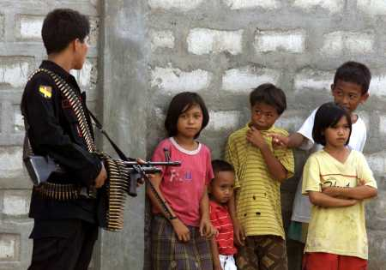
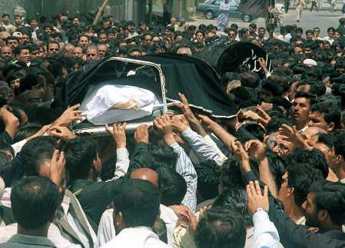
Change …..
Muslim Guerilla, Philippines
Movement, Reform & Revolution
Pakistan

Slide 2
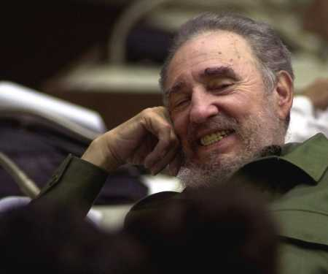
Change …..
Linear change
Abrupt change
movement
reform
revolution …..
Castro

Slide 3
Components
Organisation (coordination, control efforts, style)
Beliefs / Ideals (definition of movement, grievances, proposals, attacks, plans, resistance)
Actions (e.g. violent or non-violent, conventional and unconventional)

Slide 4
Revolution … the most extreme form
Overthrow of a regime
Use of violence / threat
Significant changes socially, economically and politically
Chechenya, Russia

Slide 5
Characteristics (Cohan)
Presence of violent behaviour
Alteration of values
Alteration of social structure / institutions
Changes in leaders and its formation
Legal / illegal transfer of power
Sierra Leone, Africa

Slide 6
Causes ... Marxist interpretation
Inevitable result
Class conflict resulted from exploitation
Alienation and formation of class
Revolt

Slide 7
Causes … non-Marxist interpertation
Mix of various factors
General causes (economic, socio-cultural, ideological, political)
Specific causes (well-organised sector, dissension within the ruling elite, lost of control, power and authority)

Slide 8
Status Politics
Non-class based movement
Seeks to protect / promote their own values / beliefs
Found in prosperous time
Rethinking Anti-Vietnam War Movement

Slide 9
Neil Smesler’s study of norm-oriented social movement
Generalised / short-circuited beliefs
Pre-conditions:
- Structural conduciveness
- Strain
Precipitating factors
Mobilisation for action
Social control

Slide 10
Structural Theories - Skocpol
Causes found in the society (not personal wishes)
International conditions play major role
State as crucial factor to success or failure

Slide 11
Skocpol’s study of France, Russia & China
Conditions promote vulnerability (weakened bureaucracy, developing of opposition)
Capacity of opposing forces
Initial reactions after taking over power

Slide 12
Organisational Theory
Discontent as normal and therefore not really critical
Lenin’s notion of party as vehicle for revolution
Will of the leaders and activists
Organisational capacity and action
East Timor

Slide 13
Social-psychological Theories
Explaining why people discontent
Rising expectation
Dissatisfaction
Relative deprivation
Frustration - aggression
Intolerable
Acheese Independence Force, Indonesia

Slide 14
Theories / Factors explaining ...
Origin of the frustration / movement
Growth / development of the movement
Outcome of the movement (success or failure)
Musharif, seize power by a military coup, Pakistan

Slide 15
Stages ….

