Slide 1
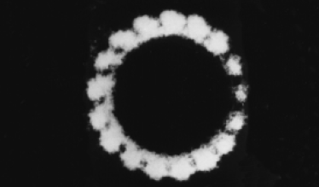
Complement

Slide 2
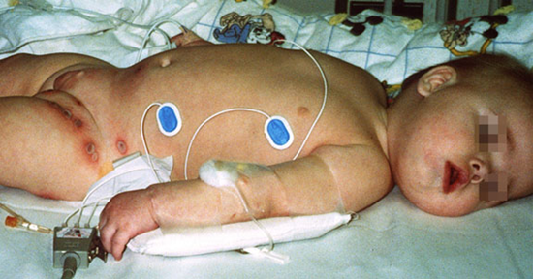
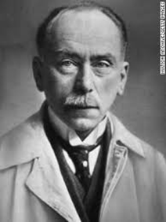
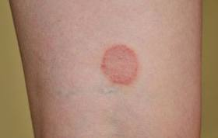
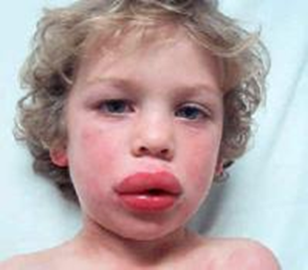
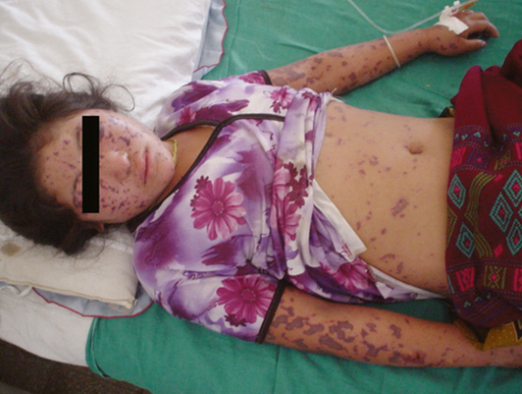
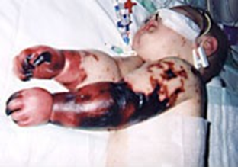

Slide 3
Introduction
The complement system is one of the major effector mechanisms of humoral immunity
Is an important effector mechanism of innate immunity.
Jules Bordet 1919
The complement system consists of serum and cell surface proteins
Activation of complement involves the sequential proteolysis
zymogens

Slide 4
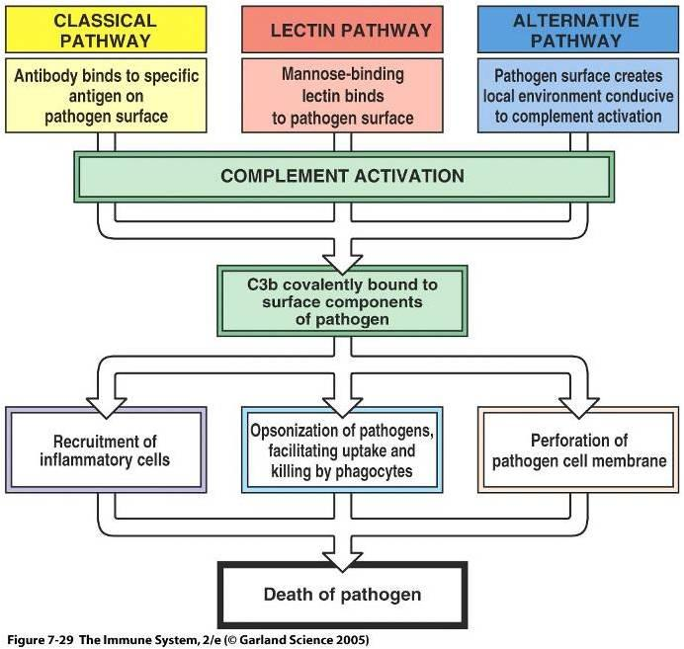

Slide 5
Complement nomenclature
Convertase
C₃
C₃b
C₃a

Slide 6
The classical pathway of complement activation

Slide 7
The classical pathway

Slide 8
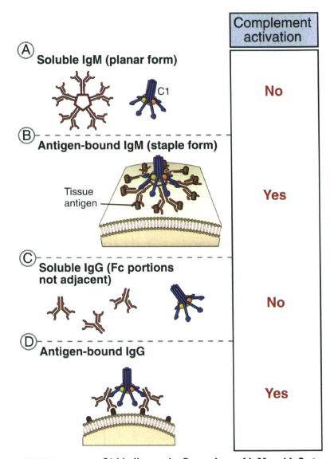
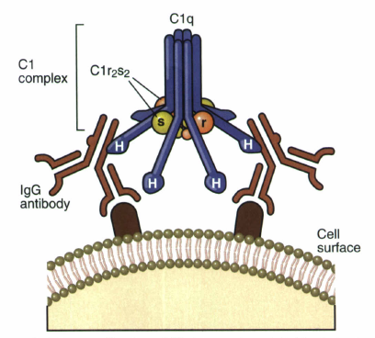
C1q molecule

Slide 9
The classical pathway of complement activation

Slide 10
The classical pathway of complement activation

Slide 11
The alternative pathway

Slide 12
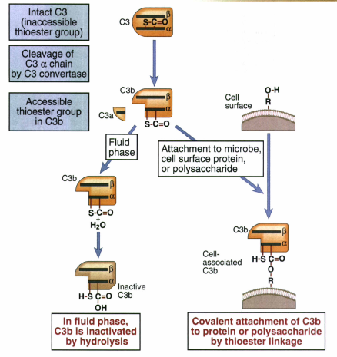
Tickover

Slide 13
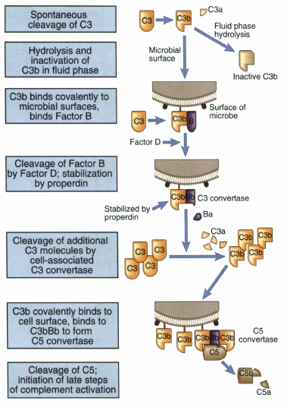
The alternative pathway
The alternative-pathway C3 and C5 convertases are both stabilized by properdin (factor P)

Slide 14
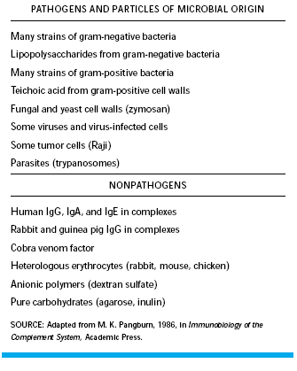

Slide 15
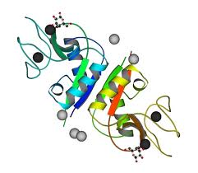
Lectin Pathway

Slide 16
Lectin Pathway of Complement Activation
Ficolin

Slide 17
MAC formation

Slide 18
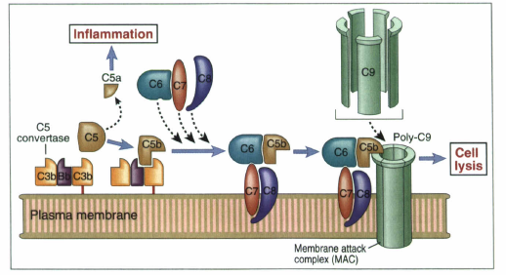
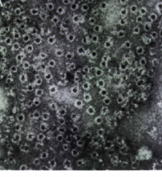
MAC formation
late steps of complement activation and formation of the MAC

Slide 19
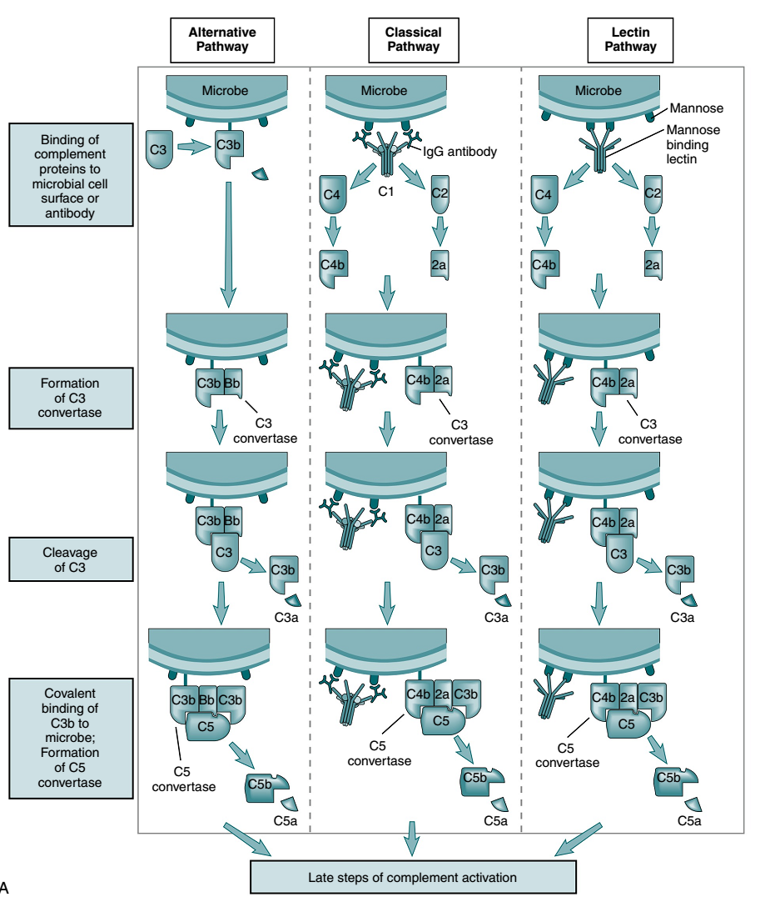
Notes:
There are three distinct pathways of complement activation, all of which converge on the complement component C3 that is cleaved to generate C3a and C3b. C3b can act to opsonize material for ingestion by phagocytic cells and to enhance clearance of immune complexes. C3b can also form part of C5 convertase, which cleaves C5 to generate the chemotactic fragment C5a. This cleavage results in assembly of the membrane attack complex (C5b-9), which can insert into cell membranes and cause lysis of bacteria and damage to nucleated cells. The classical pathway is activated following binding of IgM or complement-fixing isotypes of IgG on cell surfaces or in immune complexes. The first complement component, C1, binds to the antibody via its component C1q, and this binding initiates a cascade of protein cleavage that proceeds via C4 and C2. C1q can also be activated by binding to C-reactive protein that is bound to microbial constituents or material such as chromatin released from dead or dying cells. C1q can also be activated by binding directly to apoptotic cells. The lectin pathway is initiated by the binding of mannose-binding lectin to carbohydrates found on bacterial cell surfaces, and also proceeds via C2 and C4. The alternative pathway is activated by pathogens or by other entities such as damaged cells that do not express complement-inhibitory proteins or are unable to bind those in the circulation. The alternative pathway also acts as an amplification system once C3 is activated by the other pathways. C1-9, components of the complement pathway; MAC, membrane attack complex; MASPs, mannose-binding-lectin-associated serine proteases; MBL, mannose-binding lectin.

Slide 20
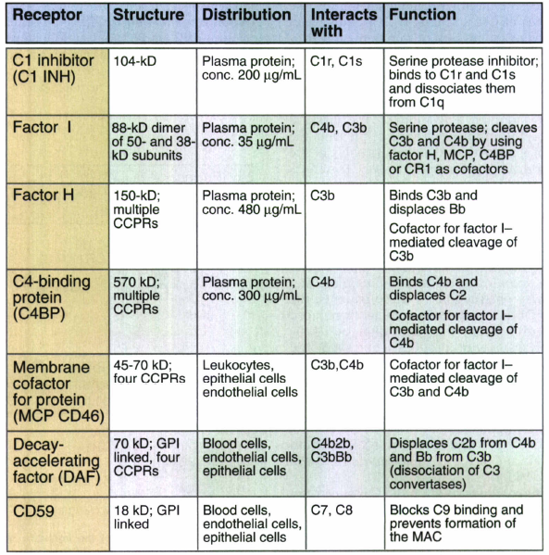
Regulator of complement activation

Slide 21
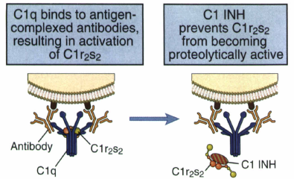
Regulator of complement activation

Slide 22
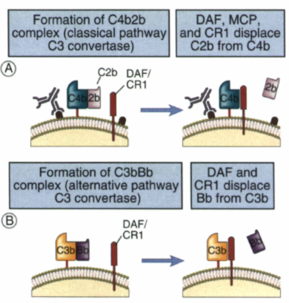
Inhibition of the formation of C3 convertases

Slide 23
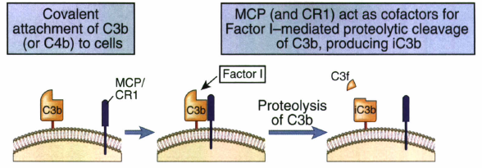
Regulator of complement activation
Factor I-mediated cleavage of C3b

Slide 24
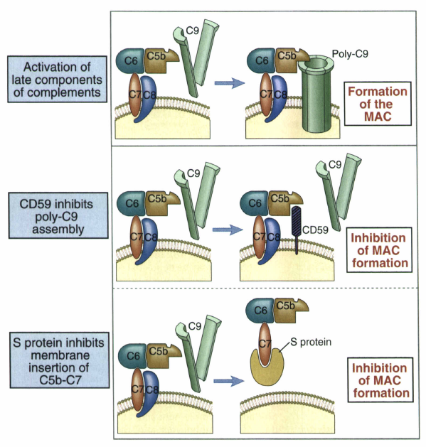
Regulation of formation of the MAC

Slide 25
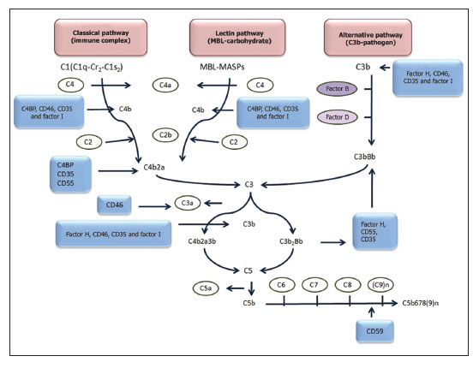

Slide 26
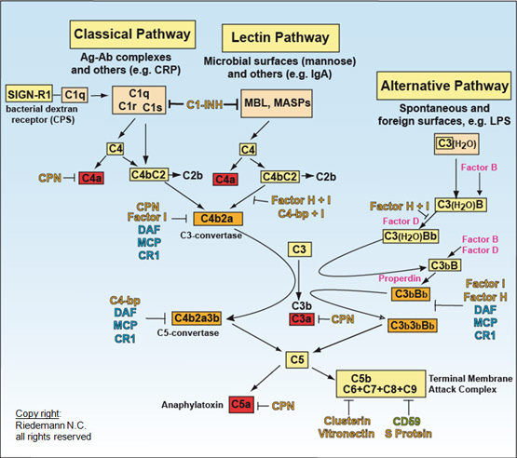

Slide 27
The Roles

Slide 28
The Good

Slide 29
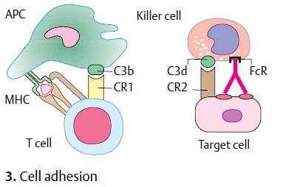
Functions of complement

Slide 30
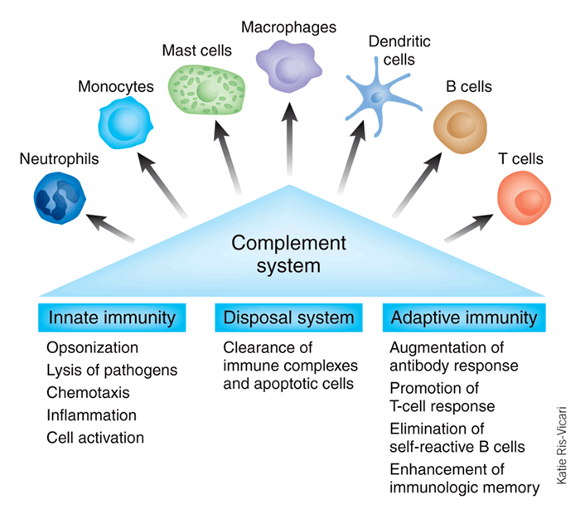
Notes:
Although the complement system has traditionally been considered part of the innate immune system, research in recent decades has revealed that complement is able to activate cells involved in both the adaptive and innate immune response. Complement triggers and modulates a variety of immune activities and acts as a linker between the two branches of the immune response. In addition, the complement system maintains cell homeostasis by eliminatiing cellular debris and immune complexes.

Slide 31
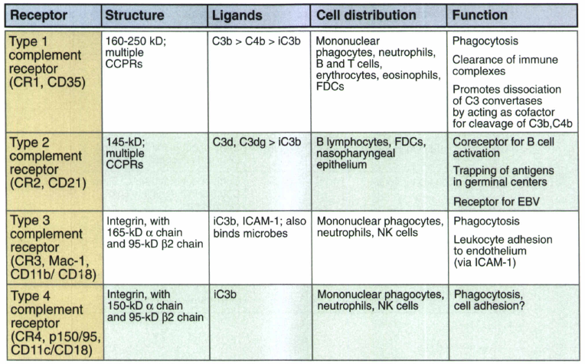
Receptors for Fragments of C3

Slide 32
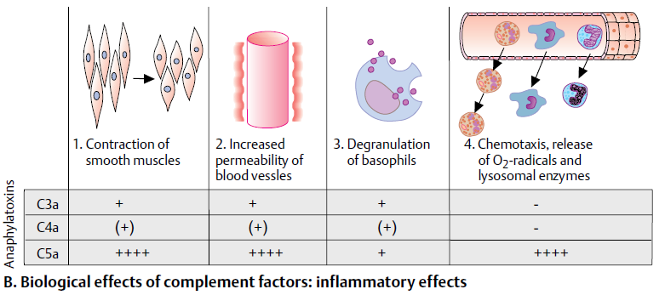
Inflammatory effects of complement

Slide 33
The bad

Slide 34
C3 deficiency
Sever recurrent infection with encapsulated bacteria
Begain shortly after birth

Slide 35
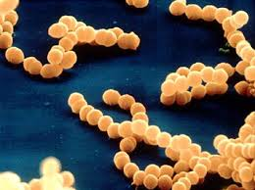
MAC (C5-C9) deficiency
Susceptible to N. meningitidis infection

Slide 36
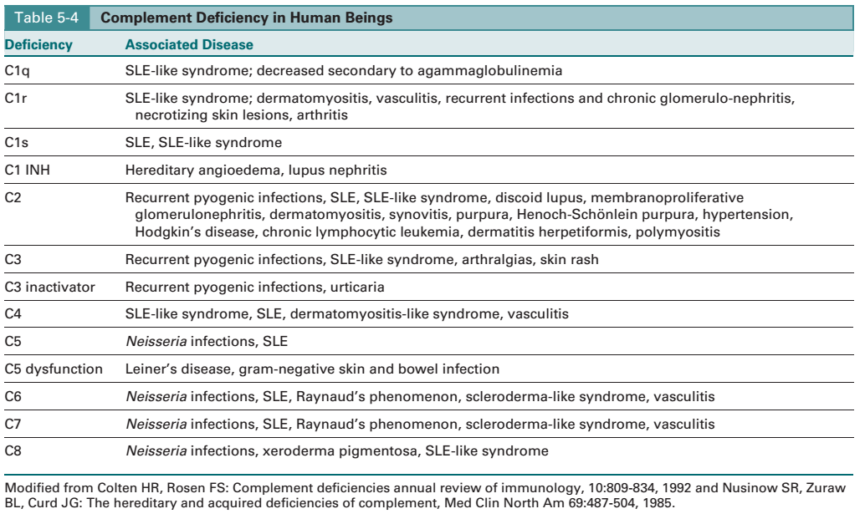

Slide 37
Complement deficiency

Slide 38
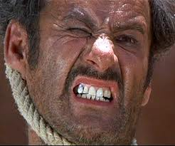
The ugly

Slide 39
C1q, C2 and C4 deficiency
Associated with the development of SLE.

Slide 40
C1INH Deficiency

Slide 41
PNH
Deficiency in DAF or CD 59

Slide 42
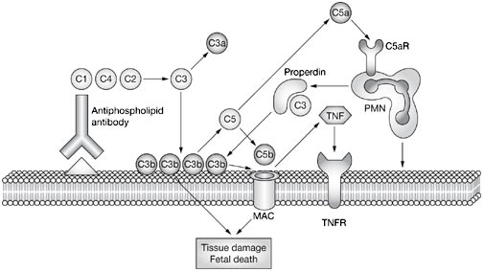
fetal loss in antiphospholipid syndrome.
Notes:
Antiphospholipid antibodies bind to the placenta and activate the classical complement pathway. This leads to deposition of C3b on the decidua and to the generation of anaphylatoxins and activators of inflammatory cells, particularly C5a. C5a attracts neutrophils and stimulates the release of inflammatory mediators including reactive oxygen species and proteolytic enzymes. Neutrophils accelerate the activation of the alternative pathway and synthesise C3 and properdin. C5 activation also leads to the formation of the membrane attack complex which might produce tissue damage. Tumor necrosis factor synthesis is stimulated, and this enhances tissue injury through tumor necrosis factor receptors.

Slide 43
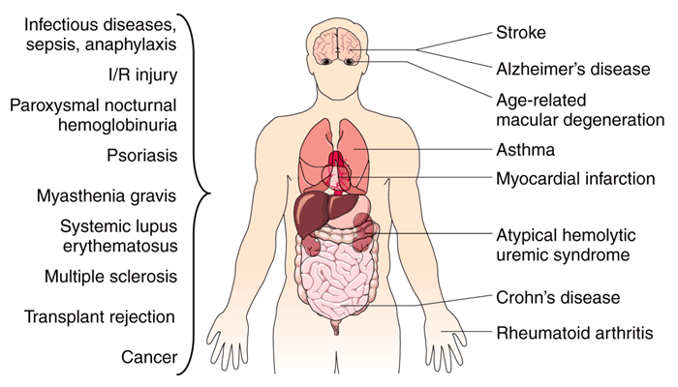
Examples of pathological conditions involving the complement system.
Notes:
Erroneous activation or insufficient regulation of the complement cascade may lead to an attack by the immune system against self-tissue. Many autoimmune, inflammatory and ischemia/reperfusion (I/R) injury-related diseases are therefore connected with complement. Whereas some of these pathological conditions are localized to specific organs and tissues, many of them are systemic. In addition, some pathogens have found ways to evade or even misuse the complement system, thereby contributing to infectious diseases and their consequences.

Slide 45
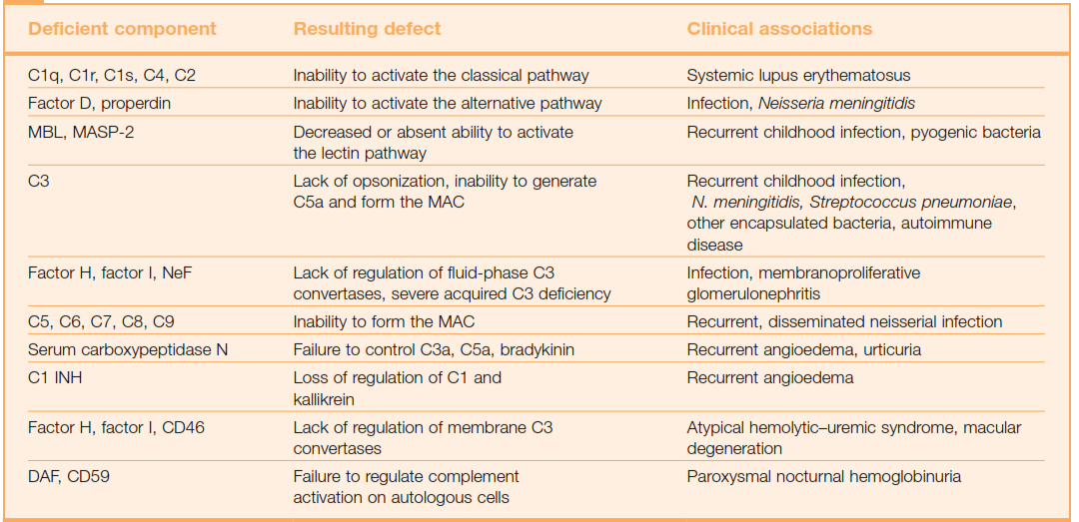
Clinical effects of complement deficiency

Slide 46
The End

