Slide 1
Services grade 9 lesson 4
By Kuchakzadeh
www.t.me/kuchakzadeh
www.prospectpowerpoints.blog.ir
1398

Slide 2
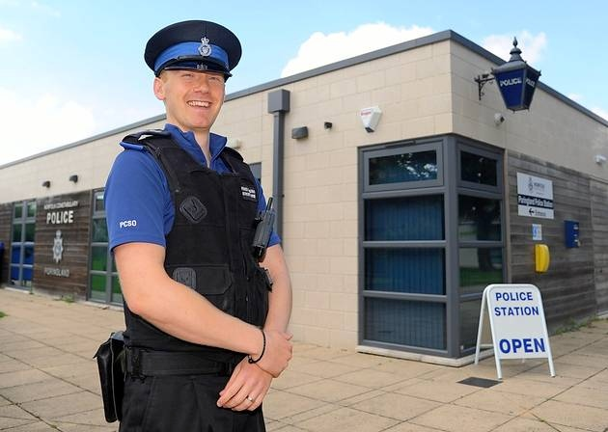
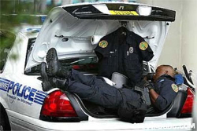
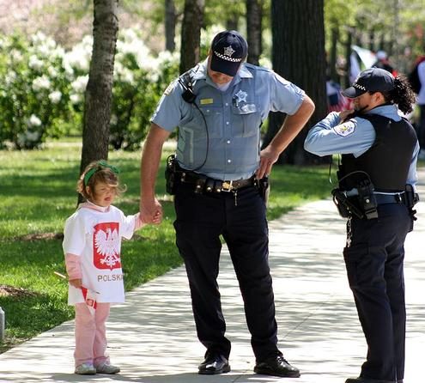
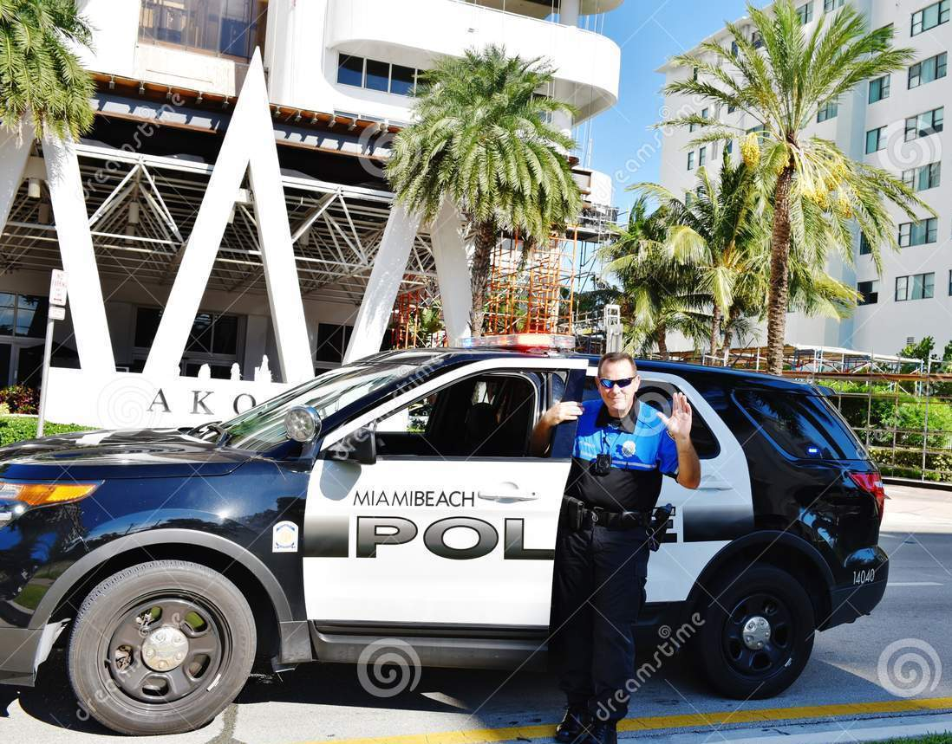
Who
is he?
He is a policeman.
When
does he go to work?
He usually works on shifts.
Where
does he work?
He works at a police station.
What
does a policeman do?
How
does he go to work?
He sometimes helps lost children.
He often goes by a car.

Slide 3
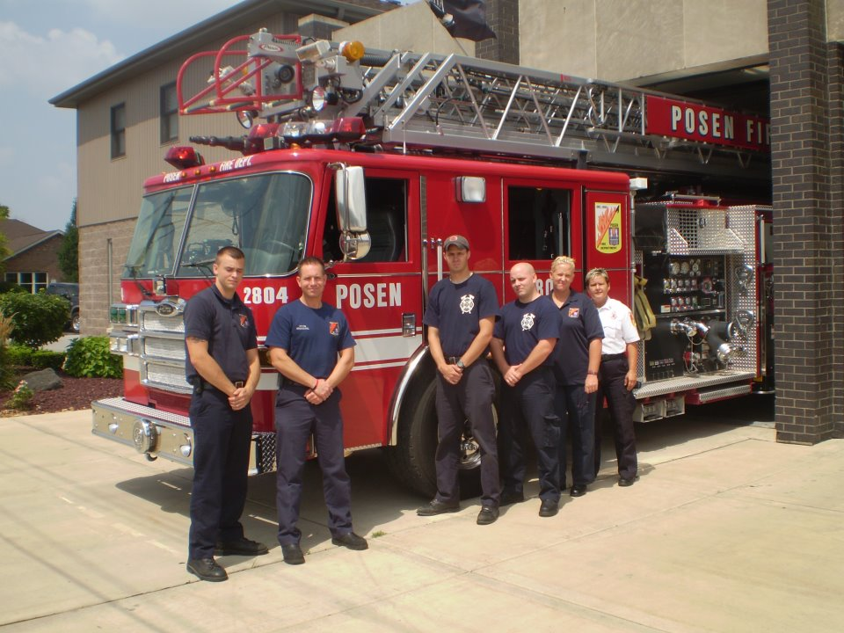
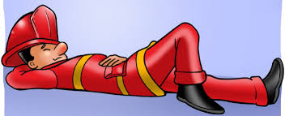
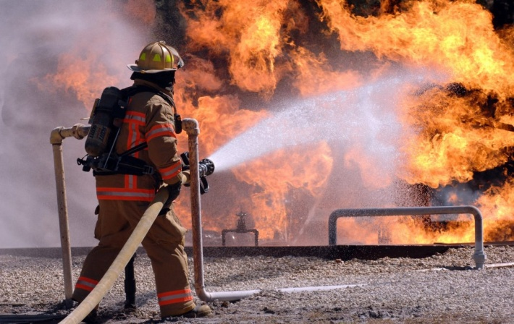
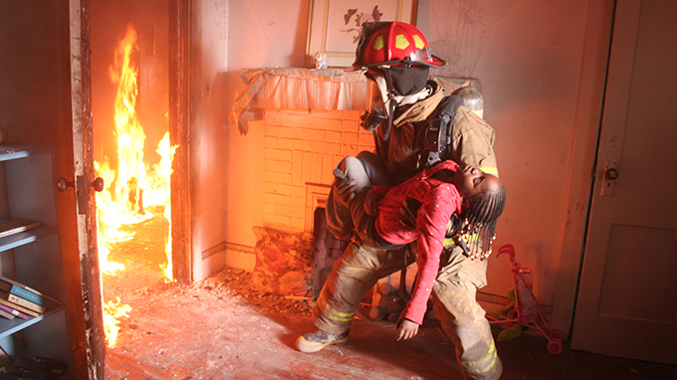
When
does he work?
are they?
He often works on shifts.
Who
They are firefighters.
Where
do they work?
They work at a fire station.
What
does a firefighter do?
What
does a firefighter do?
He sometimes saves people’s lives.
He usually puts out fire

Slide 4
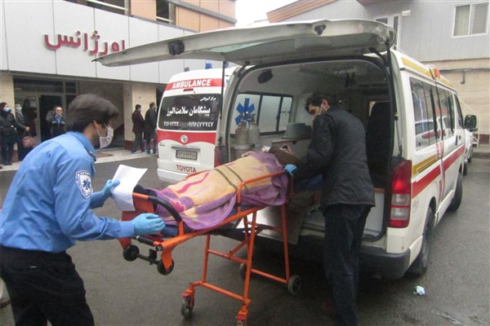
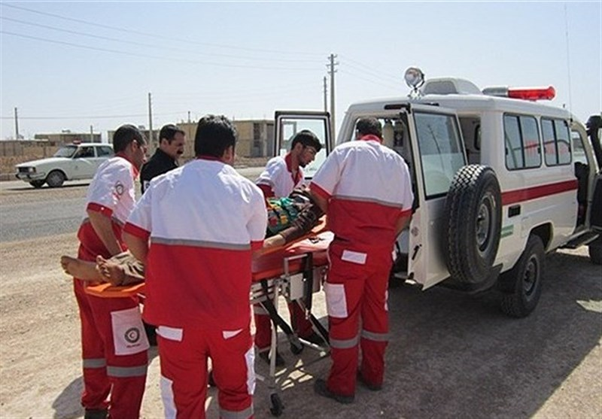
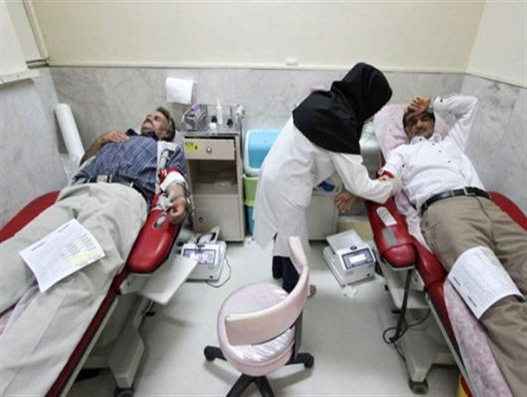
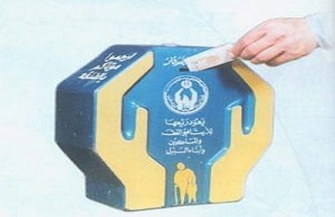
What
is his job?
He is a nurse.
Who
are they?
What
does he do?
They are nurses.
What
do they do?
He brings a patient to the ER.
They do voluntary work
How
does he help charity?
What
do people do here?
He puts money in the box.
They often donate blood

Slide 5
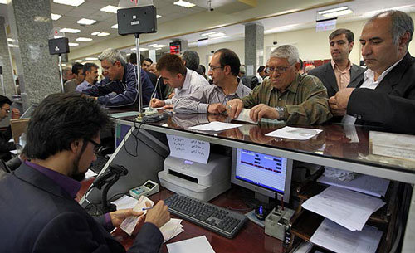
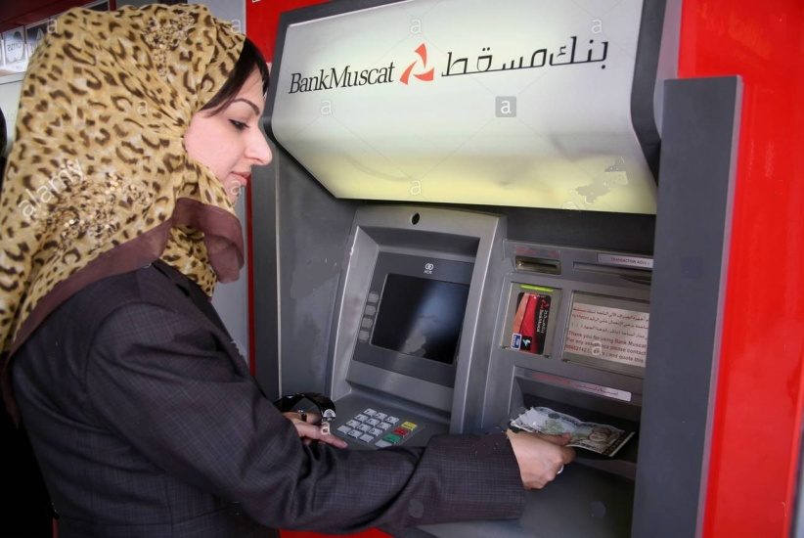
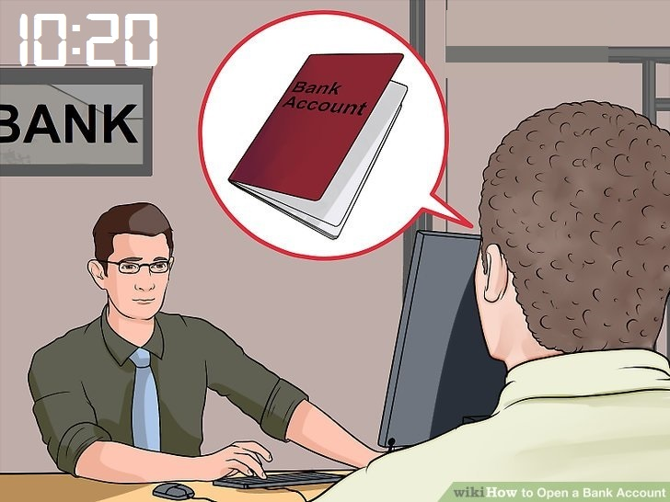
When
does it open?
Who
is he?
It opens at 7.
He is a bank teller.
What days
do they work?
They work from Saturday to Thursday.
What
does she do?
What
does he do in the bank?
She takes out money from an ATM
He opens an account

Slide 6
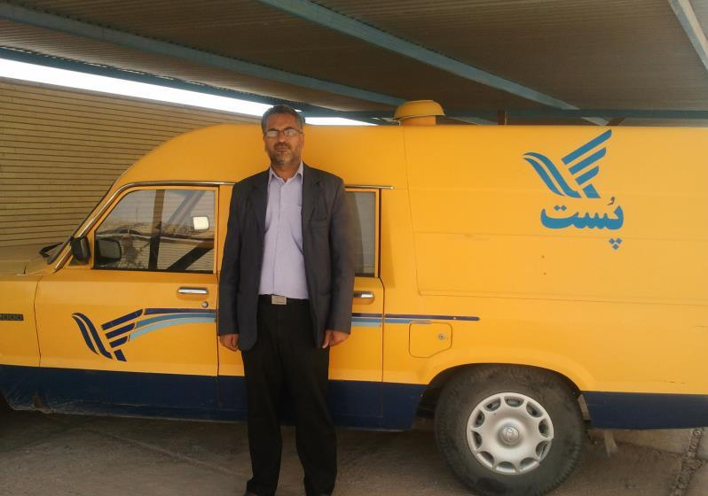
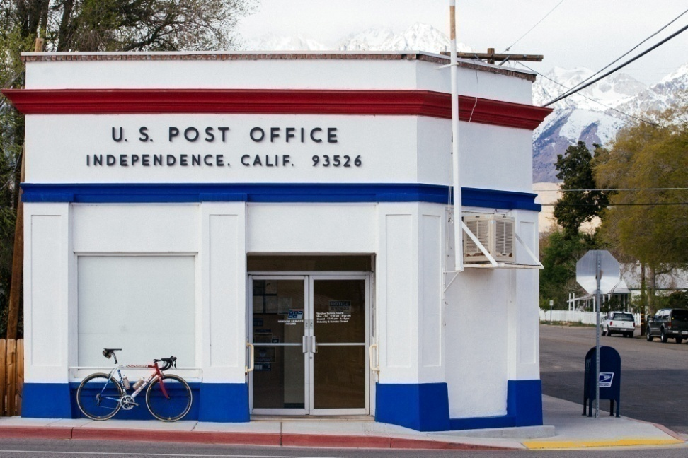
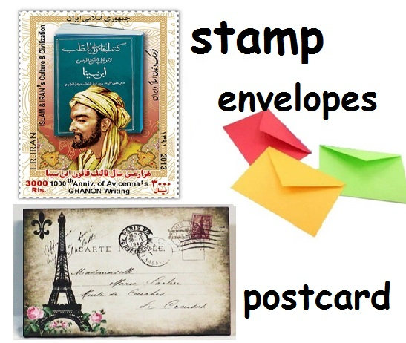
What
is his job?
He is a postman.
How
does he do his job?
He often does his job by car.
Where
is the post office?
It is just round the corner
What
do people do in a post office?
They usually send their letters and packs.

Slide 7
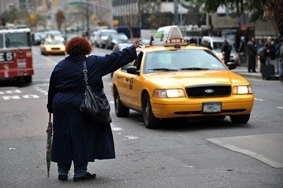
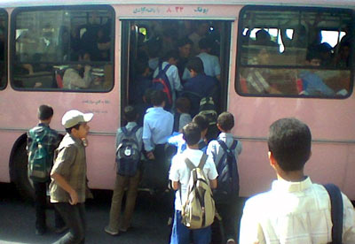
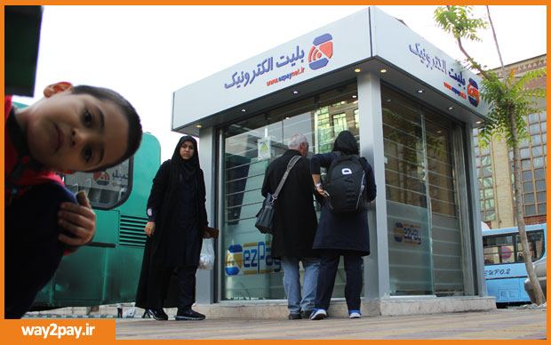
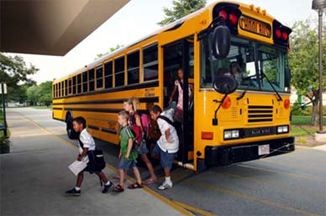
How
does she go?
How
do they go?
She often hires a taxi.
They go by bus.
Why
does she go by taxi?
What
do they do now?
Because, it’s fast.
They get on the bus.
What
do they do now?
What
do they do now?
They get off the bus.
They recharge their E-ticket.
Why
do they take a bus?
Because, it’s cheap.

Slide 8
Role Plays

Slide 9
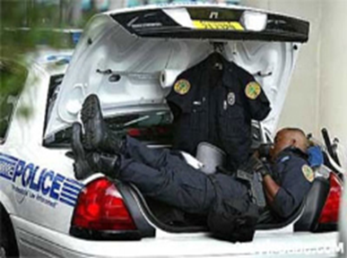
Name: Peter Smith
Job: ………………………..
Duty: …………………………
Work Time: ………………………..
Vehicle: ………………………………..

Slide 10
Name: Saman Hosseini
Job: ………………………..
Duty: ………………………………..
Work Time: …………………………………..
Go by: a bus

Slide 11
Name: Hassan Mohseni
Job: ……………………………..
Duty: ……………………………………
Work days: Saturdays to Thursdays
Work by: ………………………………

Slide 12
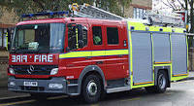
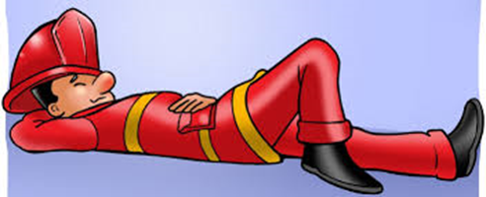
Name: Jack Richards
Job: ………………………..
Duty: ……………………..and ………………
Work Time: ………………………………
Vehicle: ……………………………….

Slide 13
Name: Ali Alavi
Job: …………………………
Duty: ………………………………….
Work Time: on shifts
Vehicle: …………………………………..

Slide 14
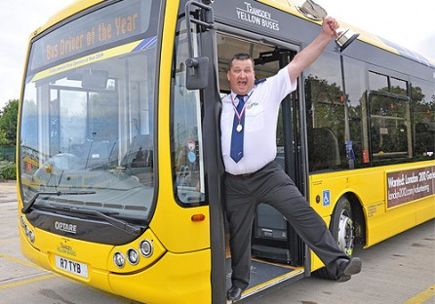
Name: Joe Hamilton
Job: …………………………….
Duty: …………………………….
Work Time: 9 am – 3 pm
Work by: a bus

Slide 15
Monolog

Slide 16
say about these people

Slide 17
say about these people

Slide 18
say about these people

Slide 19
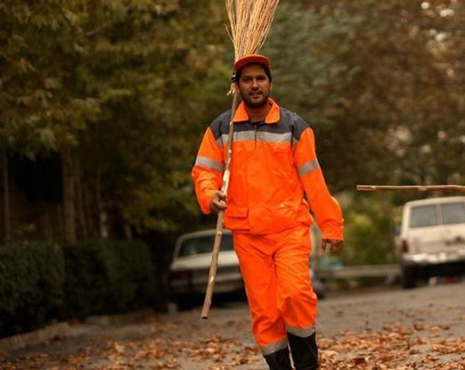
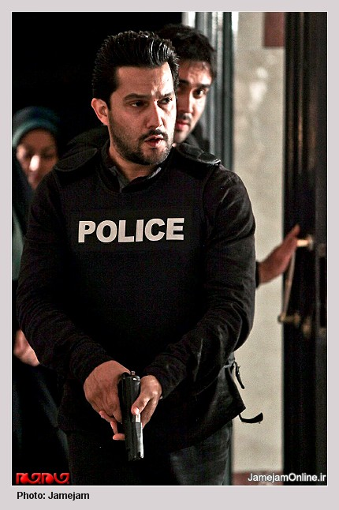
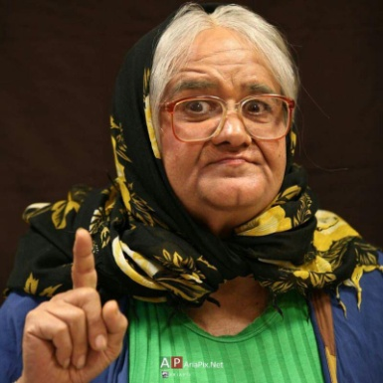
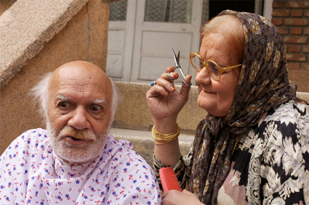
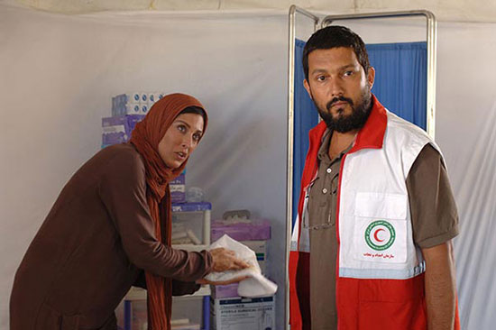
Hello, I am Hamed Behdad. I am an Iranian actor. I usually play a lot of roles. I sometimes play the role of a policeman and arrest the thieves and sometimes I play the role of a sweeper and keep the city clean. In another movie, I play the role of a nurse and help the patients. I never play the role of a woman yet, my colleague Akbar Abdi is very good at it.

Slide 20
He is Perter Smith. He is a policeman. He usually drives a police car. He works at a police station. He often works on shifts. A policeman sometimes helps lost children.
........................................................................................................................................................................................................................................................................................................................................................................................

Slide 21
Write about these people

