Slide 1
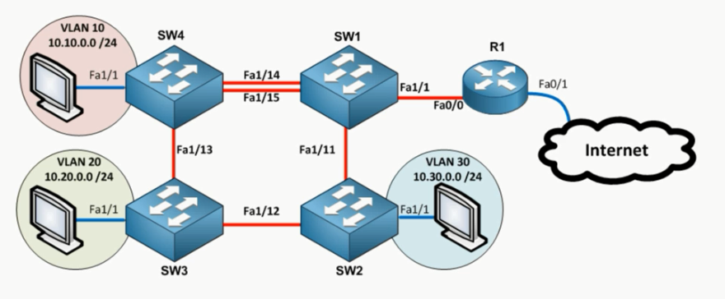
Ethernet Switching

Slide 2
VLAN | IP SUBNET
1 | 10.0.0.0/24
10 | 10.10.0.0/24
20 | 10.20.0.0/24
30 | 10.30.0.0/24
STP
ETHER-CHANNEL
TRUNKING
ACCESS
Vlan 1 management :10.0.0.10x

