Slide 1
Lesson one Prospect 3 Personality
By Kuchakzadeh
More at t.me/kuchakzadeh
1398

Slide 2
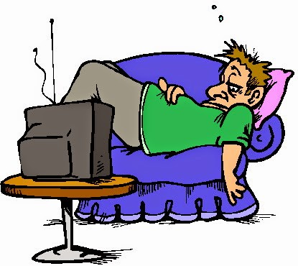
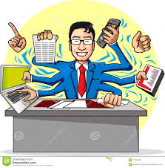
Is he lazy?
No, he isn’t.
What is he like?
He is hardworking.

Slide 3
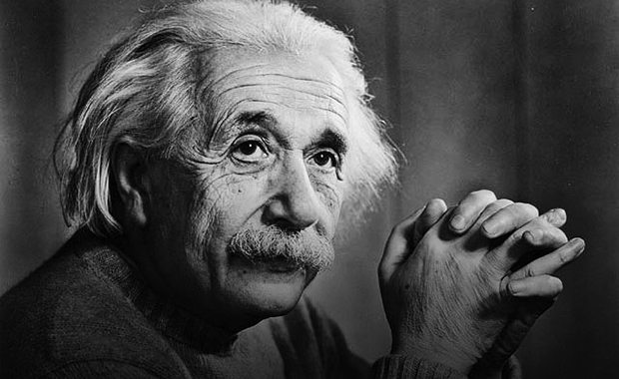
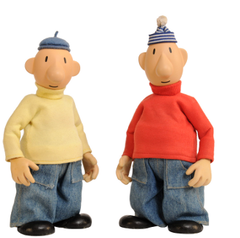
Is he fool?
No, he isn’t.
What is he like?
He is clever.

Slide 4
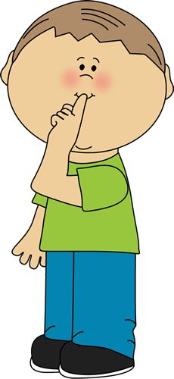
Are they quiet?
No, they aren’t.
What are they like?
They are talkative.

Slide 5
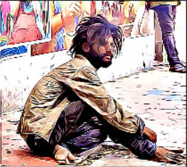
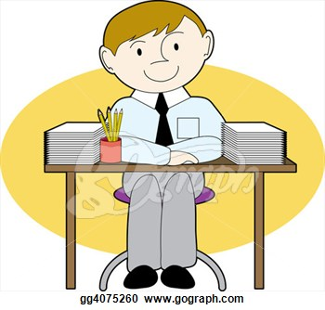
Is he dirty?
No, he isn’t.
What is he like?
He is neat.

Slide 6
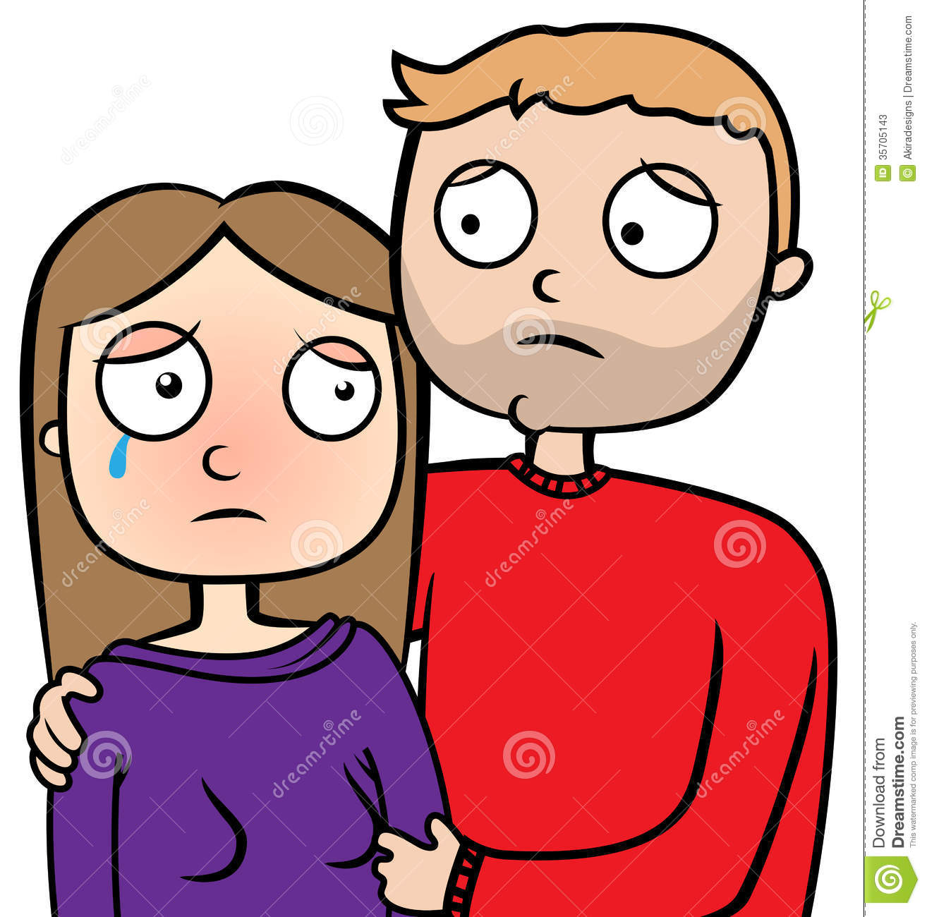
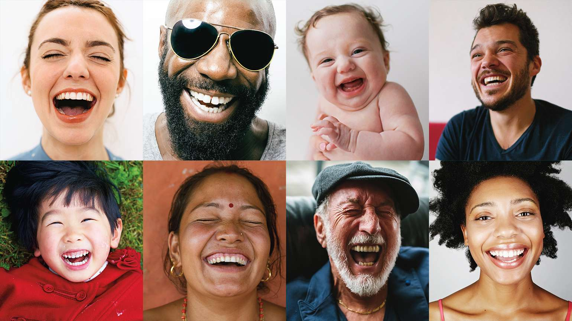
Are they happy?
No, they aren’t.
What are they like?
They are upset.

Slide 7
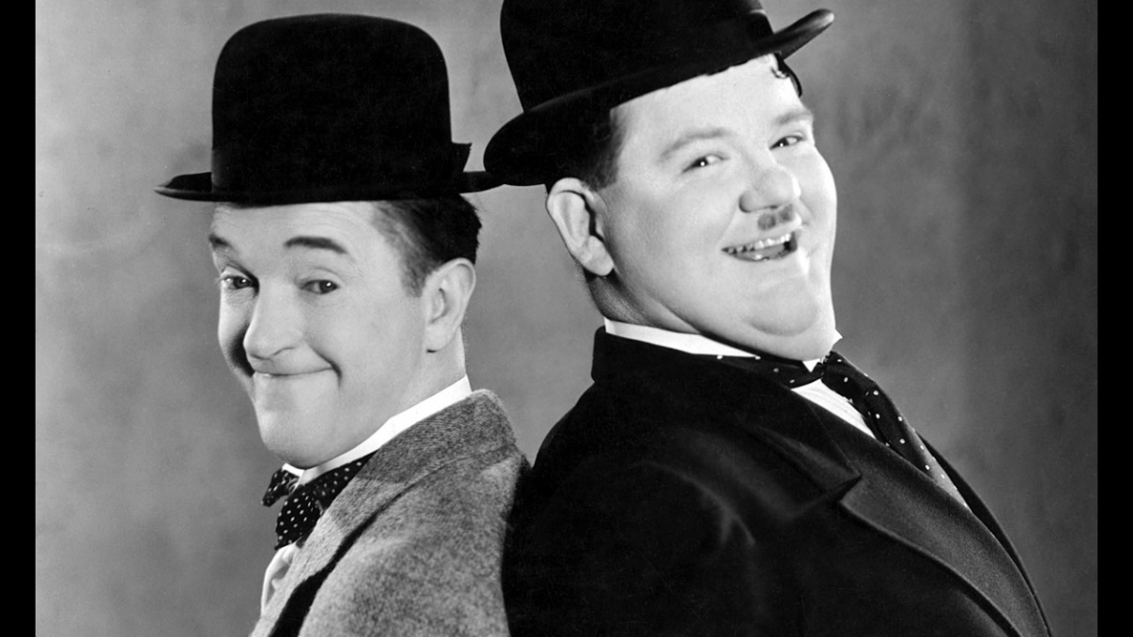
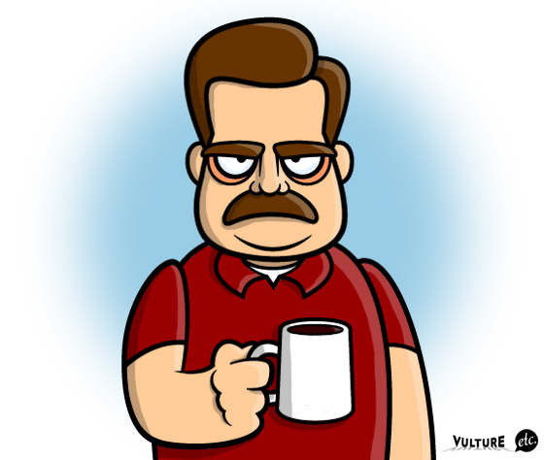
Are they serious?
No, they aren’t.
What are they like?
They are funny.

Slide 8
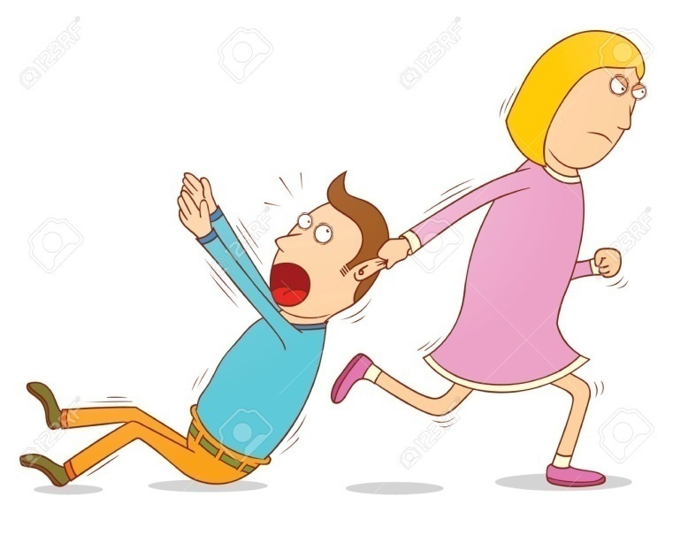
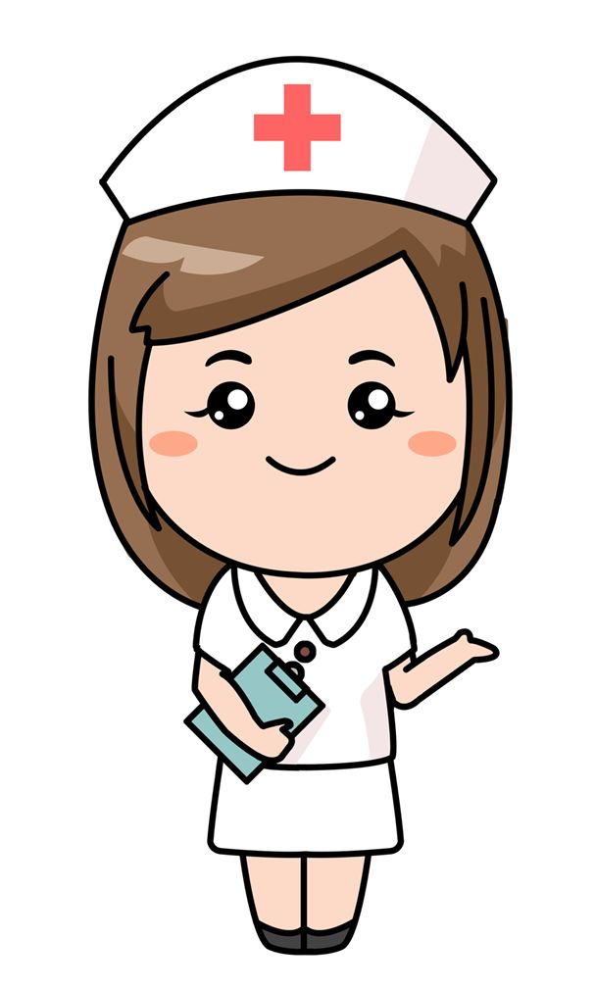
Is she cruel?
No, she isn’t.
What is she like?
She is kind and patient.

Slide 9
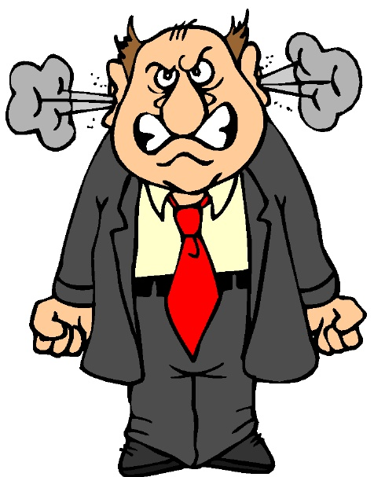
Is he happy?
No, he isn’t.
What is he like?
He is angry.

Slide 10
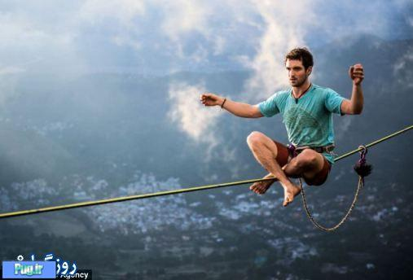
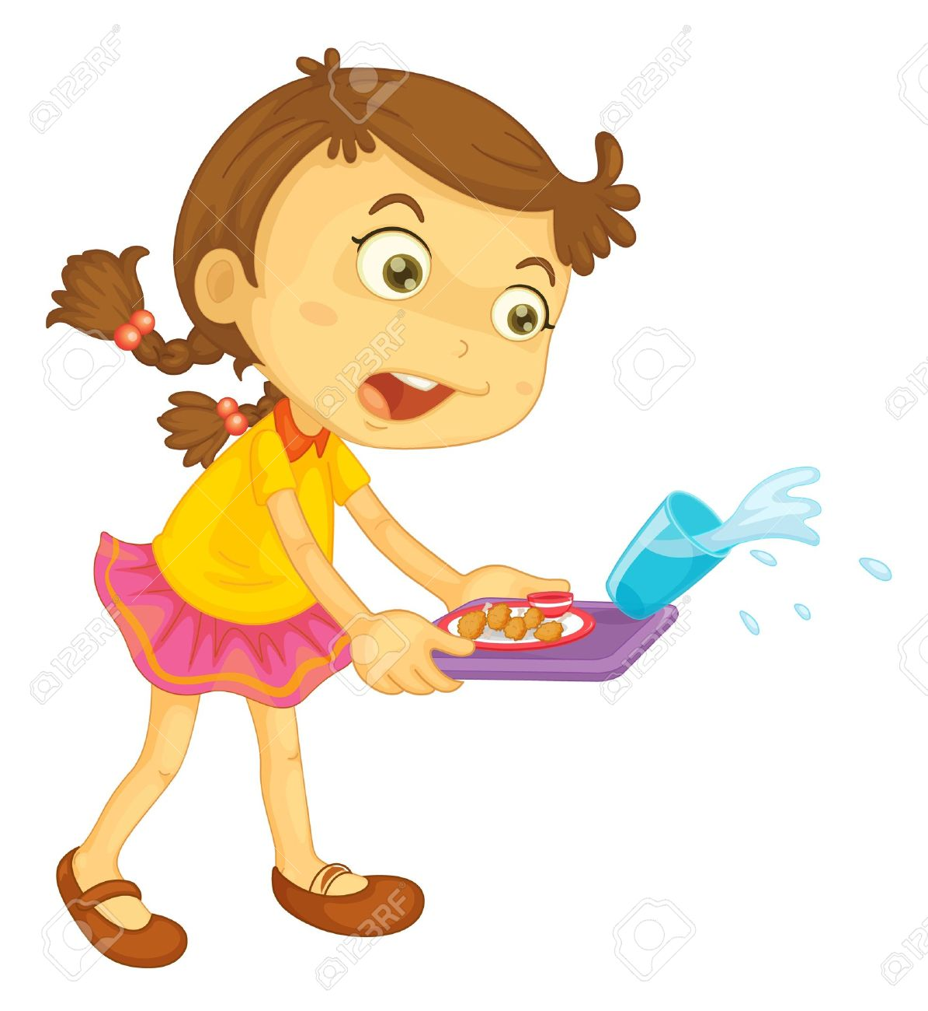
Is she careful?
No, she isn’t.
What is she like?
She is careless.

Slide 11
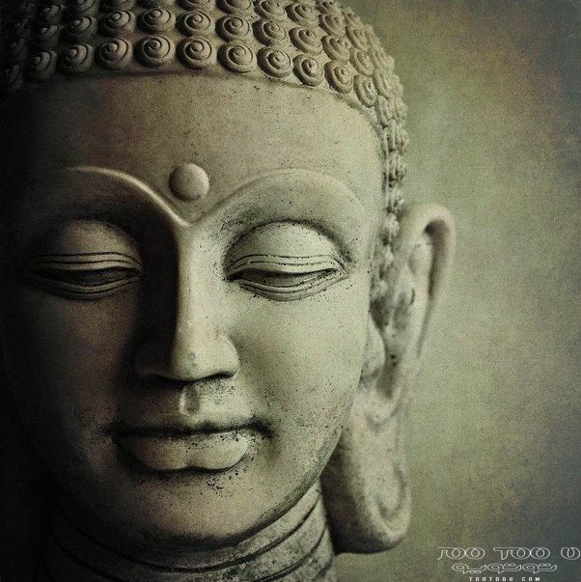
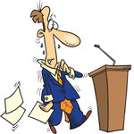
Is he pleasant?
No, he isn’t.
What is he like?
He is nervous.

Slide 12
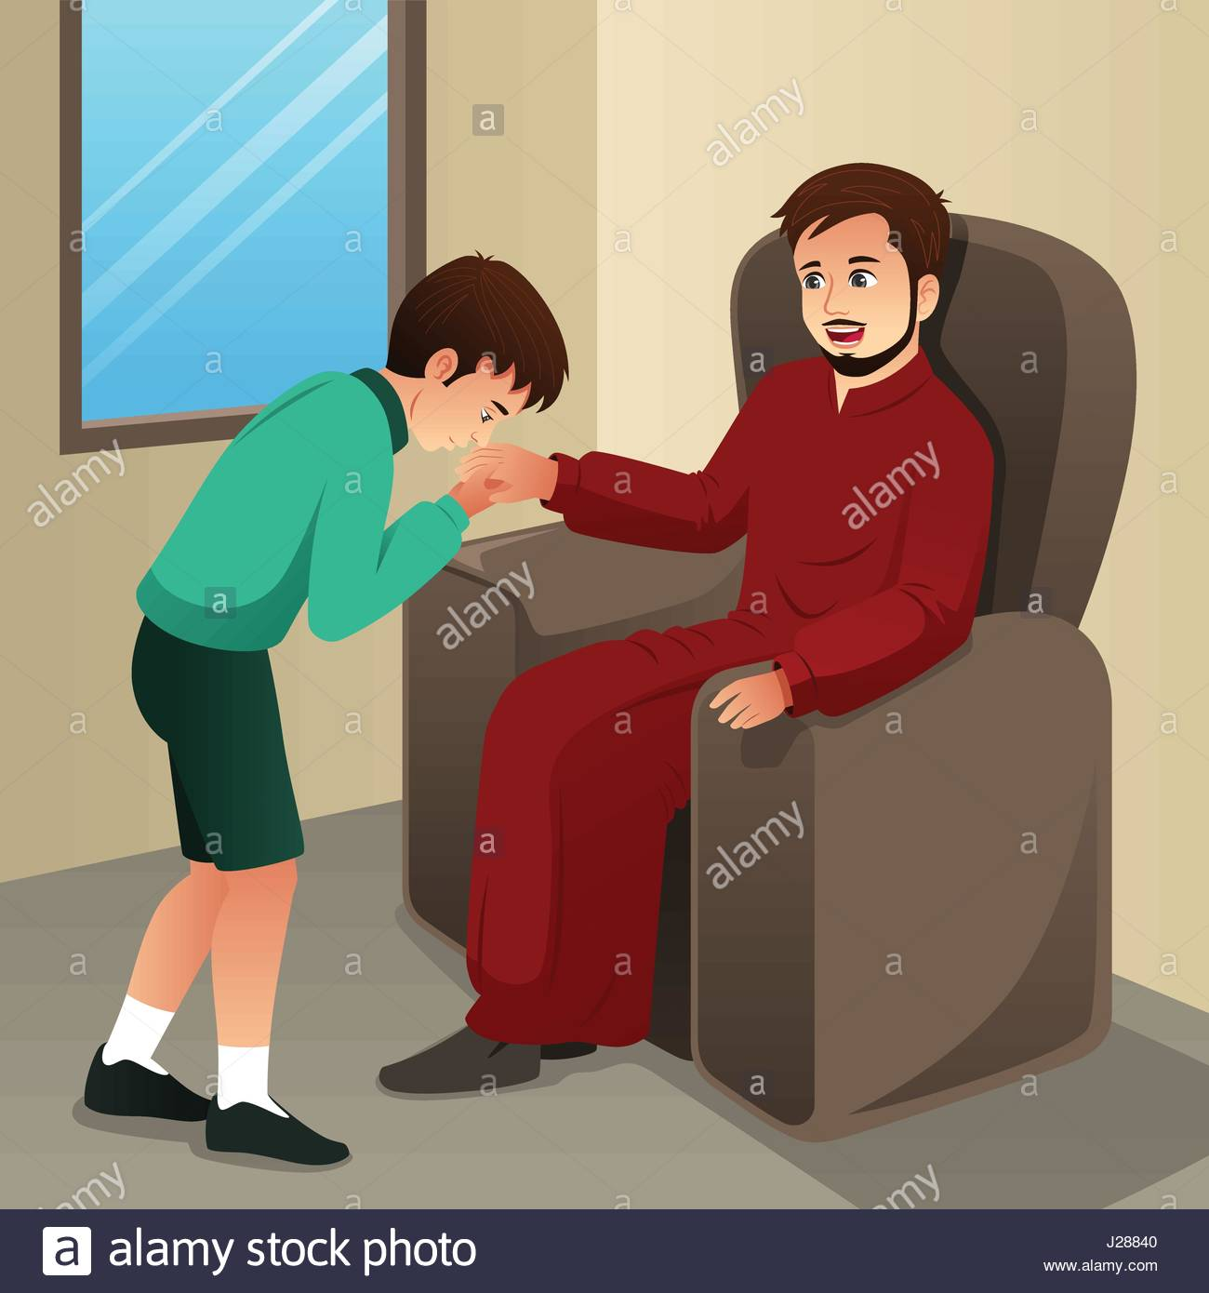
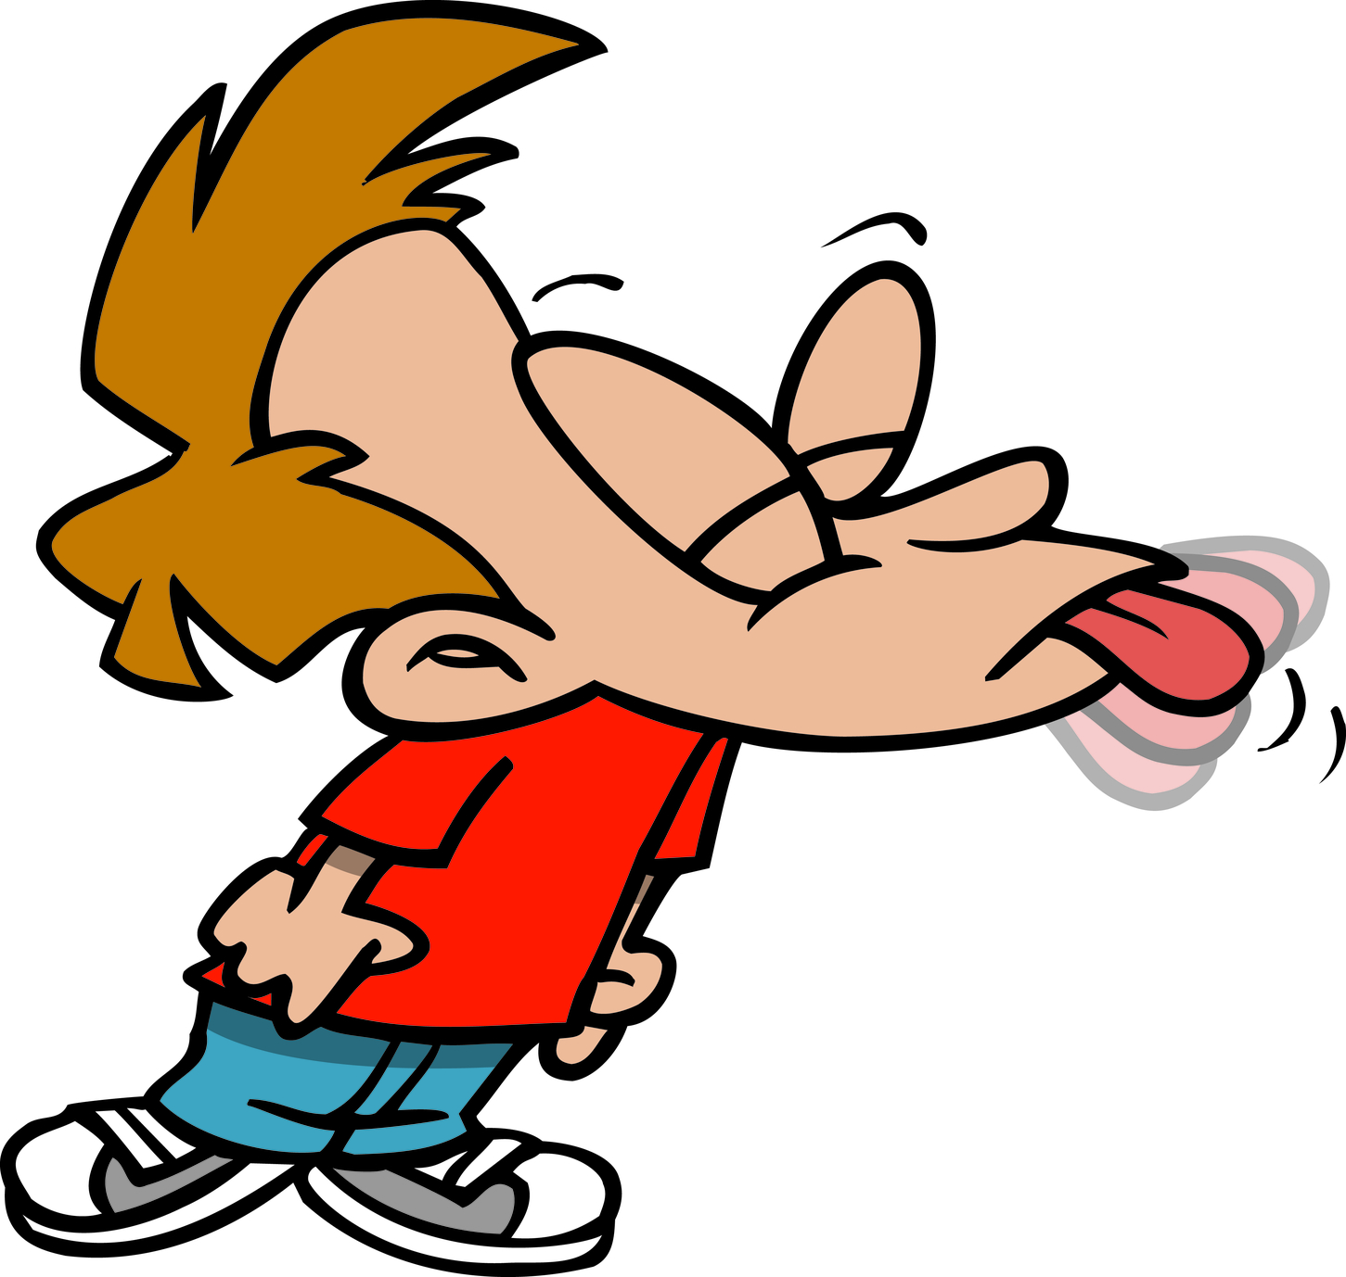
Is he polite?
No, he isn’t.
What is he like?
He is rude.

Slide 13
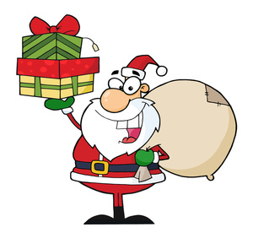
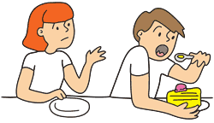
Is he generous?
No, he isn’t.
What is he like?
He is selfish.

Slide 14
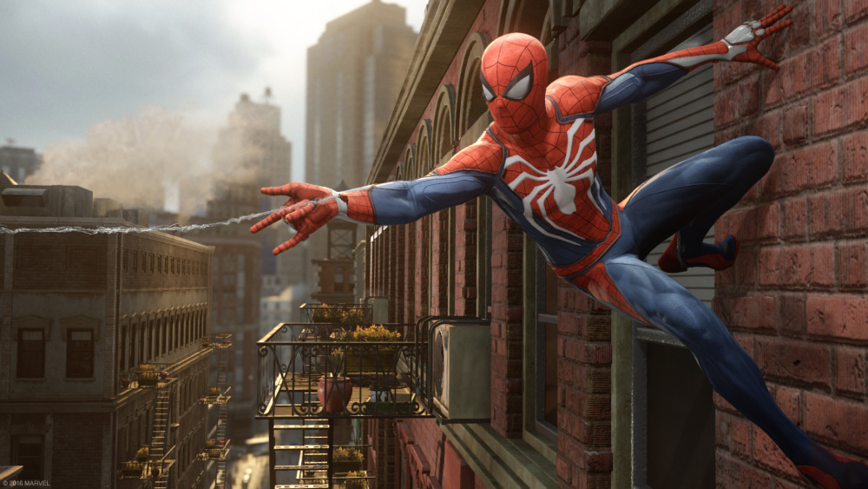
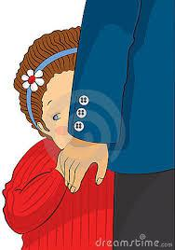
Is he shy?
No, he isn’t.
What is he like?
He is brave.

Slide 15
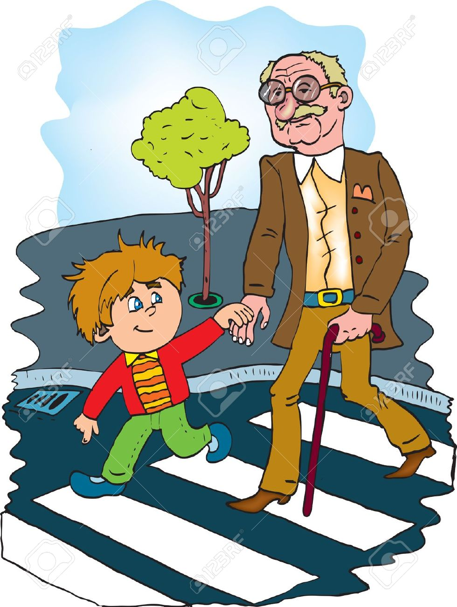
Is he selfish?
No, he isn’t.
What is he like?
He is helpful.

Slide 16
Is he/she ………………?
No,………………………
Who is ……………..?
No. …… is ………………….

Slide 17
1
2
4
3
111
5
6
7
8

Slide 18
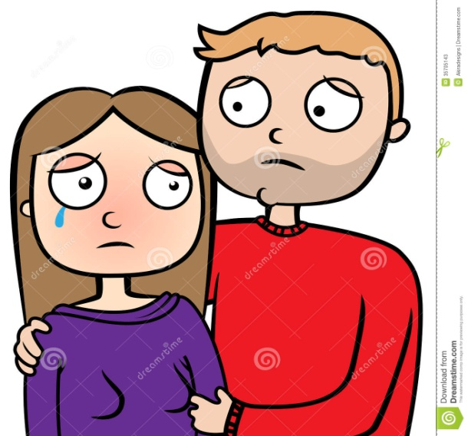
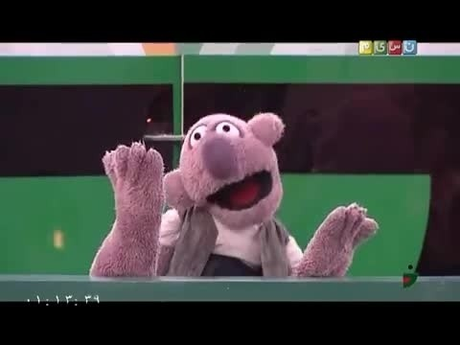
1
2
3
4
111
5
6
7
8

Slide 19
role plays

Slide 20
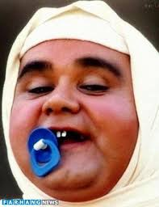
Name: Akbar Abdi
Age: 59
Nationality: Iranian
Personality: ………………..

Slide 21
Name: Albert Einstien
Age: 76
Nationality: German
Personality: ………………………….

Slide 22
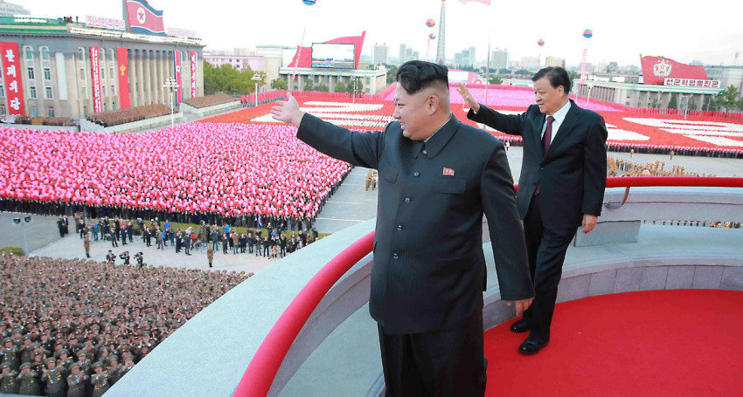
Name: Kim Jong Un
Age: 35
Nationality: Korean
Personality: ………………………..

Slide 23
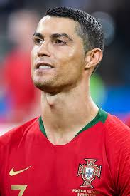
Name: Cristiano Ronaldo
Age: 34
Nationality: Portuguese
Personality: …………………………..

Slide 24
Name: Jackie Chan
Age: 64
Nationality: Chinese
Personality: ……………………..

Slide 25
Monologue

Slide 26
Talk about these people

Slide 27
Talk about these people

Slide 28
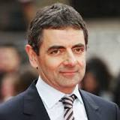
Hello, I am Rowan Atkinson and my artist name is Mr. Bean. I am British. I live in London. I am a comedian. I am good at acting in movies. My favorite food is pasta and I can cook it very well but I cannot make a cake. People say I am very funny but I am a bit serious in real life. I have a good family. I have a son and a daughter. They are kind and helpful. We are a happy family.

Slide 29
Write about your family and friends
Hello, I am ………………… I am a …………… boy.
My brother, ……………… is a …………… boy.
My………………………………………………………………………………………………………………………………………………………………………………………………………………………………………………………………………………………………………………………………………………………………..

