Slide 1


Slide 2
My Name
Lesson 1

Slide 3

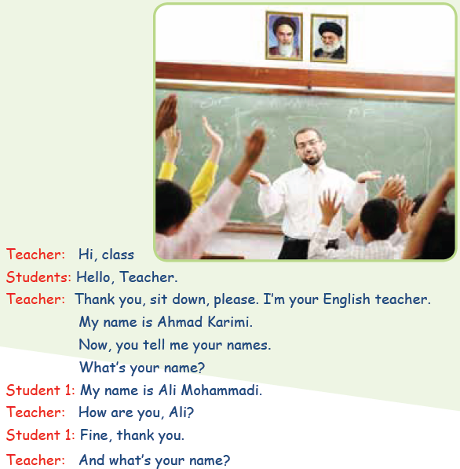
Conversation

Slide 4
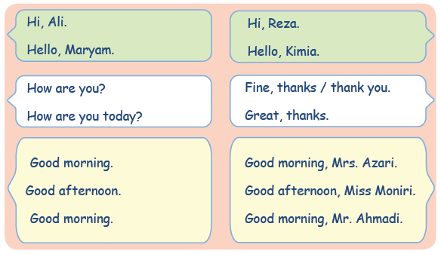
Greeting

Slide 5
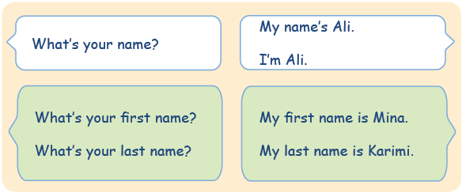
Introducing Yourself

Slide 6
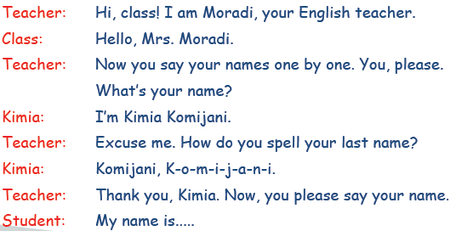
Sounds and Letters

Slide 7
How do you spell Mohammad Hesan?
M-O-H-A-M-M-A-D-H-E-S-A-N

Slide 8
Aa
Aple
Aardwolf

Slide 9
Kk
Book
Korea

Slide 10
Mm
Mom
Mall

Slide 11
Hi
How are you?
……………
What’s your name?
My Name’s …….
Good Morning
……………….
Practice

