Slide 1
Ali Shabanpour Univercity of Noortouba Effective Marketing

Slide 2
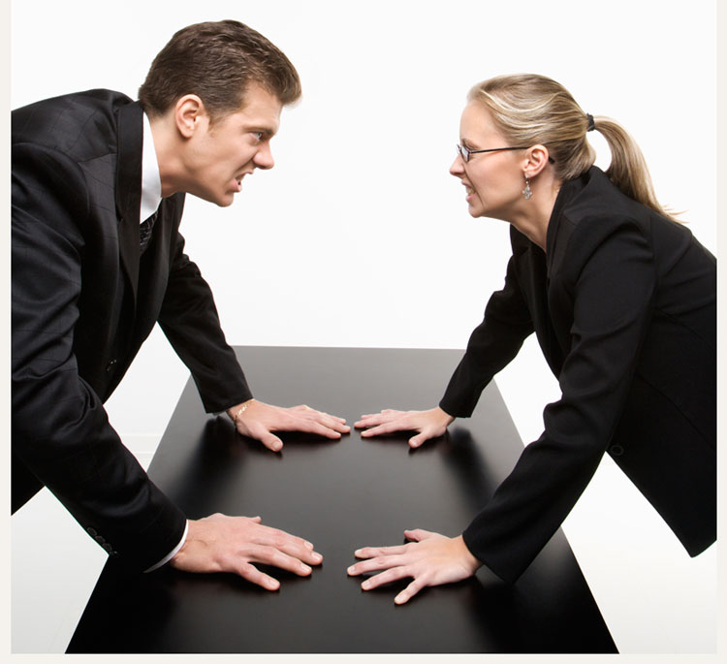
What Influence A Purchase?

Slide 3
What Influence A Purchase?
Words %
Tone of voice %
Body Language %

Slide 4
What Influence A Purchase?
Words 7 %
Tone of voice 38 %
Body Language 55 %

Slide 5
What Influence A Purchase?
Visual %
Feelings %
Logic %

Slide 6
What Influence A Purchase?
Visual 45%
Feelings 40%
Logic 15%

Slide 7
THE END

Slide 8
THE END I wish success to all my friends

