Slide 1
IN THE NAME OF GOD
LESSON 6
HEALTH AND INJURIES
BY: MAHBOUBI

Slide 2
Have an accedent
Did Ali have an accident?
Yes,he did.

Slide 3
Cut …… finger
Did Mina cut her finger?
Yes , she did.

Slide 4
Break ……… leg
Did you break your leg?
Yes, I broke my leg.

Slide 5
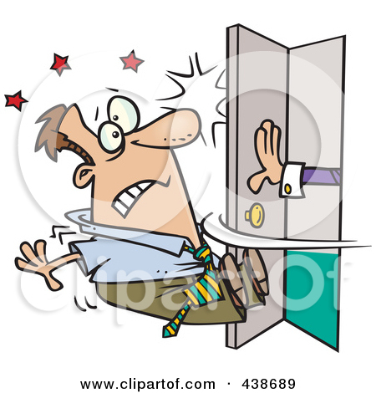
hurt
Did you hurt your back?
No, I didn’t hurt my back.

Slide 6
Have an accident
Who had an accident?
Reza.

Slide 7
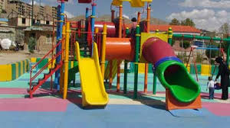
Break ………. leg
Where did he break his leg?
He broke his leg in the park.

Slide 8
Take care of
When did Mary take care of her mother?
She took care of her mother last week.

Slide 9
E door
How did Amir hurt his head?
He hit his head on the door.

Slide 10
Why did they have an accident?
Because they drove fast.

Slide 11
THE END

