Slide 2
ارائه کنندگان:
حبیبه شباهنگ – افسانه پورحمزه-سمیرا سلاطین تمر

Slide 3
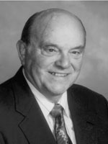
Naturalistic
nontechnical – nonrational approach
Curriculum evolves as learners, teachers, and knowledge interact
Assumptions
All goals of education cannot be predefined
Content can only be tentatively selected
Learning will be based on the creation of knowledge, especially self-knowledge
Curriculum development is highly political requiring administrators and teachers to work together
Allan A. Glatthorn

Slide 6
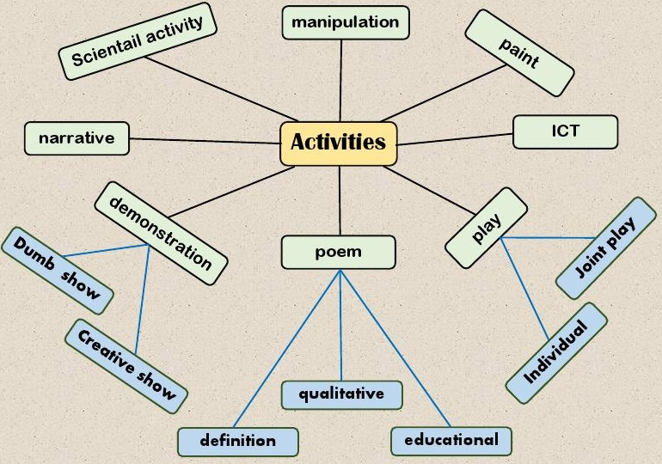

Slide 7
Taba Course Development Model
1- Produce Pilot
Units
2- Test Experimental
3- Revise and Consolidate
4- Develop a Framework
5- Install and disseminate new units

Slide 8
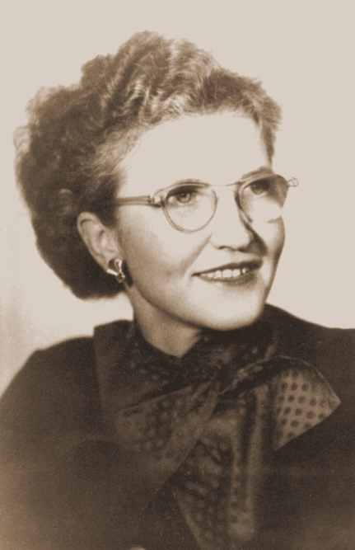
Taba Pilot Unit Development Model
1- Diagnose needs?
2- Formulate objectives
3- Select content
4- Organize content
5- Select learning experiences
6- Organize learning activites
7- Determine what to evaluate and ways
8- Check for balance and sequence
Hilda Taba (Estonia-1902-1967)

Slide 9
با تشکر از حسن توجه تان

