Slide 1
Prospect 3 Lesson 4 Services
In the name of God
خروج

Slide 2
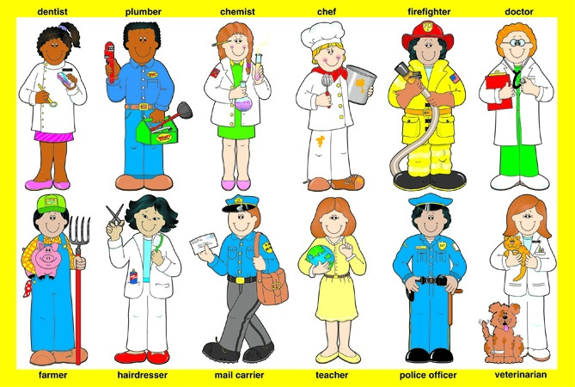
Services

Slide 3
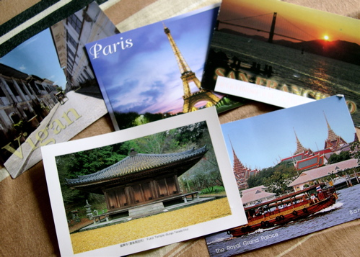
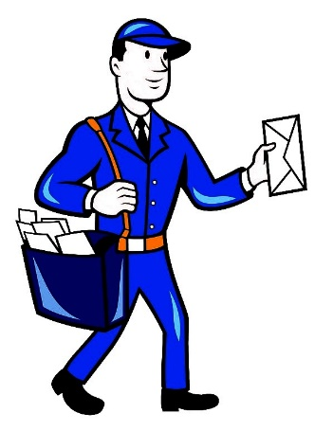
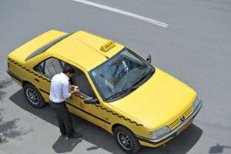
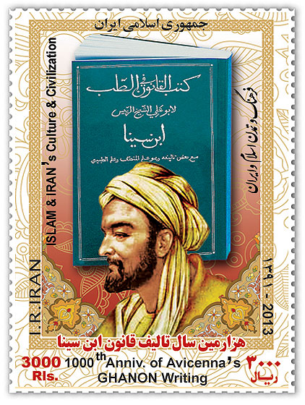
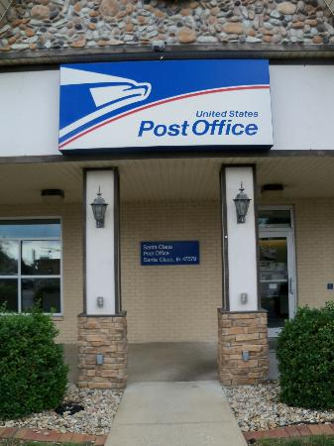
Mr Harly
postcard
postman
hire a taxi
envelope
stamp
Post office

Slide 4
Mr. Harly
Mr. Harly is a postman. He works in a post office. He goes to work at 7:30 in the morning. He takes a taxi to work. The post office opens at 8:00. People buy stamp, envelope and postcards from the post office. Mr Harly also delivers or sends people’s letter and packages to others.
1. What is Harly’s job?
2. Where does he work?
3. How does he go to work?
4. What does people buy from a post office?
5. What does Mr. Harly do?
6. What time does the post office open?
7. When does he go to work?

Slide 5
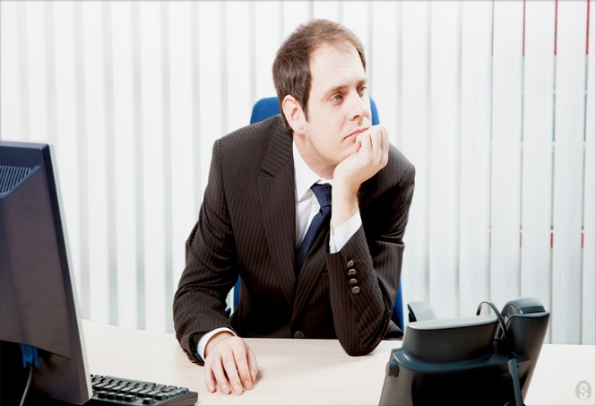
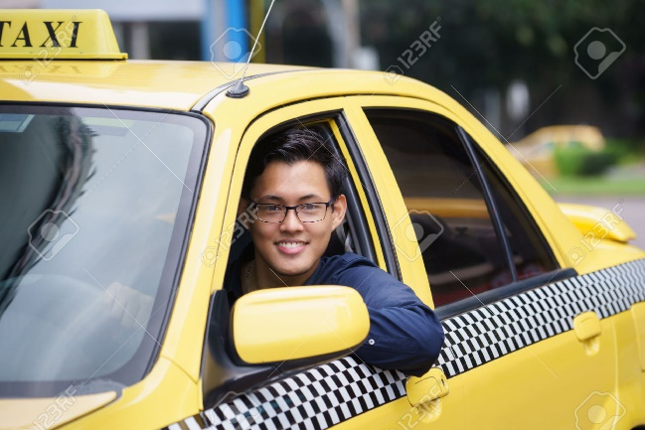
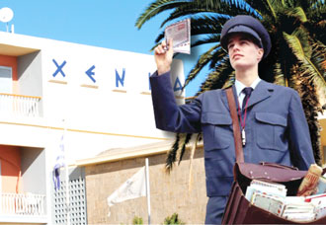
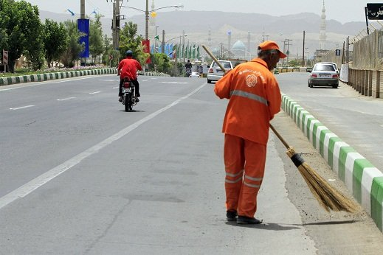
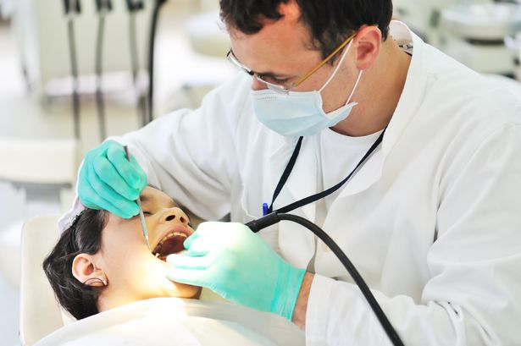
employee
taxi driver
postman
sweeper
doctor
dentist

Slide 6
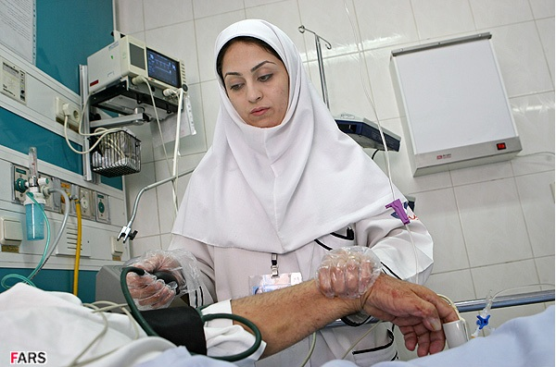
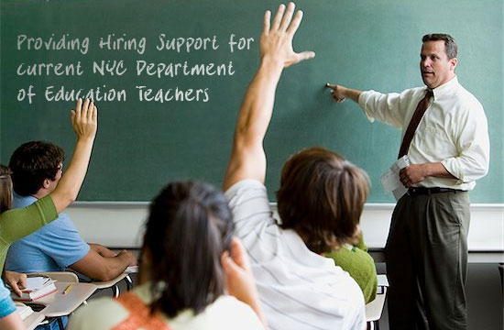
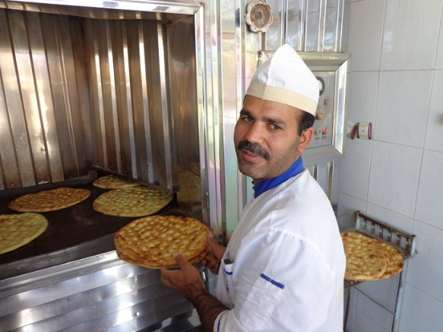
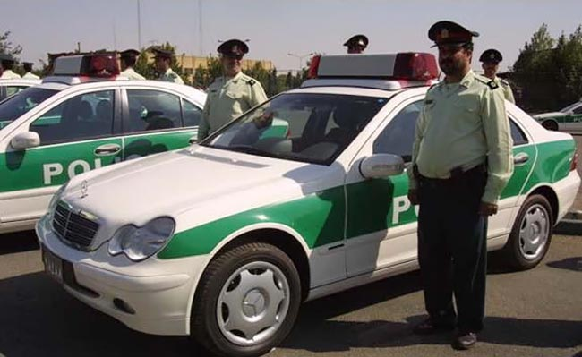
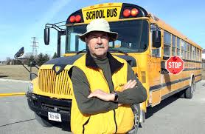
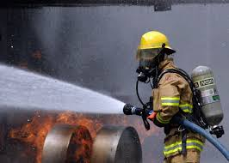
nurse
teacher
baker
Police officer
Bus driver
Fire fighter

Slide 7
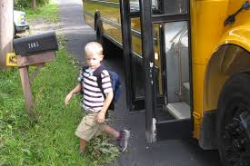
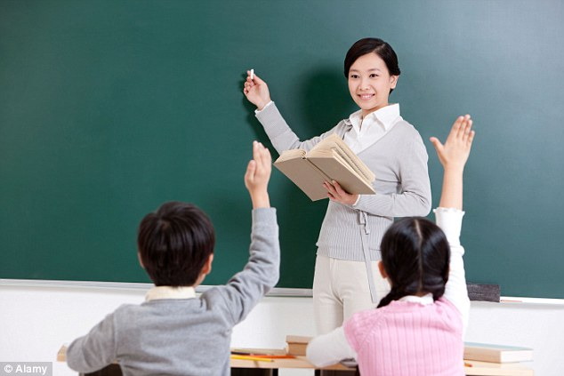
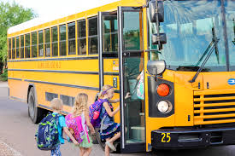
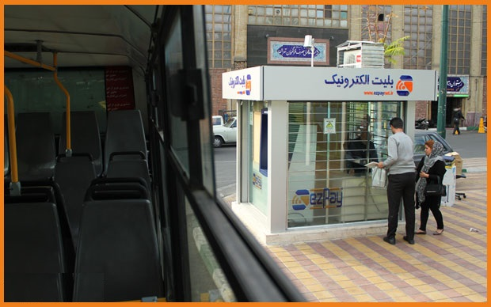
nurse
get off the bus
hire a taxi
teacher
get on the bus
recharge E ticket

Slide 8
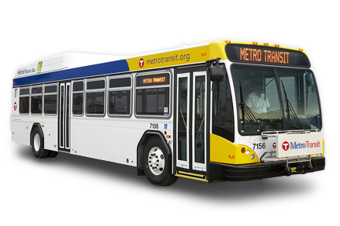
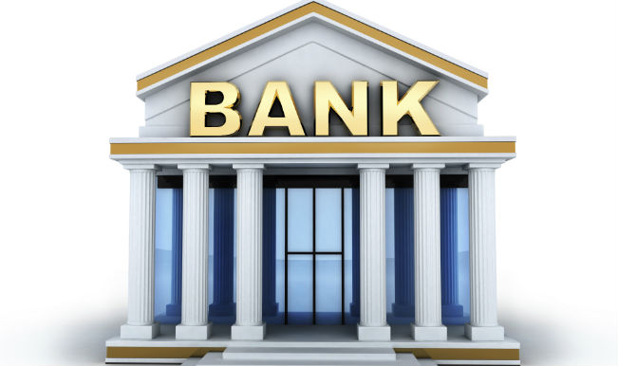
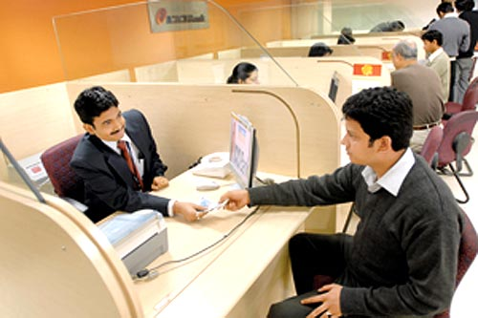
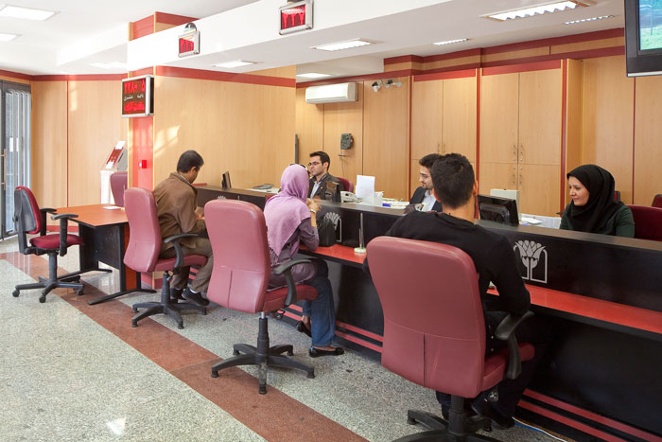
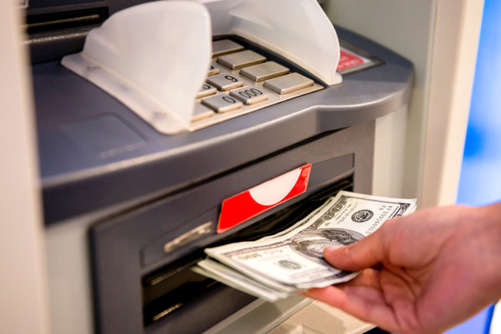
employee
bus
bank
Work in a bank
Open an account
Take out money (ATM)

Slide 9
A Bank employee
Mr. Jackson is an employee. He works in a bank. Every morning he goes to work at 7:00. He takes a bus to work. The bank opens at 7:30. People do lots of things in a bank. They open an account, get money and give money to the bank. When the bank is closed they can get money from the ATM.
1. What is Jackson’s job?
2. Where does he work?
3. How does he go to work?
4. What does people do in a bank?
5. When does the bank open?

Slide 10
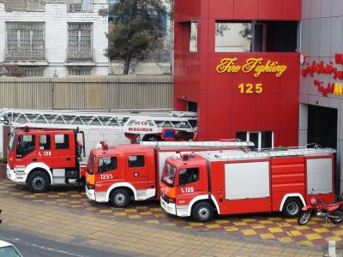
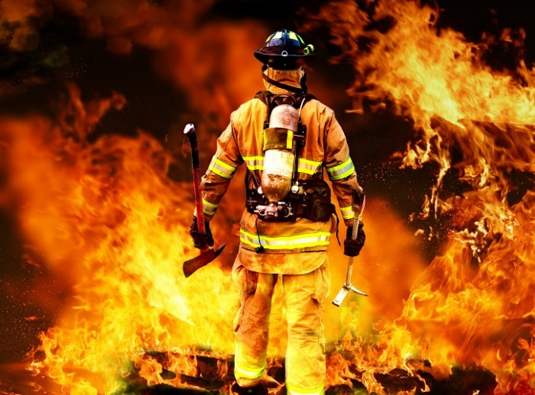
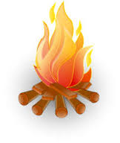
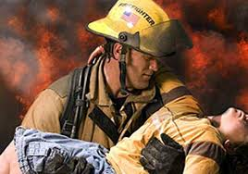
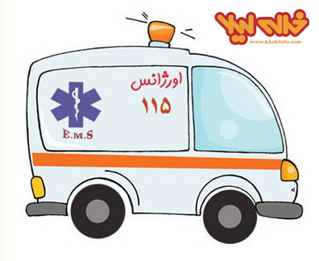
fire station
firefighter
fire
Put out firefighter
Save people’s lives
call the emergency

Slide 11
A dangerous job
Fire fighters are brave and hardworking. They put on fire and save people’s lives. Their job is dangerous and hard. Omid Abbasi is a firefighter. He works in a fire station. It is a hard job. He goes to work on shift. He drives to work. When there is a problem, people call the emergency(125) and firefighters help them.
1. What are firefighters like?
2. What do they do?
3. What is Omid’s job?
4. How does he go to work?
5. Where does he work?

