Slide 1
Goal: Learning
Iron deficiency anemia (IDA)
Epidemiology
Etiology
Clinical Presentation
Laboratory findings
Treatment

Slide 2
Iron deficiency anemia
Epidemiology
Iron deficiency is one of the most prevalent forms of malnutrition.
Globally, 50% of anemia is attributable to iron deficiency and accounts for approximately 841,000 deaths annually worldwide.
Africa and parts of Asia bear 71% of the global mortality burden.
North America represents only 1.4% of the total morbidity and mortality associated with iron deficiency.

Slide 3
Iron deficiency anemia
Etiology
Conditions that increase demand for iron, increase iron loss, or decrease iron intake or absorption can produce iron deficiency
Increased Demand for Iron
Rapid growth in infancy or adolescence
Pregnancy
Erythropoietin therapy

Slide 4
Increased Iron Loss
Chronic blood loss
Menses
Acute blood loss
Blood donation, Blood Letting
Phlebotomy as treatment for Polycythemia Vera
Decreased Iron Intake or Absorption
Inadequate diet
Malabsorption from disease (sprue, Crohn's disease)
Malabsorption from surgery (postgastrectomy)
Acute or chronic inflammation

Slide 5
Iron deficiency anemia
Clinical Presentation
Certain clinical conditions carry an increased likelihood of iron deficiency. Pregnancy, adolescence, periods of rapid growth, and an intermittent history of blood loss of any kind should alert the clinician to possible iron deficiency.
A cardinal rule is that the appearance of iron deficiency in an adult male means gastrointestinal blood loss until proven otherwise.
Signs related to iron deficiency depend on the severity and chronicity of the anemia in addition to the usual signs of anemia—fatigue, pallor, and reduced exercise capacity.
Cheilosis (fissures at the corners of the mouth) and koilonychia (spooning of the fingernails) are signs of advanced tissue iron deficiency. The diagnosis of iron deficiency is typically based on laboratory results.

Slide 6
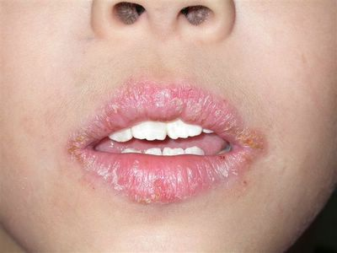
Cheilosis

Slide 7
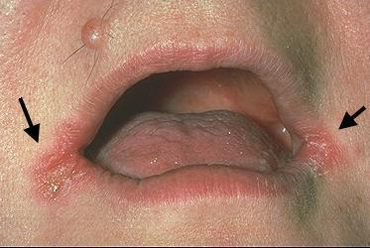
Cheilosis

Slide 8
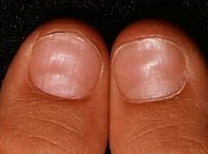
koilonychia

Slide 9
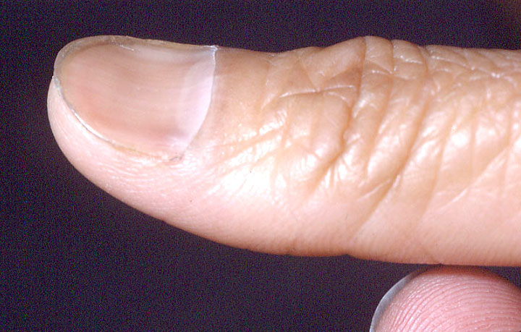
koilonychia

Slide 10
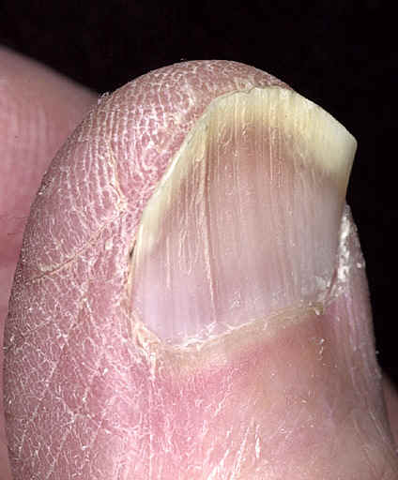
koilonychia

Slide 11
Iron deficiency anemia
Laboratory findings
Serum Iron:
The serum iron level represents the amount of circulating iron bound to transferrin. The normal range for the serum iron is 50–150 mg/dL .
Total Iron-Binding Capacity (TIBC):
The TIBC is an indirect measure of the circulating transferrin.
the normal range for TIBC is 300–360 mg/dL .
Transferrin saturation:
Is normally 25–50%, is obtained by the following formula: serum iron x 100 ÷ TIBC.
Iron-deficiency states are associated with saturation levels below 20%. There is a diurnal variation in the serum iron.

Slide 12
Iron deficiency anemia
Laboratory findings
Serum Ferritin:
Free iron is toxic to cells, and the body has established an elaborate set of protective mechanisms to bind iron in various tissue compartments.
Within cells, iron is stored complexed to protein as ferritin or hemosiderin. Apoferritin binds to free ferrous iron and stores it in the ferric state.
The serum ferritin level is the most convenient laboratory test to estimate iron stores.
The normal value for ferritin varies according to the age and gender of the individual . Adult males have serum ferritin values averaging 100 mg/L, while adult females have levels averaging 30 mg/L.
As iron stores are depleted, the serum ferritin falls to <15 mg/L. Such levels are diagnostic for absent body iron stores.

Slide 13
Iron deficiency anemia
Treatment
The severity and cause of IDA will determine the appropriate treatment.
As an example, symptomatic elderly patients with severe iron-deficiency anemia and cardiovascular instability may require red cell transfusions.
Younger individuals who have compensated for their anemia can be treated more conservatively with iron replacement.
For the majority of cases of iron deficiency (pregnant women, growing children and adolescents, patients with infrequent episodes of bleeding, and those with inadequate dietary intake of iron), oral iron therapy will suffice.
For patients with unusual blood loss or Malabsorption, specific diagnostic tests and appropriate therapy take priority.
Once the diagnosis of iron-deficiency anemia and its cause is made, there are three major therapeutic approaches.

Slide 14
Iron deficiency anemia
Treatment
1. Red Cell Transfusion
Transfusion therapy is reserved for individuals who have symptoms of anemia, cardiovascular instability, continued and excessive blood loss from whatever source, and require immediate intervention.
The management of these patients is less related to the iron deficiency than it is to the consequences of the severe anemia.
Not only do transfusions correct the anemia acutely, but the transfused red cells provide a source of iron for reutilization, assuming they are not lost through continued bleeding.
Transfusion therapy will stabilize the patient while other options are reviewed.

Slide 15
Iron deficiency anemia
Treatment
2. Oral Iron Therapy
In the asymptomatic patient with established iron-deficiency anemia, treatment with oral iron is usually adequate.
Multiple preparations are available, ranging from simple iron salts to complex iron compounds designed for sustained release throughout the small intestine.
Typically, for iron replacement therapy, up to 300 mg of elemental iron per day is given, usually as three or four iron tablets (each containing 50–65 mg elemental iron) given over the course of the day.
Ideally, oral iron preparations should be taken on an empty stomach, since food may inhibit iron absorption.
A dose of 200–300 mg of elemental iron per day should result in the absorption of iron up to 50 mg/d.

Slide 16
Iron deficiency anemia
Treatment
2. Oral Iron Therapy (continued)
The goal of therapy in individuals with iron-deficiency anemia is not only to repair the anemia, but also to provide stores of at least 0.5–1 g of iron.
Sustained treatment for a period of 6–12 months after correction of the anemia will be necessary to achieve this.
Of the complications of oral iron therapy, gastrointestinal distress is the most prominent and is seen in 15–20% of patients. Abdominal pain, nausea, vomiting, or constipation may lead to noncompliance. Although small doses of iron or iron preparations with delayed release may help somewhat, the gastrointestinal side effects are a major impediment to the effective treatment of a number of patients.
The response to iron therapy varies, depending on the erythropoietin stimulus and the rate of absorption. Typically, the reticulocyte count should begin to increase within 4–7 days after initiation of therapy and peak at 11–12 weeks.

Slide 17
Iron deficiency anemia
Treatment
3. Parenteral Iron Therapy
Intravenous iron can be given to patients who are unable to tolerate oral iron; whose needs are relatively acute; or who need iron on an ongoing basis, usually due to persistent gastrointestinal blood loss.
Iron dextran, sodium ferric gluconate (Ferrlecit), and iron sucrose (Venofer) are available.
Parenteral iron is used in two ways: one is to administer the total dose of iron required to correct the hemoglobin deficit and provide the patient with at least 500 mg of iron stores; the second is to give repeated small doses of parenteral iron over a protracted period. The latter approach is common in dialysis centers, where it is not unusual for 100 mg of elemental iron to be given weekly for 10 weeks.

