Slide 1
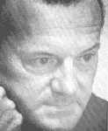
Contemporary Elite Theorist
C. Wright Mills (1950s)
Elite rule is not inevitable
Elite gain power not from personal quality but from occupying the ‘command posts’ in significant institutions
Significant institutions : corporations, military, federal government (US)
Power elite – involve elites from economic, military and political power

Slide 2
Elite unity and dominance
Elite power shifted as ‘institutional landscape’ shifted
Unity strengthened by similarity of social background, interchange and overlapping
Hence, share similar value and trust
Dominance over politics and excluded Americans participation
Elite self-recruitment – protect each other interests

Slide 3
Elite theories - questions
What is the power basis of elite?
Personal quality
‘Command posts’
Alliance with other elites
Economic power ….. as the most
important factor? Marxist perspective

Slide 4
High
Consensus
Shared interest
Shared Power
Conflict
Low
Over-ideal
Pluralism
Elitism
Marxism

Slide 5
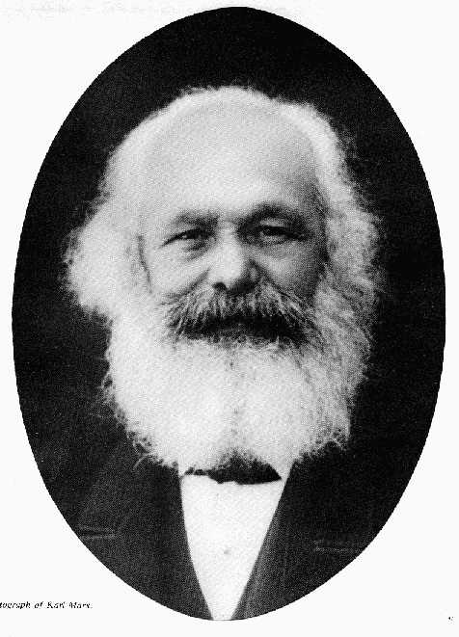
Marxism and Class
Power is controlled by a minority in the society, and was used to further their power…..

Slide 6
Power and Class
Class and means of production, economic resources as the determinant factor….
Bourgeoisie and Proletariat
And … emerging middle class ….. mitigate or start a new form of class conflict
Miliband - Instrumentalism, state controlled by the elites (with bourgeoisie background)

Slide 7
Different groups form …
Interest group
Formal organisation (society, association, chamber, union etc.)
Political parties ….
To fight for their own interest and dominate the political agenda …. and the state (the legitimate mean to gain authority)

Slide 8
Elite in Hong Kong – empirical evidence?
Analysis of the background of the decision makers -- e.g. Executive Council
Chinese - http://www.info.gov.hk/chinfo/cexe7.htm
English - http://www.info.gov.hk/info/exe7a.htm
Check their business, occupation, status, education background, joint-venture, social gathering ….
With policy cases as supporting evidence

