Slide 1
یکپارچه سازی کاربردهای سازمانی Enterprise Application Integration(EAI)
جلسه چهارم
Base Technologies

Slide 2
These 6 technologies will be
discussed in this lesson
Transactions and transaction strategies
Open Grid Services infrastructure (OGSi)
Java Connector Architecture (JCA)
Java Business Integration (JBI)
Service Component Architecture (SCA)
Service Data Objects (SDO)

Slide 3
1. Transactions and transaction strategies
Transactions and transaction strategies have a central function in every type of architecture. Knowledge of the options available, and the differences between the options, is essential when choosing suitable data access strategies. Important aspects include:
Transactional systems,
Isolation levels,
Two-phase commit,
XA

Slide 4
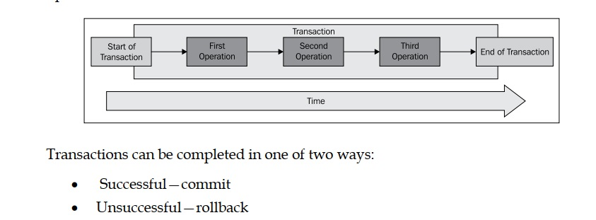
Transaction Systems
These allow for controlled "all-or-nothing" data manipulation.
Notes:
Say you want to make a bank transfer. This involves debiting the amount from your account and crediting it to another account. The bank transfer process, its sub-activities (debiting and crediting), and the data manipulation involved (deducting the amount from the first account, adding it to the second account) represent a unit of work. This takes place within one transaction to ensure that none of the sub-activities are carried out individually, for example, a debit without a credit or vice versa. The two processes are only valid in combination, even if system errors occur. This consistency is made possible by the use of transactions. All the operations in a transaction are enclosed within a transaction boundary, as shown in the following figure. It contains all the individual operations, which make up the transaction.

Slide 5
Isolation levels
These levels coordinate data access by parallel transactions and, depending on the level, determine the visibility of the manipulated data. There are four different isolation levels:
Serializable
Repeatable read
Read committed
Read uncommitted

Slide 6
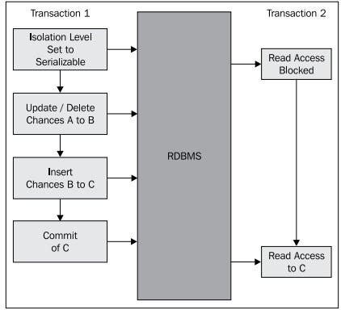
Serializable
All the transactions are completely isolated from each other. They appear to take place serially, one after another.
Relationship Data
Base Management
Systems
Notes:
To serialize an object means to convert its state to a byte stream so that the byte stream can be reverted back into a copy of the object. A Java object is serializable if its class or any of its superclasses implements either the java.io.Serializableinterface or its subinterface, java.io.Externalizable.

Slide 7
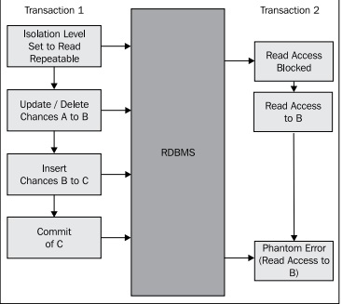
Repeatable read
Data that has been read (in an RDBMS with a SELECT, for example) cannot be changed. On this isolation level, read locks are required on all data that has been read.

Slide 8
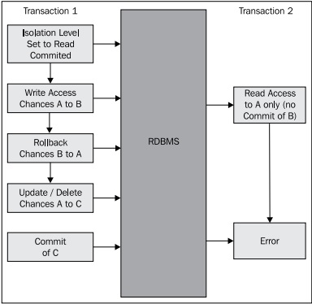
Read committed
Data that has been read (for example with a SELECT) can be changed by other transactions in the background. Read locks are released immediately after the read process has been completed. In contrast, write locks are only released at the end of the transaction

Slide 9
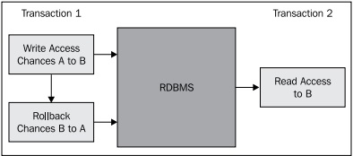
Read uncommitted
On this isolation level, so-called dirty reads are possible. Data in transaction 1 is visible to transaction 2, although transaction 1 has not yet been successfully completed (committed).

Slide 10
Two-phase commit
The Two-Phase Commit protocol is a distributed algorithm, which requires all the resources in a distributed system that are participating in a transaction to complete the transaction successfully (commit). The result is that all the resources complete the transaction with a commit, or reverse it with an abort.
A server node takes on the role of coordinator. On each of the participating nodes, there must be the possibility of buffering the local transaction status in order to ensure that, if a server crashes, the transaction can be canceled and the log data is never lost or corrupted (except, of course, in the case of total failures).
bring to a premature end because of a problem or fault.

Slide 11
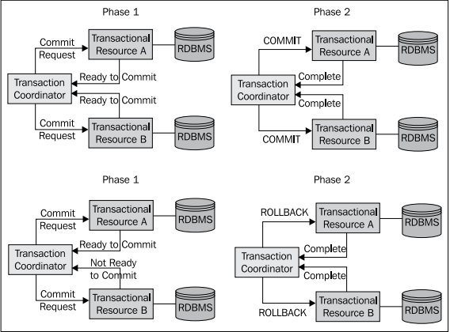
Notes:
Commit request: The transaction coordinator asks the participating resources if they are prepared to commit. Depending on the local transaction results (commit or abort), the individual resources send a corresponding reply. • Commit: On the basis of the result of the commit request phase, the transaction coordinator instructs the participating resources to implement a commit or abort locally.

Slide 12
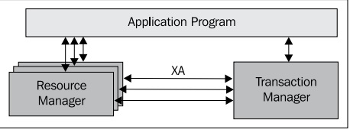
XA transactions
An XA transaction is a global (top-level) transaction, which can span several (heterogeneous) resources, as shown in the next diagram. A non-XA transaction only ever involves a single resource.
Notes:
The X/Open XA specification describes a bidirectional interface at system level for a communication bridge between several local resource managers on the one hand, and a global transaction manager on the other (OpenGroup 1991). The transaction manager controls the transaction, manages the lifecycle of the transaction, and coordinates one or more resources. The resource manager is responsible for controlling and managing its assigned resource (for example, a database or a message queue).

Slide 13
Open Grid Services infrastructure (OGSi)
Open Grid Services infrastructure (OGSi) is a hardware-independent, dynamic software platform which simplifies the process of modularizing distributed applications and their services, and managing them throughout their entire life cycle.
The OSGi platform requires a Java Virtual Machine (JVM) and provides a framework on the basis of the JVM. The most important features of OSGi are the
OSGi architecture,
the component model (the bundles),
and the collaborative model.
Notes:
To managing infrastructure integration need this software/
The Open Grid Services Infrastructure (OGSI) was published by the Global Grid Forum (GGF) as a proposed recommendation in June 2003.^{[1]} It was intended to provide an infrastructure layer for the Open Grid Services Architecture (OGSA). OGSI takes the statelessness issues (along with others) into account by essentially extending Web services to accommodate grid computing resources that are both transient and stateful.
Web services groups started to integrate their own approaches to capturing state into the Web Services Resource Framework (WSRF). With the release of GT4, the open source tool kit is migrating back to a pure Web services implementation (rather than OGSI), via integration of the WSRF

Slide 14
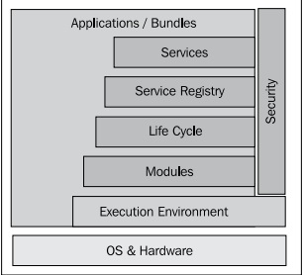
OSGi architecture
OSGi defines the following layers as its base architecture: ° Execution environment ° Module ° Life cycle ° Services ° Security ° Applications

Slide 15
Execution environment: A Java environment, such as J2SE.
Modules: All the classes and resources grouped together as bundles. A bundle can include entire applications, parts of applications, individual service components, and entire libraries. The starting point at runtime is the OSGi system bundle, which makes the OSGi software infrastructure available.
Life cycle management: A defined life cycle for each bundle in the form of an API. This API has the following life cycle statuses, as shown in the following diagram: ° install ° resolve ° start ° stop ° refresh ° update ° uninstall
Notes:
Java Platform, Standard Edition (Java SE) is a computing platform for development and deployment of portable code for desktop and server environments. Java SE was formerly known as Java 2 Platform, Standard Edition (J2SE).
Java SE (J2SE) stands for Java standard edition and is normally for developing applications. Java EE (J2EE) stands for Java enterprise edition
any of a number of distinct but interrelated units from which a program may be built up or into which a complex activity may be analysed.

Slide 16
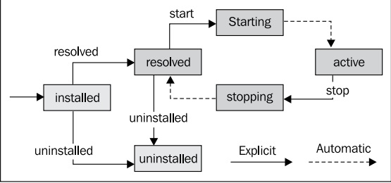
Life cycle Management

Slide 17
Service registry
The management of all services. This includes identifying services on the basis of their interface definition or properties, and sending notifications between services.
It also involves binding to one or more services using program controls, pre-defined standard behavior rules, and distribution configurations.

Slide 18
Component model
The fundamental component model consists of a bundle. In OSGi, bundles are also referred to as services, which are managed in a service registry. However, the concept of a service in OSGi has nothing in common with the concept of a service in an SOA.
The specification of the OSGi service platform defines a runtime environment (container) based on a Java Virtual Machine and Java base architecture.
OSGi focuses on the component, which is packaged as a bundle, and which can publish its interface through the service registry, making it available for use. A monitored life cycle is defined for such components.
Notes:
Bundle یک بسته نرم افزاری

Slide 19
Collaborative Software Environment
OSGi bundles can collaborate through the OSGi service registry, in which the services a bundle provides are registered.

Slide 20
Java Connector Architecture (JCA)
Java Connector Architecture (JCA) is a general architecture in the Java Enterprise Edition (JEE) environment used to connect heterogeneous systems, such as legacy applications, through a standardized interface in the form of a resource adapter. Other standardized interfaces defined by the JCA specification allow for collaboration with other system components.
ناهمگون

Slide 21
Uses of JCA
Java Connector Architecture (JCA) defines standards for connecting the Java Enterprise Edition platform with heterogeneous, distributed Enterprise Information Systems (EIS).
JCA enables EIS to be integrated with application servers and business applications as a result of its developer API and manufacturer API specifications. This guarantees that resource adapters are reusable.
The manufacturer of a business application can be certain that the application will communicate in a uniform way with a different EIS.
In the same way, the manufacturer of an EIS, which is supplied with a JCA adapter can be sure that the EIS can be addressed by all the applications on a Java EE application server, and that the EIS can be integrated into a Java EE architecture in compliance with Java standards. JCA adapters can also be used to integrate an EIS into an ESB or into a BPEL process server.

Slide 23
Resource adapter: This is the core of the JCA functionality and contains the Java interfaces/classes in the form of the resource adapter archive. The resource adapter runs in an application server. • Common Client Interface (CCI): The CCI is the API for the resource adapter. It is used to implement the application contract. This is the API applications use to access the EIS. • Container-Component Contracts: These link the application that uses a JCA adapter and the application server. They define the services provided by the component.

Slide 24
System-Level Contracts: These link the application server and the EIS. They also extend the application server with regard to the EIS, so that connection pooling, transaction management, and security management can be used when accessing an EIS. They add connection pooling, transaction management, and security management functionality to the application server. • Enterprise Information System: This is the system with which the connection is to be created using JCA.

Slide 25
Contracts JCA defines a series of different system-level contracts (agreements), which determine the way in which the application server, JCA, EIS, and application work together: • Connection management: This concerns managing the connection pool with the EIS. The application is provided with connections from this pool, and the application server is responsible for making valid connections available. The functionality for putting in place and testing the connection to the EIS must be in place. • Transaction management: This allows the application server to use a transaction manager to support transactions across several resource managers. The contract also enables internal EIS transaction mechanisms to be used without the need for an external transaction manager. • Security management: This supports a secure environment on the application server in order to protect valuable information provided by the EIS.

Slide 26
The Java Business Integration (JBI)
JBI specification describes the functionality of a standardized ESB. JBI can also be regarded as a service-oriented meta-container that implements a component architecture.
JBI uses two types of containers: service engines and binding components. The service engines contain the business logic, while the binding components merely act as a proxy for the service users.
Notes:
ESB- Enterprise Service Bus

Slide 28
JBI environment: A JBI environment is represented by an individual Java Virtual Machine. Therefore, JBI can take the form of an independent ESB, or can be integrated into an application server and its JVM. Where the environment is integrated into an application server, the Enterprise JavaBean (EJB) components installed on the server can function as service providers, or as consumers of the ESB.
• JBI container: This is comparable to the EJB container of a Java EE application server. The JBI environment itself is a container, which provides service engines and binding components.

Slide 29
Pluggable components: Service engines (SEs) and binding components (BCs) are pluggable components. They are connected to the normalized message router through delivery channels, which allows them to communicate with one another.
• Service engine (SE): These are service providers or consumers that are installed locally in a JBI environment. They represent the business components or the essential functionality that supports the business logic, such as Extensible Stylesheet Language (XSL) transformations or database accesses.

Slide 30
Binding components (BCs): These encapsulate the communications and decouple the communication functionality from the business components (SEs). Binding components allow remote access to distributed services, and also enable distributed services to access the JBI environment. • Normalized Message Router (NMR): This is the backbone of the JBI architecture. All communications between providers and consumers pass through this router. The NMR uses a canonical format.
Notes:
NMR- between JBI components NMR mediate massages – JBI never send message directly to each others instead they pass it to NMR…NMR decide which message will go where … these helps for location independency…using WSDL-based model for decoupling…canonical mans has all the qualities needed and independent from any specific application

Slide 31
Normalized message: This type of message has two parts. There is the header, which contains the metadata (metadata in this context is also referred to as message context data), and the payload, in the form of an XML structure that contains the normalized message. The structure of the normalized message is comparable to that of XML messages from Java Message Service (JMS).
• Delivery channel (DC): This connects a message source with a message target. A channel is a virtual construct that conceals the communication details from the providers and consumers and decouples them from the NMR. Delivery channels connect components (providers and consumers) to the NMR, which is responsible for coordinating communications. Channels are logical addresses in the ESB that encapsulate the physical addresses.

Slide 32
Service Component Architecture (SCA)
Service Component Architecture (SCA) is a collection of specifications that describe a model for developing applications and systems on the basis of an SOA.
SCA models solutions as groups of service components that provide services and include references to other services.
Service components have properties that describe the specific characteristics of the components and are used to configure them.
Notes:
Provide a model to build a SOA- business function is provided as a series of services – therefore SCA provides a model from existing components and application ( reuse the existing ones)

Slide 33
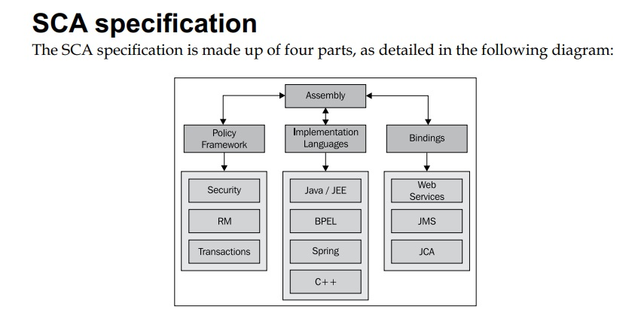

Slide 34
SCA assembly model: This describes how SOA applications are created with SCA. It also defines how individual modules, in the form of components, can be combined and integrated to produce more complex modules, and how these modules communicate. • SCA policy framework: This defines how security, transaction behavior, message exchange, and reliable messaging can be specified declaratively for a service. • SCA implementation: This defines how SCA components can be implemented in different programming languages and on different platforms (for example Java, .NET, C++). • SCA binding specification: This describes how various access technologies and protocols (such as SOAP, JMS, RMI-IIOP, REST, HTTP) can be used.

Slide 35
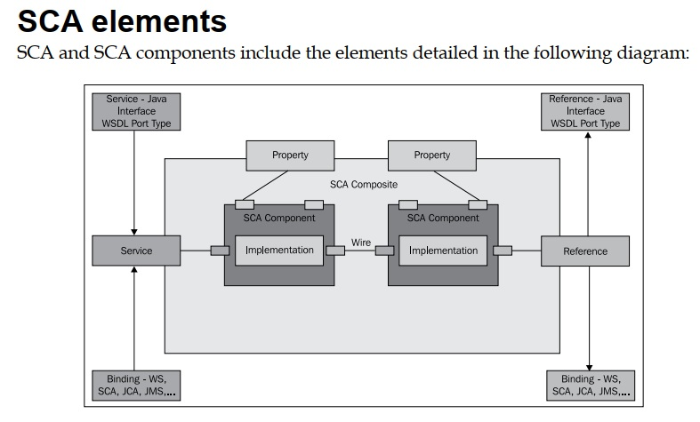
Notes:
Properties – allow for the configuration of an implementation with externally set values … it means if a specific value is required with external services, it can be set here in properties

Slide 36
Service: A service represents the starting point for access to an SCA component or composite. • Reference: A reference is a pointer to an external service. • Binding: This is both an interface and a binding. In this case, an interface is an external declaration of the service, represented by a Java interface, a Web Service Definition Language (WSDL) port type, a Business Process Execution Language (BPEL) partner link, a C++ class, and so on. An interface binding can be bound to a service or a reference.
Notes:
Reference- represents a requirement that the implementation has on a service provided by another component

Slide 37
Property: This is a type/value pair used to describe and configure specific characteristics of the component. • Implementation: This defines the way in which an SCA component is implemented or, in other words, the form that the logic takes. The implementation types can be some Java code, for example, but can also be a human interaction. • Wire: This is the mechanism that links two SCA components together. Normally, one component's reference is bound to the service offered by another component.

Slide 38
Service Data Objects (SDO)
Service Data Objects (SDO) offer a consistent model for managing data, regardless of its source system and source format. SDO makes use of a Disconnected Data Architecture. Although SCA and SDO can be used independently of one another, a combination of the two specifications represents a powerful and flexible tool for developing distributed applications.
Notes:
A framework providing convenient and uniform layer to access data from a wide range of data sources.

Slide 39
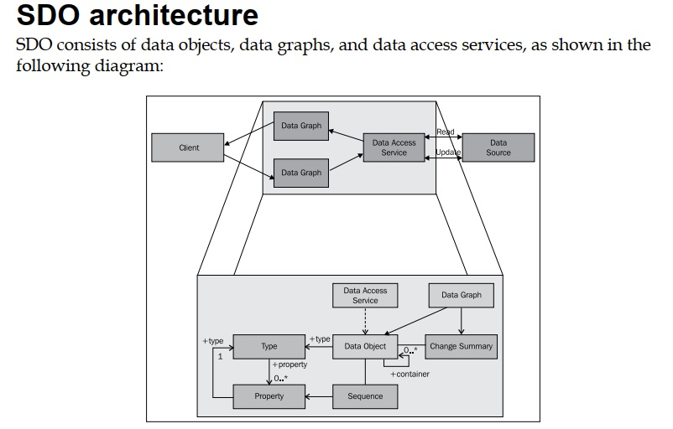

Slide 40
Data object: This is the object-oriented representation of the fundamental data. It encapsulates the data attributes in the form of simple values, as a reference to other objects and the descriptive metadata.
• Data graph: This represents a Data Transfer Object (DTO), which is transferred between the different tiers of an architecture. It can be made up of several individual data objects by using object graphs. These can include, for example, a master data set consisting of several detail data sets and their relationships to one another. In addition to the user data, changes to the object are included, or in other words, all the data objects that have been added, modified, and deleted are included.

Slide 41
Data access service: This is the interface between the client and the data sources. The data access service is responsible for decoupling the applications from the physical accesses to the source systems, which hold the data. This service uses the data access object pattern.
SDO also provides metadata for describing data objects, including data types, relationships between data objects, and constraints. The metadata API is used by tools and other frameworks to simplify the development of applications that make use of SDO.

Slide 42
References
Chapter 2 , Service Oriented Architecture- a blue print, Welkenbach,

