Slide 1
پروژه ترجمه زبان انگلیسی
Active 4 - Unit 7 - Chapter 2
Genetically Modified Food
مترجمان: رادین علی نژاد– محمد قطبی
1401-1402

Slide 2
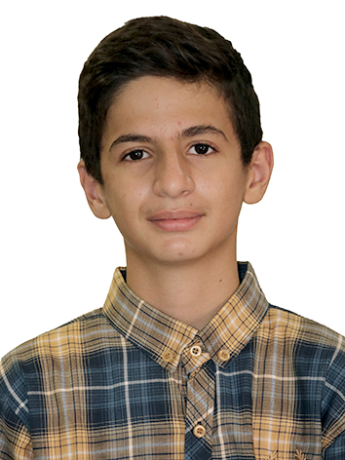
فهرست
مطالب
رادین علی نژاد– محمد قطبی

Slide 3
Genetically Modified Food
"What's for dinner?" It used to be that the answer to that household question was an issue for debate among family members only. But not anymore. Now scientists, advocacy groups, economists, trade experts, geneticists, and politicians are all discussing what should be served for dinner.
The food fuss revolves around one phrase: genetic modification. There are two groups with strong views on both sides of that phrase. One side argues that genetic modification of food enhances the quality and nutritional value of already-existing foods as well as generates new ways to produce that food. The other side questions the technology's safety and long-term effects, arguing that people simply don't know what they're putting in their mouths.
ترجمه خود را جایگزین این متن کنید.

Slide 4
The term "genetically modified" (GM) is an offspring of another term: biotechnology. A word that's been around for about thirty years, biotechnology was created in the shadow of new techniques that allowed scientists to modify the genetic material in living cells.' Basically, that means playing around with various biological processes to produce substances that, arguably, benefit things like agriculture, medicine, and the environment
ترجمه خود را جایگزین این متن کنید.

Slide 5
If you know how to cut-and-paste on a computer, you've figured out genetic modification. The Canadian Food Inspection Agency describes it like this: it all begins with a cell made up of chromosomes;2 the chromosomes are made up of DNA and are organized into sections called genes; genes determine the characteristics of an organism. These genes can be "cut" from one organism and "pasted" into another. Several foods that people eat every day are products of this process, such as tomatoes that ripen on the vine and maintain their texture and tough skin for several weeks. A potato plant developed to resist an insect known to attack it is another example. In the latter case, the GM version eliminates the need for chemical pesticides.
ترجمه خود را جایگزین این متن کنید.

Slide 6
Proponents of GM foods argue using biotechnology in the production of food products has many benefits. It speeds up the process of breeding plants and animals with desired characteristics, can be used to introduce new characteristics that a product wouldn't normally have, and can improve the nutritional value of products. And, say the supporters, all of this is done safely.
ترجمه خود را جایگزین این متن کنید.

Slide 7
Groups who advocate against the use of GM foods don't see things quite the same way. They point to studies that argue GM foods could be harmful to people's health. To the groups on this side of the issue, that "could" provides more than enough reason to go forward with extreme caution, something they say isn't currently being done. GM critics say not enough time has passed to study the long-term effects of the foods. In Europe, hardly a week goes by without some headline about GM foods or, rather, "Frankenfoods"3 as they've been called by the European media. The Church of England has entered the debate, criticizing the production of GM crops. Ever responsive to consumer demands, the European Union has taken a strong position on this issue, going so far as to propose a moratorium" on approving GM foods. These responses are the outcome of a grassroots campaign.5 Various scares, the best-known being mad cow disease,6 have consumers in Europe cautious of food genetically altered to kill pests or resist herbicides.
ترجمه خود را جایگزین این متن کنید.

Slide 8
Two British food companies have even dropped GM ingredients from their products, something the North American branches of these companies haven't done. That's not all that surprising for one simple reason: there's an unmistakable split in the policies toward GM foods between the two sides of the Atlantic that some call the Atlantic Divide. Supporters argue North America's approach is more progressive, while skeptics argue it's less safe.
Whatever the case, the Atlantic Divide can be attributed to two things. The first is all about the experience: the North American side of the Atlantic hasn't seen a scare comparable to mad cow disease. The second is all about dollars: North Americans expect their food to be cheap. And while the Atlantic may divide the approach to GM foods, it doesn't stop the two sides from butting heads.'
ترجمه خود را جایگزین این متن کنید.

Slide 9
The fuss over food extends to whether the manufacturing process is made known. Canada has adopted both a mandatory and voluntary labeling policy. According to the Canadian Food Inspection Agency, mandatory labeling applies to all foods that have been changed nutritionally or compositionally, or to alert consumers of possible allergens.8 That doesn't mean, though, that all GM foods will be labeled. If it can be shown through tests that the nutrition or composition of such foods remains unchanged, no special label is required. Even though labels are not required, they are allowed, but only when "truthful and not misleading.
ترجمه خود را جایگزین این متن کنید.

Slide 10
“A good example is the "fat free" claim made on some products. Because of the ambiguity surrounding voluntary labeling, it's been determined that clearer rules are needed. The GM debate makes us consider the role technology has in our lives. What makes this debate unique is that every meal we eat is at its very core. And that fact means one thing: it's an issue that will be discussed not only around policy tables, but dinner tables as well.
ترجمه خود را جایگزین این متن کنید.

